Slide 1

2.3 Control Flow
Peter H. Chen

Slide 2
2.3 Control Flow
https://github.com/freechipsproject/chisel-bootcamp
Control Flow
We discuss how to implement the Control Flow with Scala.
Topics:
1. Setup: Scala uses maven to configure chisel libraries inside the source folder.
2. Wire connect multiple times. The last wire connection over write the previous connection.
3. when, elsewhen, otherwise: All these 3-statements must all in the structure. If we do not have all 3-statements, we use if {…} else {…} structure instead in Scala.
4. Code Example using when, elsewhen, otherwise.
5. Implement Sorter Code Example using when, elsewhen, otherwise
6. Exercise 1 (Polynomial Circuit): Pass in select flag and use when, elsewhen, otherwise to do the polynomial computation.
7. Exercise (Finite State Machine): Implement the FSM (Finite State Machine) for the Life of Graduate Student according the Finite State Machine (idea, coffee, coding, pressure, writing paper, graduated).

Slide 3
2.3.1 Setup

Slide 4
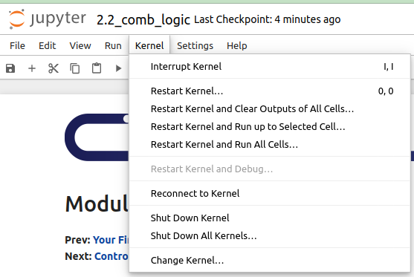
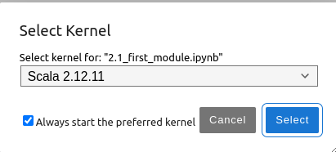
2.3.1 Setup
https://github.com/freechipsproject/chisel-bootcamp
Setup
1. Change folder to chisel-bootcamp. If you want to work on your working space, copy image folder and source folder to your working directory.
> cd chisel-bootcamp
2. Start Jupyter notebook
> jupyter notebook 2.3_first_module.ipynb
3. Select the scala interpreter: > Kernel > Change Kernel… >Scala 2.12.11
3

Slide 5
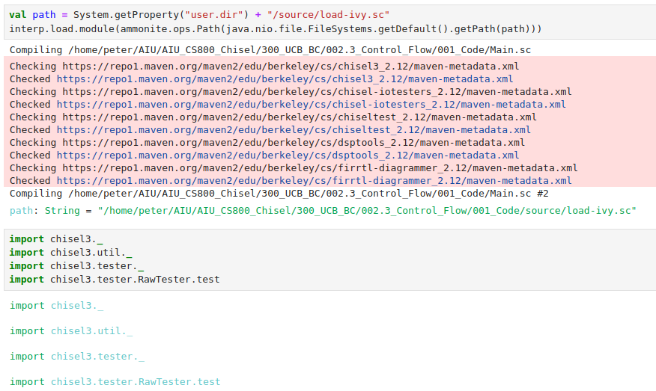
2.3.1 Setup
https://github.com/freechipsproject/chisel-bootcamp
Setup
1. Scala uses maven to setup path to with for source folder for Scala Libraries and get Scala Property.
2. import chisel3 library, utility, tester harness (horse controller), and test interface function.

Slide 6
2.3.2 Connect Multiple Times

Slide 7
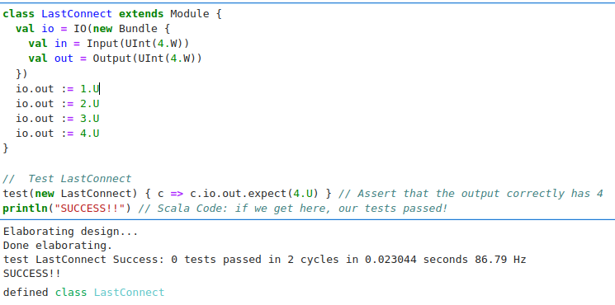
2.3.2 Connect Multiple Times
https://github.com/freechipsproject/chisel-bootcamp
Connect Multiple Times
We can connect the same component multiple times using the := operator.
When we connect multiple times, the last statement will overwrite the previous connection.

Slide 8
2.3.3 when, elsewhen, and otherwise

Slide 9
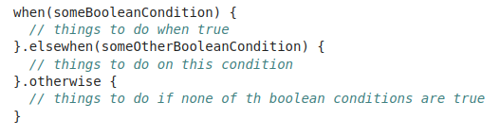

2.3.3 when, elsewhen, and otherwise
https://github.com/freechipsproject/chisel-bootcamp
when, elsewhen, and otherwise
Below, we have the main conditional logic of structures: when, elsewhen, and otherwise.
Scala’s when structure is not like if structure.
Scala does not allow “when and otherwise” only.
In this case, we need to use if {…} else {…} instead.

Slide 10
2.3.4 Complete when Structures Example

Slide 11
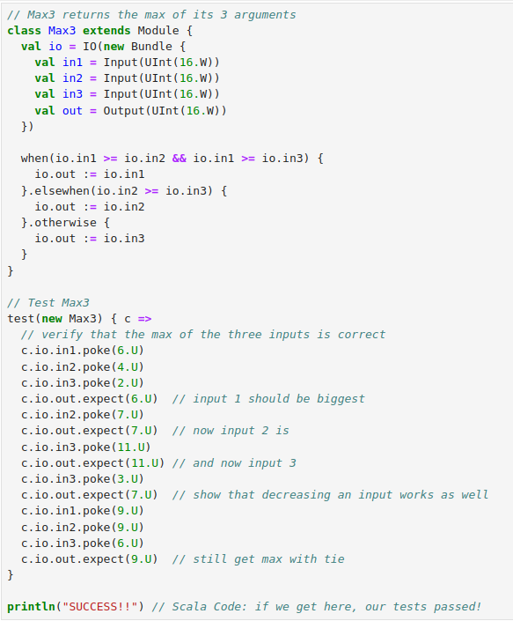
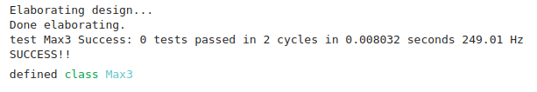
2.3.4 Complete when Structures Example
https://github.com/freechipsproject/chisel-bootcamp
Complete when Structure Example
On the right, we use the complete structures of when, elsewhen, and otherwise.

Slide 12
2.3.5 Sorter Example with Wire

Slide 13
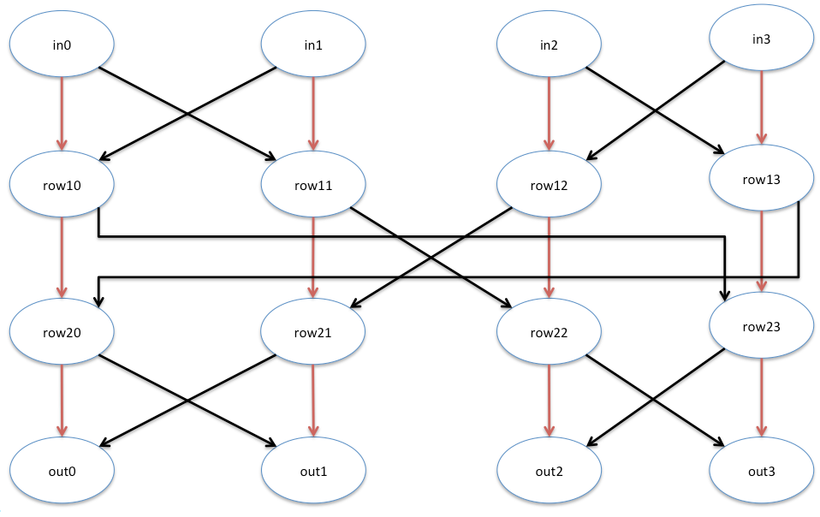
2.3.5 Sorter Example with Wire
https://github.com/freechipsproject/chisel-bootcamp
Sorter Example with Wire
Wire defines a circuit component that can appear on the right hand side or left hand side of a connect := operator.
Below is a example of Combinational Sorter. We input 4-numeric values and output 4-numeric values.
We do in0 and in1 as a pair and in2 and in3 is another pair. We do several layers of comparison.
Red lines are left value is less than the right, no swap. Black lines are for the left is greater than the right and swap.
smaller
bigger

Slide 14
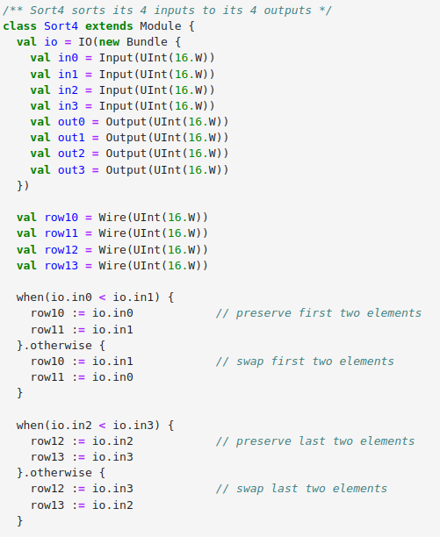
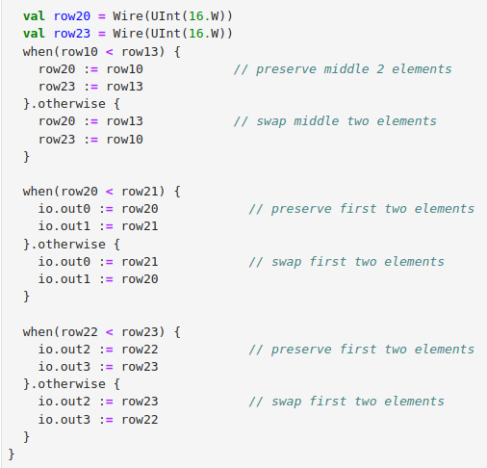
5
4
3
2
2.3.5 Sorter Example with Wire
5
3
https://github.com/freechipsproject/chisel-bootcamp
2
4
Sorter Example with Wire
Below is the implementation of diagram.
3
2
5
4
2
3
4
5

Slide 15
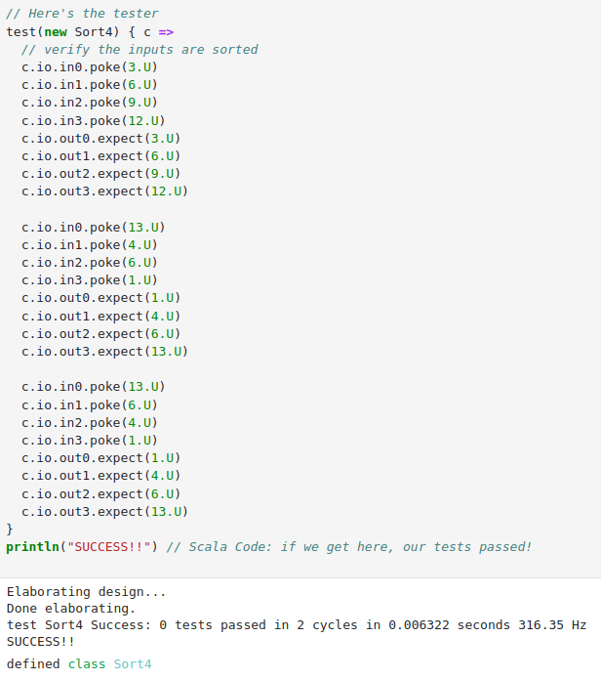
2.3.5 Sorter Example with Wire
https://github.com/freechipsproject/chisel-bootcamp
Sorter Example with Wire
On the right is the testbench of Sorter.

Slide 16
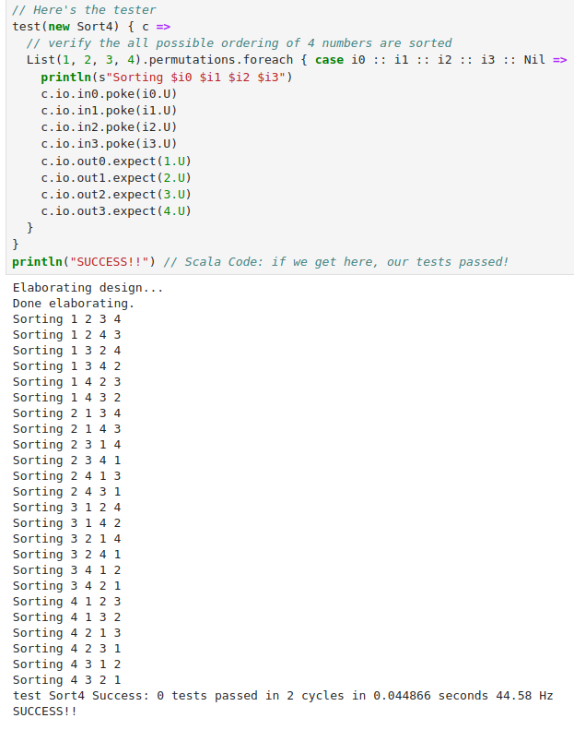
2.3.5 Sorter Example with Wire
https://github.com/freechipsproject/chisel-bootcamp
Sorter Example with Wire
On the right is anther testbench of Sorter.

Slide 17
2.3.6 Exercise 1: Polynomial Circuit

Slide 18

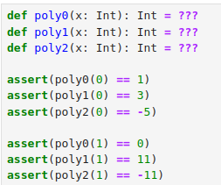
2.3.6 Exercise 1: Polynomial Circuit
https://github.com/freechipsproject/chisel-bootcamp
Exercise 1: Polynomial Circuit
1. Build a Module that will compute the values of these polynomials.
2. A selector input will determine which polynomial to calculate.
3. Use Wires so that the computation appears only once in the module and so that there is a single connection to the output.

Slide 19
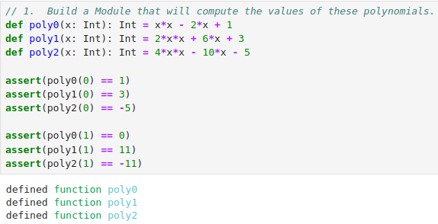
2.3.6 Exercise 1: Polynomial Circuit
https://github.com/freechipsproject/chisel-bootcamp
Exercise 1: Polynomial Circuit
1. Build a Module that will compute the values of these polynomials.
Below, we build a Module that compute the polynomial:

Slide 20
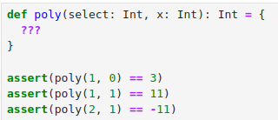
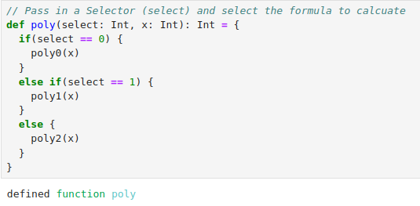
2.3.6 Exercise 1: Polynomial Circuit
https://github.com/freechipsproject/chisel-bootcamp
Exercise 1: Polynomial Circuit
2. We pass in a selector and select the which formula to calculate.

Slide 21
2.3.6 Exercise 1: Polynomial Circuit
https://github.com/freechipsproject/chisel-bootcamp
Exercise 1: Polynomial Circuit
2. We pass in a selector and select the which formula to calculate.
Below, we pass in a selector and select the which formula to calculate.

Slide 22
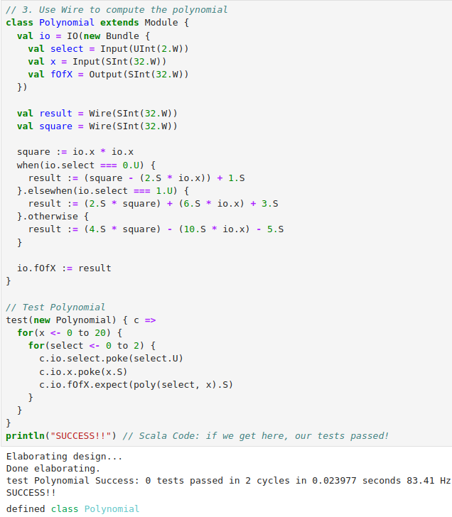
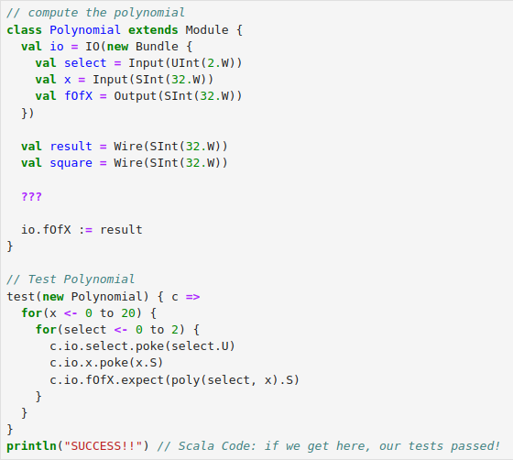
2.3.6 Exercise 1: Polynomial Circuit
https://github.com/freechipsproject/chisel-bootcamp
Exercise 1: Polynomial Circuit
3. Use Wires to compute the module and so that there is a single connection to the output.

Slide 23
2.3.8 Exercise 2: Finite State Machine

Slide 24
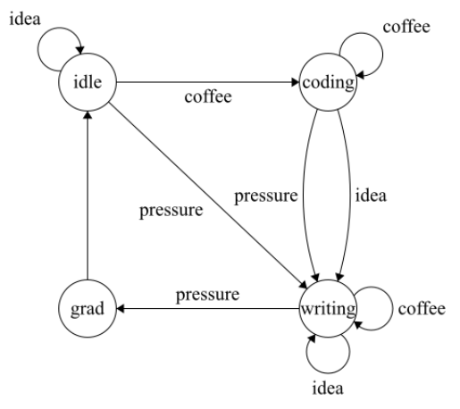
2.3.8 Exercise 2: Finite State Machine
https://github.com/freechipsproject/chisel-bootcamp
Exercise 2: Finite State Machine
1. Use Karnaugh maps to optimize the logic for state machines is tedious and solved by synthesis tools.
2. It also produces unintuitive and unreadable code. So we'll write a more sensible one using Chisel control flow and last connect semantics.
3. The diagram shows the Grad students pass through four states in their career: Idle, Coding, Writing, and Graduating.
4. These states transition based off three inputs: Coffee, Ideas they come up with, and Pressure from their advisor to make progress.
5. Once they Graduate, they return to the Idle state.
6. The FSM (Finite State Machine) diagram below shows these states and transitions.
7. Any unlabeled transition (i.e. when there are no inputs) returns a grad student to the Idle state instead of staying in the current state.
8. The input precedence is coffee > idea > pressure, so when in the Idle state and receiving both coffee and pressure, a graduate student will move to the Coding state.

Slide 25
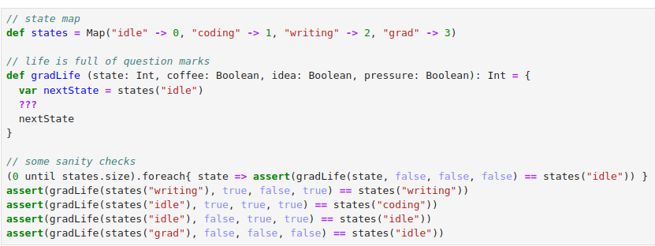
2.3.8 Exercise 2: Finite State Machine
https://github.com/freechipsproject/chisel-bootcamp
Exercise 2: Finite State Machine
1. First we'll construct a model to test against our hardware. Complete the following functional description of our state machine. It has four inputs. The output is the next state. The state map is provided for you. You can access it like states("grad").

Slide 26
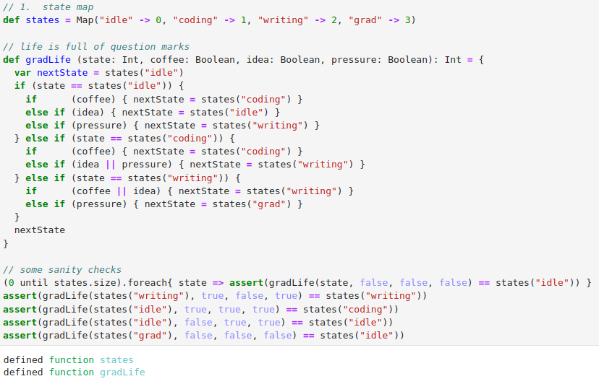
2.3.8 Exercise 2: Finite State Machine
https://github.com/freechipsproject/chisel-bootcamp
Exercise 2: Finite State Machine
1. First we'll construct a model to test against our hardware. Complete the following functional description of our state machine. It has four inputs. The output is the next state. The state map is provided for you. You can access it like states("grad").

Slide 27
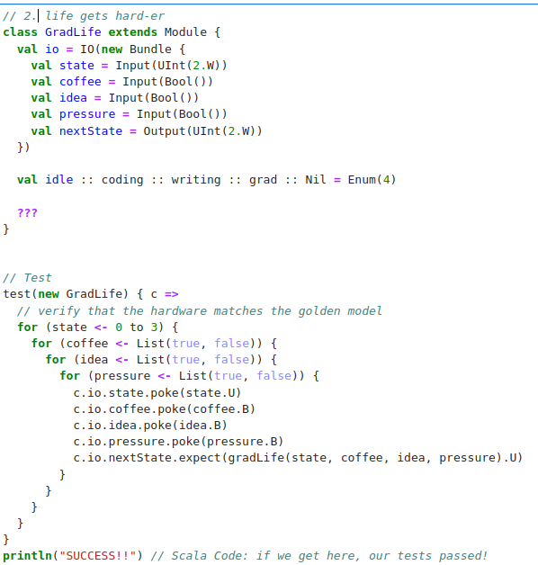
2.3.8 Exercise 2: Finite State Machine
https://github.com/freechipsproject/chisel-bootcamp
Exercise 2: Finite State Machine
1. Now, we implement the state machine in Chisel to pass the tester.
Chisel provides a convenient state machine mapping function for us called Enum.
2. To use these states, treat them like UInt literals.
3. Remember that hardware equality is performed with the triple equals sign.

Slide 28
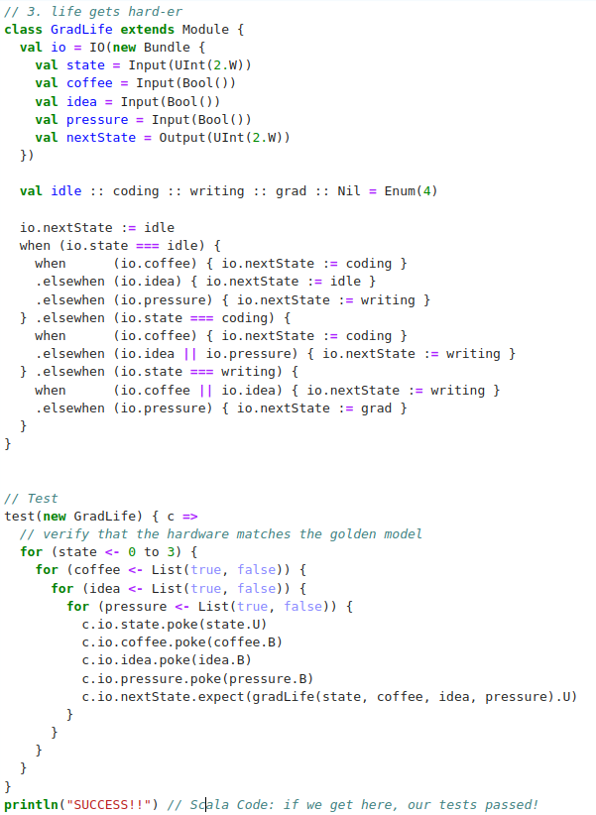
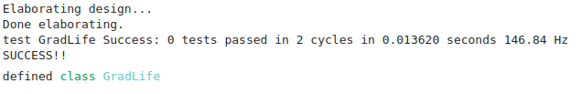
2.3.8 Exercise 2: Finite State Machine
https://github.com/freechipsproject/chisel-bootcamp
Exercise 2: Finite State Machine
1. Now, we implement the state machine in Chisel to pass the tester.
Chisel provides a convenient state machine mapping function for us called Enum.
2. To use these states, treat them like UInt literals.
3. Remember that hardware equality is performed with the triple equals sign.

Slide 29
End

