Slide 1

13.1 Chisel FPGA
Peter H. Chen

Slide 2
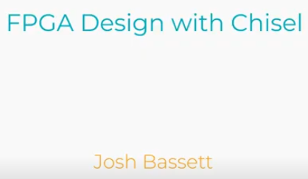
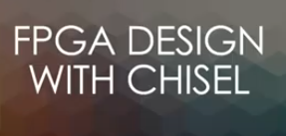
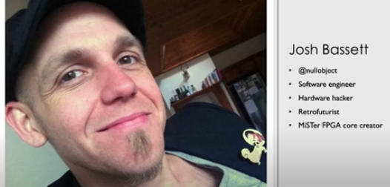
13.1 Chisel FPGA
https://www.youtube.com/watch?v=Wst8IoYRWKo&list=PLlu0CT-JnSasfpk8tq1ZDiE2G0AK1BhOg&index=13
Chisel FPGA (0:00-2:34/40:19)
Josh Bassett, Software Engineer/Hardware Hacker/FPGA Engineer, Linux Conf Au Online (2021).

Slide 3
13.1 Chisel FPGA
https://www.youtube.com/watch?v=Wst8IoYRWKo&list=PLlu0CT-JnSasfpk8tq1ZDiE2G0AK1BhOg&index=13
FPGA Summary (0:00-2:34/40:19)
1. FPGA Behave like micro-controller, but FPGA is not the same as micro-controller, such as, Raspberry Pi.
2. FPGA are circuits made from “sea pf Gates” (AND, OR, NOT, etc)
3. Configure with “bit-stream” at run-time, can be stored in the EEPROM.
4. Can use used for simple logic to extremely complex design, such as, CPU, GPU, etc.
5. Use for hardware prototyping.
6. Can be shipped with products to justify the custom chip.
7. Allow hardware bugs to be fixed after shipping.

Slide 4
13.2 Overview

Slide 5
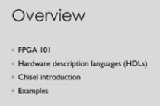
13.2 Overview
https://www.youtube.com/watch?v=Wst8IoYRWKo&list=PLlu0CT-JnSasfpk8tq1ZDiE2G0AK1BhOg&index=13
Overview (2:35-3:20/40:19)

Slide 6
13.3 Field-Programmable Gate Array

Slide 7

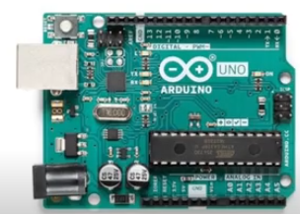
13.3 Field-Programmable Gate Array
https://www.youtube.com/watch?v=Wst8IoYRWKo&list=PLlu0CT-JnSasfpk8tq1ZDiE2G0AK1BhOg&index=13
Field-Programmable Gate Array (3:21-3:33/40:19)
FPGA similar to the micro-controller.

Slide 8
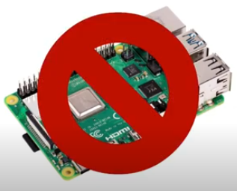
13.3 Field-Programmable Gate Array
https://www.youtube.com/watch?v=Wst8IoYRWKo&list=PLlu0CT-JnSasfpk8tq1ZDiE2G0AK1BhOg&index=13
Field-Programmable Gate Array (3:34-3:36/40:19)
FPGA is not a micro-computer like Raspberry Pi.

Slide 9
13.4 What is FPGA?

Slide 10
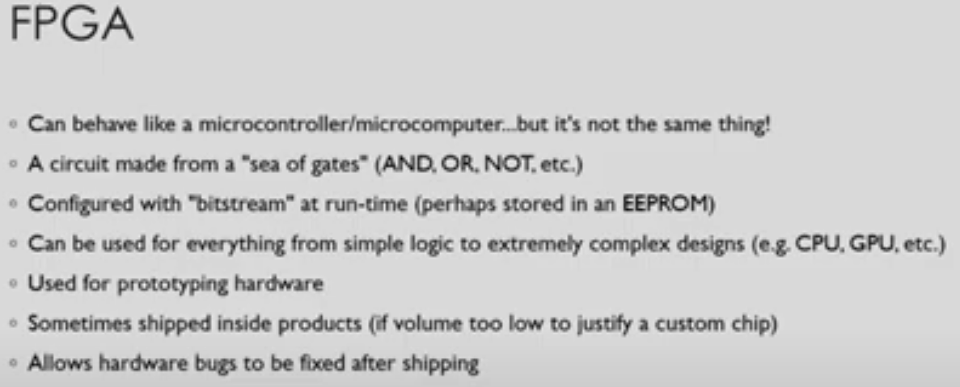
13.4 What is FPGA?
https://www.youtube.com/watch?v=Wst8IoYRWKo&list=PLlu0CT-JnSasfpk8tq1ZDiE2G0AK1BhOg&index=13
What is FPGA? (3:38-5:50/40:19)
1. FPGA Behave like micro-controller, but FPGA is not the same as micro-controller, such as, Raspberry Pi.
2. FPGA are circuits made from “sea pf Gates” (AND, OR, NOT, etc)
3. Configure with “bit-stream” at run-time, can be stored in the EEPROM.
4. Can use used for simple logic to extremely complex design, such as, CPU, GPU, etc.
5. Use for hardware prototyping.
6. Can be shipped with products to justify the custom chip.
7. Allow hardware bugs to be fixed after shipping.

Slide 11
13.5 Pin Count/Power Management

Slide 12
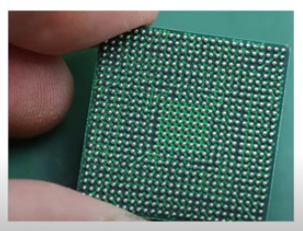
13.5 Pin Count/Power Management
https://www.youtube.com/watch?v=Wst8IoYRWKo&list=PLlu0CT-JnSasfpk8tq1ZDiE2G0AK1BhOg&index=13
Pin Count/Power Management (5:51-6:02/40:19)
1. FPGA is very high pin count.
2. FPGA has programmable logic and power management.

Slide 13
13.6 Prototype Board

Slide 14

13.6 Prototype Board
https://www.youtube.com/watch?v=Wst8IoYRWKo&list=PLlu0CT-JnSasfpk8tq1ZDiE2G0AK1BhOg&index=13
Prototype Board (6:03-7:14/40:19)
We have many way to prototype FPGA, like Raspberry Pi and Arduino.

Slide 15
13.7 Intel/Altera DE10-Nano

Slide 16
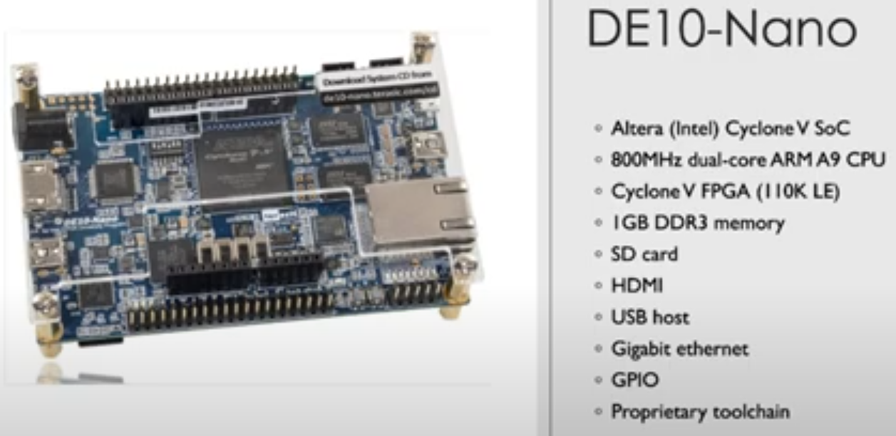
13.7 Intel/Altera DE10-Nano
https://www.youtube.com/watch?v=Wst8IoYRWKo&list=PLlu0CT-JnSasfpk8tq1ZDiE2G0AK1BhOg&index=13
DE10-Nano (6:15-7:27/40:19)
Below is DE10-Nano FPGA.
DE10-Nano was made by Altera Cyclone-V for SoC. Now, Altera is acquired by Intel and become Intel/Altera Cyclone-V SoC.
It is 800 MHz dual-core ARM A9 CPU. Cyclone V FPGA has 110K LE (logic Elements).
1GB DDR3 Memory, SD Card, HDMI, USB, GPIO, Gbit Ethernet, Toolchain from Intel

Slide 17
13.8 AMD/Xilinx PYNQ-Z1

Slide 18
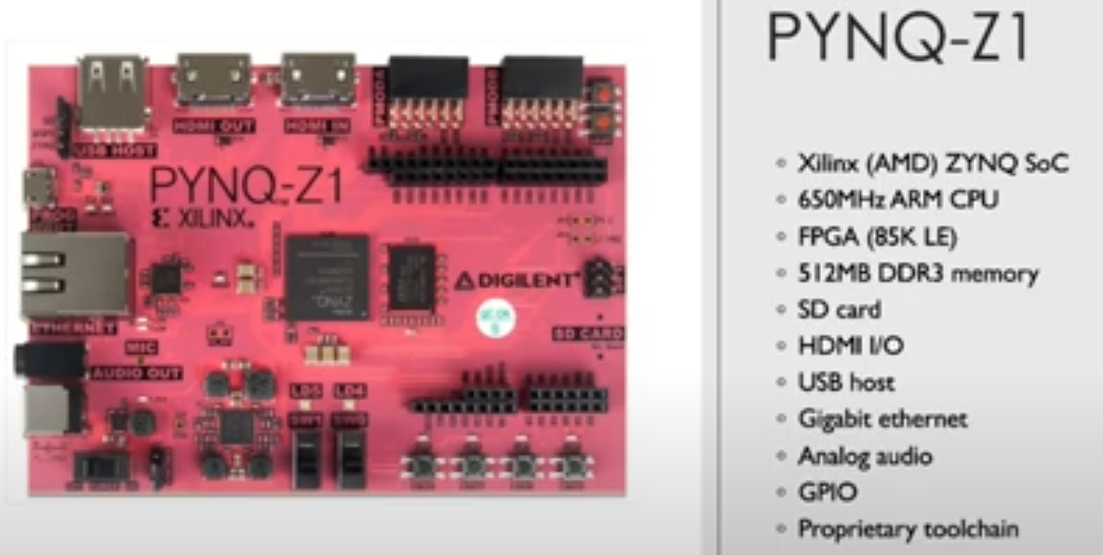
13.8 AMD/Xilinx PYNQ-Z1
https://www.youtube.com/watch?v=Wst8IoYRWKo&list=PLlu0CT-JnSasfpk8tq1ZDiE2G0AK1BhOg&index=13
AMD/Xilinx PYNQ-Z1 (7:28-8:16/40:19)
Below is PYNQ-Z1 FPGA.
PYNQ-Z1 was made by Xilinx ZYNQ for SoC. Now, Xilinx is acquired by AMD and become Intel/Altera PYNQ-Z1 SoC.
It is 650 MHz ARM CPU. PYNA-Z1 FPGA has 85K LE (logic Elements).
512 MB DDR3 Memory, SD Card, HDMI, USB, Gbit Ethernet, Analog Audio, GPIO, Toolchain from AMD

Slide 19
13.9 Open HW/SW ULX3S

Slide 20
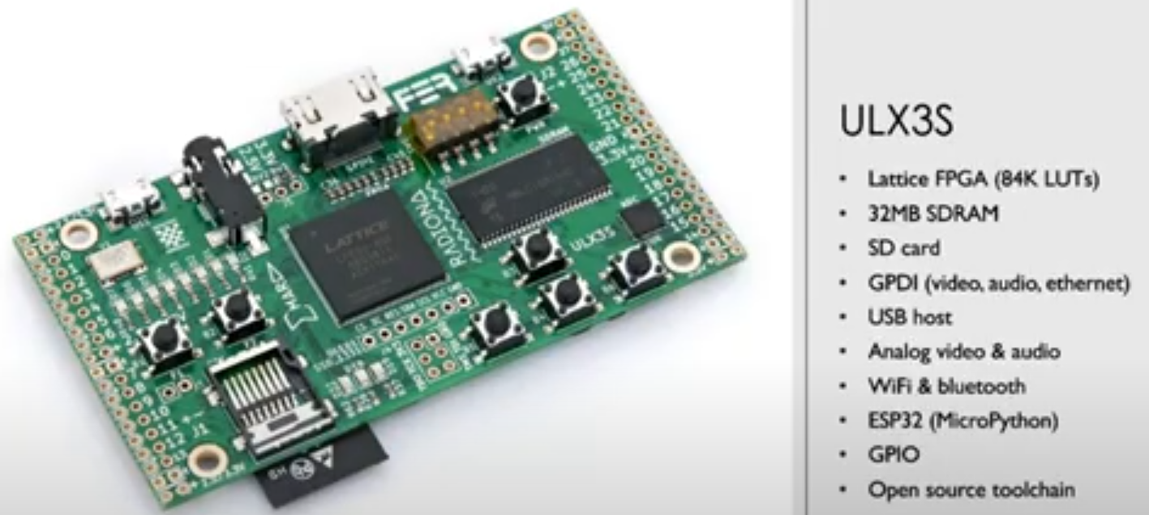
13.9 Open HW/SW ULX3S
https://www.youtube.com/watch?v=Wst8IoYRWKo&list=PLlu0CT-JnSasfpk8tq1ZDiE2G0AK1BhOg&index=13
Open HW/SW ULX3S (8:17-9:22/40:19)
Below is ULX3S FPGA.
ULLX3S is made by Lattice with Open Hardware and Open Software.
32 MB DDR3 Memory, SD Card, HDMI, USB, Gbit Ethernet, Analog Video/Audio, WIFI/Bluetooth, MicroPython, GPIO, Open source Toolchain

Slide 21
13.0 HW Description Language

Slide 22

13.0 HW Description Language
https://www.youtube.com/watch?v=Wst8IoYRWKo&list=PLlu0CT-JnSasfpk8tq1ZDiE2G0AK1BhOg&index=13
HW Description Language (9:23-9:34/40:19)
HDL (Hardware Description Language) is used to program the board.

Slide 23
End

