Slide 1

13.11 Schematic Diagram
Peter H. Chen

Slide 2
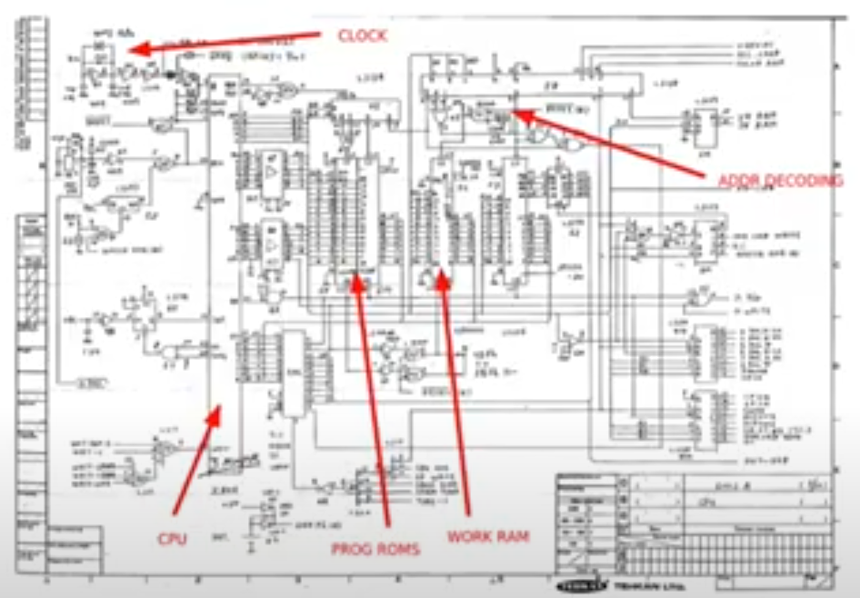
13.11 Schematic Diagram
https://www.youtube.com/watch?v=Wst8IoYRWKo&list=PLlu0CT-JnSasfpk8tq1ZDiE2G0AK1BhOg&index=13
Schematic Diagram (9:35-10:03/40:19)
FPGA board comes with a Schematic Diagram.
The schematic diagram shows the elements of circuit, different wires, signals, and interconnections of the components. We can fit them together in the different parts, like CPI, Memory, etc.
How do we convert a bitstream to put onto an FPGA?

Slide 3
13.12 HDL

Slide 4
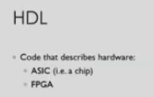
13.12 HDL
https://www.youtube.com/watch?v=Wst8IoYRWKo&list=PLlu0CT-JnSasfpk8tq1ZDiE2G0AK1BhOg&index=13
HDL (10:04-11:34/40:19)
Code

Slide 5
End

