Slide 1

9 Testing
Peter H. Chen

Slide 2
9 Testing
https://www.youtube.com/watch?v=5_z3YfBTaTs&list=PLfrN7RIcMe6g2LBRJLTHTdhyj5s8ag0Rg&index=9
Testing (0:00-0:24/1:04:03)
Note: by Peter Hanping Chen
1. Why do I modify?
I cannot use configuration file (chisel_deps.sc) from Prof. Scott Beamer which have error in dependencies on my Ubuntu OS.
2. Instead, I used UCB bootcamp configuration file (load_ivy.sc) below.
Since load-ivy.sc is not 100% compatible in dependencies as chisel.deps.sc, I made some modification to make them work.
3. source/load-ivy.sc (https://github.com/freechipsproject/chisel-bootcamp)

Slide 3
9 Testing
https://www.youtube.com/watch?v=5_z3YfBTaTs&list=PLfrN7RIcMe6g2LBRJLTHTdhyj5s8ag0Rg&index=9
Testing (0:21-0:25/1:04:03)
We discuss how to write the Chisel Testbench.
Topics:
1. Setup: jupyter notebook, select scala, and run cells.
2. Chisel use test() utility to write the testbench. Other test tools: Tread, Verilator, and Verilog Simulator.
3. Simple Test: Combinational Component, modelAdd, and Passthrough
4. Queue Model Test case:
  4.1 Define a Queue Model for complete test/simulation.
  4.2 Short test for pass/fail for Queue Model
  4.3 Long/Loop test for Queue Model
  4.4 Manually Comparison for Queue Model
  4.5 Automate Interaction for Queue Model
  4.6 Fill/Drain with sequence of data for Queue Model
  4.7 Random Test for Queue Model
5. Summary:
  5.1 Make test by human
  5.2 Random test maybe good, maybe be not great
  5.3 Verilog Assertion only good for static test, not for simulation.

Slide 4
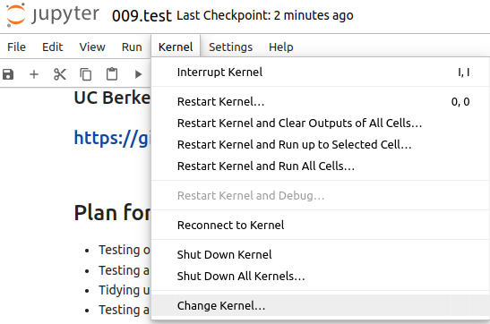
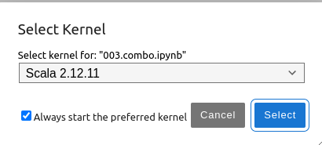
9 Testing
https://www.youtube.com/watch?v=5_z3YfBTaTs&list=PLfrN7RIcMe6g2LBRJLTHTdhyj5s8ag0Rg&index=9
Testing (0:26-0:50/1:04:03)
We discuss Chisel Collection.
> jupyter notebook 009.test.ipynb > Kernel > Change Kernel … > Select Scala2.21.22
> Run All Cells

Slide 5
9.1 Plan

Slide 6
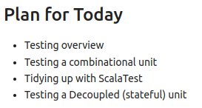
9.1 Plan
https://www.youtube.com/watch?v=5_z3YfBTaTs&list=PLfrN7RIcMe6g2LBRJLTHTdhyj5s8ag0Rg&index=9
Plan (0:51-0:53/1:04:03)

Slide 7
9.2 Import Chisel Library

Slide 8
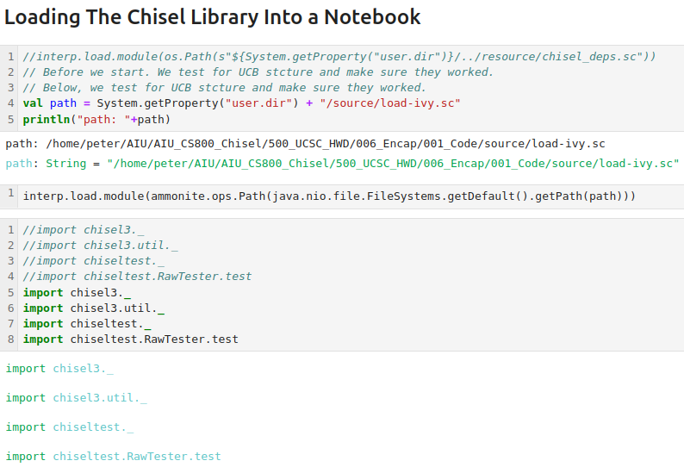
9.2 Import Chisel Library
https://www.youtube.com/watch?v=5_z3YfBTaTs&list=PLfrN7RIcMe6g2LBRJLTHTdhyj5s8ag0Rg&index=9
Import Chisel Library (0:54-0:55/1:04:03)

Slide 9
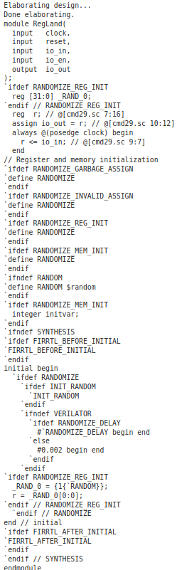
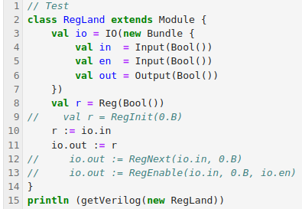
9.2 Import Chisel Library
https://www.youtube.com/watch?v=5_z3YfBTaTs&list=PLfrN7RIcMe6g2LBRJLTHTdhyj5s8ag0Rg&index=9
Import Chisel Library (0:56-0:58/1:04:03)
Test

Slide 10
9.3 Why Test?

Slide 11
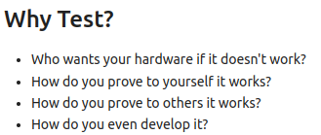
9.3 Why Test?
https://www.youtube.com/watch?v=5_z3YfBTaTs&list=PLfrN7RIcMe6g2LBRJLTHTdhyj5s8ag0Rg&index=9
Why Test? (0:59-3:05/1:04:03)
Who wants your hardware if it doesn't work?
  Both hardware and software need to be worked.
How do you prove to yourself it works?
How do you prove to others it works?
How do you even develop it?
  Test helped developer

Slide 12
9.4 Goal of Test

Slide 13
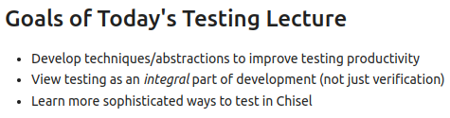
9.4 Goal of Test
https://www.youtube.com/watch?v=5_z3YfBTaTs&list=PLfrN7RIcMe6g2LBRJLTHTdhyj5s8ag0Rg&index=9
Goal of Test (3:06-3:45/1:04:03)
Develop techniques/abstractions to improve testing productivity
View testing as an integral part of development (not just verification)
Learn more sophisticated ways to test in Chisel

Slide 14
9.6 Main Test Component

Slide 15
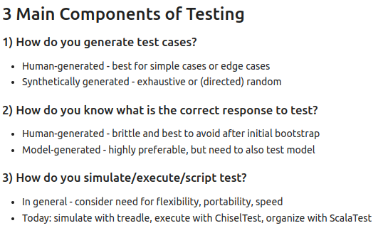
9.6 Main Test Component
https://www.youtube.com/watch?v=5_z3YfBTaTs&list=PLfrN7RIcMe6g2LBRJLTHTdhyj5s8ag0Rg&index=9
Main Test Component (3:46-8:02/1:04:03)
1. Generate the test case: human-generate, random generate
2. Correct response, Golden answer for test
3. Run Test Simulation: treadle is very nice, chisel uses ChiselTest.

Slide 16
9.7 Design Test

Slide 17
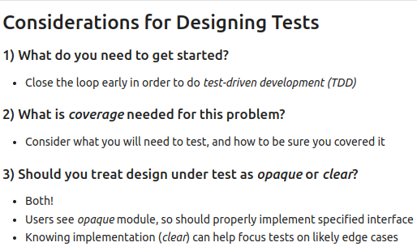
9.7 Design Test
https://www.youtube.com/watch?v=5_z3YfBTaTs&list=PLfrN7RIcMe6g2LBRJLTHTdhyj5s8ag0Rg&index=9
Design Test (8:03-10:13/1:04:03)
1. TDD (Test-Driven Development):
2. Test Coverage:
3. Design Under Test: Black box and white box test.

Slide 18
9.8 When To Test

Slide 19
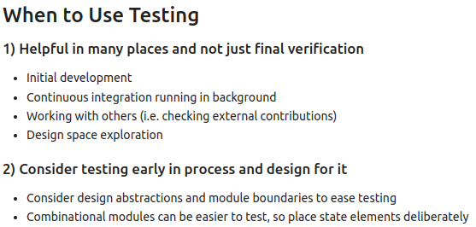
9.8 When To Test
https://www.youtube.com/watch?v=5_z3YfBTaTs&list=PLfrN7RIcMe6g2LBRJLTHTdhyj5s8ag0Rg&index=9
When To Test (10:14-12:40/1:04:03)
1. Verification: Initial development (Write test at very beginning of design), Continuous Integration in background (Test after design, weekly test, monthly test, 6 month test), External contributors, DSE (Design Space Exploration).
2. Early test: Before the Design

Slide 20
9.9 Chisel Test

Slide 21
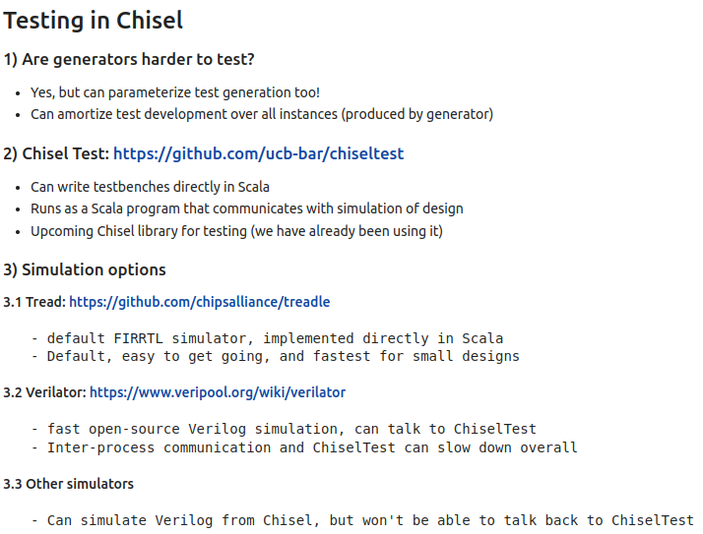
9.9 Chisel Test
https://www.youtube.com/watch?v=5_z3YfBTaTs&list=PLfrN7RIcMe6g2LBRJLTHTdhyj5s8ag0Rg&index=9
Chisel Test (12:41-15:55/1:04:03)
We use ChiselTest to do test. We need the simulations (tread, verilator, other Verilog simulator, etc.)

Slide 22
9.10 Test Combinational Component

Slide 23
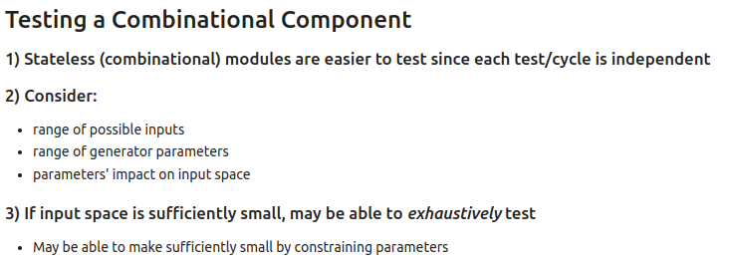
9.10 Test Combinational Component
https://www.youtube.com/watch?v=5_z3YfBTaTs&list=PLfrN7RIcMe6g2LBRJLTHTdhyj5s8ag0Rg&index=9
Test Combinational Component (12:41-16:55/1:04:03)
1. Stateless
2. range: Inputs, parameters, impacts
3. Exhaustive test

Slide 24
9.11 Example: Test Combinational Component

Slide 25

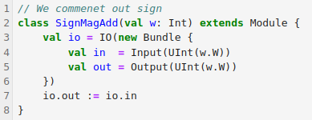
9.11 Example: Test Combinational Component
https://www.youtube.com/watch?v=5_z3YfBTaTs&list=PLfrN7RIcMe6g2LBRJLTHTdhyj5s8ag0Rg&index=9
Example: Test Combinational Component (16:56-18:10/1:04:03)
We have
1. Sign with Bool: For simplified, we comment out sign.
2. magnitude with Unsigned Integer.
3. Convert the input with sign and magnitude and output

Slide 26
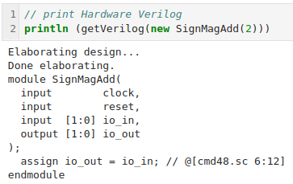
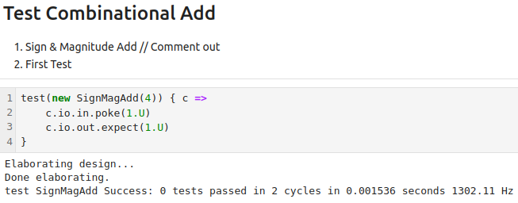
9.11 Example: Test Combinational Component
https://www.youtube.com/watch?v=5_z3YfBTaTs&list=PLfrN7RIcMe6g2LBRJLTHTdhyj5s8ag0Rg&index=9
Example: Test Combinational Component (18:11-18:50/1:04:03)
1. Print generate Hardware Verilog.
2. We make a simple test.
1
2

Slide 27
9.12 Example: modelAdd

Slide 28
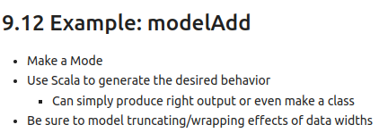
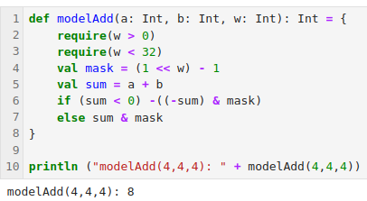
9.12 Example: modelAdd
https://www.youtube.com/watch?v=5_z3YfBTaTs&list=PLfrN7RIcMe6g2LBRJLTHTdhyj5s8ag0Rg&index=9
Example: modelAdd (18:51-21:50/1:04:03)

Slide 29
9.13 Example: Test PassthroughGenerator

Slide 30
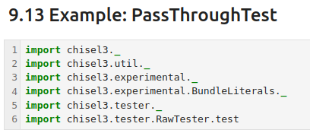
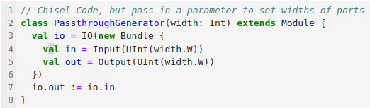
9.13 Example: Test PassthroughGenerator
https://www.youtube.com/watch?v=5_z3YfBTaTs&list=PLfrN7RIcMe6g2LBRJLTHTdhyj5s8ag0Rg&index=9
Example: Test Passthrough Generator (18:51-21:50/1:04:03)

Slide 31
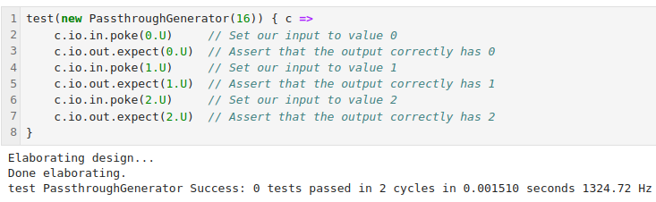
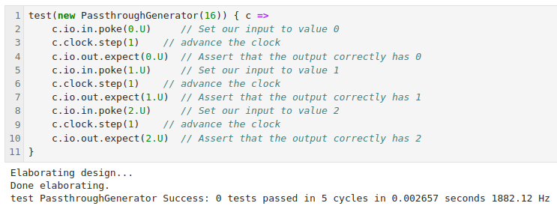
9.13 Example: Test PassthroughGenerator
https://www.youtube.com/watch?v=5_z3YfBTaTs&list=PLfrN7RIcMe6g2LBRJLTHTdhyj5s8ag0Rg&index=9
Example: Test Passthrough Generator (18:51-43:27/1:04:03)
Poke, expect, step

Slide 32
9.14 Chisel Queue Introduction

Slide 33
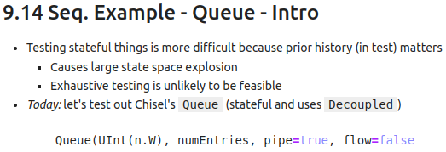
9.14 Chisel Queue Introduction
https://www.youtube.com/watch?v=5_z3YfBTaTs&list=PLfrN7RIcMe6g2LBRJLTHTdhyj5s8ag0Rg&index=9
Chisel Queue Introduction (43:28-44:49/1:04:03)
We have discussed the basic concept of Scala Test and Chisel Test.
Now, we want to move into Sequential and State Machine.
These are harder because the input sequences are very fast due to the DSE (Design State-Space Exploration).
These DSE data are large amount of input data for exhausted testing.
To schedule the large amount of input data, we need to put the data on the queue.
We use Chisel Queue which built into Scala language.
> Queue (UInt (n.W), numEntries, pipe=true, flow=false)
We passed in the Input data in UInt format, number of entries, pipe, and flow parameter.
The flow is used to optimize (manage and move) items to minimize the wait times.
The pipe is used to keep track for full/empty with Enqueue or Dequeue.

Slide 34
9.15 Implement Chisel Queue Model

Slide 35
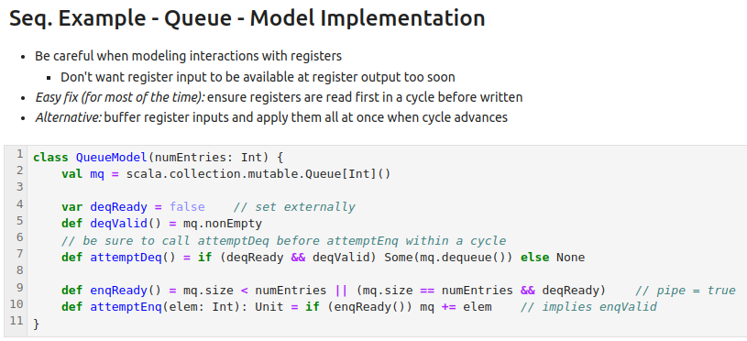
9.15 Implement Chisel Queue Model
https://www.youtube.com/watch?v=5_z3YfBTaTs&list=PLfrN7RIcMe6g2LBRJLTHTdhyj5s8ag0Rg&index=9
Implement Chisel Queue Model (44:50-48:57/1:04:03)
Be careful about the model interact with register
  when input register send the data, the output register need some clock cycles have the data
  Try to write in Scala instead of Chisel. It is too hard to write Chisel directly.
For the buffer register, we need some cycle advanced to get the data.
> mq = scala.collection.mutable.Queue[Int]()
> deqReady = false …
> if deqReady && deqValid() then do dequeue() ...

Slide 36
9.16 Chisel Queue Model: Test Short Logic

Slide 37
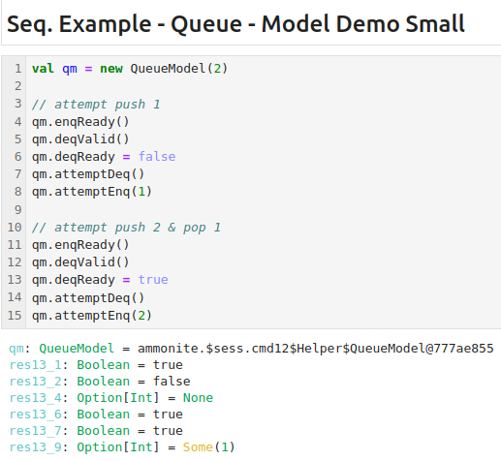
9.16 Chisel Queue Model: Test Short Logic
https://www.youtube.com/watch?v=5_z3YfBTaTs&list=PLfrN7RIcMe6g2LBRJLTHTdhyj5s8ag0Rg&index=9
Chisel Queue Model: Test Short Logic (48:57-50:32/1:04:03)
We test the short logic for Chisel Queue Model.
We only look at the logic/behavior true/false only to make sure the logic/behavior is correct.

Slide 38
9.17 Chisel Queue Model: Test Long Loop

Slide 39
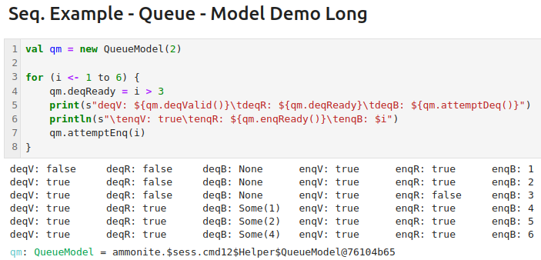
9.17 Chisel Queue Model: Test Long Loop
https://www.youtube.com/watch?v=5_z3YfBTaTs&list=PLfrN7RIcMe6g2LBRJLTHTdhyj5s8ag0Rg&index=9
Chisel Queue Model: Test Long Loop (50:33-51:41/1:04:03)
We test the long loop for Chisel Queue Model.
We make sure the long loop/behavior are all correct as we expect.

Slide 40
9.18 Chisel Queue Model: Manually Compare

Slide 41
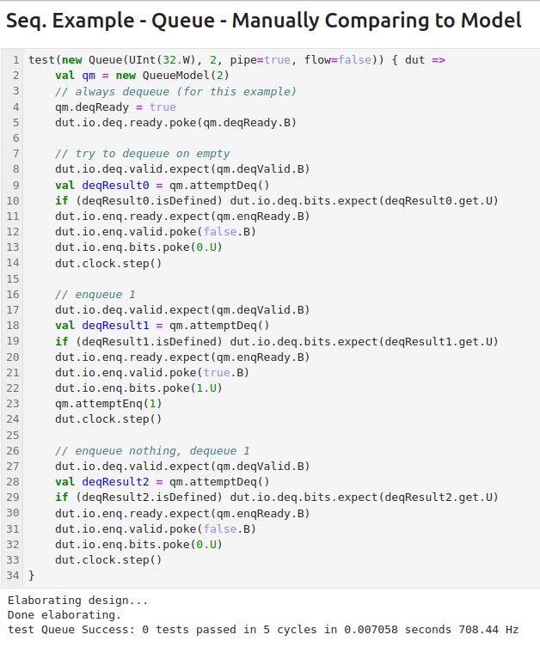
9.18 Chisel Queue Model: Manually Compare
https://www.youtube.com/watch?v=5_z3YfBTaTs&list=PLfrN7RIcMe6g2LBRJLTHTdhyj5s8ag0Rg&index=9
Chisel Queue Model: Manually Compare (51:42-53:16/1:04:03)
Compare manually the output of model to the results we expected.

Slide 42
9.19 Chisel Queue Model: Automate Interaction

Slide 43
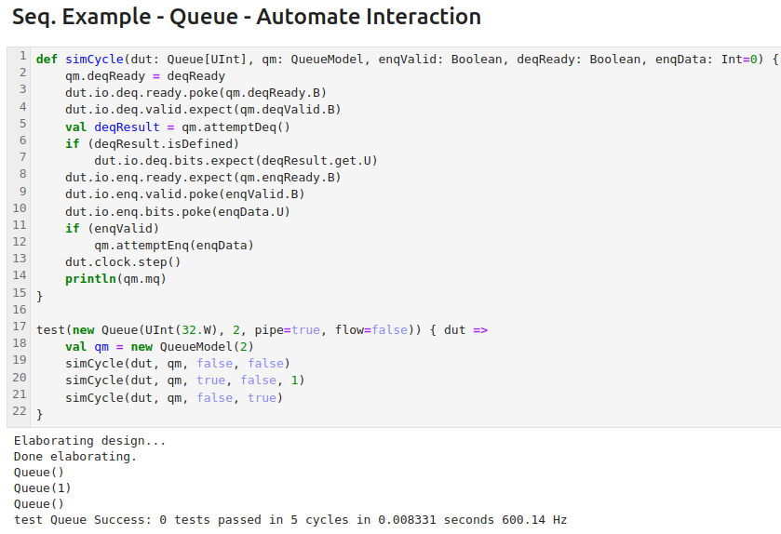
9.19 Chisel Queue Model: Automate Interaction
https://www.youtube.com/watch?v=5_z3YfBTaTs&list=PLfrN7RIcMe6g2LBRJLTHTdhyj5s8ag0Rg&index=9
Chisel Queue Model: Automate Interaction (53:17-57:50/1:04:03)
After automate interaction is done, we can pass in the easy interface with the clock cycle.
Note: Waveform viewer is for debugging and will be discussed later on.

Slide 44
9.20 Chisel Queue Model: Test Fill/Drain

Slide 45
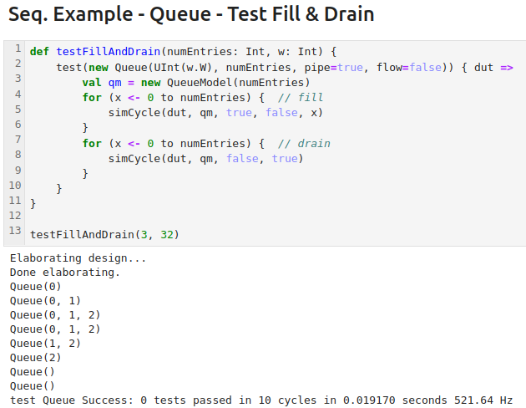
9.20 Chisel Queue Model: Test Fill/Drain
https://www.youtube.com/watch?v=5_z3YfBTaTs&list=PLfrN7RIcMe6g2LBRJLTHTdhyj5s8ag0Rg&index=9
Chisel Queue Model: Test Fill/Drain (57:51-58:29/1:04:03)
We fill sequence of data and drain results.

Slide 46
9.21 Chisel Queue Model: Test Randomly

Slide 47
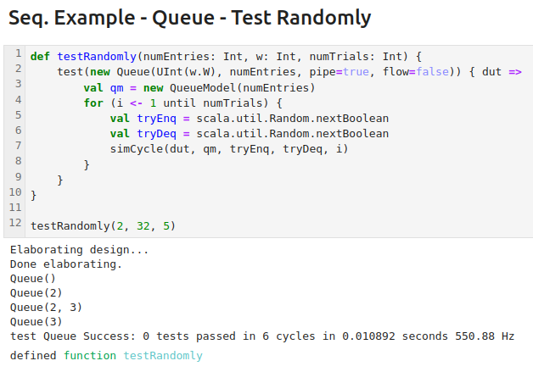
9.21 Chisel Queue Model: Test Randomly
https://www.youtube.com/watch?v=5_z3YfBTaTs&list=PLfrN7RIcMe6g2LBRJLTHTdhyj5s8ag0Rg&index=9
Chisel Queue Model: Test Randomly (58:30-59:34/1:04:03)
Chisel is a great technology for testing.

Slide 48
9.22 Test Advice

Slide 49
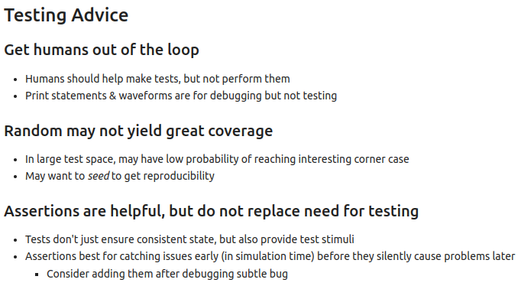
9.22 Test Advice
https://www.youtube.com/watch?v=5_z3YfBTaTs&list=PLfrN7RIcMe6g2LBRJLTHTdhyj5s8ag0Rg&index=9
Test Advice (59:35-1:04:03/1:04:03)
1. Get human out of loop: Automatic test
2. Radom test be good in some time not all the time.
3. Verilog Assertion is good but cannot replace testing.

Slide 50
End

