Slide 1

2.4 Sequential Logic
Peter H. Chen

Slide 2
2.4 Sequential Logic
https://github.com/freechipsproject/chisel-bootcamp
Sequential Logic
We discuss how to implement the Register Control Flow with Scala.
Topics:
1. Setup: Start the Jupyter Notebook, select the scalar interpreter, run Scala in Jupyter Notebook.
2. Register: Register contains the clock for sequential logic synchronization.
3. RegNext: Convenient function which helps programmer to figure bit width of register creation.
4. RegInit: Use different syntax for both Chisel initialization and in Verilog initialization.
5. Register Control Flow: Same as Wire Control Flow.
6. Register Operation: Register Operators (+, -, etc) for Unsigned Integer and Signed Integer.
7. Reset and Multi-Clock
8. Multi-Clock Example: Chisel code/Generated Verilog for Reset and Multi-Clock.
9. Exercise 1: Problem and Solution of LFSR (Linear Feedback Shift Register)
10. Exercise 2: Problem and Solution of Reset for Shift Register.
11. Wrap Up: We have finished both the Combinational and Sequential Logic. Next, we will combine them together for the design.

Slide 3
2.4.1 Setup

Slide 4
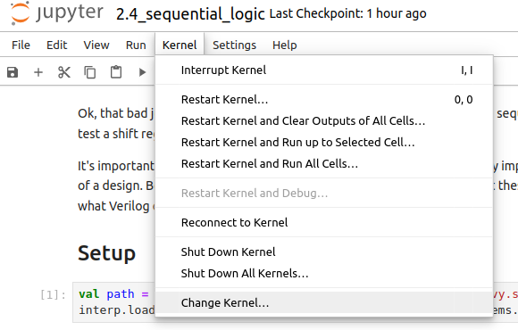
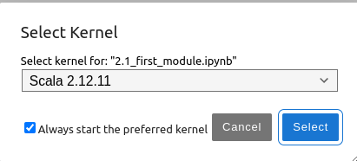
2.4.1 Setup
https://github.com/freechipsproject/chisel-bootcamp
Setup
1. Change folder to chisel-bootcamp. If you want to work on your working space, copy image folder and source folder to your working directory.
> cd chisel-bootcamp
2. Start Jupyter notebook
> jupyter notebook 2.4_sequential_loigc.ipynb
3. Select the scala interpreter: > Kernel > Change Kernel… >Scala 2.12.11
3

Slide 5
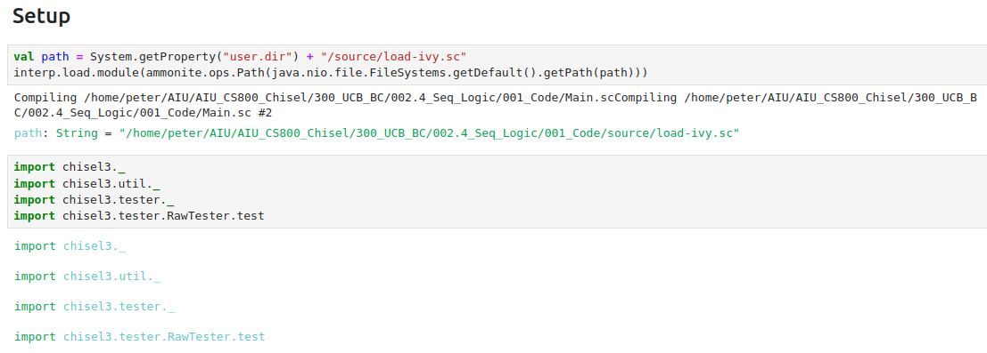
2.4.1 Setup
https://github.com/freechipsproject/chisel-bootcamp
Setup
1. Scala uses maven to setup path to with for source folder for Scala Libraries and get Scala Property.
2. import chisel3 library, utility, tester harness (horse controller), and test interface function.

Slide 6
2.4.2 Register

Slide 7
2.4.2 Register
https://github.com/freechipsproject/chisel-bootcamp
Register
1. The basic stateful element in Chisel is the register.
2. The basic register element as Reg.
3. A Reg holds its output value until the rising edge of its clock. At the rising edge of clock, it takes the value of its input.
4. By default, every Chisel Module has an implicit clock. The clock is used by every register in the design.
5. The Chisel Module saves your time to specify the clock all over your code.

Slide 8
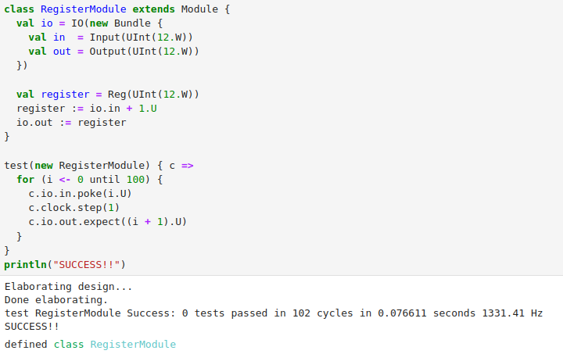
2.4.2 Register
https://github.com/freechipsproject/chisel-bootcamp
Register
1. Example: Using a Register
2. Below code implements a module that takes the input, adds 1 to it, and connects it as the input of a register.
Note:
a. The implicit clock can be overridden for multi-clock designs.
b. See the appendix for an example.
2

Slide 9
2.4.2 Register
https://github.com/freechipsproject/chisel-bootcamp
Register
1. The register is created by calling Reg(tpe), where tpe is a variable that encodes the type of register we want.
2. In this example, tpe is a 12-bit UInt.
3. Look at what the tester above is doing. Between calls to poke() and expect, there is a call to step(1). This tells the test harness to tick the clock once, which will cause the register to pass its input to its output.
4. Calling step(n) will tick the clock n times. The smart observer will notice that previous testers testing combinational logic did not call step(). This is because calling poke() on an input immediately propagates the updated values through combinational logic.
5. Calling step() is only needed to update state elements in sequential logic.

Slide 10
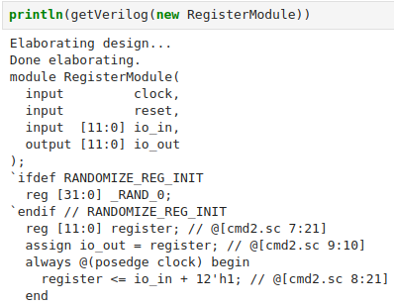
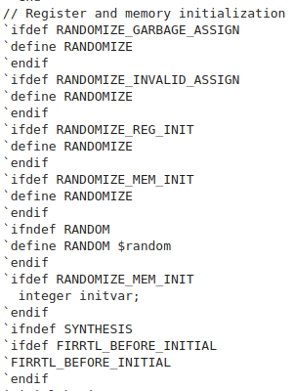
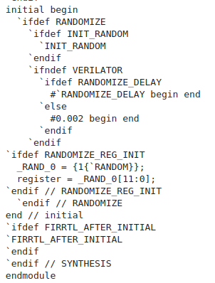
2.4.2 Register
https://github.com/freechipsproject/chisel-bootcamp
Register
1. The code block below will show the Verilog generated by RegisterModule by
> println (getVerilog (new RegisterModule))

Slide 11
2.4.2 Register
https://github.com/freechipsproject/chisel-bootcamp
Register
Note:
1. The module has an input for clock (and reset) that we didn't add.
2. The clock is the implicit clock
3. The variable register shows up as reg [11:0], as expected
4. There is a block sectioned off by ifdef Randomize (RANDOMIZE_REF_INIT).
5. The register [11:0] is initialized to some random variable before simulation starts.
6. register is updated on posedge clock.

Slide 12
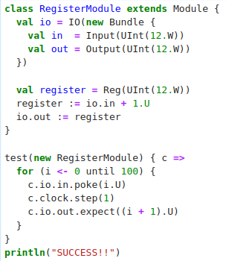
2.4.2 Register
https://github.com/freechipsproject/chisel-bootcamp
Register
Note:
1. Chisel distinguishes between types (e.g., UInt used in chisel module), hardware nodes (e.g., 12.U used ins the Verilog), and the output of myReg (Used in Chisel) .
2. The code
> val myReg = Reg(UInt(12.W))
is legal because a Reg needs a data type as a model.
3. However,
> val myReg = Reg (12.U)
is an error because 12.U is already a hardware node and cannot be inside the chisel module.

Slide 13
2.4.3 RegNext

Slide 14
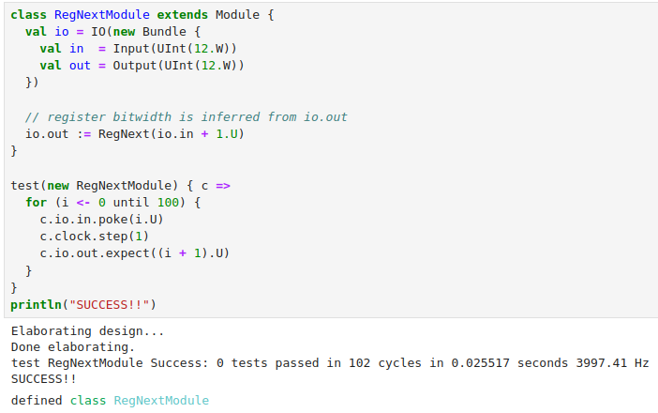
2.4.3 RegNext
https://github.com/freechipsproject/chisel-bootcamp
RegNext
1. Chisel has a convenience register object for registers with simple input connections.
2. The previous Module can be shortened to the following Module.
3. Note:
a. We can use RegNext() and we do not need to specify the register bitwidth.
b. Chisel can figure out the width of register output io.out from the io.out.

Slide 15
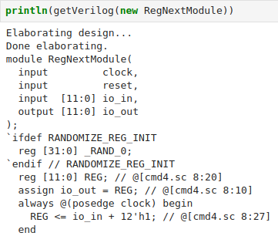
2.4.3 RegNext
https://github.com/freechipsproject/chisel-bootcamp
RegNext
The Verilog are the same as previous one. Only register name is generated instead of explicitly defined.
Generated by NexReg
Previous: Explicitly

Slide 16
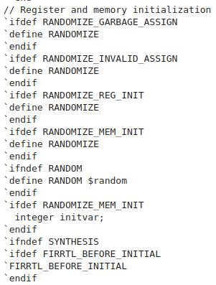
2.4.3 RegNext
https://github.com/freechipsproject/chisel-bootcamp
RegNext
The Verilog are the same as before. Only register name is generated instead of explicitly defined.
Generated by NexReg
Previous: Explicitly
Same

Slide 17
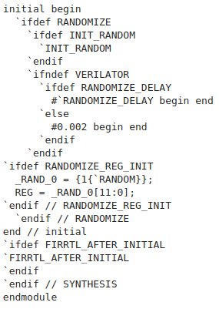
2.4.3 RegNext
https://github.com/freechipsproject/chisel-bootcamp
RegNext
The Verilog are the same as before. Only register name is generated instead of explicitly defined.
Generated by NexReg
Previous: Explicitly

Slide 18
2.4.4 RegInit

Slide 19
2.4.4 RegInit
https://github.com/freechipsproject/chisel-bootcamp
RegInit
1. The register in RegisterModule was initialized to random data for simulation.
2. Unless otherwised specified, registers do not have a reset value (or a reset).
3. The way to create a register that resets to a given value is with RegInit.
4. For instance, a 12-bit register initialized to zero can be created with the following.
5. Both versions below are valid and do the same thing:
> val myReg = RegInit(UInt(12.W), 0.U)
> val myReg = RegInit(0.U(12.W))
6. The first version has two arguments.
7. The first argument is a type node that specified the datatype and its width.
8. The second argument is a hardware node that specified the reset value, in this case 0.
9. The second version has one argument.
10. It is a hardware node that specifies the reset value, but normally 0.U.

Slide 20
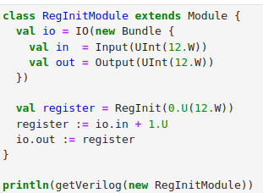
2.4.4 RegInit
https://github.com/freechipsproject/chisel-bootcamp
RegInit
1. Example: Initialized Register
2. Chisel Code:
> val register = RegInit (0.U(12.W))

Slide 21
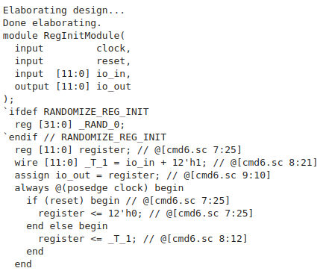
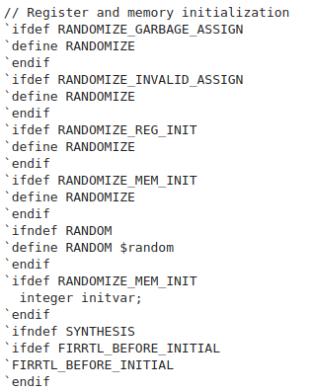
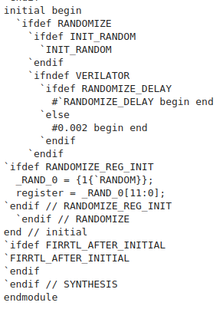
2.4.4 RegInit
https://github.com/freechipsproject/chisel-bootcamp
RegInit
1. Example: Initialized Register
2. The following Verilog code is generated by RegInit(), initialized to zero.
3. Note:
a. The generated Verilog now has a block that checks if (reset) to reset the register to 0.
b. The “if (reset)” is inside the always @(posedge clock) block.
c. Chisel is always implicitly reset is active high and synchronous.
d. The register is initialized to random junk before reset is called (When reset is called, it rest to low).
e. The PeekPokeTesters always call reset before running your test, but you can manually call reset as well using the reset(n) function, where reset is high for n cycles.

Slide 22
2.4.5 Register Control Flow

Slide 23
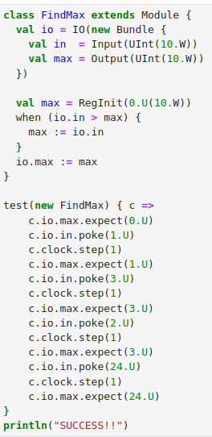
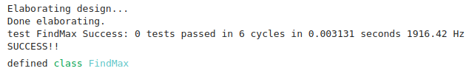
2.4.5 Register Control Flow
https://github.com/freechipsproject/chisel-bootcamp
Register Control Flow
1. The “Register Control Flow“ is similar to “Wire Control Flow”.
2. Same as “Wire Control Flow”:
  2.1 “Register Control Flow” can be assigned to conditionally with when, elsewhen, and otherwise.
  2.2 “Register Control Flow” has latest statement overwrite the previous connection
3. Example: Register Control Flow
The right-hand side example finds the maximum value in a sequence of inputs using conditional register assignments.
2
2.1
2.2

Slide 24
2.4.6 Register Operation

Slide 25
2.4.6 Register Operation
https://github.com/freechipsproject/chisel-bootcamp
Register Operation
1. Operation on a register are performed on the output of the register,
2. The kind of operations depend on the register's type.
For example, if we have register in UInt (Unsigned Integer),
> val reg: UInt = Reg(UInt(4.W))
For UInt register, we can do things you can normally do mathematical operations ( +, -, etc) for UInt Register.
We can use SInt (Signed Integer) and etc for mathematical operation.

Slide 26
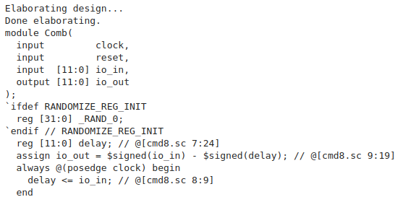
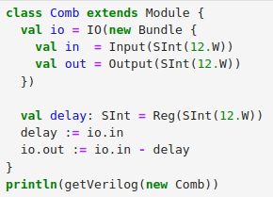
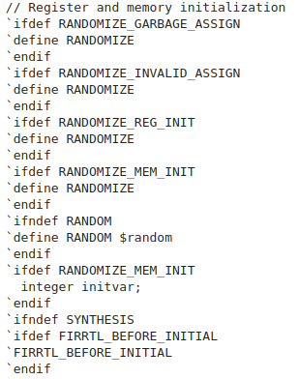
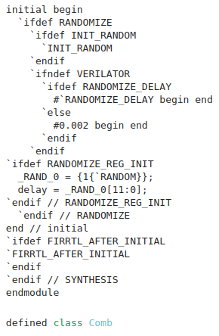
2.4.6 Register Operation
https://github.com/freechipsproject/chisel-bootcamp
Register Operation
Register Combinational Filter with operator “-”.

Slide 27
2.4.7 Reset and Multi-Clock

Slide 28
2.4.7 Reset and Multi-Clock
https://github.com/freechipsproject/chisel-bootcamp
Rest and Multi-Clock
1. Chisel modules have a default clock and reset that are implicitly used by every register created inside them.
2. There are times where we want to be able to override this default behavior, for example, we have
  2.1 a reset signal,
  2.2 a multi-clock design
  2.3 a generated clock
3. Chisel provides construction for multi-clock, generate clock. and reset.
4. Clocks and resets can be overridden separately or together with withClock() {}, withReset() {}, and withClockAndReset() {}.
5. The following code blocks will give examples of using these functions.
6. One thing to be aware of is that reset is always synchronous and of type Bool.
7. Clocks have their own type in Chisel (Clock) and should be declared as such.
8. Bools can be converted to Clocks by calling asClock() on them, but we should be careful when we do that.
9. Note:
Currently, chisel-testers do not have complete support for multi-clock designs. They will be improve in future.

Slide 29
2.4.8 Multi-Clock Example

Slide 30
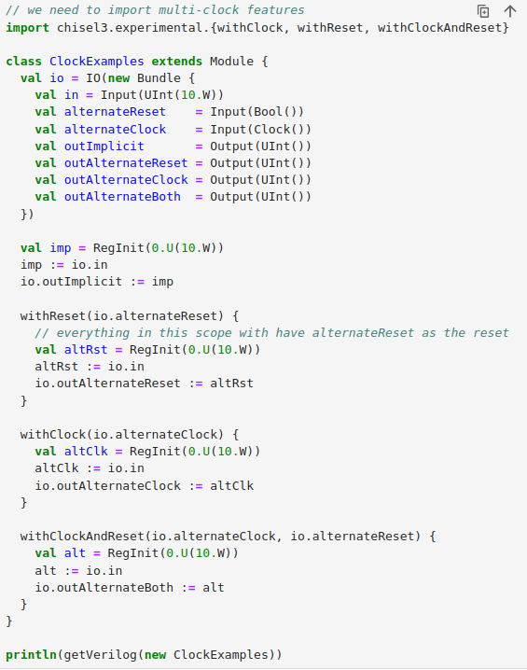
2.4.8 Multi-Clock Example
https://github.com/freechipsproject/chisel-bootcamp
Multi-Clock Example
On the right, we have a module with
1. Reset signal
2. Multiple clocks
1
2
2
2
2

Slide 31
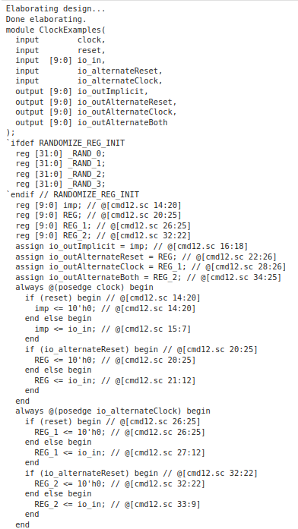
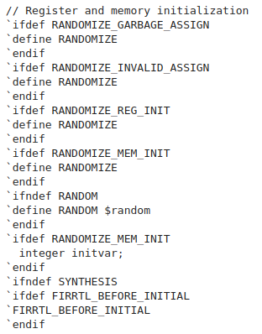
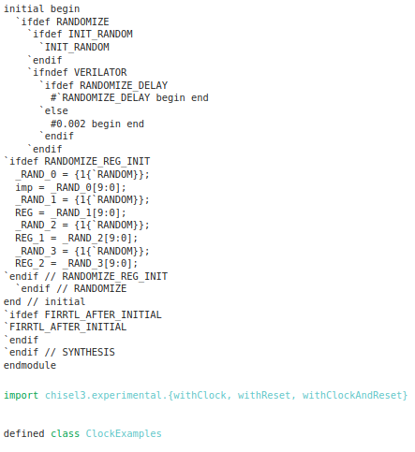
2.4.8 Multi-Clock Example
https://github.com/freechipsproject/chisel-bootcamp
Multi-Clock Example
Result Verilog.

Slide 32
2.49 Exercise 1: LFSR

Slide 33
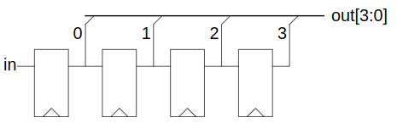
2.4.9 Exercise 1: LFSR
https://github.com/freechipsproject/chisel-bootcamp
Exercise 1: LFSR (Linear Feedback Shift Register)
Below, is a LFSR (Linear Feedback Shift Register):
1. Each element is a single bit wide.
2. Has a 4-bit output signal.
3. Takes a single input bit, which is the next value into the shift register.
4. Outputs the parallel output of the shift register, with the most significant bit being the last element of the shift register and the least significant bit being the first element of the shift register. Cat may come in handy.
5. The output initializes at b0001.
6. Shifts each clock cycle (no enable signal).
7. Note: In Chisel, subword assignment IS ILLEGAL; something like out(0) := in will not work.

Slide 34
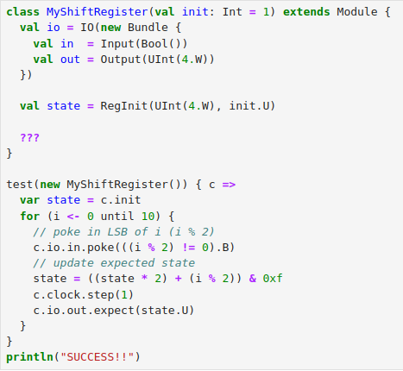
2.4.9 Exercise 1: LFSR
https://github.com/freechipsproject/chisel-bootcamp
Exercise 1: LFSR (Linear Feedback Shift Register)
1. A basic Module skeleton, testvector, and Driver invocation is provided below.
2. The first register has been provided for you.
3. Implement the “???”

Slide 35
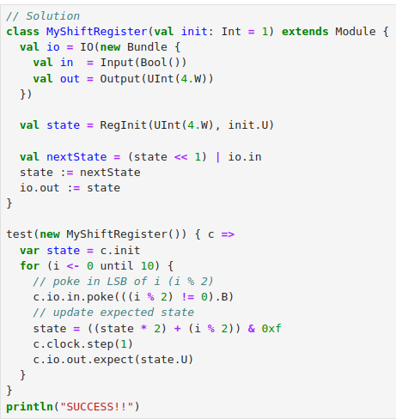
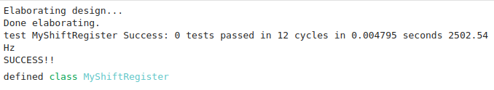
2.4.9 Exercise 1: LFSR
https://github.com/freechipsproject/chisel-bootcamp
Exercise 1: LFSR (Linear Feedback Shift Register)
Problem and Solution

Slide 36
2.4.10 Exercise 2: Parameterized Shift Register

Slide 37
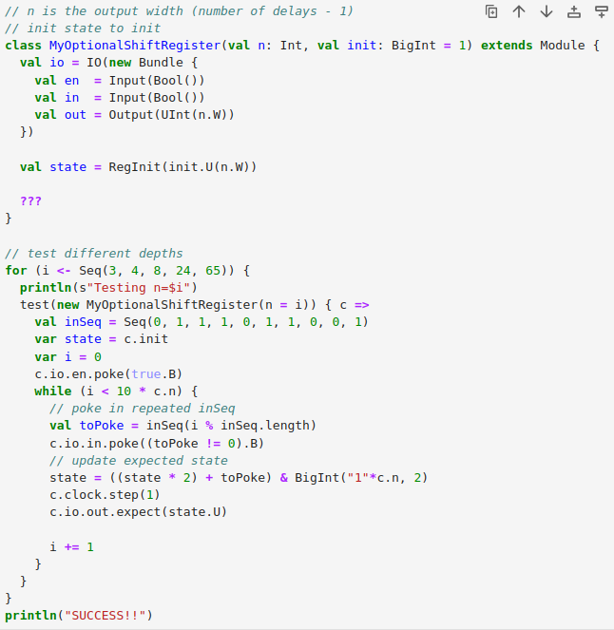
2.4.10 Exercise 2: Parameterized Shift Register
https://github.com/freechipsproject/chisel-bootcamp
Exercise 2: Parametrized Shift Register
Write a shift register that is parameterized by its delay (n), its initial value (init), add enable input signal (en).

Slide 38
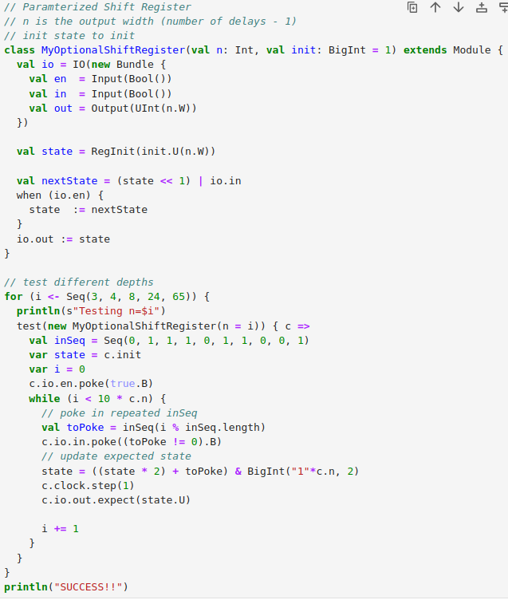
2.4.10 Exercise 2: Parameterized Shift Register
https://github.com/freechipsproject/chisel-bootcamp
Exercise 2: Parametrized Shift Register
Problem and Solution.

Slide 39
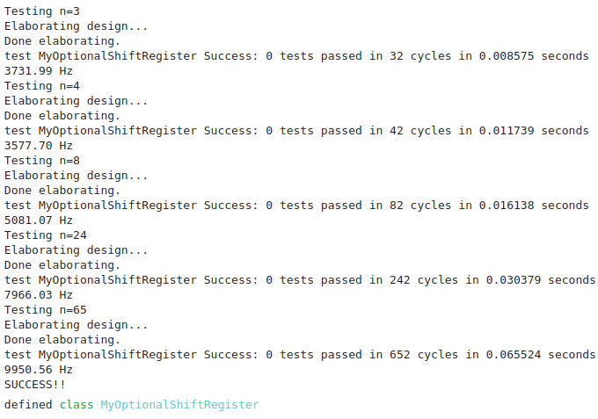
2.4.10 Exercise 2: Parameterized Shift Register
https://github.com/freechipsproject/chisel-bootcamp
Exercise 2: Parametrized Shift Register
Solution and test result.

Slide 40
2.4.11 Wrap Up

Slide 41
2.4.11 Wrap Up
https://github.com/freechipsproject/chisel-bootcamp
Wrap UP
We have done how to use Chisel to:
1. Create registers
2. write sequential logic
Now, we have enough basic building blocks to write real circuits.
Next, we will combine everything we have.

Slide 42
End

