Slide 1

1.9 Valid Wrapper

Slide 2
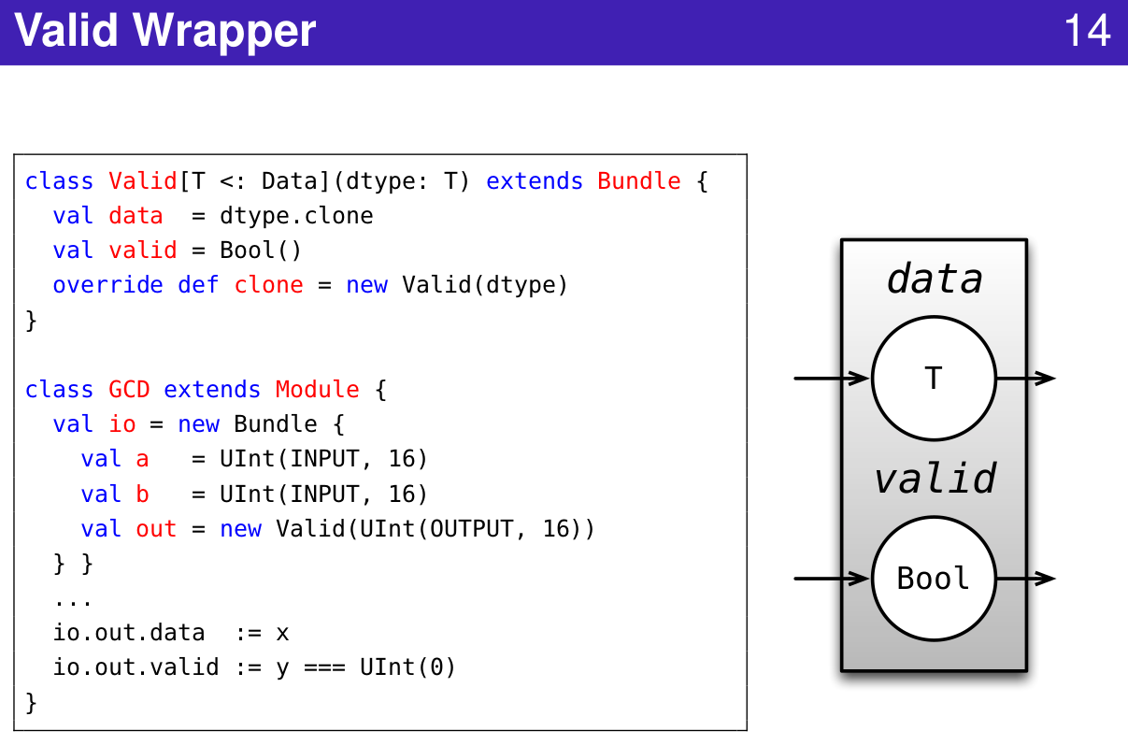
1.9 Valid Wrapper
https://www.youtube.com/watch?v=pfM1WUWbfBs&list=PLlu0CT-JnSasfpk8tq1ZDiE2G0AK1BhOg&index=1
Valid Wrapper (11:47-12:29/51:50)
Valid Wrapper

Slide 3
1.10 Function Filter

Slide 4
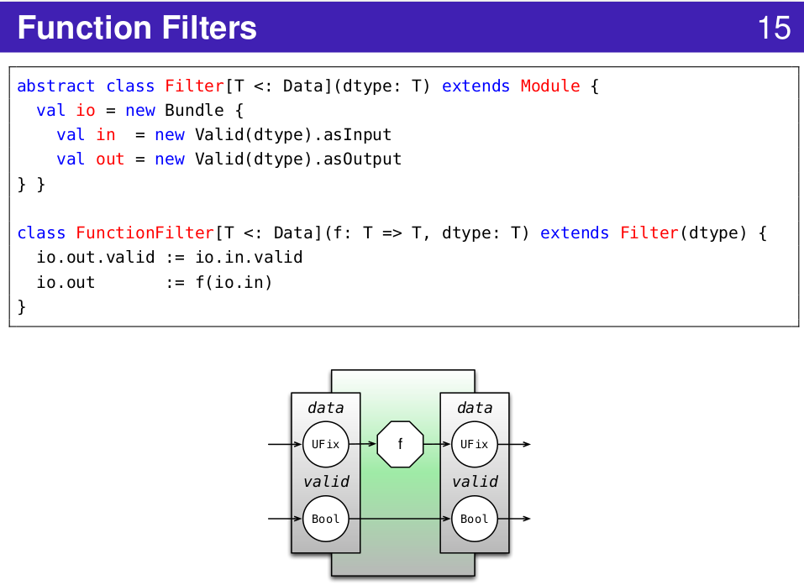
1.10 Function Filter
https://www.youtube.com/watch?v=pfM1WUWbfBs&list=PLlu0CT-JnSasfpk8tq1ZDiE2G0AK1BhOg&index=1
Function Filters (12:30-13:36/51:50)

Slide 5
1.10 Clip/Shift Filter

Slide 6
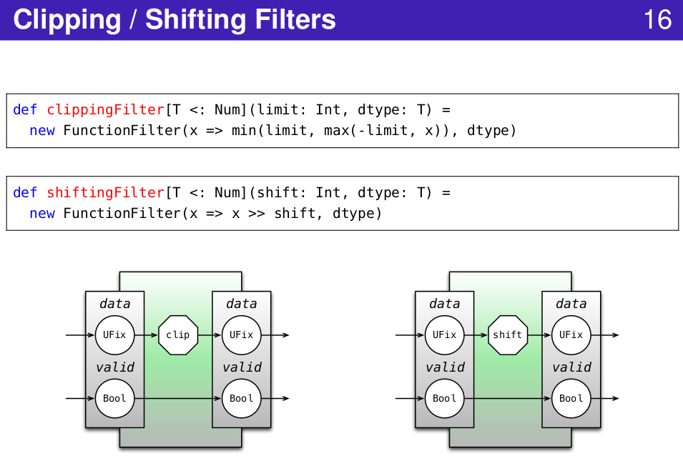
1.10 Clip/Shift Filter
https://www.youtube.com/watch?v=pfM1WUWbfBs&list=PLlu0CT-JnSasfpk8tq1ZDiE2G0AK1BhOg&index=1
Clip/Shift Filters (13:37-14:24/51:50)

Slide 7
1.11 Chain Filter

Slide 8
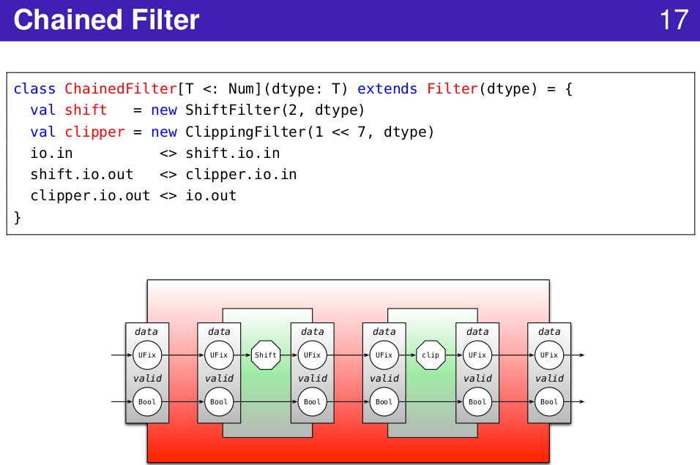
1.11 Chain Filter
https://www.youtube.com/watch?v=pfM1WUWbfBs&list=PLlu0CT-JnSasfpk8tq1ZDiE2G0AK1BhOg&index=1
Chain Filter (14:25-18:19/51:50)

Slide 9
1.12 Composition

Slide 10
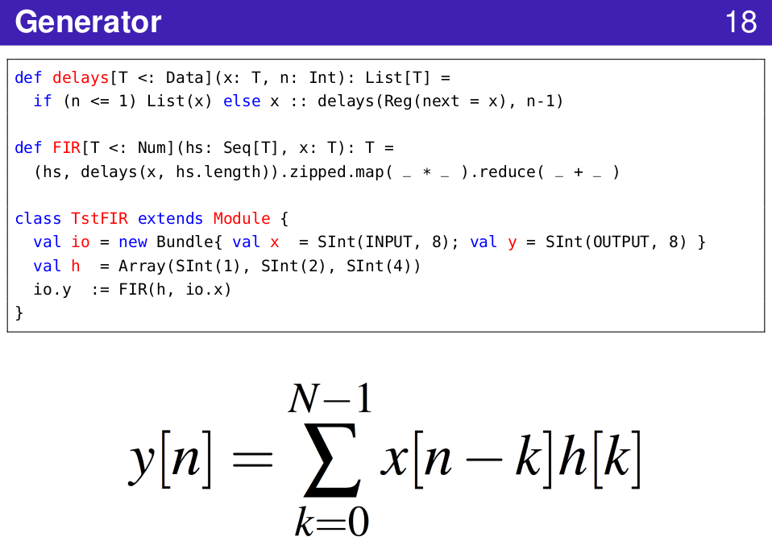
1.12 Composition
https://www.youtube.com/watch?v=pfM1WUWbfBs&list=PLlu0CT-JnSasfpk8tq1ZDiE2G0AK1BhOg&index=1
Composition (18:20-20:52/51:50)

Slide 11
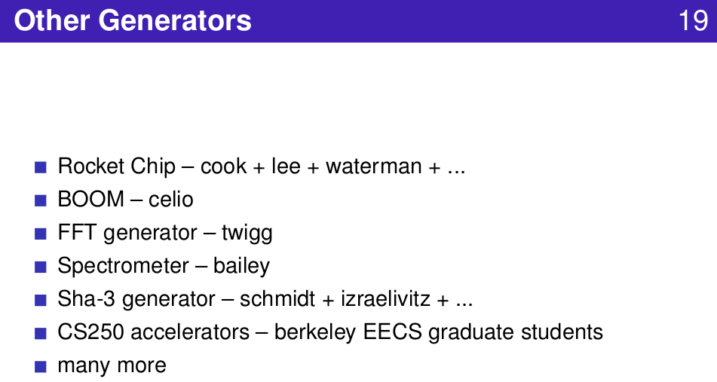
1.12 Composition
https://www.youtube.com/watch?v=pfM1WUWbfBs&list=PLlu0CT-JnSasfpk8tq1ZDiE2G0AK1BhOg&index=1
Other Generators (18:20-20:52/51:50)

Slide 12
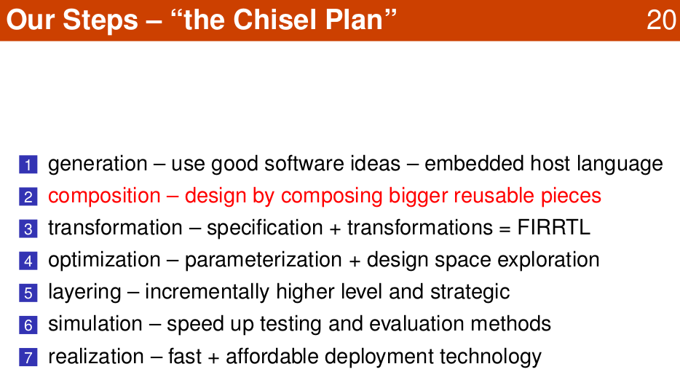
1.12 Composition
https://www.youtube.com/watch?v=pfM1WUWbfBs&list=PLlu0CT-JnSasfpk8tq1ZDiE2G0AK1BhOg&index=1
Chisel Plan (11:47-12:29/51:50)

Slide 13
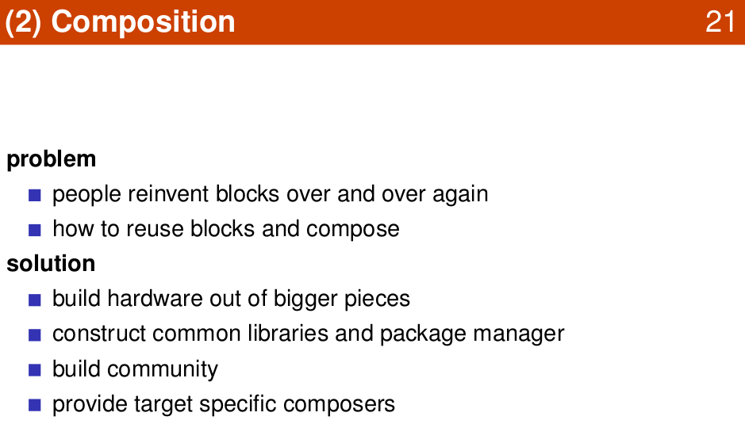
1.12 Composition
https://www.youtube.com/watch?v=pfM1WUWbfBs&list=PLlu0CT-JnSasfpk8tq1ZDiE2G0AK1BhOg&index=1
Composition (11:47-12:29/51:50)

Slide 14
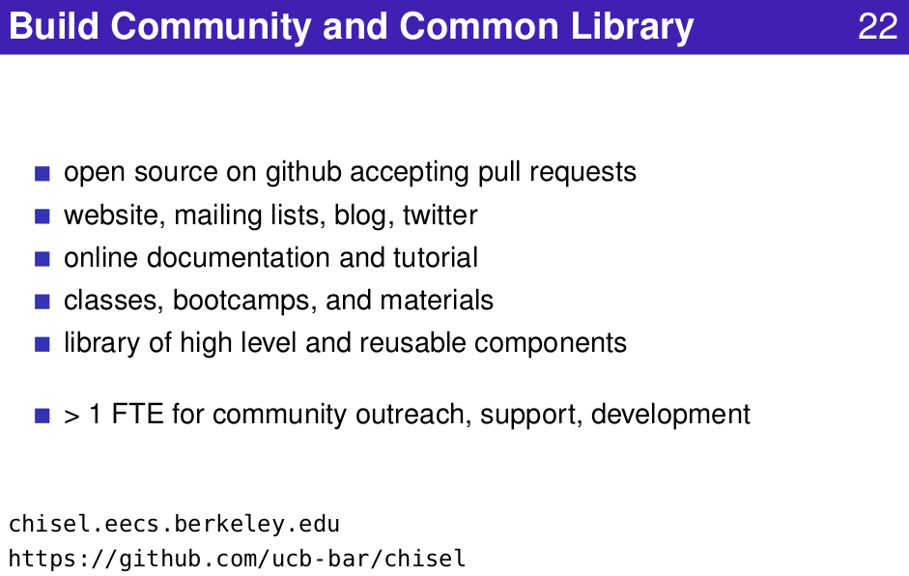
1.12 Composition
https://www.youtube.com/watch?v=pfM1WUWbfBs&list=PLlu0CT-JnSasfpk8tq1ZDiE2G0AK1BhOg&index=1
Build Community and Library (11:47-12:29/51:50)

Slide 15
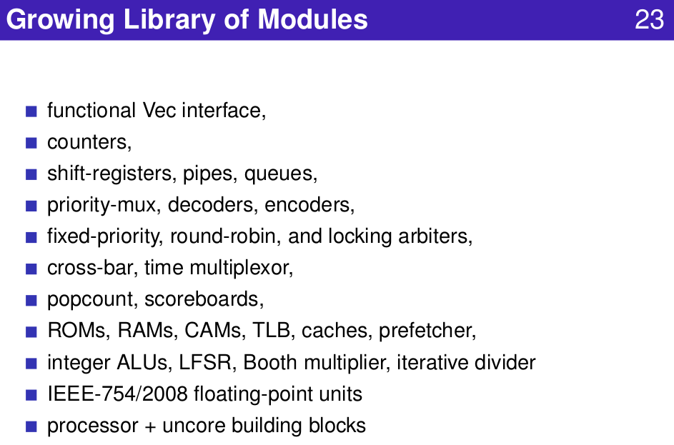
1.12 Composition
https://www.youtube.com/watch?v=pfM1WUWbfBs&list=PLlu0CT-JnSasfpk8tq1ZDiE2G0AK1BhOg&index=1
Module Library (11:47-12:29/51:50)

Slide 16
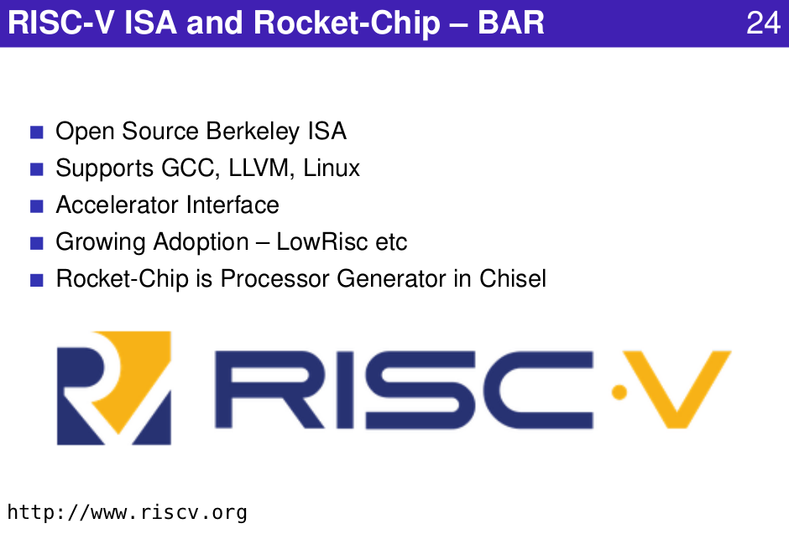
1.12 Composition
https://www.youtube.com/watch?v=pfM1WUWbfBs&list=PLlu0CT-JnSasfpk8tq1ZDiE2G0AK1BhOg&index=1
RISCV and Rocket Chip (11:47-12:29/51:50)

Slide 17
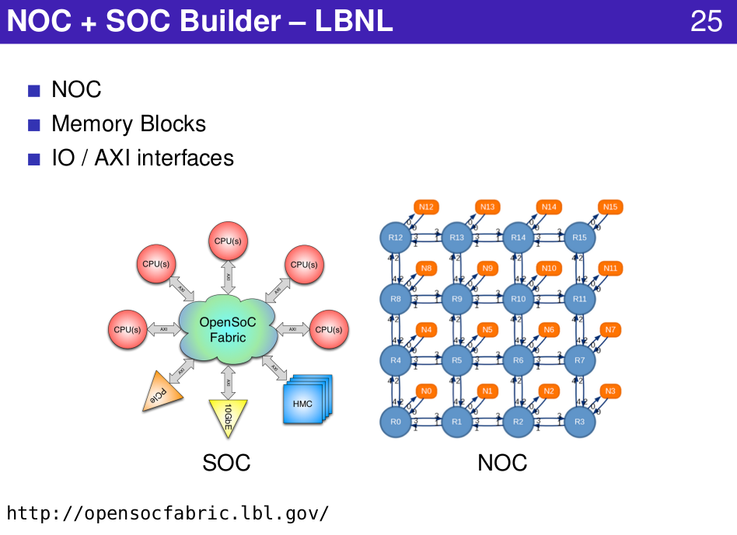
1.12 Composition
https://www.youtube.com/watch?v=pfM1WUWbfBs&list=PLlu0CT-JnSasfpk8tq1ZDiE2G0AK1BhOg&index=1
NOC and SOC (11:47-12:29/51:50)

Slide 18
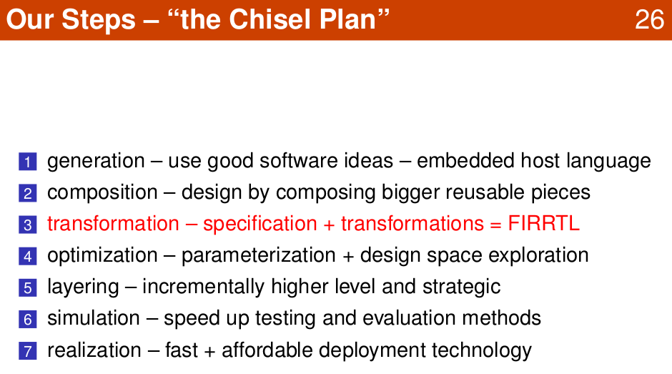
1.9 Valid Wrapper
https://www.youtube.com/watch?v=pfM1WUWbfBs&list=PLlu0CT-JnSasfpk8tq1ZDiE2G0AK1BhOg&index=1
Transformation: FIRRTL (11:47-12:29/51:50)

Slide 19
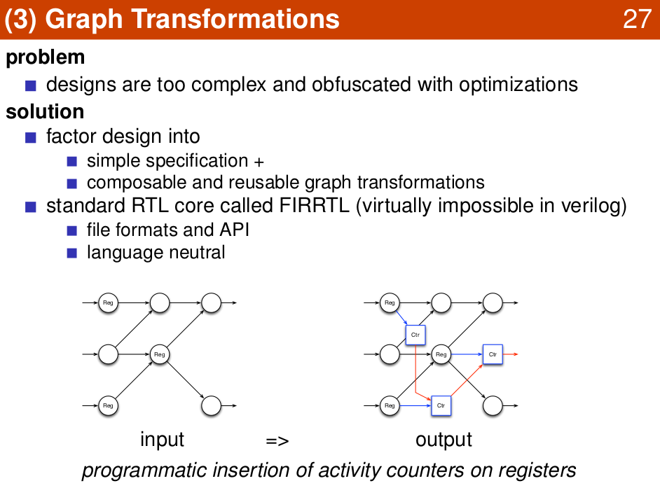
1.9 Valid Wrapper
https://www.youtube.com/watch?v=pfM1WUWbfBs&list=PLlu0CT-JnSasfpk8tq1ZDiE2G0AK1BhOg&index=1
Graph Transformation (11:47-12:29/51:50)

Slide 20
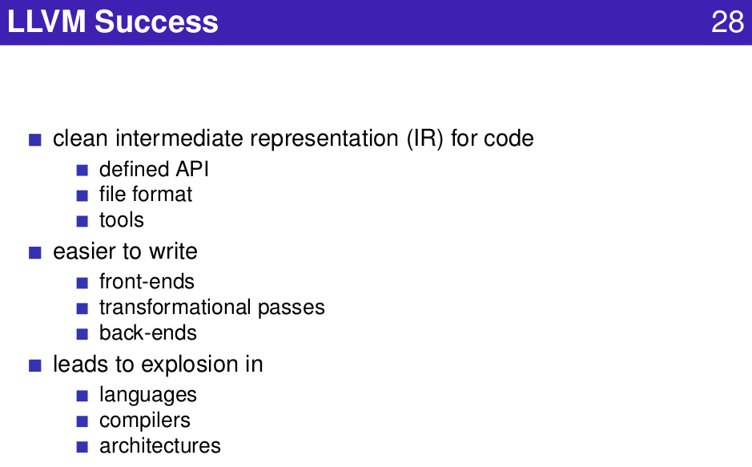
1.9 Valid Wrapper
https://www.youtube.com/watch?v=pfM1WUWbfBs&list=PLlu0CT-JnSasfpk8tq1ZDiE2G0AK1BhOg&index=1
LLVM (11:47-12:29/51:50)

Slide 21
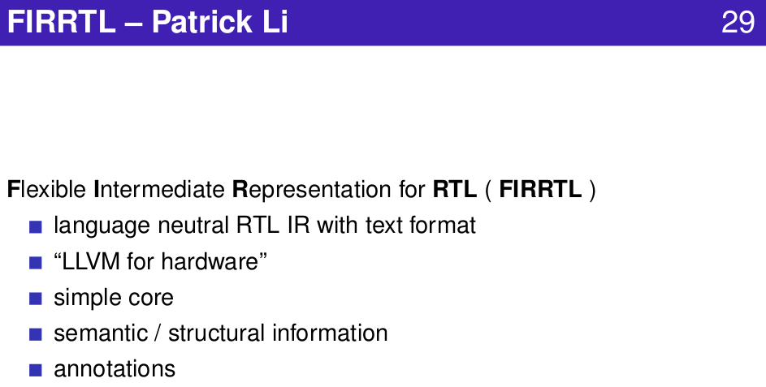
1.9 Valid Wrapper
https://www.youtube.com/watch?v=pfM1WUWbfBs&list=PLlu0CT-JnSasfpk8tq1ZDiE2G0AK1BhOg&index=1
FIRRTL (11:47-12:29/51:50)

Slide 22
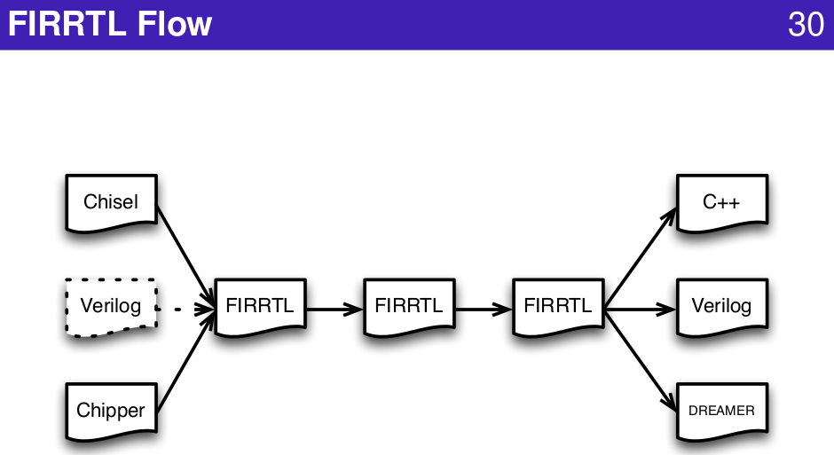
1.9 Valid Wrapper
https://www.youtube.com/watch?v=pfM1WUWbfBs&list=PLlu0CT-JnSasfpk8tq1ZDiE2G0AK1BhOg&index=1
FIRRTL Flow (11:47-12:29/51:50)

Slide 23
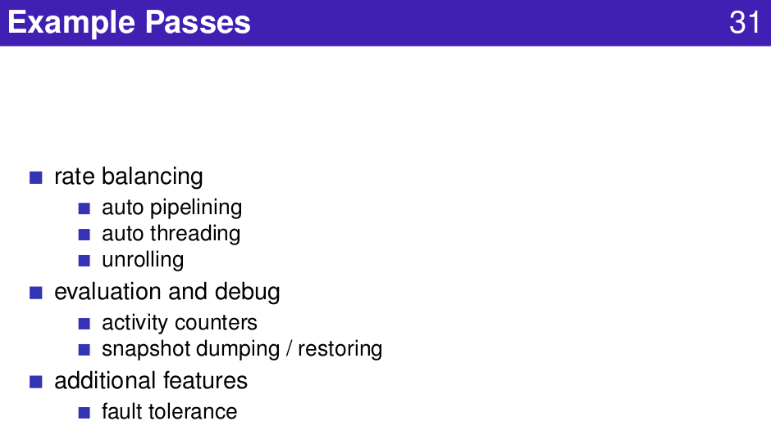
1.9 Valid Wrapper
https://www.youtube.com/watch?v=pfM1WUWbfBs&list=PLlu0CT-JnSasfpk8tq1ZDiE2G0AK1BhOg&index=1
Passes (11:47-12:29/51:50)

Slide 24
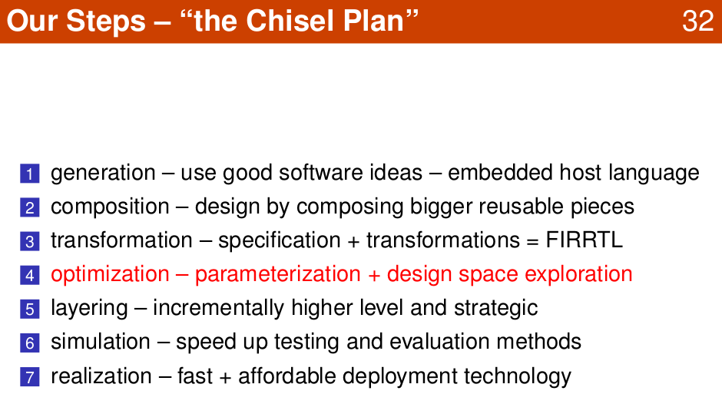
1.9 Valid Wrapper
https://www.youtube.com/watch?v=pfM1WUWbfBs&list=PLlu0CT-JnSasfpk8tq1ZDiE2G0AK1BhOg&index=1
Optimization: Parameter and Design Space (11:47-12:29/51:50)

Slide 25
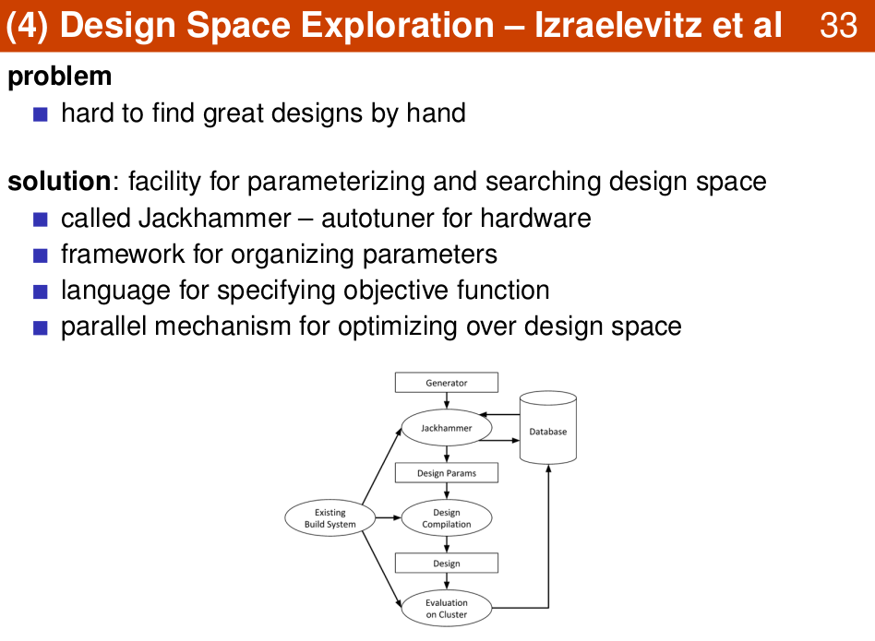
1.9 Valid Wrapper
https://www.youtube.com/watch?v=pfM1WUWbfBs&list=PLlu0CT-JnSasfpk8tq1ZDiE2G0AK1BhOg&index=1
Design Space Exploration (11:47-12:29/51:50)

Slide 26
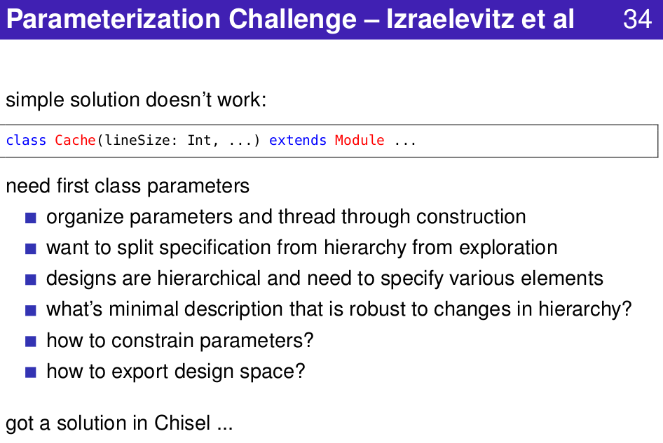
1.9 Valid Wrapper
https://www.youtube.com/watch?v=pfM1WUWbfBs&list=PLlu0CT-JnSasfpk8tq1ZDiE2G0AK1BhOg&index=1
Parametrization (11:47-12:29/51:50)

Slide 27
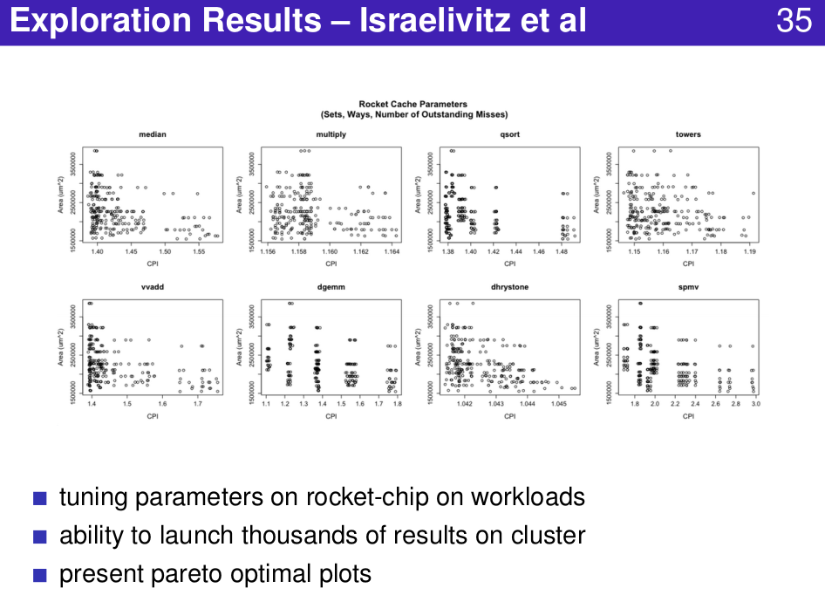
1.9 Valid Wrapper
https://www.youtube.com/watch?v=pfM1WUWbfBs&list=PLlu0CT-JnSasfpk8tq1ZDiE2G0AK1BhOg&index=1
Exploration Results (11:47-12:29/51:50)

Slide 28
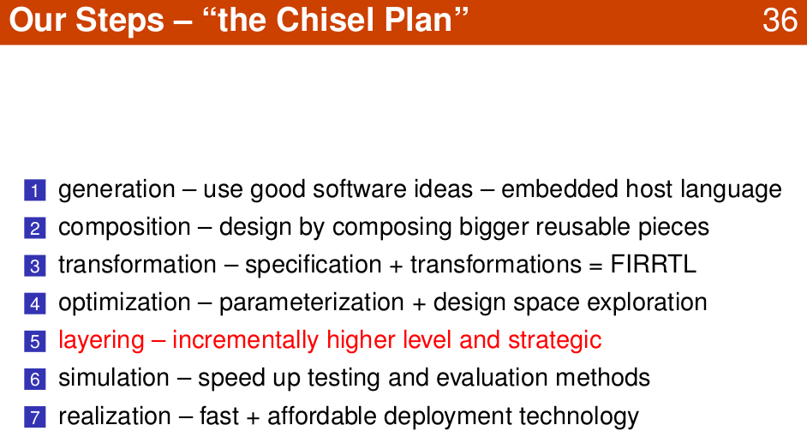
1.9 Valid Wrapper
https://www.youtube.com/watch?v=pfM1WUWbfBs&list=PLlu0CT-JnSasfpk8tq1ZDiE2G0AK1BhOg&index=1
Layering (11:47-12:29/51:50)

Slide 29
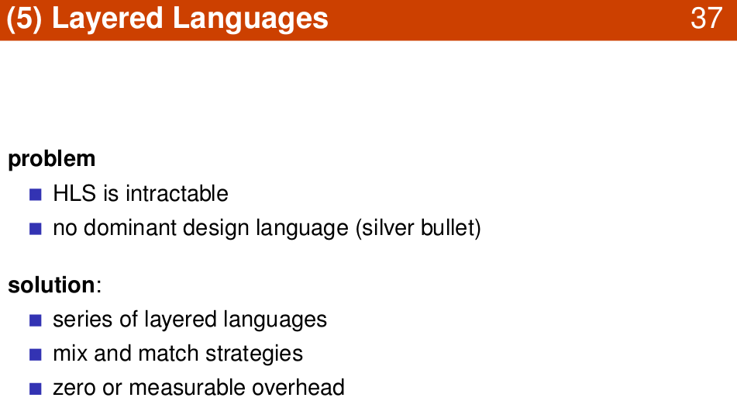
1.9 Valid Wrapper
https://www.youtube.com/watch?v=pfM1WUWbfBs&list=PLlu0CT-JnSasfpk8tq1ZDiE2G0AK1BhOg&index=1
Layered Language (11:47-12:29/51:50)

Slide 30
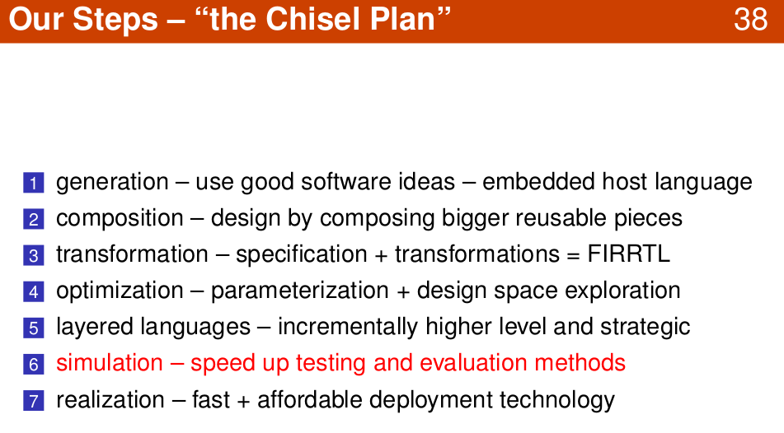
1.9 Valid Wrapper
https://www.youtube.com/watch?v=pfM1WUWbfBs&list=PLlu0CT-JnSasfpk8tq1ZDiE2G0AK1BhOg&index=1
Simulation (11:47-12:29/51:50)

Slide 31
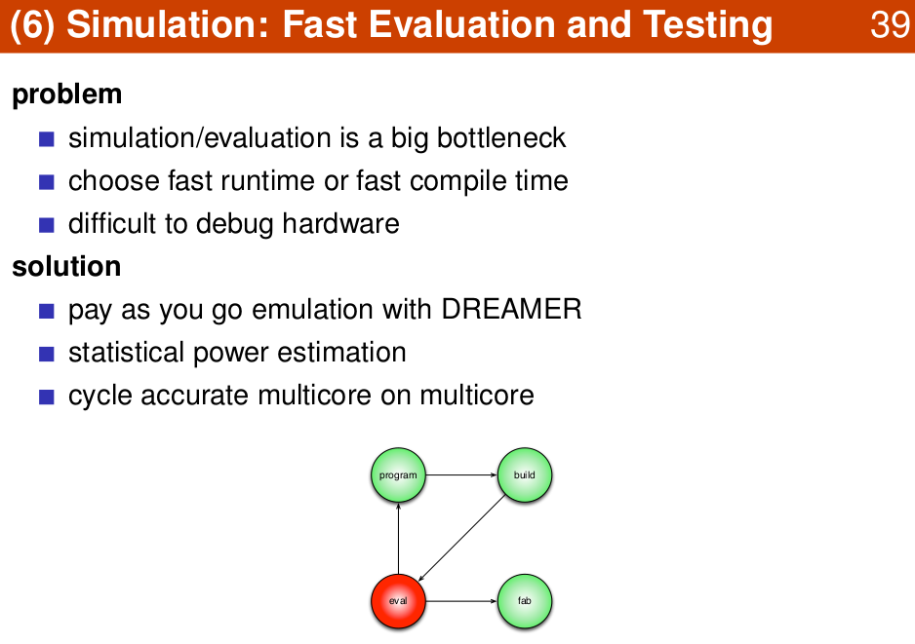
1.9 Valid Wrapper
https://www.youtube.com/watch?v=pfM1WUWbfBs&list=PLlu0CT-JnSasfpk8tq1ZDiE2G0AK1BhOg&index=1
Evaluation and Test (11:47-12:29/51:50)

Slide 32
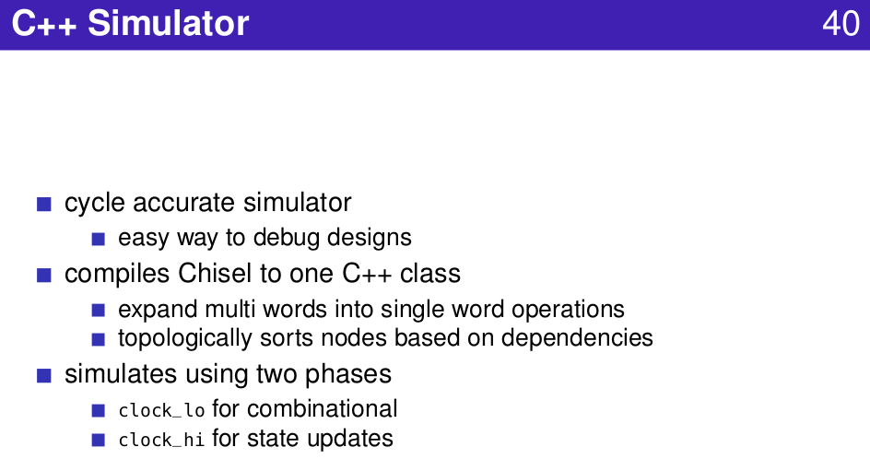
1.9 Valid Wrapper
https://www.youtube.com/watch?v=pfM1WUWbfBs&list=PLlu0CT-JnSasfpk8tq1ZDiE2G0AK1BhOg&index=1
C++ Simulator (11:47-12:29/51:50)

Slide 33
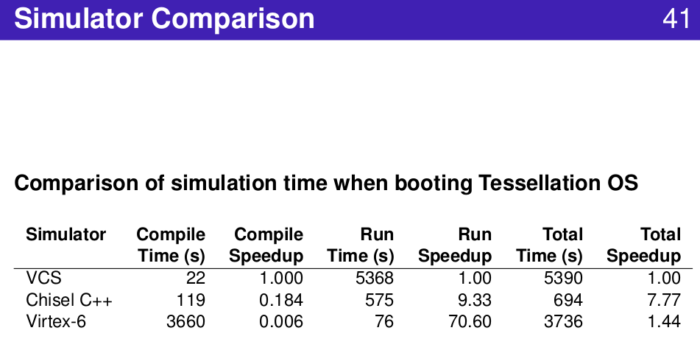
1.9 Valid Wrapper
https://www.youtube.com/watch?v=pfM1WUWbfBs&list=PLlu0CT-JnSasfpk8tq1ZDiE2G0AK1BhOg&index=1
Compare Simulator (11:47-12:29/51:50)

Slide 34
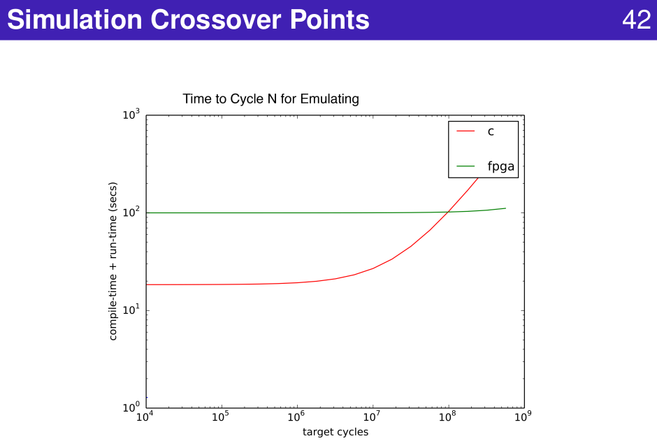
1.9 Valid Wrapper
https://www.youtube.com/watch?v=pfM1WUWbfBs&list=PLlu0CT-JnSasfpk8tq1ZDiE2G0AK1BhOg&index=1
Simulation Crossover (11:47-12:29/51:50)

Slide 35
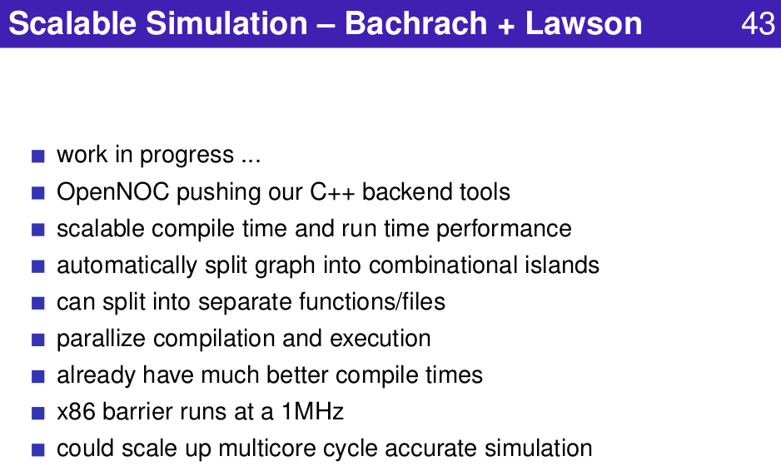
1.9 Valid Wrapper
https://www.youtube.com/watch?v=pfM1WUWbfBs&list=PLlu0CT-JnSasfpk8tq1ZDiE2G0AK1BhOg&index=1
Scalable Simulation (11:47-12:29/51:50)

Slide 36
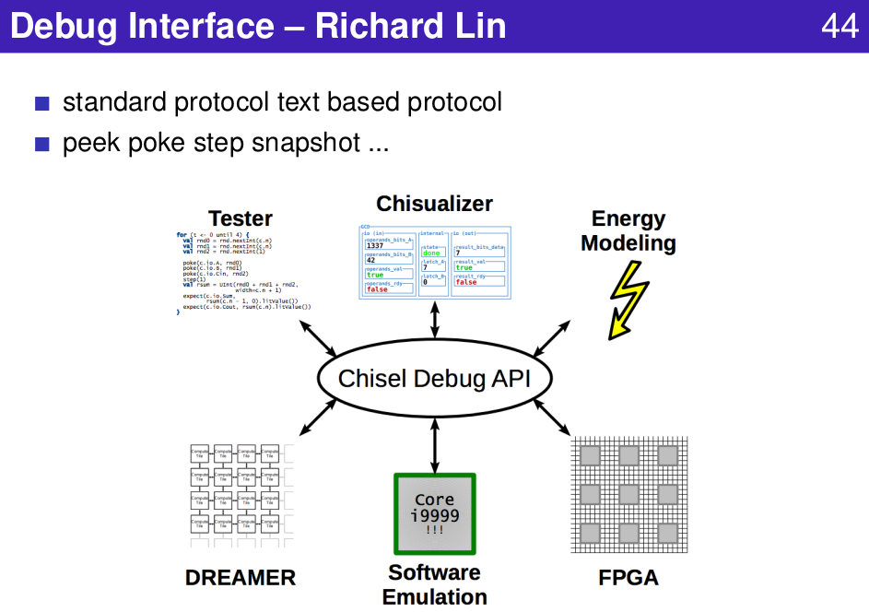
1.9 Valid Wrapper
https://www.youtube.com/watch?v=pfM1WUWbfBs&list=PLlu0CT-JnSasfpk8tq1ZDiE2G0AK1BhOg&index=1
Debug Interface (11:47-12:29/51:50)

Slide 37
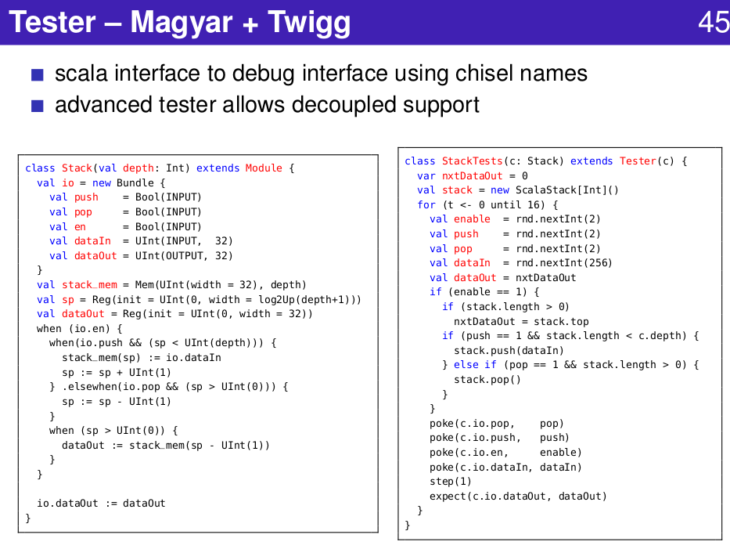
1.9 Valid Wrapper
https://www.youtube.com/watch?v=pfM1WUWbfBs&list=PLlu0CT-JnSasfpk8tq1ZDiE2G0AK1BhOg&index=1
Debug Interface (11:47-12:29/51:50)

Slide 38
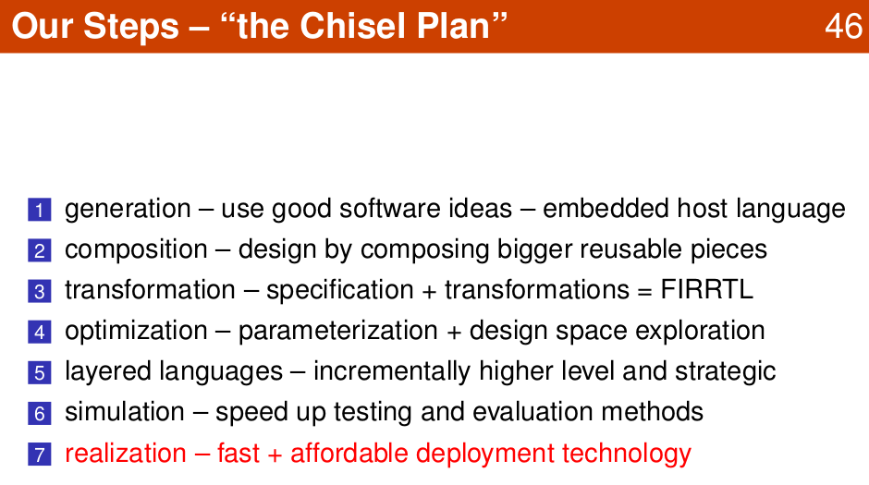
1.9 Valid Wrapper
https://www.youtube.com/watch?v=pfM1WUWbfBs&list=PLlu0CT-JnSasfpk8tq1ZDiE2G0AK1BhOg&index=1
Realization (11:47-12:29/51:50)

Slide 39
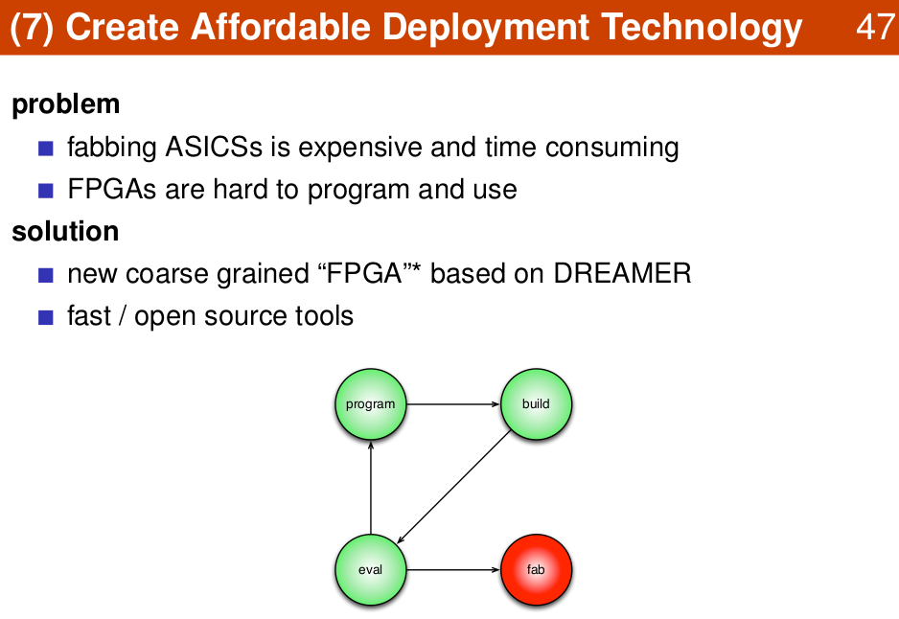
1.9 Valid Wrapper
https://www.youtube.com/watch?v=pfM1WUWbfBs&list=PLlu0CT-JnSasfpk8tq1ZDiE2G0AK1BhOg&index=1
Create Deployment (11:47-12:29/51:50)

Slide 40
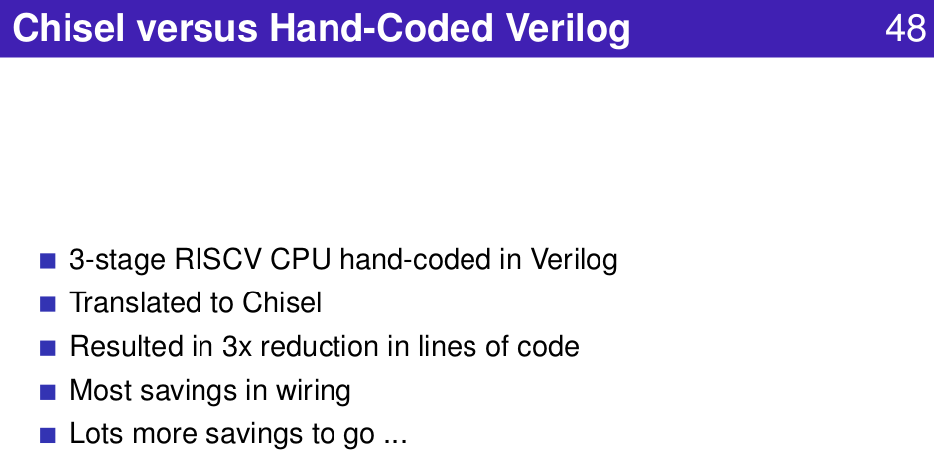
1.9 Valid Wrapper
https://www.youtube.com/watch?v=pfM1WUWbfBs&list=PLlu0CT-JnSasfpk8tq1ZDiE2G0AK1BhOg&index=1
Create Deployment (11:47-12:29/51:50)

Slide 41
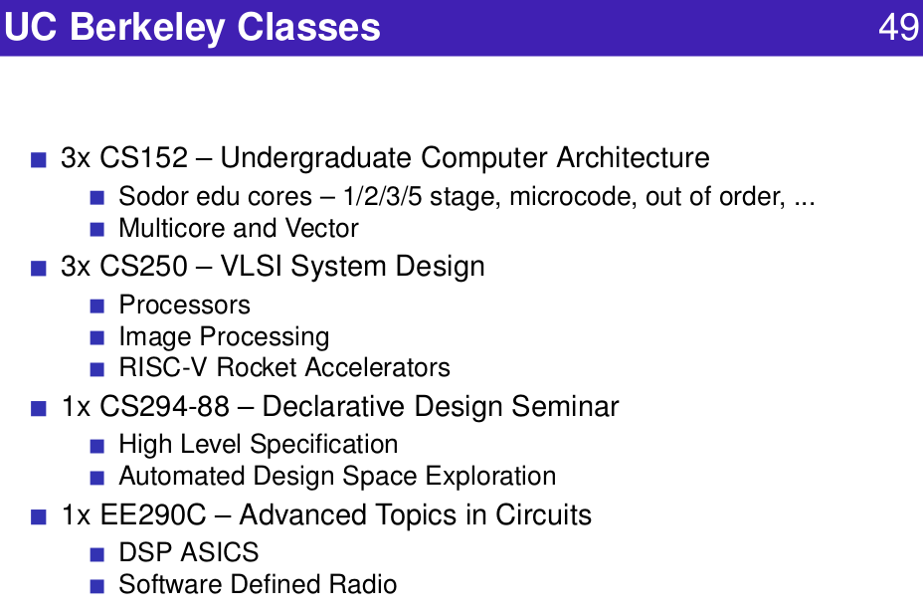
1.9 Valid Wrapper
https://www.youtube.com/watch?v=pfM1WUWbfBs&list=PLlu0CT-JnSasfpk8tq1ZDiE2G0AK1BhOg&index=1
Create Deployment (11:47-12:29/51:50)

Slide 42
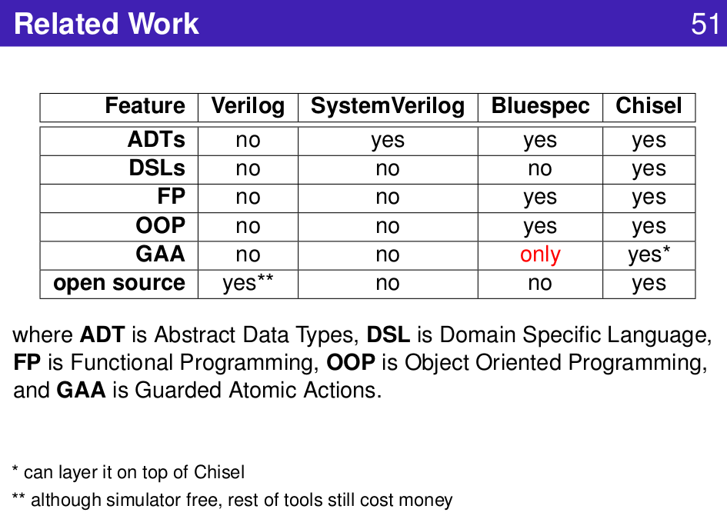
1.9 Valid Wrapper
https://www.youtube.com/watch?v=pfM1WUWbfBs&list=PLlu0CT-JnSasfpk8tq1ZDiE2G0AK1BhOg&index=1
Related Work (11:47-12:29/51:50)

Slide 43
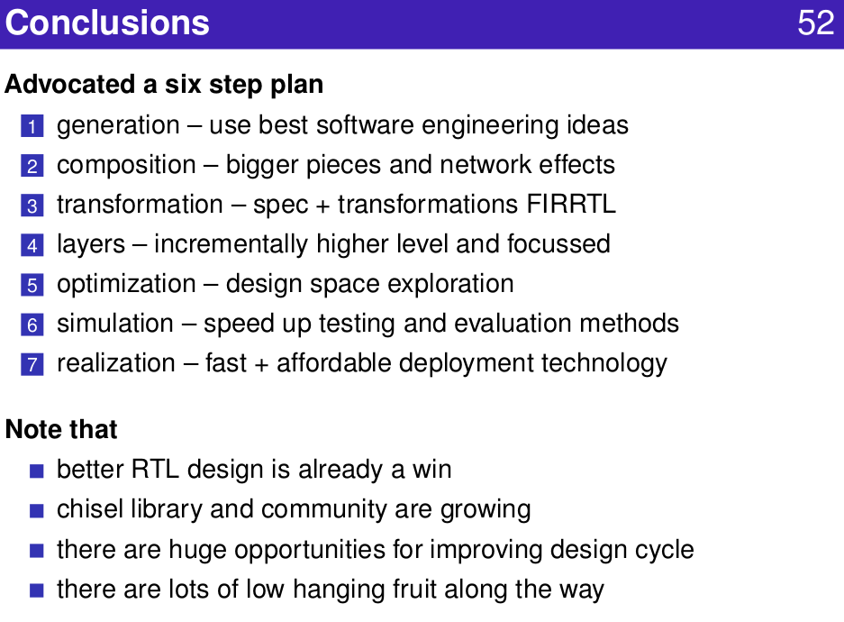
1.9 Valid Wrapper
https://www.youtube.com/watch?v=pfM1WUWbfBs&list=PLlu0CT-JnSasfpk8tq1ZDiE2G0AK1BhOg&index=1
Conclusion (11:47-12:29/51:50)

Slide 44
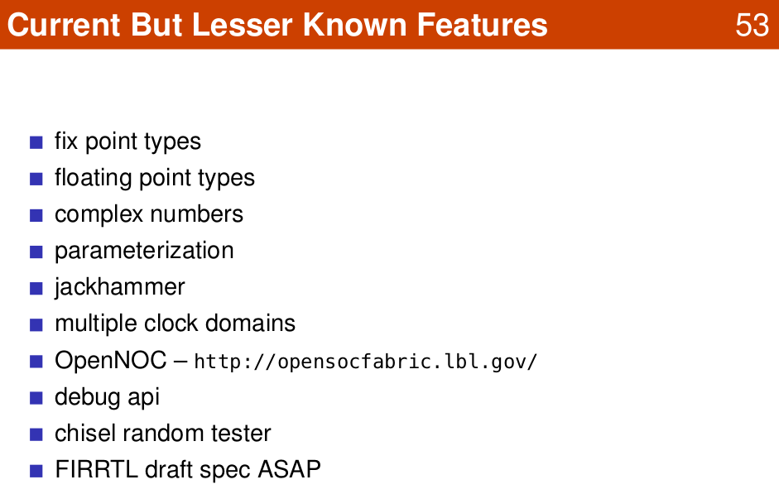
1.9 Valid Wrapper
https://www.youtube.com/watch?v=pfM1WUWbfBs&list=PLlu0CT-JnSasfpk8tq1ZDiE2G0AK1BhOg&index=1
Some Features (11:47-12:29/51:50)

Slide 45
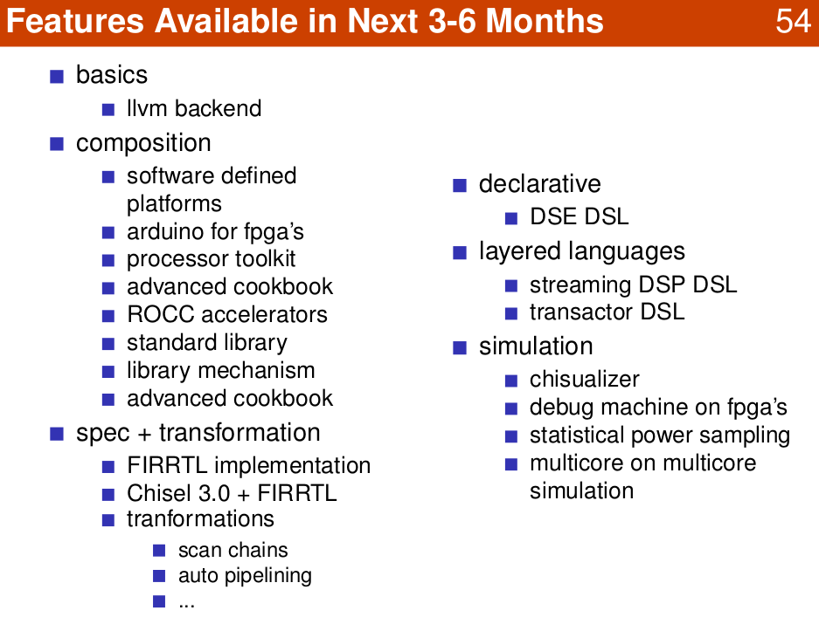
1.9 Valid Wrapper
https://www.youtube.com/watch?v=pfM1WUWbfBs&list=PLlu0CT-JnSasfpk8tq1ZDiE2G0AK1BhOg&index=1
Some Features (11:47-12:29/51:50)

Slide 46
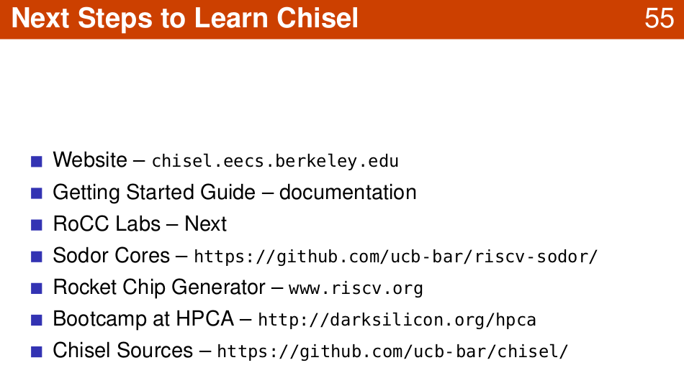
1.9 Valid Wrapper
https://www.youtube.com/watch?v=pfM1WUWbfBs&list=PLlu0CT-JnSasfpk8tq1ZDiE2G0AK1BhOg&index=1
Next (11:47-12:29/51:50)

Slide 47
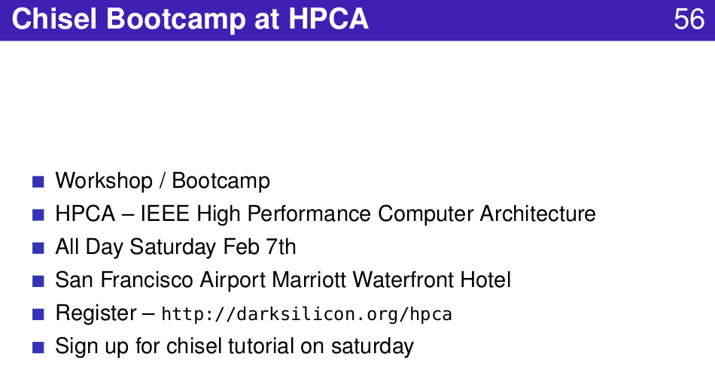
1.9 Valid Wrapper
https://www.youtube.com/watch?v=pfM1WUWbfBs&list=PLlu0CT-JnSasfpk8tq1ZDiE2G0AK1BhOg&index=1
Bootcamp (11:47-12:29/51:50)

Slide 48
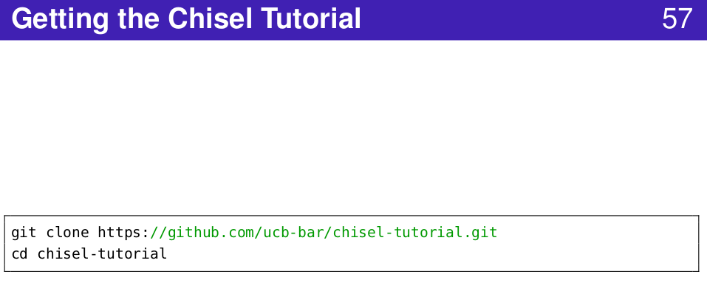
1.9 Valid Wrapper
https://www.youtube.com/watch?v=pfM1WUWbfBs&list=PLlu0CT-JnSasfpk8tq1ZDiE2G0AK1BhOg&index=1
GitHub (11:47-12:29/51:50)

Slide 49
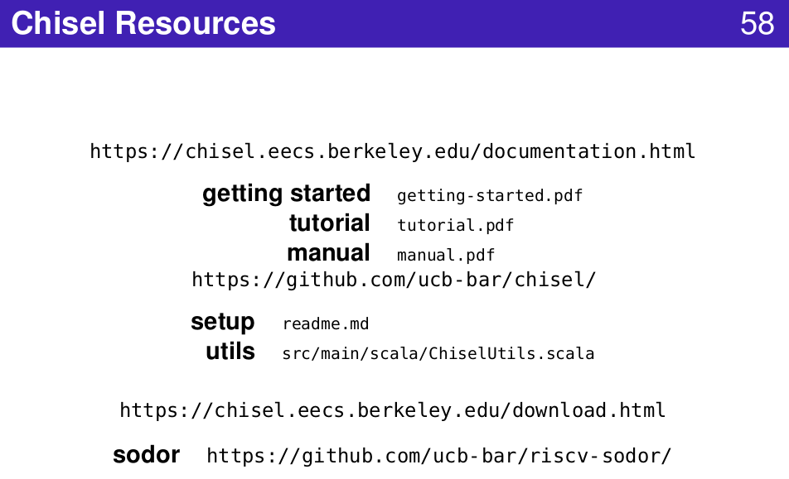
1.9 Valid Wrapper
https://www.youtube.com/watch?v=pfM1WUWbfBs&list=PLlu0CT-JnSasfpk8tq1ZDiE2G0AK1BhOg&index=1
Chisel Resources (11:47-12:29/51:50)

Slide 50
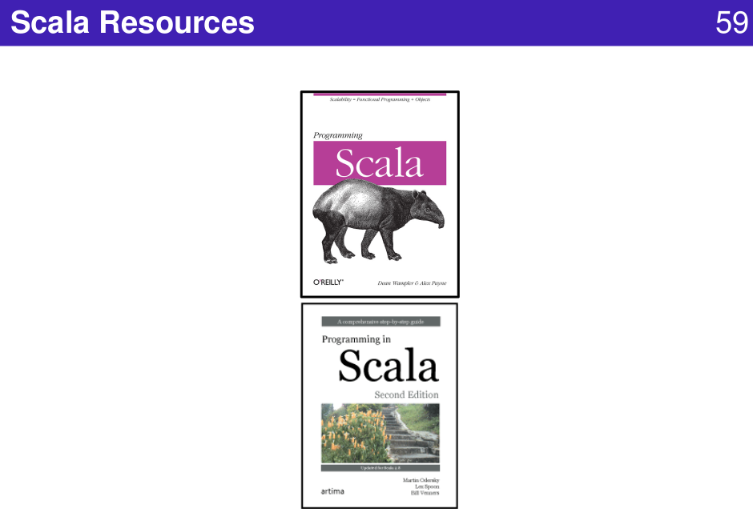
1.9 Valid Wrapper
https://www.youtube.com/watch?v=pfM1WUWbfBs&list=PLlu0CT-JnSasfpk8tq1ZDiE2G0AK1BhOg&index=1
Scala Resources (11:47-12:29/51:50)

Slide 51
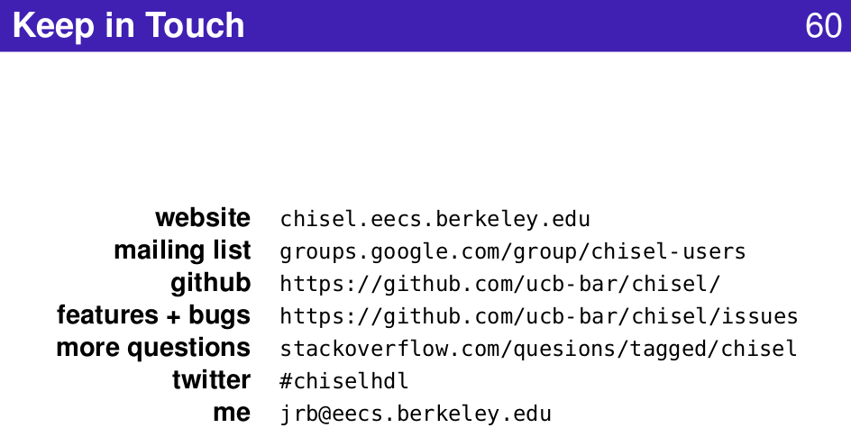
1.9 Valid Wrapper
https://www.youtube.com/watch?v=pfM1WUWbfBs&list=PLlu0CT-JnSasfpk8tq1ZDiE2G0AK1BhOg&index=1
Link (11:47-12:29/51:50)

Slide 52
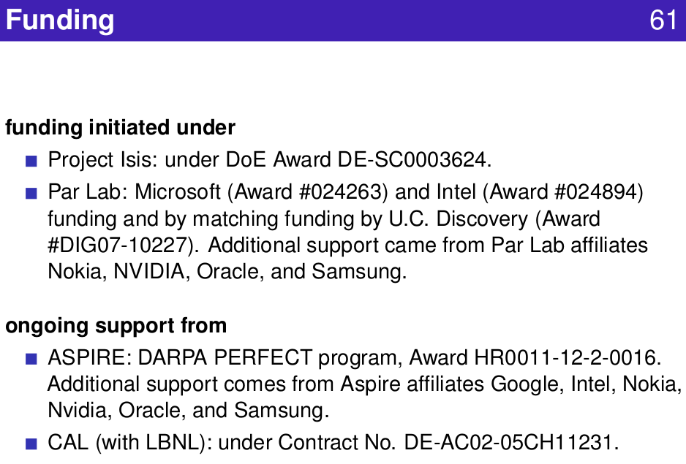
1.9 Valid Wrapper
https://www.youtube.com/watch?v=pfM1WUWbfBs&list=PLlu0CT-JnSasfpk8tq1ZDiE2G0AK1BhOg&index=1
Funding (11:47-12:29/51:50)

Slide 53
End

