Slide 1

1.21 Simulation Crossover Point

Slide 2
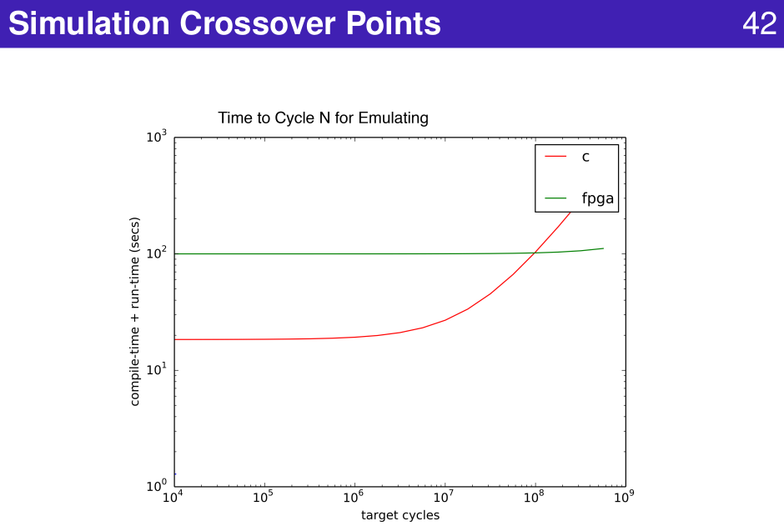
1.21 Simulation Crossover Point
https://www.youtube.com/watch?v=pfM1WUWbfBs&list=PLlu0CT-JnSasfpk8tq1ZDiE2G0AK1BhOg&index=1
Simulation Crossover (30:23-31:23/51:50)

Slide 3
1.22 Scalable Simulation

Slide 4
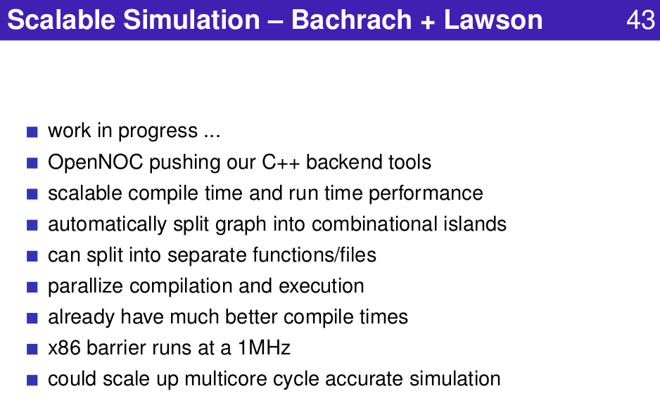
1.22 Scalable Simulation
https://www.youtube.com/watch?v=pfM1WUWbfBs&list=PLlu0CT-JnSasfpk8tq1ZDiE2G0AK1BhOg&index=1
Scalable Simulation (31:24-31:56/51:50)

Slide 5
1.23 Sample-Based Power Estimation

Slide 6
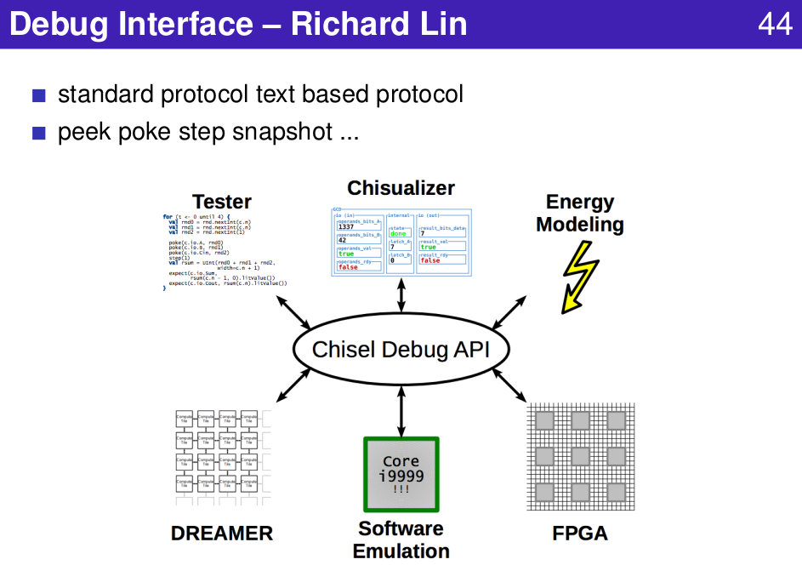
1.23 Sample-Based Power Estimation
https://www.youtube.com/watch?v=pfM1WUWbfBs&list=PLlu0CT-JnSasfpk8tq1ZDiE2G0AK1BhOg&index=1
Debug Interface (31:57-36:40/51:50)

Slide 7
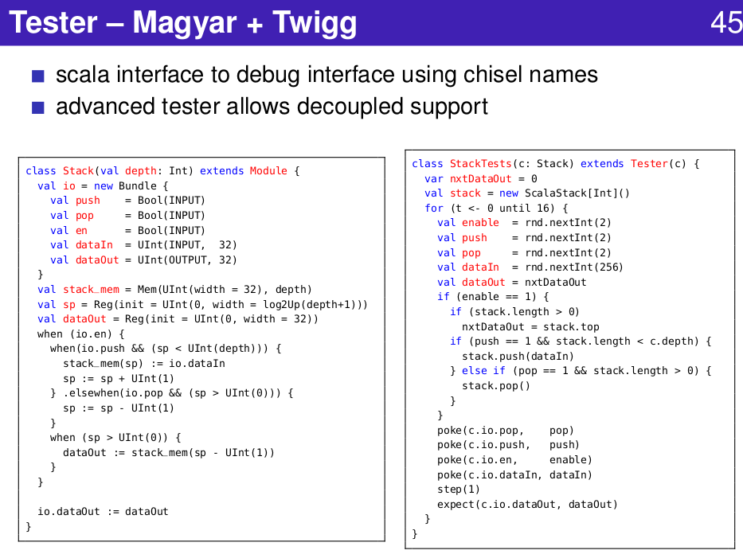
1.23 Sample-Based Power Estimation
https://www.youtube.com/watch?v=pfM1WUWbfBs&list=PLlu0CT-JnSasfpk8tq1ZDiE2G0AK1BhOg&index=1
Debug Interface (31:57-36:40/51:50)

Slide 8
1.23 Create Affordable Deployment

Slide 9
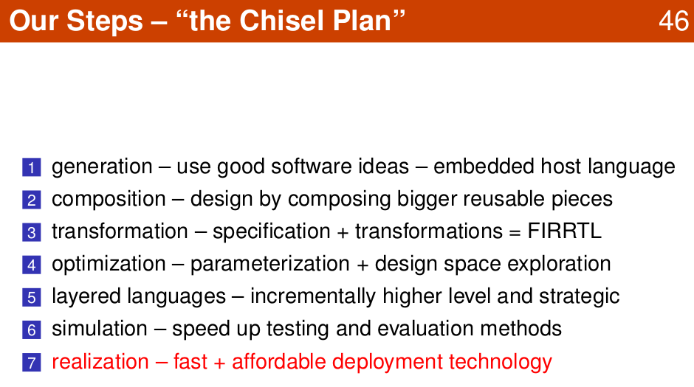
1.23 Create Affordable Deployment
https://www.youtube.com/watch?v=pfM1WUWbfBs&list=PLlu0CT-JnSasfpk8tq1ZDiE2G0AK1BhOg&index=1
Create Affordable Deployment (36:41-39:04/51:50)

Slide 10
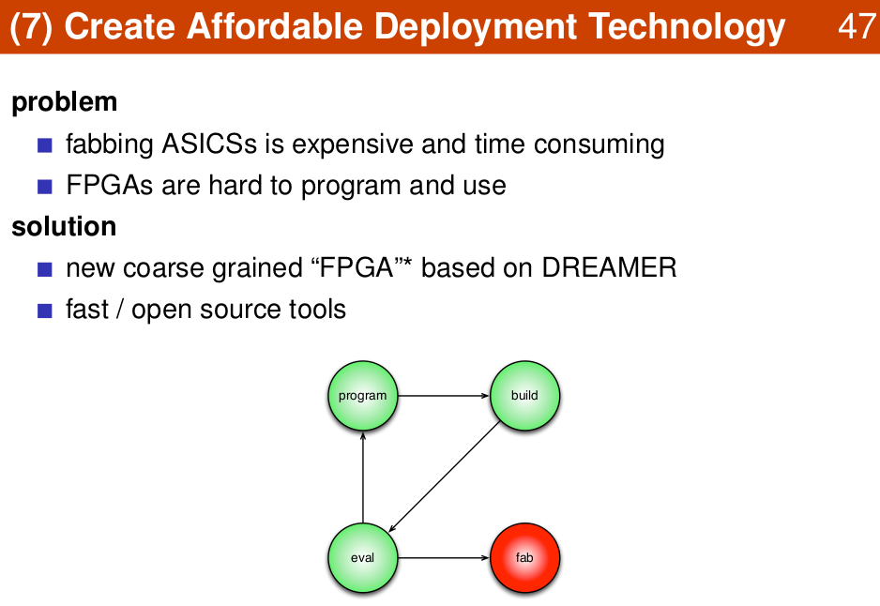
1.23 Create Affordable Deployment
https://www.youtube.com/watch?v=pfM1WUWbfBs&list=PLlu0CT-JnSasfpk8tq1ZDiE2G0AK1BhOg&index=1
Create Affordable Deployment (36:41-39:04/51:50)

Slide 11
1.24 Chisel Project

Slide 12
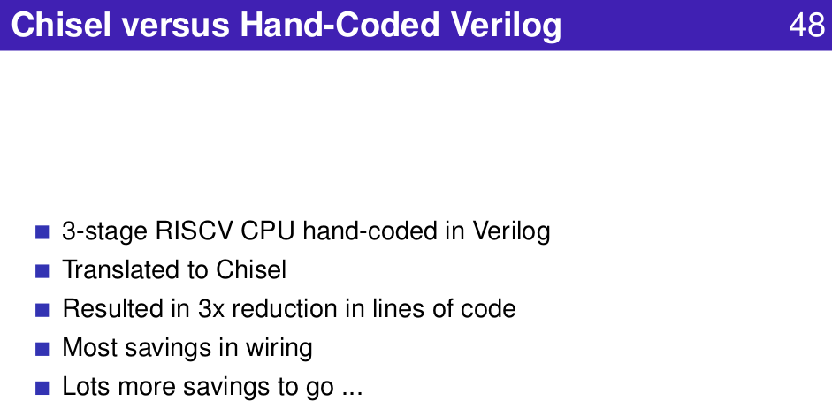
1.24 Chisel Project
https://www.youtube.com/watch?v=pfM1WUWbfBs&list=PLlu0CT-JnSasfpk8tq1ZDiE2G0AK1BhOg&index=1
Chisel Project (39:05-41:45/51:50)

Slide 13
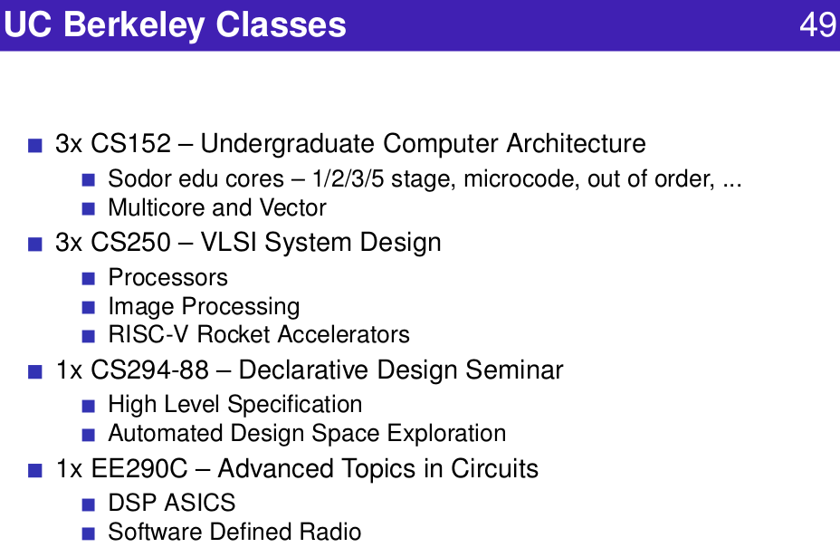
1.24 Chisel Project
https://www.youtube.com/watch?v=pfM1WUWbfBs&list=PLlu0CT-JnSasfpk8tq1ZDiE2G0AK1BhOg&index=1
Create Deployment (39:05-41:45/51:50)

Slide 14
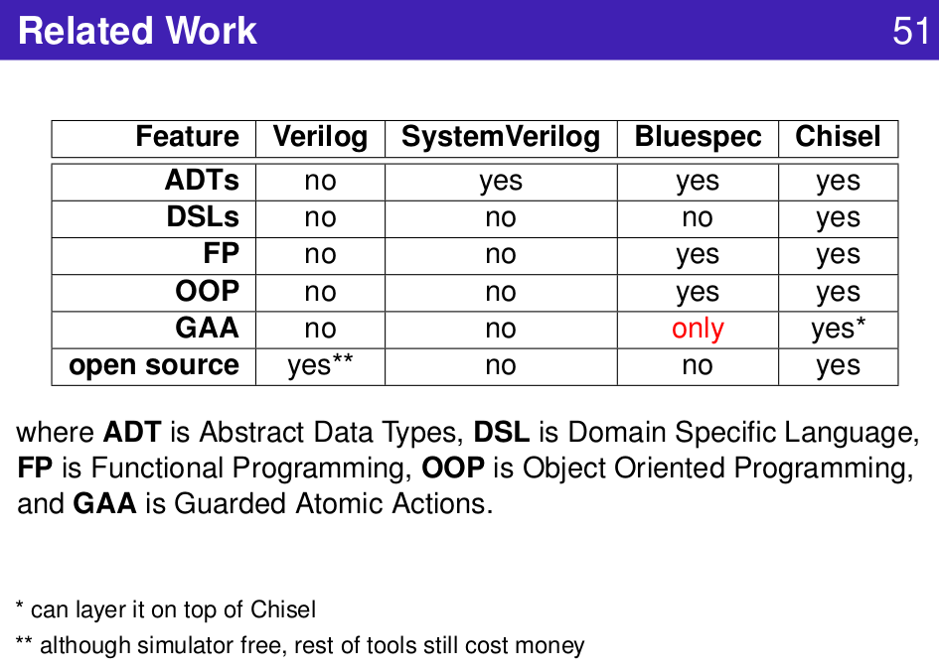
1.24 Chisel Project
https://www.youtube.com/watch?v=pfM1WUWbfBs&list=PLlu0CT-JnSasfpk8tq1ZDiE2G0AK1BhOg&index=1
Related Work (39:05-41:45/51:50)

Slide 15
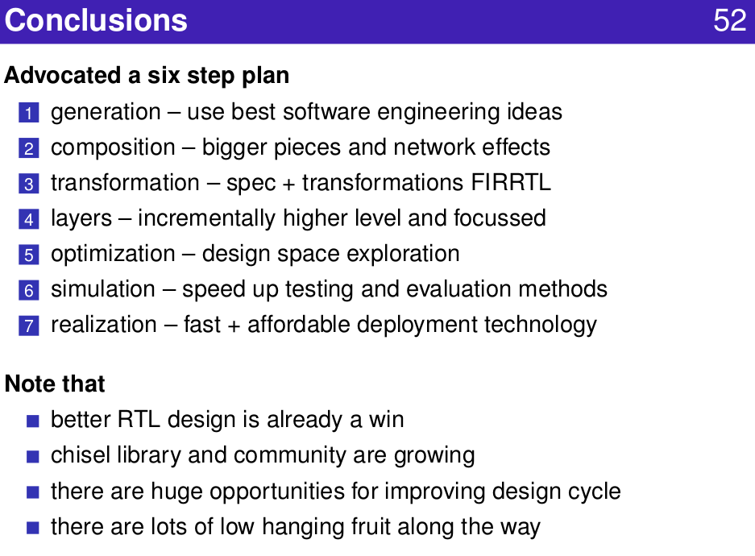
1.24 Chisel Project
https://www.youtube.com/watch?v=pfM1WUWbfBs&list=PLlu0CT-JnSasfpk8tq1ZDiE2G0AK1BhOg&index=1
Conclusion (39:05-41:45/51:50)

Slide 16
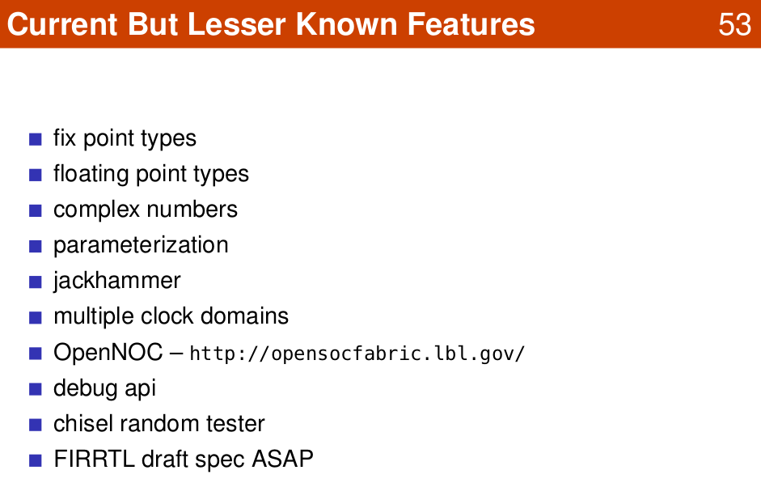
1.24 Chisel Project
https://www.youtube.com/watch?v=pfM1WUWbfBs&list=PLlu0CT-JnSasfpk8tq1ZDiE2G0AK1BhOg&index=1
Some Features (39:05-41:45/51:50)

Slide 17
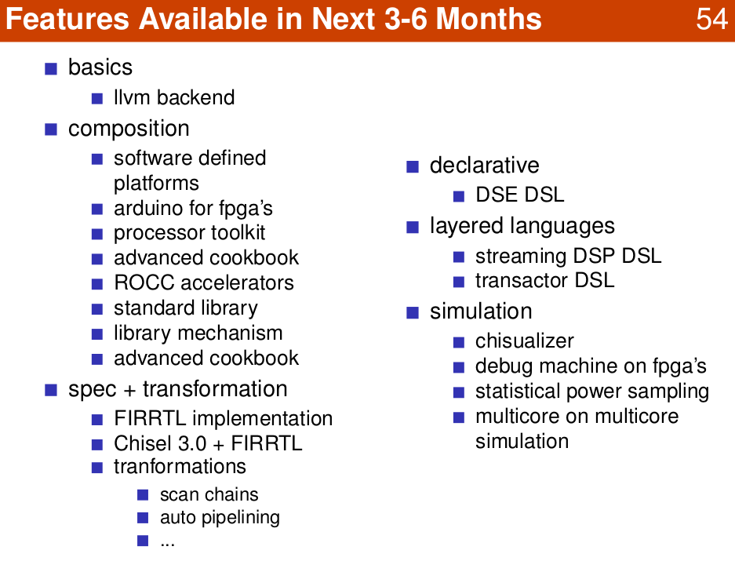
1.24 Chisel Project
https://www.youtube.com/watch?v=pfM1WUWbfBs&list=PLlu0CT-JnSasfpk8tq1ZDiE2G0AK1BhOg&index=1
Some Features (39:05-41:45/51:50)

Slide 18
End

