Slide 1

1.1 Introduction
Peter H. Chen

Slide 2
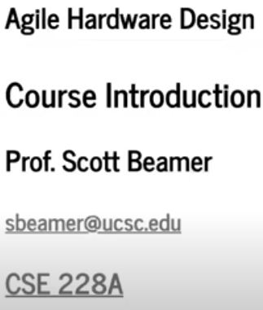
1.1 Introduction
https://www.youtube.com/watch?v=L2e-55iSA_8&list=PLfrN7RIcMe6g2LBRJLTHTdhyj5s8ag0Rg&index=1
Introduction (0:00-0:41/56:21)
This course “Agile Hardware Design” is taught by Professor Scott Beamer at UC Santa Cruz. The tool Chisel is used in the class. Chisel is developed by UC Berkeley and released in 2012. Chisel is used to construct 128 bits RISCV architecture.
Chisel
1. Bootcamp: https://github.com/freechipsproject/chisel-bootcamp
2. Exercise: https://github.com/schoeberl/chisel-lab
Related notes:
https://scottbeamer.net/pubs/beamer-dsd2024.pdf

Slide 3
1.2 Agenda

Slide 4
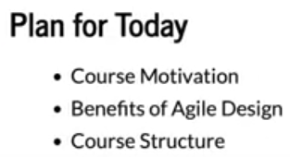
1.2 Agenda
https://www.youtube.com/watch?v=L2e-55iSA_8&list=PLfrN7RIcMe6g2LBRJLTHTdhyj5s8ag0Rg&index=1
Agenda (0:42-1:00/56:21)
Motivation:
Why do we need Agile in Hardware Design?

Slide 5
1.3 Need Advanced Design

Slide 6
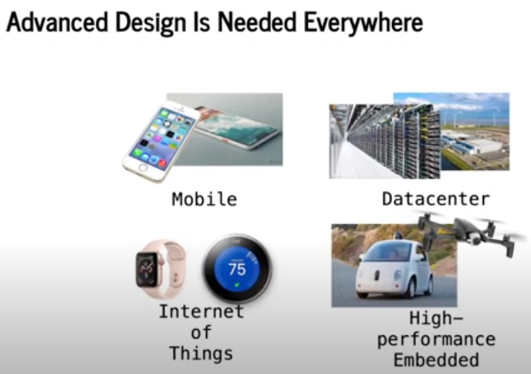
1.3 Need Advanced Design
https://www.youtube.com/watch?v=L2e-55iSA_8&list=PLfrN7RIcMe6g2LBRJLTHTdhyj5s8ag0Rg&index=1
Need Advanced Design (1:01-1:34/56:21)
A lot of hardware design, Mobile phone, Data center, IoT, Electrical Vehicle, and AI, is everywhere, not just a laptop. We need Advanced Chips and All these designs come together.

Slide 7
1.4 Hardware Design Challenge

Slide 8
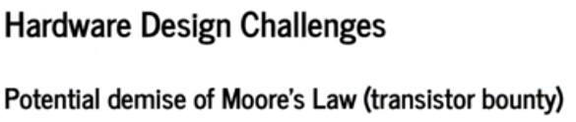
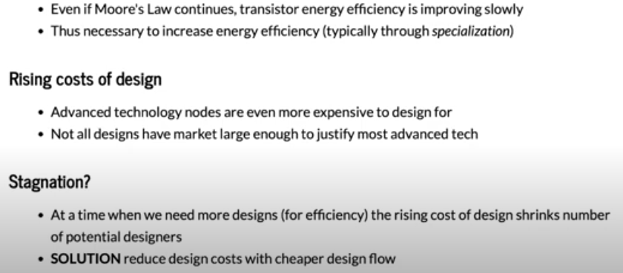
1.4 Hardware Design Challenge
https://www.youtube.com/watch?v=L2e-55iSA_8&list=PLfrN7RIcMe6g2LBRJLTHTdhyj5s8ag0Rg&index=1
Hardware Design Challenge (1:35-3:09/56:21)
Moore’s law disappear quickly: Hardware Design need to increase energy efficiency even Moore’s Law is still appear. CPU and AI accelerator need to improve energy efficient for application.
Design Cost need to be reduced: 3nm, 2nm, etc. Cost hundreds of million dollars for design.
Solution: We need cheaper design flow. How do we get there?

Slide 9
1.5 Contrast Philosophy

Slide 10
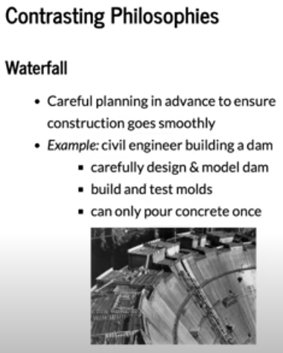
1.5 Contrast Philosophy
https://www.youtube.com/watch?v=L2e-55iSA_8&list=PLfrN7RIcMe6g2LBRJLTHTdhyj5s8ag0Rg&index=1
Contrast Philosophy (3:10-4:24/56:21)
Historically, we have the Waterfall philosophy for hardware design flow.
We have a lot of engineers try to build a dam.
1. We carefully design and model dam.
2. We build and test model
3. Finally, we pour the concrete. We only have one chance. You can pour the concrete only you are very sure.

Slide 11
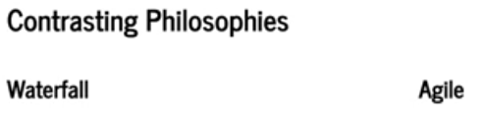
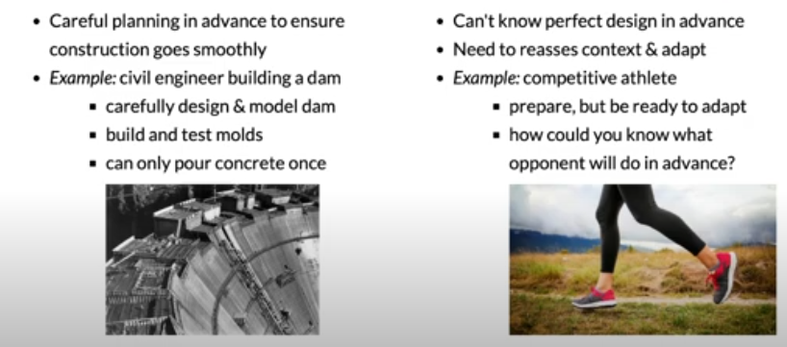
1.5 Contrast Philosophy
https://www.youtube.com/watch?v=L2e-55iSA_8&list=PLfrN7RIcMe6g2LBRJLTHTdhyj5s8ag0Rg&index=1
Contrast Philosophy (4:25-5:45/56:21)
In the software computing age, we have contrast software philosophy for agile hardware design. We can try things out with software.
Maybe the design is not perfect. We can change a line of code.
In Waterfall Hardware design, we need a design document, we need specification. In Agile Hardware Design, we get something working by software, not all features, not be optimized. It is iterated and improve upon it.
In Waterfall, we do once. In Agile software, we take advantage to do several times, if something wrong, we change one line of code and test, again and again.

Slide 12
1.6 Contrast HW Design Philosophies

Slide 13
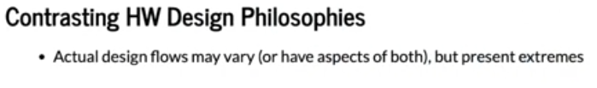
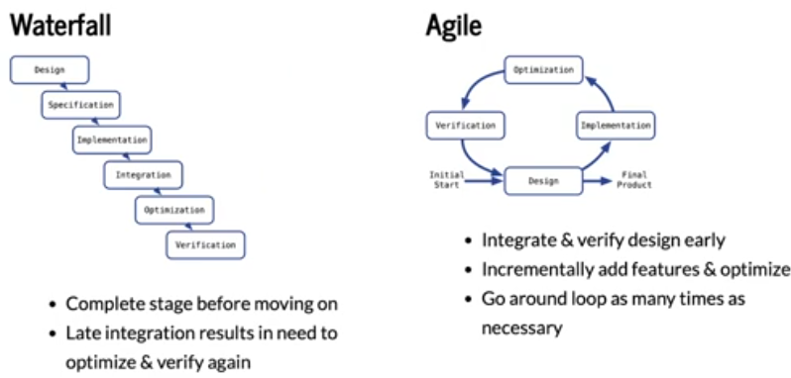
1.6 Contrast HW Design Philosophies
https://www.youtube.com/watch?v=L2e-55iSA_8&list=PLfrN7RIcMe6g2LBRJLTHTdhyj5s8ag0Rg&index=1
Contrast HW Design Philosophy (5:46-8:18/56:21)
Below, we compare the Waterfall vs. Agile HW Design flow.
Waterfall/HW Design: Design, Specification, Implementation, Integration, Optimization, Verification.
Agile Software Design Loop: Design, Implementation, Optimization, Verification.

Slide 14
1.7 Agile Technique

Slide 15

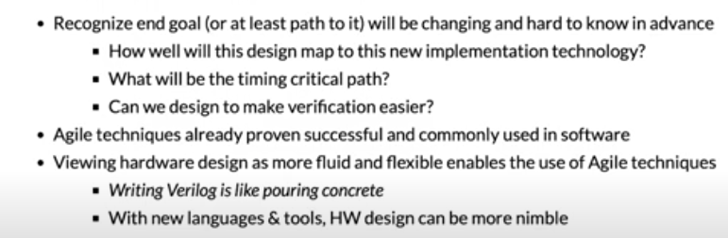
1.7 Agile Technique
https://www.youtube.com/watch?v=L2e-55iSA_8&list=PLfrN7RIcMe6g2LBRJLTHTdhyj5s8ag0Rg&index=1
Agile Technique (8:19-10:57/56:21)
We change hardware design concept with software philosophy. We adapt design frequently.
Write Verilog is just like pour the concrete.
With Chisel/Scala tools, Hardware design become more nimble/agile.

Slide 16
1.8 Agile Technique for HW Design

Slide 17
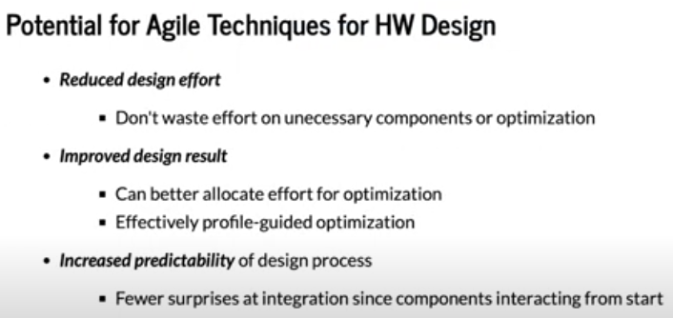
1.8 Agile Technique for HW Design
https://www.youtube.com/watch?v=L2e-55iSA_8&list=PLfrN7RIcMe6g2LBRJLTHTdhyj5s8ag0Rg&index=1
Agile Technique for HW Design (10:58-13:12/56:21)
We use Software Agile Technique for Hardware Waterfall Design.
1. Reduce Design time: Reduce revised time, Optimization
2. Improve design: Resource allocation, profile optimization
3. Predictability: Easier to integrate
a

Slide 18
1.9 Open Source Design

Slide 19
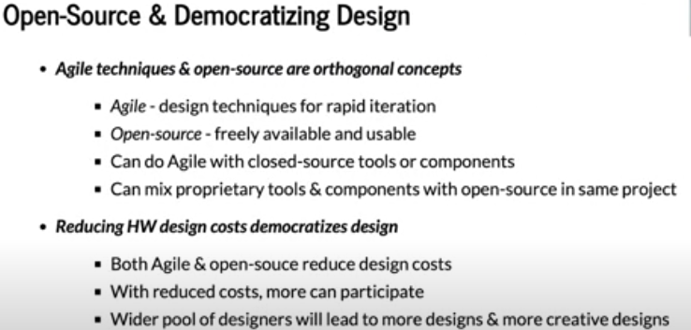
1.9 Open Source Design
https://www.youtube.com/watch?v=L2e-55iSA_8&list=PLfrN7RIcMe6g2LBRJLTHTdhyj5s8ag0Rg&index=1
Open Source Design (13:13-15:19/56:21)
1. Open source are free to university and agile design: Save cost and rapid design
2. Open source has more participation big designer pool: More people involved and better result.

Slide 20
1.10 Improve Productivity

Slide 21
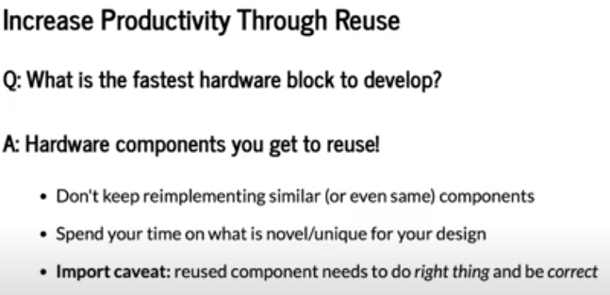
1.10 Improve Productivity
https://www.youtube.com/watch?v=L2e-55iSA_8&list=PLfrN7RIcMe6g2LBRJLTHTdhyj5s8ag0Rg&index=1
Improve Productivity (15:20-18:07/56:21)
Q: What is the fastest block to develop?
Ans: Change passing parameter and reuse.
The reuse block need to be correct.

Slide 22
End

