Slide 1

1.11 HW Generator
Peter H. Chen

Slide 2

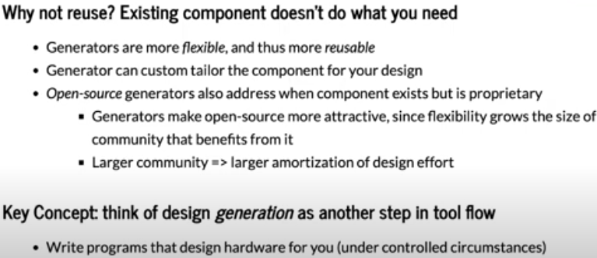
1.11 HW Generator
https://www.youtube.com/watch?v=L2e-55iSA_8&list=PLfrN7RIcMe6g2LBRJLTHTdhyj5s8ag0Rg&index=1
HW Generator (18:08-20:19/56:21)
HW Generator increase usability.

Slide 3
End

