Slide 1

25 Spade HDL
Peter H. Chen

Slide 2

25 Spade HDL
https://www.youtube.com/watch?v=Exk50eKHmoI&list=PLfrN7RIcMe6g2LBRJLTHTdhyj5s8ag0Rg&index=25
Spade HDL (0:00-0:56/57:12)
We discuss the Building hardware with Space HDL (Hardware Description Language) with Frans Skarman, PhD Candidate from Linkoping University, Sweden.

Slide 3
25.1 Project Suffer with Spade

Slide 4

25.1 Project Suffer with Spade
https://www.youtube.com/watch?v=Exk50eKHmoI&list=PLfrN7RIcMe6g2LBRJLTHTdhyj5s8ag0Rg&index=25
Project Suffer with Spade (0:57-1:05/57:12)
We use Spade for the Project Suffer.

Slide 5
25.2 Spade

Slide 6

25.2 Spade
https://www.youtube.com/watch?v=Exk50eKHmoI&list=PLfrN7RIcMe6g2LBRJLTHTdhyj5s8ag0Rg&index=25
Spade (1:06-2:46/57:12)
Spade is a new HDL (Hardware Description Language) for agile Hardware Design.
Chisel is based on a software language as a meta programming, Scala, to implement hardware. Chisel elaborate software into hardware Verilog. Chisel is good for software algorithm into hardware implementation,
However, Spade is directly specify the hardware accelerator implementation.
Q. What are difference between Chisel and Spade?
Ans:
1. Chisel: Based on Scala. Translate Scala into HDL. Chisel aims at basic hardware construction in registers, pipeline, memories,
2. Spade: Standalone language with HDL language. More Abstraction than Chisel.

Slide 7
25.3 Chisel

Slide 8
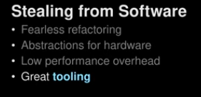
25.3 Chisel
https://www.youtube.com/watch?v=Exk50eKHmoI&list=PLfrN7RIcMe6g2LBRJLTHTdhyj5s8ag0Rg&index=25
Chisel (2:47-6:56/57:12)
1. Use Software to develop Hardware
2. Chisel make Abstractions for Hardware: Chisel is not really a hardware. Difficult detail the hardware.
3. Low Performance and Overhead: Chisel is easy to work but also have low performance and overhead problems. We develop hardware have the performance requirement. It is very hard to control the timing requirement.
4. Chisel is a great tool: Chisel is really good tool for algorithm development.

Slide 9
25.4 Original Pipeline

Slide 10
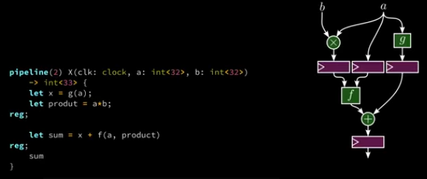
25.4 Original Pipeline
https://www.youtube.com/watch?v=Exk50eKHmoI&list=PLfrN7RIcMe6g2LBRJLTHTdhyj5s8ag0Rg&index=25
Original Pipeline (6:57-9:03/57:12)
Below, we have diagram for pipelines concept. We define the abstraction to represent the Pipeline.
Define function pipeline X(clock, a <32>, b<32>) -> int <33>:
  Input clock, 32 bits a, 32 bits b
  Output 33 bits.
1. First pipeline:
  Define variable x (let x = g(a))
  Define variable product (let product = a * b)
2. Second pipeline:
  Add the data and, let sum = x + f (a, product)
3. Third pipeline:
  Return the data in the register.

Slide 11
25.5 Register for Pipeline

Slide 12
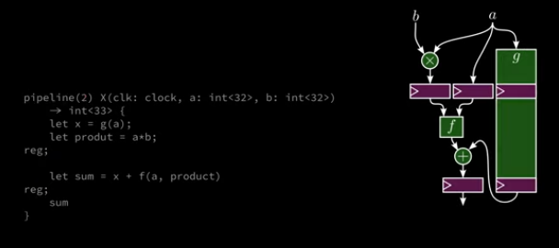
25.5 Register for Pipeline
https://www.youtube.com/watch?v=Exk50eKHmoI&list=PLfrN7RIcMe6g2LBRJLTHTdhyj5s8ag0Rg&index=25
Register for Pipeline (9:04-9:30/57:12)
We need the register g for pipeline.

Slide 13
25.6 Create Register

Slide 14
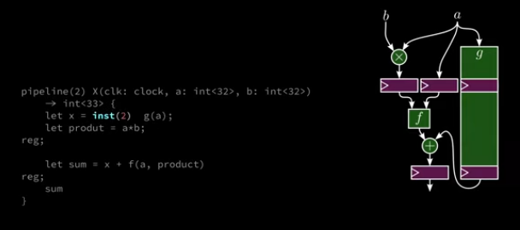
25.6 Create Register
https://www.youtube.com/watch?v=Exk50eKHmoI&list=PLfrN7RIcMe6g2LBRJLTHTdhyj5s8ag0Rg&index=25
Create Register (9:31-10:56/57:12)
We create the Register instance with depth 2.
> let x = inst(2) g(a);

Slide 15
End

