Slide 1

23 Taskflow and OpenTimer
Peter H. Chen

Slide 2
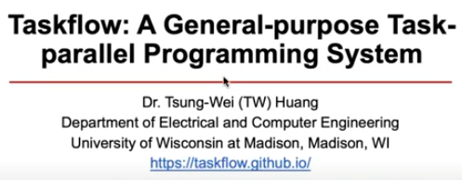
23 Taskflow and OpenTimer
https://www.youtube.com/watch?v=SB557WnWKEc&list=PLfrN7RIcMe6g2LBRJLTHTdhyj5s8ag0Rg&index=21
Taskflow and OpenTimer (0:00-0:54/1:02:41)
We discuss the OpenTimer based on ”Taskflow: A General-purpose Task-parallel Programming System”, by Dr. Tsung-Wei Huang.
Taskflow is a general purpose parallel programming library. We use Taskflow library to create the OpenTimer. OpenTimer is a timing analysis tool. We use Taskflow and OpenTimer for STA (Static Timing Analysis).
References:
1. https://taskflow.github.io/
2. https://tsung-wei-huang.github.io/papers/2022-tcad-taskflow.pdf
3. https://tsung-wei-huang.github.io/

Slide 3
23.1 Main Point

Slide 4
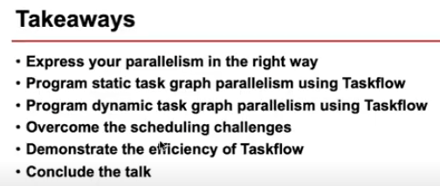
23.1 Main Point
https://www.youtube.com/watch?v=SB557WnWKEc&list=PLfrN7RIcMe6g2LBRJLTHTdhyj5s8ag0Rg&index=21
Main Point (0:55-1:40/1:02:41)
1. Run Parallel task in easy way
2. Task in Static Task Graph
3. Task Dynamic Task Graph
4. Task Scheduling
5. Taskflow efficiency
6. Conclusion

Slide 5
23.2 Parallel Computing

Slide 6
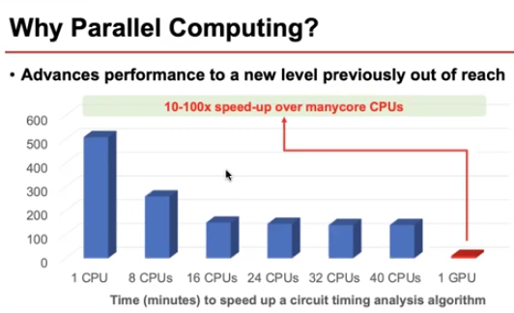
23.2 Parallel Computing
https://www.youtube.com/watch?v=SB557WnWKEc&list=PLfrN7RIcMe6g2LBRJLTHTdhyj5s8ag0Rg&index=21
Parallel Computing (1:41-2:00/1:02:41)
We can use multiple cores, we can reduce run time with parallel run several tasks.
GPUs are hardware logic gate for math/matrix computing. With GPUs, we can run 10-100 faster than CPU speed. We can benchmark the performance with STA (Static Timing Analysis).

Slide 7
23.3 Workload

Slide 8
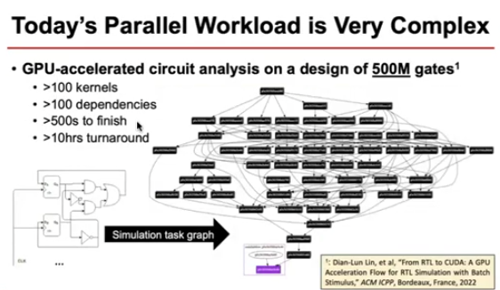
23.3 Workload
https://www.youtube.com/watch?v=SB557WnWKEc&list=PLfrN7RIcMe6g2LBRJLTHTdhyj5s8ag0Rg&index=21
Workload (2:01-3:00/1:02:41)
Below, we use GPUs as the accelerator to run a task.
CPU submit task to GPU for math calculation.

Slide 9
End

