Slide 1

0 Chisel Bootcamp
Peter H. Chen

Slide 2
0 Chisel Bootcamp
https://github.com/freechipsproject/chisel-bootcamp
Chisel Bootcamp
Chisel (Constructing Hardware in Scala Embedded Language) is a tool for digital hardware design.
1. This Bootcamp shows how to use Chisel, a Berkeley hardware construction DSL written in Scala.
2. This Bootcamp uses Scala and Chisel for hardware generators.
Topics:
1. Introduction: Why do we need Chisel (Constructing Hardware in Scala Language)? how to use Scala to write design/Test? How to use Chisel libraries?
2. Prerequisites: Verilog/VHDL, FPGA, Digital Design, Scala Programming,
3. Installation and download: Introduce the installation and chisel-bootcamp download.
4. Install SBT (Scala Build Tool): SBT is for Chisel running in batch mode
5. Install Open JDK Java 8: Java 8 for chisel.
6. Install Docker: Docker hub keep the working version for Chisel-bootcamp. It prevents tool chain compilation error due to dependencies .
7. Install Jupyter Notebook: Jupyter provides the interpreter for code and document presentation.
8. Install Scala: Chisel use Scala
9. Install Graphviz for Scala Module viewer
10. Install scala inside the Jupyter notebook: install coursier, almond, use almond to scala into jupyter notebook. In jupyter notebook, select scala as the default interpreter.
11. Outline: chisel-bootcamp web site organization
12. Why do we need chisel? Chisel use modern programming language Scala, write chisel generators instead of Verilog instance, better hardware design.

Slide 3
0.1 Bootcamp Overview

Slide 4
0.1 Bootcamp Overview
https://github.com/freechipsproject/chisel-bootcamp
Bootcamp Overview
1. Why do we need Chisel for hardware designs with generators instead of instances
2. Scala (Scalable Language): programming language
3. Chisel (Constructing Hardware in Scala Embedded Language): a hardware description language embedded in Scala
4. Write unit tests for Chisel designs
5. Chisel libraries: basic libraries, dsptools, and rocketchip.

Slide 5
0.2 Prerequisites

Slide 6
0.2 Prerequisites
https://github.com/freechipsproject/chisel-bootcamp
Prerequisites
1. Familiarity with Verilog, VHDL, or digital hardware design
2. Programming experience with in Scala/Python/Java/C++.
3. Strong desire to learn

Slide 7
0.3 Installation and Download

Slide 8
0.3 Installation and Download
https://github.com/freechipsproject/chisel-bootcamp
Installation and Download
1. SBT Installation
2. Java 8 Installation
3. Docker Installation
4. Jupyter Notebook Installation
5. Scala Installation
6. Install Graphviz for Chisel Module visualization
7. Download Chisel-bootcamp
https://github.com/freechipsproject/chisel-bootcamp/blob/master/Install.mdmd

Slide 9
0.4 Install SBT

Slide 10
0.4 Install SBT
https://docs.docker.com/engine/install/ubuntu/
Install SBT
Install SBT
> wget http://apt.typesafe.com/repo-deb-build-0002.deb
> sudo dpkg -i repo-deb-build-0002.deb
> sudo apt-get update
> sudo apt-get install sbt
https://stackoverflow.com/questions/13711395/install-sbt-on-ubuntu

Slide 11
0.8 Install Java 8

Slide 12
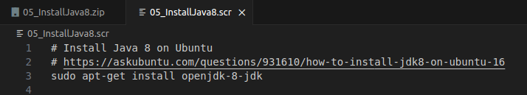
0.5 Install Java 8
https://docs.docker.com/engine/install/ubuntu/
Install Java 8
Install Java 8 on Ubuntu
> sudo apt-get install openjdk-8-jdk
https://stackoverflow.com/questions/71017113/how-to-install-jdk-8-on-ubuntu-server-18-04

Slide 13
0.6 Install Docker

Slide 14
0.6 Install Docker
https://docs.docker.com/engine/install/ubuntu/
Install Docker
Docker Installation
1. Remove old docker:
> for pkg in docker.io docker-doc docker-compose docker-compose-v2 podman-docker containerd runc; do sudo apt-get remove $pkg; done
2. Install the new docker
# Add Docker's official GPG key:
> sudo apt-get update
> sudo apt-get install ca-certificates curl
> sudo install -m 0755 -d /etc/apt/keyrings
> sudo curl -fsSL https://download.docker.com/linux/ubuntu/gpg -o /etc/apt/keyrings/docker.asc
> sudo chmod a+r /etc/apt/keyrings/docker.asc
# Add the repository to Apt sources:
> echo \
"deb [arch=$(dpkg --print-architecture) signed-by=/etc/apt/keyrings/docker.asc] https://download.docker.com/linux/ubuntu \
$(. /etc/os-release && echo "$VERSION_CODENAME") stable" | \
sudo tee /etc/apt/sources.list.d/docker.list > /dev/null
> sudo apt-get update

Slide 15
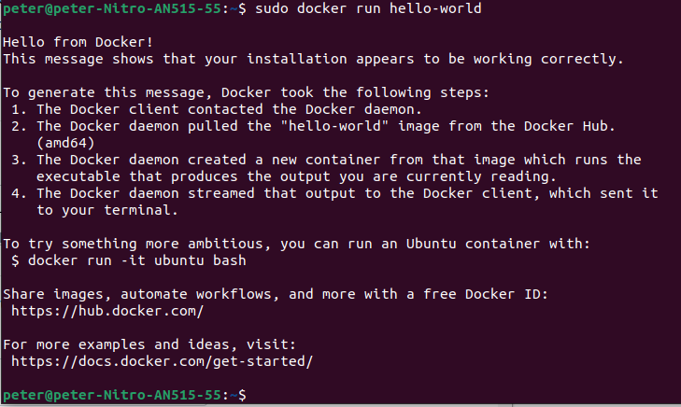
0.6 Install Docker
https://docs.docker.com/engine/install/ubuntu/
Check Docker run “hello-world”
3 Check Docker run with example “hello-world”
> sudo docker run hello-world

Slide 16
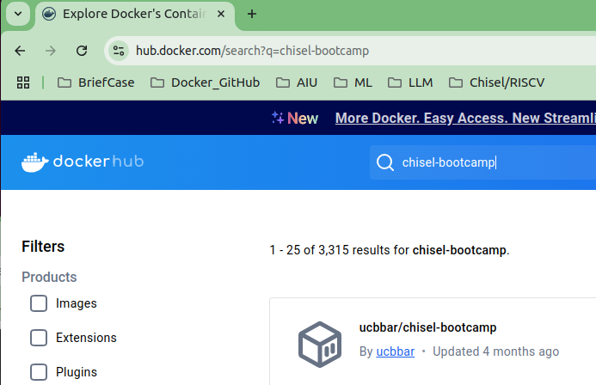
0.6 Install Docker
https://github.com/freechipsproject/chisel-bootcamp
Check Docker run with “Chisel-bootcamp”
4. Search “docker hub”
5. Search for “ucbbar/chisel-bootcaml”

Slide 17
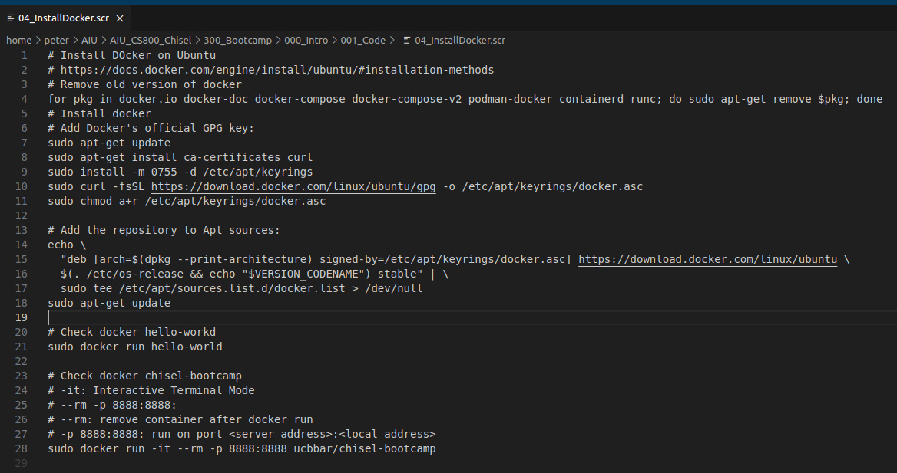
0.6 Install Docker
https://github.com/freechipsproject/chisel-bootcamp
Check Docker run with “Chisel-bootcamp”
5. Start the Docker and chisel-bootcamp
> sudo docker run -it --rm -p 8888:8888 ucbbar/chisel-bootcamp
# Check docker chisel-bootcamp
# -it: Interactive Terminal Mode
# --rm -p 8888:8888:
# --rm: remove container after docker run
# -p 8888:8888: run on port <server address>:<local address>

Slide 18
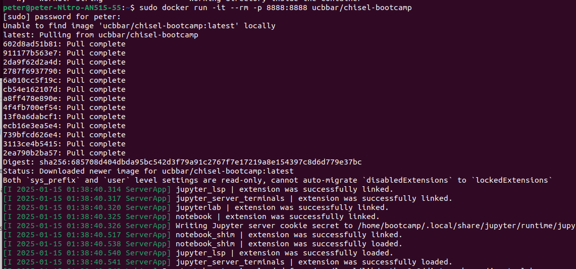
0.6 Install Docker
https://github.com/freechipsproject/chisel-bootcamp
Check Docker run with “Chisel-bootcamp”
> sudo docker run -it --rm -p 8888:8888 ucbbar/chisel-bootcamp
6. Result:

Slide 19
0.7 Install Jupyter

Slide 20

0.7 Install Jupyter
https://github.com/freechipsproject/chisel-bootcamp
Install Jupyter notebook on Ubuntu
https://jupyter.org/install
> pip install notebook
> jupyter notebook

Slide 21
0.8 Install Scala

Slide 22
0.8 Install Scala
https://github.com/freechipsproject/chisel-bootcamp
Install Scala on Ubuntu
https://www.scala-lang.org/download/
1. > curl -fL https://github.com/coursier/coursier/releases/latest/download/cs-x86_64-pc-linux.gz | gzip -d > cs && chmod +x cs && ./cs setup
2. > scala -version
1
2

Slide 23
0.9 Install Graphviz

Slide 24
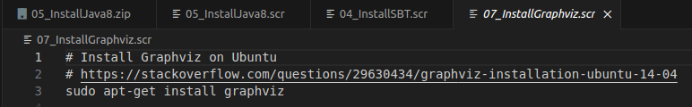
0.9 Install Graphviz
https://github.com/freechipsproject/chisel-bootcamp
Install Graphviz on Ubuntu
# Install Graphviz on Ubuntu
# https://stackoverflow.com/questions/29630434/graphviz-installation-ubuntu-14-04
> sudo apt-get install graphviz

Slide 25
0.10 Install Scala for Jupyter Notebook

Slide 26
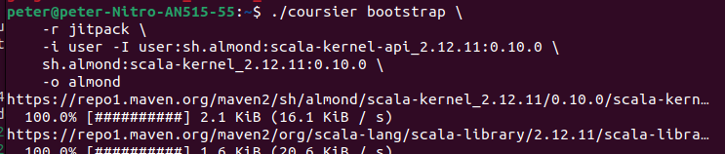
0.10 Install Scala for Jupyter Notebook
https://github.com/freechipsproject/chisel-bootcamp
Install Scala for Jupyter Notebook
https://queirozf.com/entries/jupyter-kernels-how-to-add-change-remove
1. Download Coursier to the current directory
> curl -Lo coursier https://git.io/coursier-cli && chmod +x coursier
2. Replace Scala and Almond version
> ./coursier bootstrap \
-r jitpack \
-i user -I user:sh.almond:scala-kernel-api_2.12.11:0.10.0 \
sh.almond:scala-kernel_2.12.11:0.10.0 \
-o almond
3. Install Scala Kernel into the Jupyter notebook
> ./almond --install --id scala_2_12_11 --display-name "Scala 2.12.11"
2
3

Slide 27
0.10 Install Scala for Jupyter Notebook
https://github.com/freechipsproject/chisel-bootcamp
Install Scala for Jupyter Notebook
https://queirozf.com/entries/jupyter-kernels-how-to-add-change-remove
1. Start the jupyter notebook with model 0 (0_demo.ipynb)
> jupyter notebook 0_demo.ipynb

Slide 28
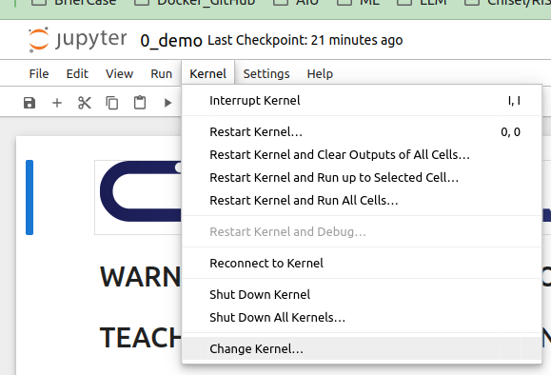
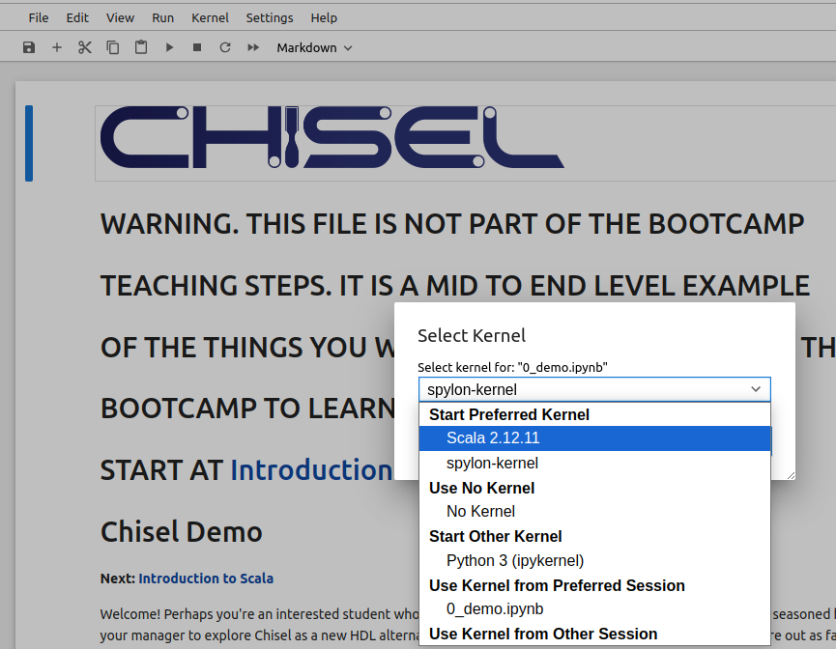
0.10 Install Scala for Jupyter Notebook
https://github.com/freechipsproject/chisel-bootcamp
Install Scala for Jupyter Notebook
https://queirozf.com/entries/jupyter-kernels-how-to-add-change-remove
1. Change kernel from ipython (interactive python) to scala
> Kernel > change Kernel...
2. Select “Scala 2.12.11”
1
2

Slide 29
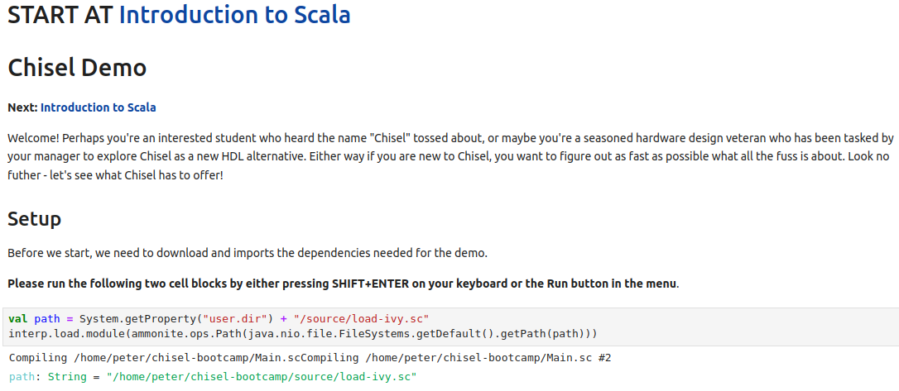
0.10 Install Scala for Jupyter Notebook
https://github.com/freechipsproject/chisel-bootcamp
Install Scala for Jupyter Notebook
Run Scala code in Jupyter Notebook:

Slide 30
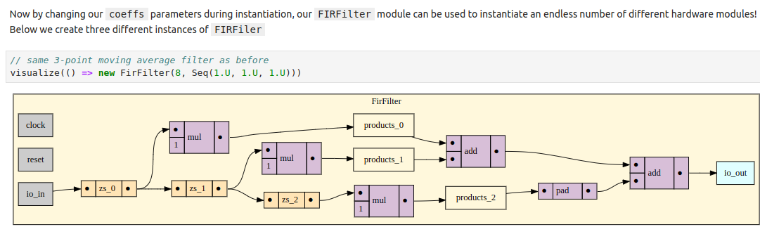
0.10 Install Scala for Jupyter Notebook
https://github.com/freechipsproject/chisel-bootcamp
Install Scala for Jupyter Notebook
Display with graphviz

Slide 31
0.11 Outline

Slide 32
0.11 Outline
https://github.com/freechipsproject/chisel-bootcamp
Outline
The Bootcamp is divided into modules.
0. Module 0: README, an introduction to Chisel.
1. Module 1: Scala Introduction. We start writing Chisel and concept.
2. Module 2: Chisel introduction. We start with hardware example: combinational, sequential logic, software and hardware control flow.
3. Module 3: We write hardware generators in Chisel with Scala's high-level programming language features. By the end, you will be able to read and understand most of the Chisel code base and begin using Rocket Chip.
Note:
This Bootcamp does not yet cover SBT, build systems, backend flows for FPGA or ASIC processes, or analog circuits.

Slide 33
0.12 Why Do We Need Chisel?

Slide 34
0.12 Why Do We Need Chisel?
https://github.com/freechipsproject/chisel-bootcamp
Why Do We Need Chisel?
1. All hardware description languages support writing single instances.
2. However, writing instances is tedious. Why make the same mistakes writing a slightly modified version of something somebody else has likely already designed?
3. Verilog supports limited parameterization, such as bitwidths and generate statements, but this only gets you so far.
4. If we can't write a Verilog generator, we need to write a new instance, thus doubling our code size.
5. As a better option, we should write one program that generates both hardware instances, which would reduce our code size and make tedious things easier. These programs are called generators.
6. Ideally, we want our generators to be
  1. composable,
  2. powerful, and
  3. enable fine-grained control over the generated design.
7. Error checking is necessary to make sure a composition is legal; without it, debugging is difficult. This requires a generator language to understand the semantics of the design (to know what’s legal and what’s not).
8. The generator should not be overly verbose! We want the generator program to concisely express many different designs, without rewriting it in if statements for each instance.
9. Finally, the Generator should be a zero-cost abstraction. Hardware design performance is very sensitive to small changes, and because of that, you need to be able to exactly specify the micro-architecture. Generators are very different than high-level-synthesis (HLS).

Slide 35
0.12 Why Do We Need Chisel?
https://github.com/freechipsproject/chisel-bootcamp
Why Do We Need Chisel?
Note:
1. The benefits of Chisel are in how you use it, not in the language itself.
2. If we decide to write instances instead of generators, you will see fewer advantages of Chisel over Verilog. If you take the time to learn how to write generators, then the power of Chisel will become apparent and you will realize you can never go back to writing Verilog.
3. Learning to write generators is difficult, but we hope this tutorial will pave the way for you to become a better hardware designer, programmer, and thinker.

Slide 36
End

