Slide 1

18 Delay
Peter H. Chen

Slide 2
18 Delay
https://www.youtube.com/watch?v=UaHhJ69DwAw&list=PLfrN7RIcMe6g2LBRJLTHTdhyj5s8ag0Rg&index=19
Delay (0:00-0:05/53:15)
Delay
Topics:
1. Setup: jupyter notebook and run cells. This code is not ready.
2. Rest tops are not ready.

Slide 3
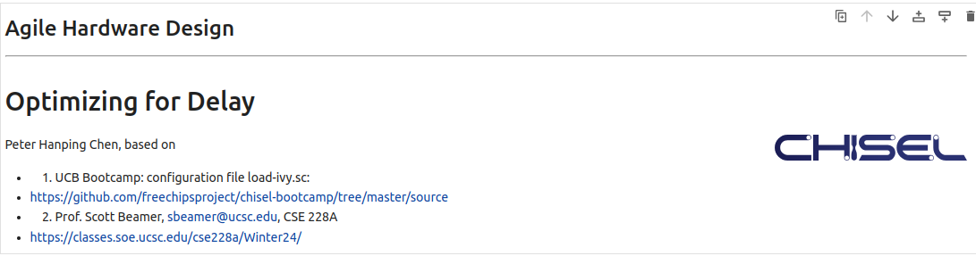
18 Delay
https://www.youtube.com/watch?v=UaHhJ69DwAw&list=PLfrN7RIcMe6g2LBRJLTHTdhyj5s8ag0Rg&index=19
Delay (0:06-1:30/53:15)
STA (Static Timing Analysis) with OpenTimer for VLSI design to analyze the timing behavior of circuits.
OpenTimer project is created by Professor Tsung-Wei Huang (University of Wisconsin-Madison).
https://github.com/OpenTimer/OpenTimer

Slide 4
18.1 Plan

Slide 5
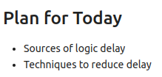
18.1 Plan
https://www.youtube.com/watch?v=UaHhJ69DwAw&list=PLfrN7RIcMe6g2LBRJLTHTdhyj5s8ag0Rg&index=19
Plan (1:06-1:20/53:15)
Today, we talk about Delay.
1. Sources of Logic delay
2. Techniques of Reduce Delay

Slide 6
18.2 Import Library

Slide 7
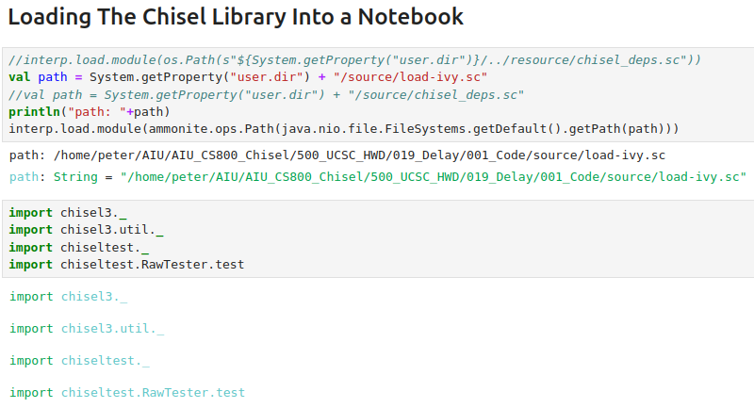
18.2 Import Library
https://www.youtube.com/watch?v=UaHhJ69DwAw&list=PLfrN7RIcMe6g2LBRJLTHTdhyj5s8ag0Rg&index=19
Import Library (1:21-3:59/53:15)

Slide 8
18.3 Source of Delay

Slide 9
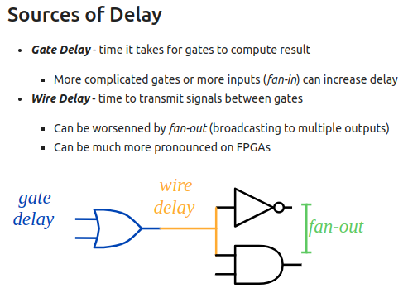
18.3 Source of Delay
https://www.youtube.com/watch?v=UaHhJ69DwAw&list=PLfrN7RIcMe6g2LBRJLTHTdhyj5s8ag0Rg&index=19
Source of Delay (4:01-5:26/53:15)
1. Gate Delay
2. Wire Delay

Slide 10
18.4 Unit of Delay

Slide 11
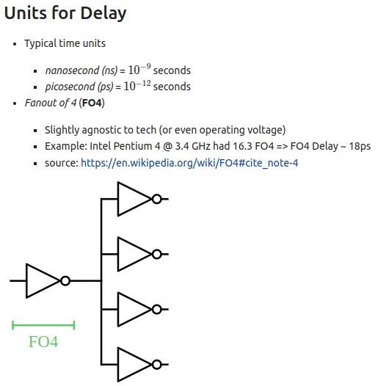
18.4 Unit of Delay
https://www.youtube.com/watch?v=UaHhJ69DwAw&list=PLfrN7RIcMe6g2LBRJLTHTdhyj5s8ag0Rg&index=19
Unit of Delay (4:01-9:18/53:15)
1. Time Units: ns = 10^(-9) sec, ps = 10 ^ (-12) sec
2. FO4 (Fanout 4): Gate delay for 4 Fanout gates.
3. Intel Pentium 4 with 3.4 GHz has 16.3 FO4
4. T (Period) = 1/ f (Frequency)
T = 1/ (3.4 GHz) = 1/3.4 ns = 0.29ns.
5. For FO4 (4 gates Fanout), number of buffer is generally between 2.7 to 5.3.
6. FO4 = log4 (Fanout/Input) = log4 (16.3) ≈ 2.02
7. FO4 delay = 18 ps = 0.018ns
8. We need the registers to hold setup and hold time to satisfy the Fanout delay.
9. Notes:
9.1 https://en.wikipedia.org/wiki/FO4
9.2 https://web.archive.org/web/20131203095021/http://www.itrs.net/Links/2003ITRS/LinkedFiles/Design/FO4Writeup.pdf

Slide 12
18.5 Critical Path

Slide 13
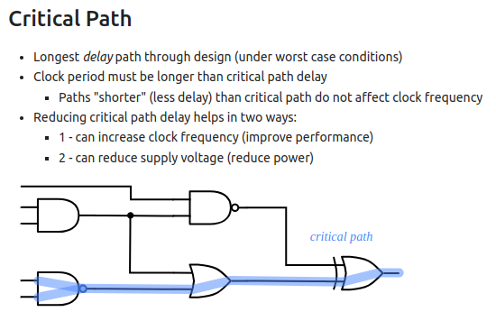
18.5 Critical Path
https://www.youtube.com/watch?v=UaHhJ69DwAw&list=PLfrN7RIcMe6g2LBRJLTHTdhyj5s8ag0Rg&index=19
Critical Path (9:19-12:34/53:15)
1. Critical Path: The longest path (longest delay) from input to the output.
2. The latency transition depends on the input value from 1 to 0 or from 0 to 1.
3. The values synchronize with the clock. We make sure the clock period is greater in time than the critical path. If clock period is less than the critical path delay, we will get the wrong answer.
To solve the critical path delay problem, we can
1. Increase clock rate: If we overclock, i.e., increase the clock frequency, then the hardware will be working fine. If we overclock too much, then the hardware stop working, or
2. Reduce the critical path: If we reduce the path, we can reduce the clock frequency and hardware work faster. This is a good way to short the critical path as much as possible,
3. Reduce the voltage level, then we get the signal faster for better performance and have less power consumption.

Slide 14
18.6 STA (Static Timing Analysis)

Slide 15
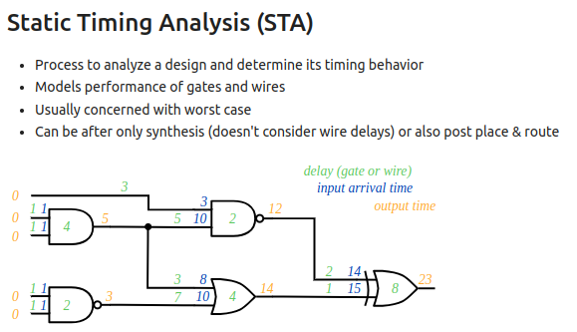
18.6 STA (Static Timing Analysis)
https://www.youtube.com/watch?v=UaHhJ69DwAw&list=PLfrN7RIcMe6g2LBRJLTHTdhyj5s8ag0Rg&index=19
STA (Static Timing Analysis) (12:35-22:20/53:15)
1. In ASIC or FPGA, we have design synthesized and placed and routed, in some point, we want to convinced ourselves that how fast can system run.
2. One way to do that is to use STA (Static Timing Analysis). STA is the process of trying to analyze our design and figure out various timing properties of our design,
3. Here, we are going to check the critical path latency, what is the longest critical path.
4. Below, we have first signal pass to green path (wire “3”), and then go to the gate “2”.
5. In have second signal pass through gate “4”, wire 5, then gate “2”.
6. We start all the orange color and arrive the same point with different paths and different time..
7. We go through different path and finally will get the the longest path time.
8. We can go back and forth and find the longest timing path.
9. Depending on different technology, we may get different timing paths.
10. ASIC, CPU, FPGA may have different paths as well.
11. Here, we only talk the combinational path, the sequential paths are different. The sequential circuit have setup/hold time violation.

Slide 16
18.7 Fix Critical Path

Slide 17
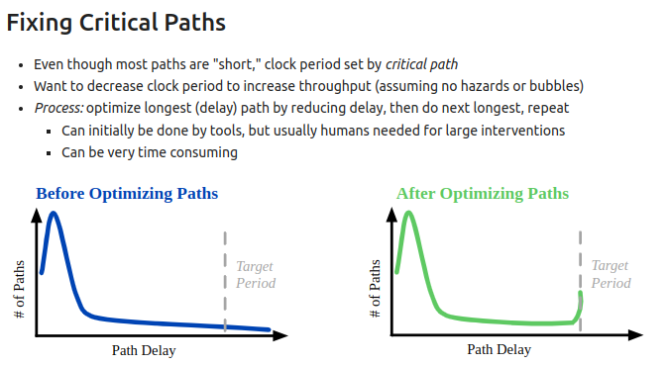
18.7 Fix Critical Path
https://www.youtube.com/watch?v=UaHhJ69DwAw&list=PLfrN7RIcMe6g2LBRJLTHTdhyj5s8ag0Rg&index=19
Fix Critical Path (20:21-23:20/53:15)
1. Below left, before optimization, we have some paths outside (or longer than) the “target period”.
2. After optimization, we fix the some longest paths, we have all paths which met the “target period” requirements. There are many paths close to the target period.

Slide 18
18.8 Who Fix Delay?

Slide 19
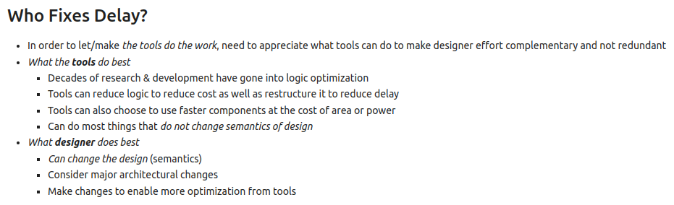
18.8 Who Fix Delay?
https://www.youtube.com/watch?v=UaHhJ69DwAw&list=PLfrN7RIcMe6g2LBRJLTHTdhyj5s8ag0Rg&index=19
Who Fix Delay? (23:21-25:20/53:15)
1.

Slide 20
End

