Slide 1

1.21 Resource
Peter H. Chen

Slide 2

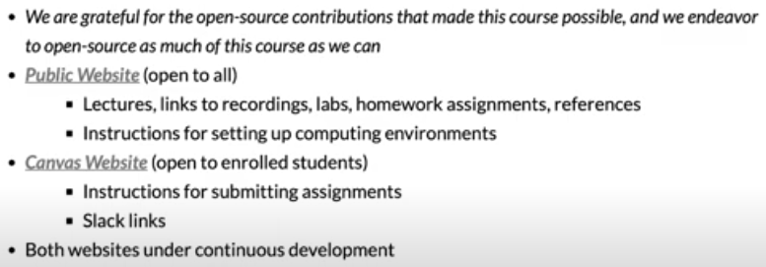
1.21 Resource
https://www.youtube.com/watch?v=L2e-55iSA_8&list=PLfrN7RIcMe6g2LBRJLTHTdhyj5s8ag0Rg&index=1
Resource (51:44-53:20/56:21)
We use open sources.

Slide 3
1.22 Concrete Learning Objective

Slide 4
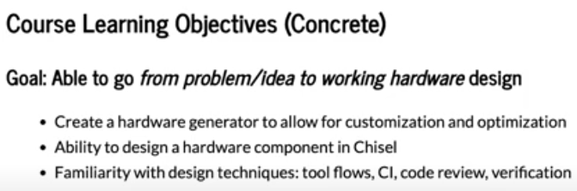
1.22 Concrete Learning Objective
https://www.youtube.com/watch?v=L2e-55iSA_8&list=PLfrN7RIcMe6g2LBRJLTHTdhyj5s8ag0Rg&index=1
Concrete Learning Objective (53:21-54:41/56:21)
Concrete Goal: From problem/idea to Hardware Design
CI (Continuous Integration)

Slide 5
1.23 Meta Learning Objective

Slide 6
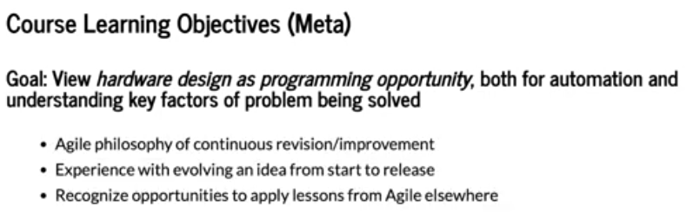
1.23 Meta Learning Objective
https://www.youtube.com/watch?v=L2e-55iSA_8&list=PLfrN7RIcMe6g2LBRJLTHTdhyj5s8ag0Rg&index=1
Meta Learning Objective (54:42-56:21/56:21)
From Hardware Design to Programming, automation, key factors of solved problem
1. Improvement
2. New idea
3. Agile

Slide 7
End

