Slide 1

14 Inheritance
Peter H. Chen

Slide 2
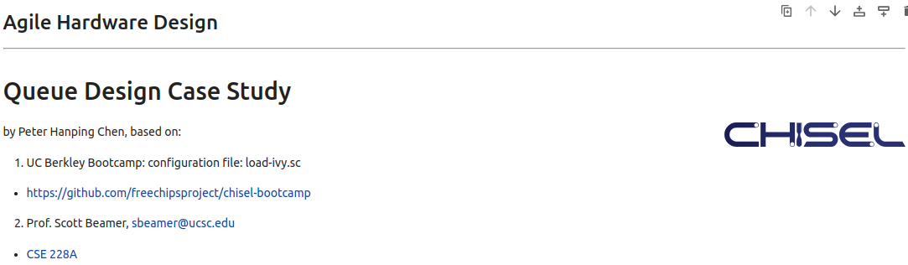
14 Inheritance
https://www.youtube.com/watch?v=-yCzIXXbfeE&list=PLfrN7RIcMe6g2LBRJLTHTdhyj5s8ag0Rg&index=14
Inheritance (0:00-0:01/57:09)
We used UCB bootcamp configuration file (load_ivy.sc)
source/load-ivy.sc (https://github.com/freechipsproject/chisel-bootcamp)

Slide 3
14 Inheritance
https://www.youtube.com/watch?v=-yCzIXXbfeE&list=PLfrN7RIcMe6g2LBRJLTHTdhyj5s8ag0Rg&index=14
Inheritance (0:02-0:45/57:09)
We discuss Scala and Chisel to implement design with Inheritance, Abstract Class, Trait, Template Type.
Topics:
1. Setup: jupyter notebook, select scala, and run cells.
2. Scala: Inheritance, Abstract Class (Single Inheritance), Trait (Multiple Inheritance), Generic/Template Type, Template/Type Hierarchy Diagram.
3. Chisel Verilog/Hardware Generator: Inheritance, Abstract Class (Single Inheritance), Trait (Multiple Inheritance. Not work well), Generic/Template Type, Template/Type Hierarchy Diagram.
4. Implement Operator with Inheritance
5. Implement Queue with Template/Generic type.

Slide 4
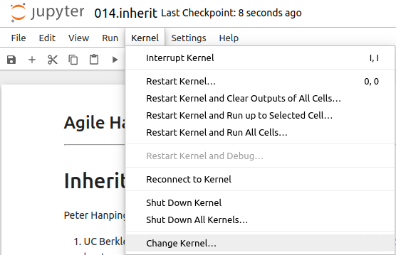
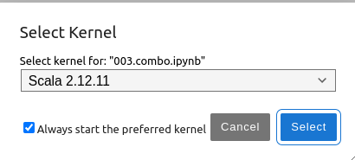
14 Inheritance
https://www.youtube.com/watch?v=-yCzIXXbfeE&list=PLfrN7RIcMe6g2LBRJLTHTdhyj5s8ag0Rg&index=14
Inheritance (0:03-1:20/57:09)
We discuss Chisel Collection.
> jupyter notebook 014.inherit.ipynb > Kernel > Change Kernel … > Select Scala2.21.22
> Run All Cells

Slide 5
14.1 Plan

Slide 6
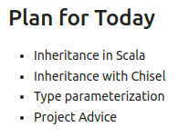
14.1 Plan
https://www.youtube.com/watch?v=-yCzIXXbfeE&list=PLfrN7RIcMe6g2LBRJLTHTdhyj5s8ag0Rg&index=14
Plan (0:46-0:50/57:09)
Today, we talk about Inheritance.

Slide 7
14.2 Import Chisel Library

Slide 8
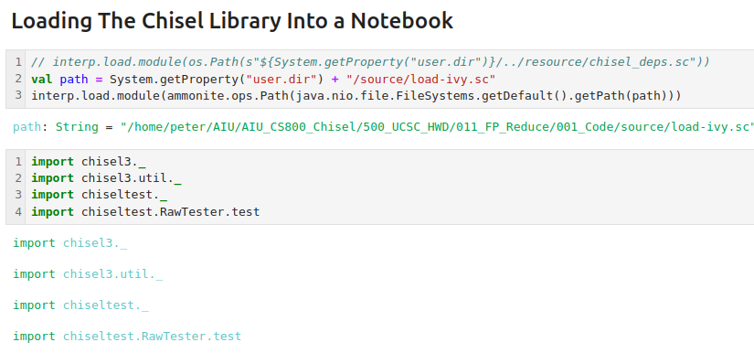
14.2 Import Chisel Library
https://www.youtube.com/watch?v=-yCzIXXbfeE&list=PLfrN7RIcMe6g2LBRJLTHTdhyj5s8ag0Rg&index=14
Import Chisel Library (00:51-0:52/57:09)

Slide 9
14.3 Why OOP Inheritance?

Slide 10
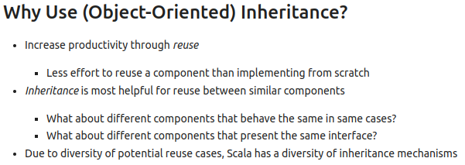
14.3 Why OOP Inheritance?
https://www.youtube.com/watch?v=-yCzIXXbfeE&list=PLfrN7RIcMe6g2LBRJLTHTdhyj5s8ag0Rg&index=14
Why OOP Inheritance? (0:53-4:00/57:09)
We want to reuse (or inherit) the property from from the parents (or ancestors).

Slide 11
14.4 Scala: Inheritance

Slide 12
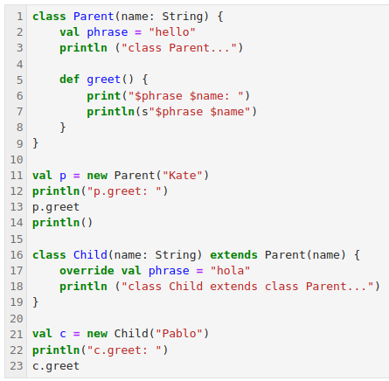
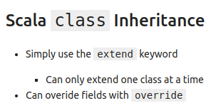
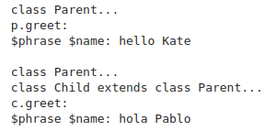
14.4 Scala: Inheritance
https://www.youtube.com/watch?v=-yCzIXXbfeE&list=PLfrN7RIcMe6g2LBRJLTHTdhyj5s8ag0Rg&index=14
Scala: Inheritance (4:01-6:35/57:09)
We want to reuse (or inherit) the property from from the parents (or ancestors) and override the information.
We can only
1. inherit one class at a time.
2. override to override the inherit information
Below,
1. The Parent class define English “hello”. We pass in “Kate”, then we have “hello Kate”
2. The Child class define Spanish “hola”. We pass in “Pablo (Paul in Spanish)”, we have “hola Pablo”.

Slide 13
14.5 Scala: Abstract Inheritance

Slide 14
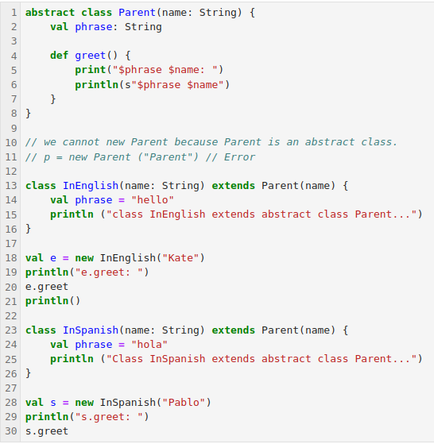
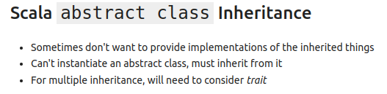
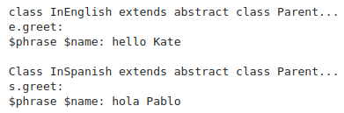
14.5 Scala: Abstract Inheritance
https://www.youtube.com/watch?v=-yCzIXXbfeE&list=PLfrN7RIcMe6g2LBRJLTHTdhyj5s8ag0Rg&index=14
Scala: Abstract Class Inheritance (6:36-13:45/57:09)
We use the abstract class to manage different concrete classes,
1. abstract class Parent, we did not define anything (abstract).
2. We cannot create an object with the abstract class Parent.
3. class InEnglish inherit abstract class Parent and defines concrete information“hello”. Here, Override keyword is not required. We pass in “Kate”, then we have “hello Kate”
4. class InSpanish defines concrete information “hola” and inherit abstract class Parent. We pass in “Pablo”, then we have “hola Pablo”.
5. In Scala, for multiple inheritance, we need to use trait.

Slide 15
14.6 Scala: Type Hierarchy

Slide 16
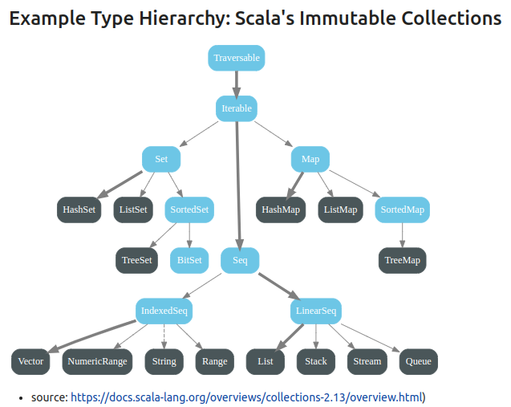
14.6 Scala: Type Hierarchy
https://www.youtube.com/watch?v=-yCzIXXbfeE&list=PLfrN7RIcMe6g2LBRJLTHTdhyj5s8ag0Rg&index=14
Scala: Type Hierarchy (13:46-22:00/57:09)
Below is the Inheritance Diagram of Type Hierarchy for Scala collection.
The Type is a parameter.
We have based class traversable. There iterable, Set, Seq, Map, List, etc.

Slide 17
14.7 Chisel: Type

Slide 18
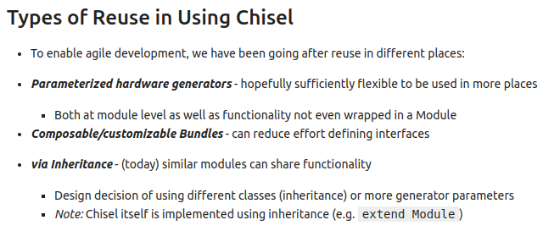
14.7 Chisel: Type
S
https://www.youtube.com/watch?v=-yCzIXXbfeE&list=PLfrN7RIcMe6g2LBRJLTHTdhyj5s8ag0Rg&index=14
Chisel: Type (22:01-25:05/57:09)
Chisel Reuse by Type:
1. Build parameterized generator
2. Bundle
3. Inheritance
Design Hardware Generator with Inheritance design is very common.

Slide 19
14.8 Chisel: Abstract Class Inheritance

Slide 20
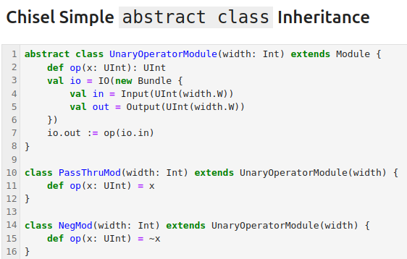
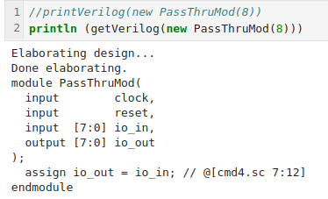
14.8 Chisel: Abstract Class Inheritance
https://www.youtube.com/watch?v=-yCzIXXbfeE&list=PLfrN7RIcMe6g2LBRJLTHTdhyj5s8ag0Rg&index=14
Chisel: Abstract Class Inheritance (22:01-26:34/57:09)
Below is the abstract class Unary Operator.
We have abstract based class UnaryOperatorModule which have IO.
We have both PassThruMod and NegMod inherited based on UnaryOperatorModule.
We can generate the Verilog.

Slide 21
14.9 Chisel: Build Operator Library

Slide 22
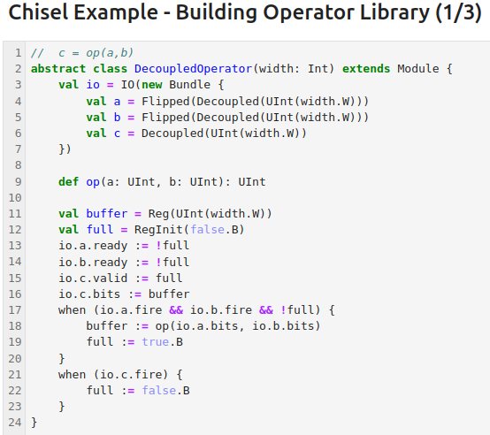
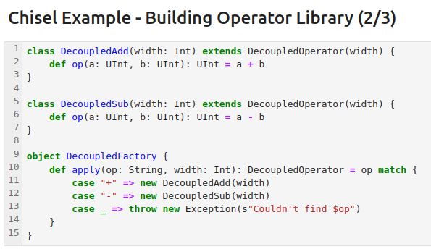
14.9 Chisel: Build Operator Library
https://www.youtube.com/watch?v=-yCzIXXbfeE&list=PLfrN7RIcMe6g2LBRJLTHTdhyj5s8ag0Rg&index=14
Chisel: Build Operator Library (26:35-28:40/57:09)
Below, we define abstract class DecoupledOperator. We have both DecoupledAdd and DecopuledSub DecopuledFactor inherited abstract based DecoupledOperator.
The object DecoupledFactory apply the operations for class DecoupledAdd and DecopuledSub.

Slide 23
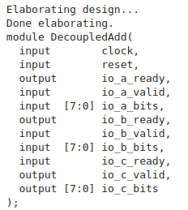

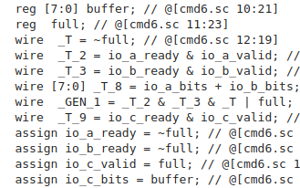
14.9 Chisel: Build Operator Library
https://www.youtube.com/watch?v=-yCzIXXbfeE&list=PLfrN7RIcMe6g2LBRJLTHTdhyj5s8ag0Rg&index=14
Chisel: Build Operator Library (28:41-29:00/57:09)
Generate Verilog.

Slide 24
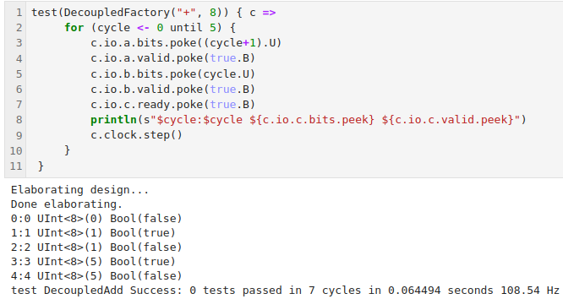
14.9 Chisel: Build Operator Library
https://www.youtube.com/watch?v=-yCzIXXbfeE&list=PLfrN7RIcMe6g2LBRJLTHTdhyj5s8ag0Rg&index=14
Chisel: Build Operator Library (29:01-31:12/57:09)
Run Simulation for +, - operators. We can define abstract class for operator overload.

Slide 25
14.10 Scala: trait

Slide 26
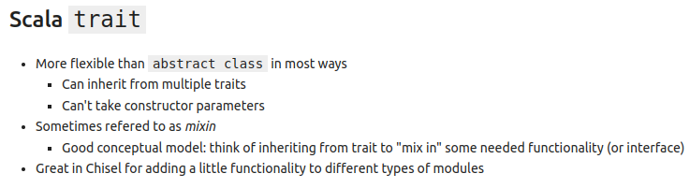
14.10 Scala: trait
https://www.youtube.com/watch?v=-yCzIXXbfeE&list=PLfrN7RIcMe6g2LBRJLTHTdhyj5s8ag0Rg&index=14
Scala: trait (31:13-37:10/57:09)
The trait is more flexible thant abstract class.
1. Multiple inhertiance: abstract class can only do the single inheritance. Trait can do multiple traits ineritance.
2. trait cannot constrct parameters: trait has constraint on paramters.
Trait is called “mixin” (mix in). Trait mixed in several funcitonality.

Slide 27
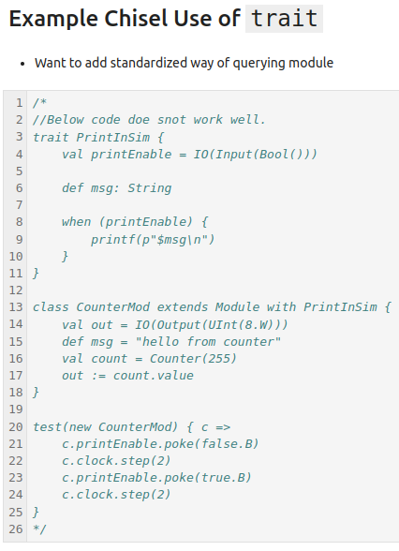
14.10 Scala: trait
https://www.youtube.com/watch?v=-yCzIXXbfeE&list=PLfrN7RIcMe6g2LBRJLTHTdhyj5s8ag0Rg&index=14
Scala: trait (37:11-38:55/57:09)
The trait does not worked in UC Berkeley Bootcamp configrutation file “load-ivy.sc”

Slide 28
14.11 Scala: Class Review

Slide 29
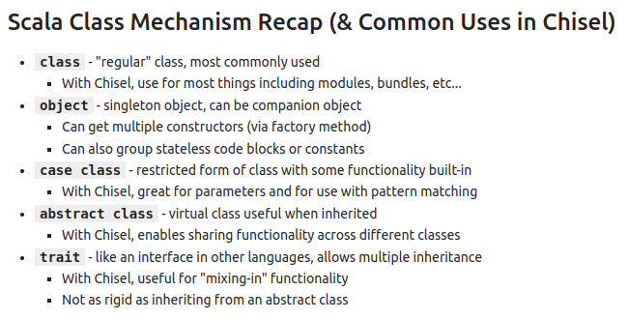
14.11 Scala: Class Review
https://www.youtube.com/watch?v=-yCzIXXbfeE&list=PLfrN7RIcMe6g2LBRJLTHTdhyj5s8ag0Rg&index=14
Scala: Class Review (38:56-41:33/57:09)
We have five kinds of class in Scala.
1. Class: regular class.
2. Object: Singleton object (Only one object in the program) and companion object.
Q: What is companion object?
Ans: A companion object can be defined inside the class and access with class.
3. case class: for chisel parameters passing and pattern matching.
4. abstract class: virtual class for handle management.
5. trait: for multiple inheritance.

Slide 30
14.12 Scala: Template Type

Slide 31
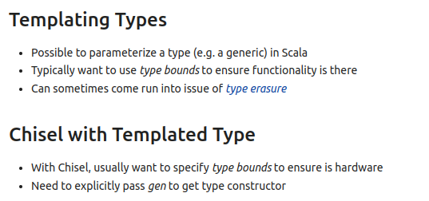
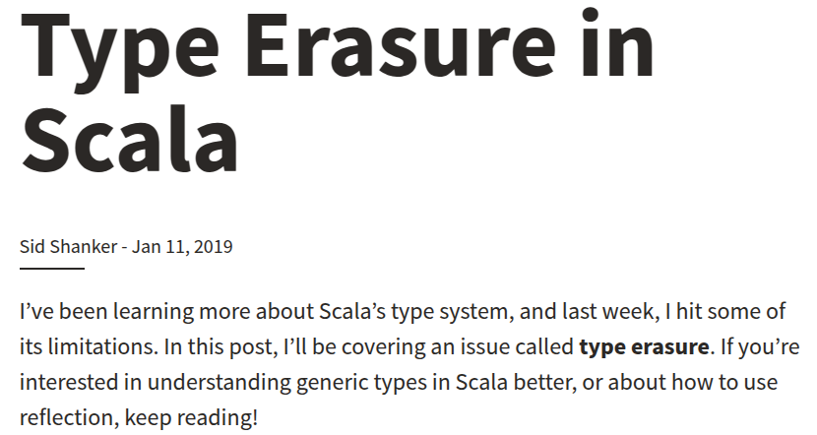
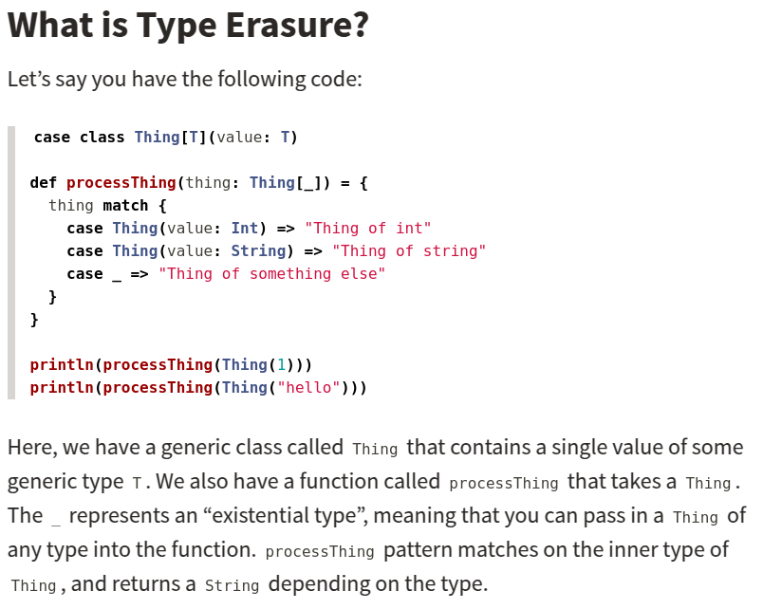
14.12 Scala: Template type
https://www.youtube.com/watch?v=-yCzIXXbfeE&list=PLfrN7RIcMe6g2LBRJLTHTdhyj5s8ag0Rg&index=14
Scala: Template Type (41:34-44:00/57:09)
Java original template name is called Generics. People use the generic type <T> to remove type called Type Erasure (删除).
Import library to do scala template.

Slide 32
14.13 Chisel: Template Type

Slide 33
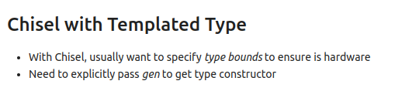
14.13 Chisel: Template Type
https://www.youtube.com/watch?v=-yCzIXXbfeE&list=PLfrN7RIcMe6g2LBRJLTHTdhyj5s8ag0Rg&index=14
Chisel: Template Type (44:01-45:00/57:09)
Chisel template is limited for Verilog hardware only. The Scala template is used for software programming.
We can pass in type easily with Unit(8.W) into class GenericPassThru and generate the Verilog Hardware.

Slide 34
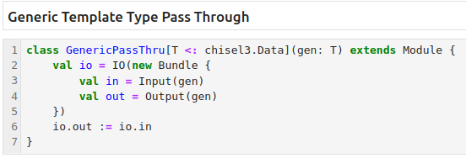
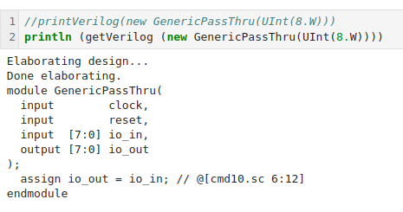
14.13 Chisel: Template Type
https://www.youtube.com/watch?v=-yCzIXXbfeE&list=PLfrN7RIcMe6g2LBRJLTHTdhyj5s8ag0Rg&index=14
Chisel: Template Type (44:01-45:00/57:09)
Below is Generic Template Type Pass Through Example.

Slide 35
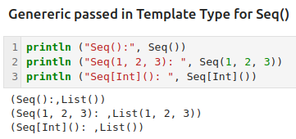
14.13 Chisel: Template Type
https://www.youtube.com/watch?v=-yCzIXXbfeE&list=PLfrN7RIcMe6g2LBRJLTHTdhyj5s8ag0Rg&index=14
Chisel: Template Type (45:01-46:09/57:09)
Below, the Seq(), Seq(1,2, 3), Seq[Int](), etc. with type specification.

Slide 36
14.14 Chisel: Type Hierarchy

Slide 37
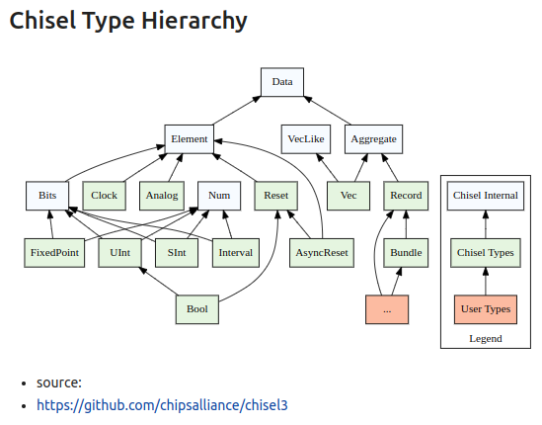
14.14 Chisel: Type Hierarchy
https://www.youtube.com/watch?v=-yCzIXXbfeE&list=PLfrN7RIcMe6g2LBRJLTHTdhyj5s8ag0Rg&index=14
Chisel: Type Hierarchy (46:10-47:30/57:09)

Slide 38
14.15 Queue with Template Type

Slide 39
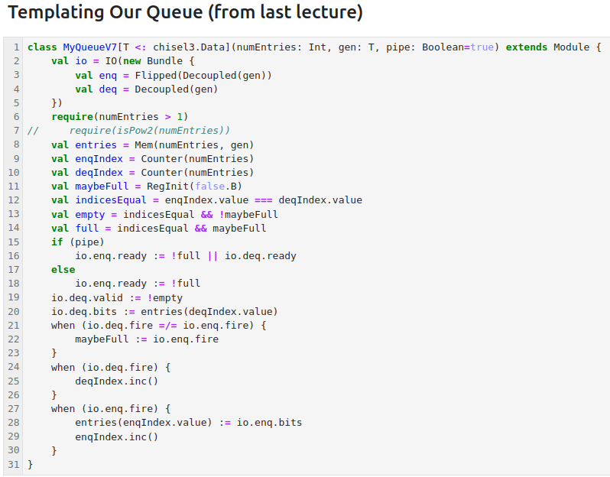
14.15 Queue with Template Type
https://www.youtube.com/watch?v=-yCzIXXbfeE&list=PLfrN7RIcMe6g2LBRJLTHTdhyj5s8ag0Rg&index=14
Queue with Template Type (47:31-47:51/57:09)
Define class QueueV7 with template type T.

Slide 40
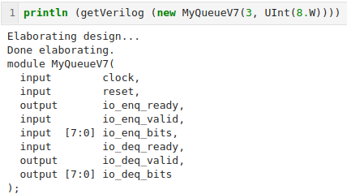
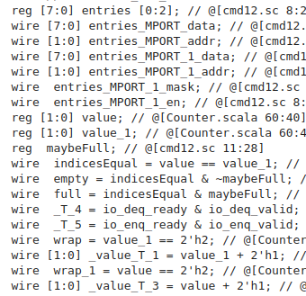
14.15 Queue with Template Type
https://www.youtube.com/watch?v=-yCzIXXbfeE&list=PLfrN7RIcMe6g2LBRJLTHTdhyj5s8ag0Rg&index=14
Queue with Template Type (47:51-47:55/57:09)
Generate Verilog.

Slide 41
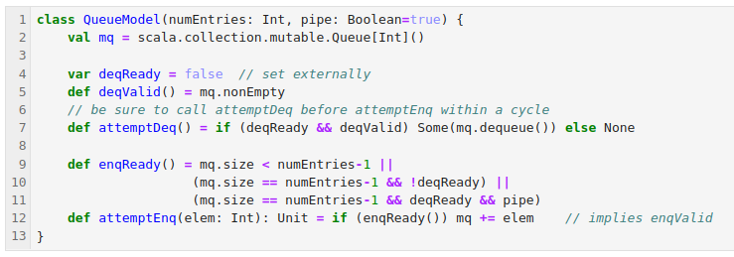
14.15 Queue with Template Type
https://www.youtube.com/watch?v=-yCzIXXbfeE&list=PLfrN7RIcMe6g2LBRJLTHTdhyj5s8ag0Rg&index=14
Queue with Template Type (47:56-48:00/57:09)
Define QueueModel

Slide 42
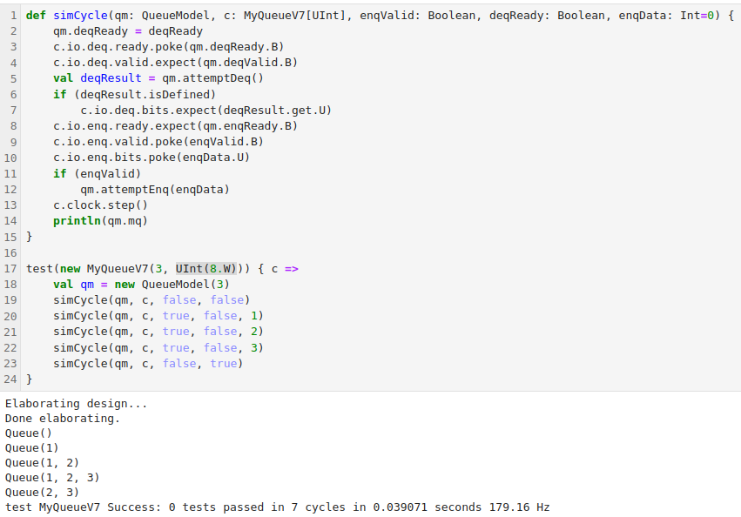
14.15 Queue with Template Type
https://www.youtube.com/watch?v=-yCzIXXbfeE&list=PLfrN7RIcMe6g2LBRJLTHTdhyj5s8ag0Rg&index=14
Queue with Template Type (48:01-48:10/57:09)
Simulation

Slide 43
14.16 Project

Slide 44
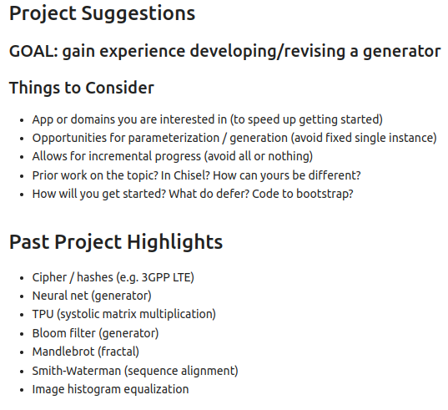
14.16 Project
https://www.youtube.com/watch?v=-yCzIXXbfeE&list=PLfrN7RIcMe6g2LBRJLTHTdhyj5s8ag0Rg&index=14
Project (48:11-57:09/57:09)

Slide 45
End

