Slide 1

11.1 Chisel Language
Peter H. Chen

Slide 2
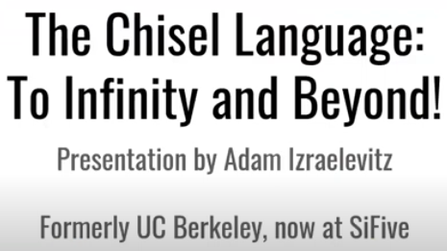
11.1 Chisel Language
https://www.youtube.com/watch?v=VU9XdMJqkeM&list=PLlu0CT-JnSasfpk8tq1ZDiE2G0AK1BhOg&index=11
Chisel Language (0:00-0:10/27:20)
The Chisel Language: To Infinity and Beyond.

Slide 3
End

