Slide 1

1 Chisel Bootcamp
Peter H. Chen

Slide 2
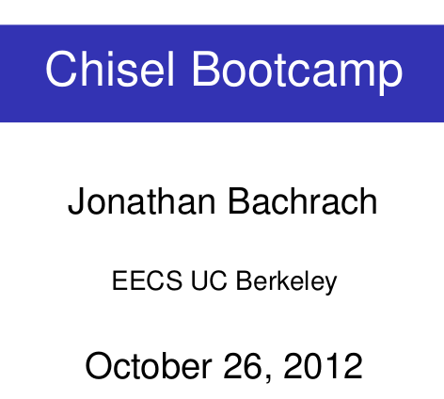
1 Chisel Bootcamp
https://www.youtube.com/watch?v=OPhFfNLcVsI&list=PLlu0CT-JnSasfpk8tq1ZDiE2G0AK1BhOg&index=2
Goal for Bootcamp (0:00-2:57/1:05:46)
This Bootcamp material is provided by Jonathan Bachrach who is a faculty of UC Berkeley.
UC Berkeley started to work on Chisel since 4-5 years ago (2010-2011).
Related notes:
https://aspire.eecs.berkeley.edu/chisel-archive/bootcamp-20121026.pdf

Slide 3
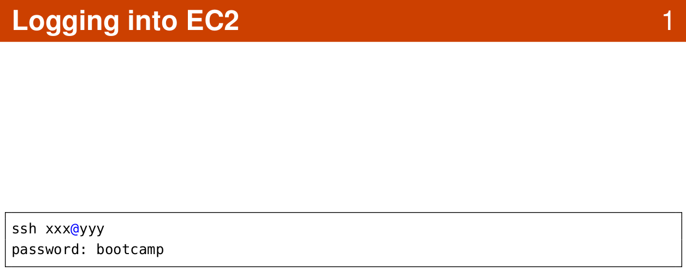
1 Chisel Bootcamp
https://www.youtube.com/watch?v=OPhFfNLcVsI&list=PLlu0CT-JnSasfpk8tq1ZDiE2G0AK1BhOg&index=2
Logging into EC2 (0:00-2:57/1:05:46)

Slide 4
1.1 User Screen

Slide 5
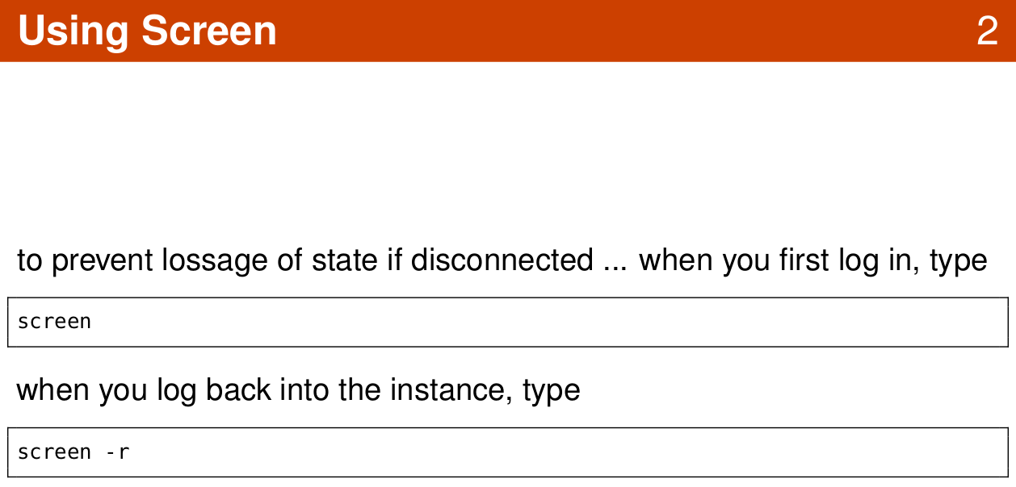
1.1 User Screen
https://www.youtube.com/watch?v=OPhFfNLcVsI&list=PLlu0CT-JnSasfpk8tq1ZDiE2G0AK1BhOg&index=2
Logging into EC2 (2:58-7:58/1:05:46)

Slide 6
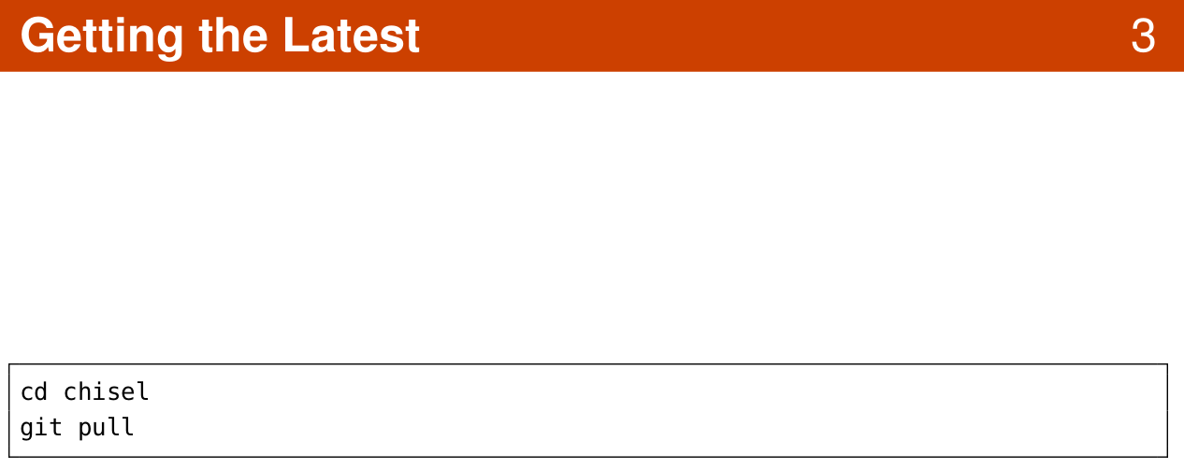
1.1 User Screen
https://www.youtube.com/watch?v=OPhFfNLcVsI&list=PLlu0CT-JnSasfpk8tq1ZDiE2G0AK1BhOg&index=2
Logging into EC2 (2:58-7:58/1:05:46)

Slide 7
1.2 Scala Programming

Slide 8
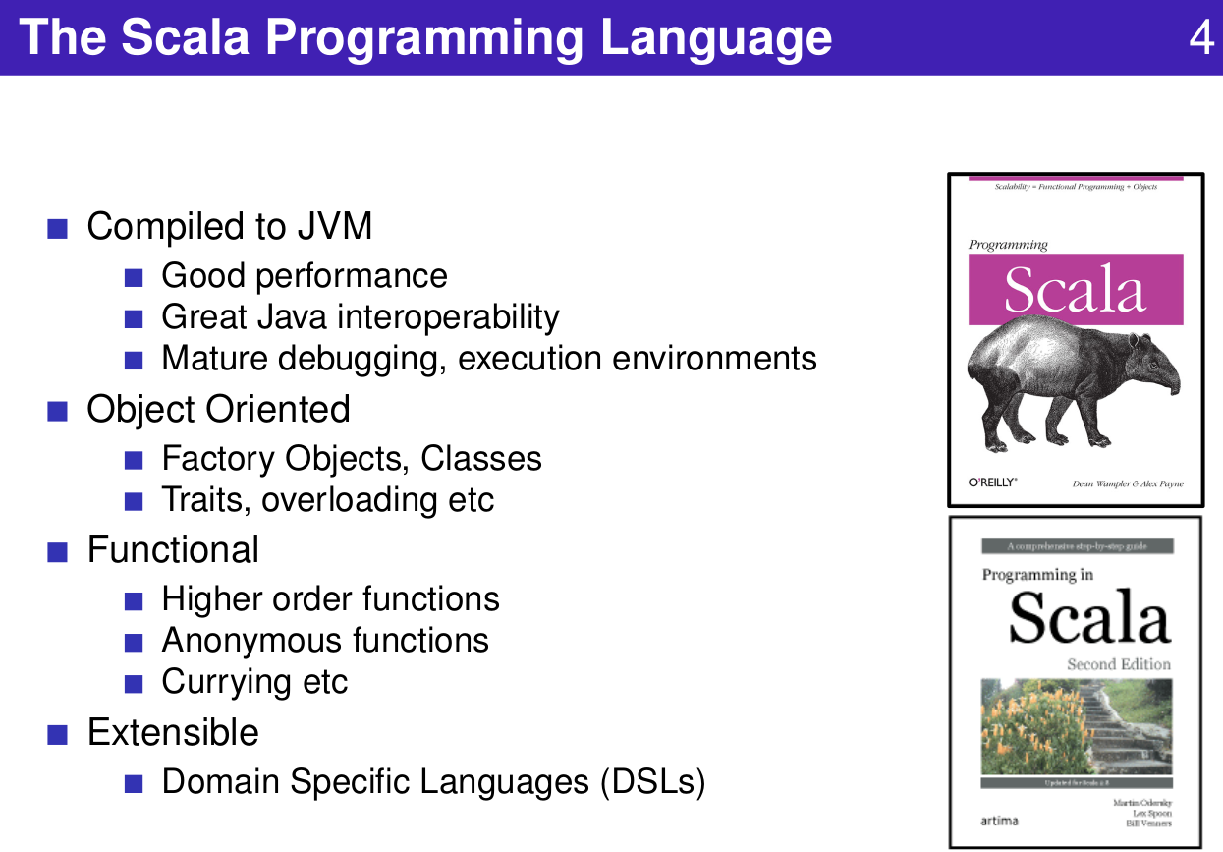
1.2 Scala Programming
https://www.youtube.com/watch?v=OPhFfNLcVsI&list=PLlu0CT-JnSasfpk8tq1ZDiE2G0AK1BhOg&index=2
Scala Programming (7:59-8:49/1:05:46)

Slide 9
End

