Slide 1

1.11 Define Construct Function

Slide 2
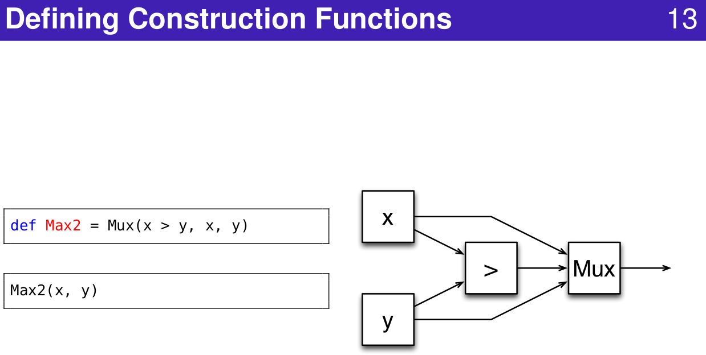
1.11 Define Construct Function
https://www.youtube.com/watch?v=OPhFfNLcVsI&list=PLlu0CT-JnSasfpk8tq1ZDiE2G0AK1BhOg&index=2
Define Construct Function (20:44-21:03/1:05:46)

Slide 3
End

