Slide 1

1.3 Scala Binding

Slide 2
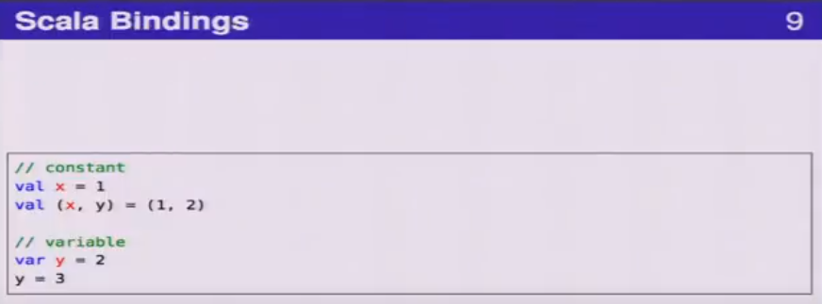
1.3 Scala Binding
https://www.youtube.com/watch?v=OPhFfNLcVsI&list=PLlu0CT-JnSasfpk8tq1ZDiE2G0AK1BhOg&index=2
Scala Binding (8:50-12:10/1:05:46)

Slide 3
1.4 Scala Function

Slide 4
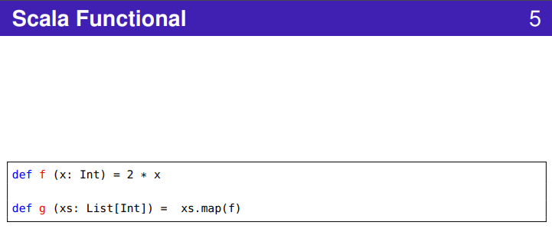
1.4 Scala Function
https://www.youtube.com/watch?v=OPhFfNLcVsI&list=PLlu0CT-JnSasfpk8tq1ZDiE2G0AK1BhOg&index=2
Scala Function (12:11-14:14/1:05:46)

Slide 5
1.5 Scala Object Oriented

Slide 6
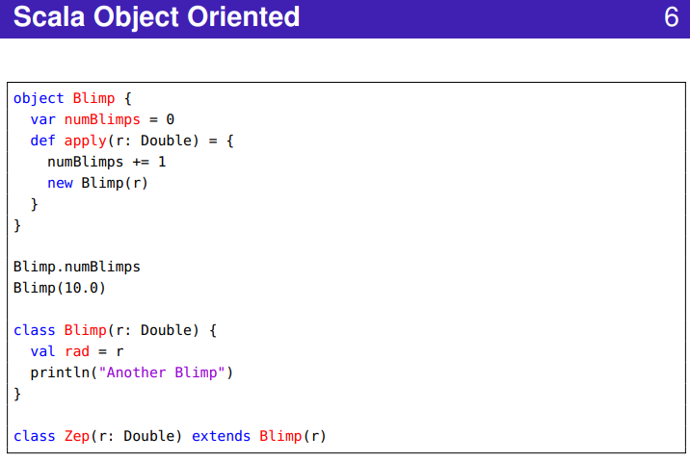
1.5 Scala Object Oriented
https://www.youtube.com/watch?v=OPhFfNLcVsI&list=PLlu0CT-JnSasfpk8tq1ZDiE2G0AK1BhOg&index=2
Scala Object Oriented (14:15-15:50/1:05:46)

Slide 7
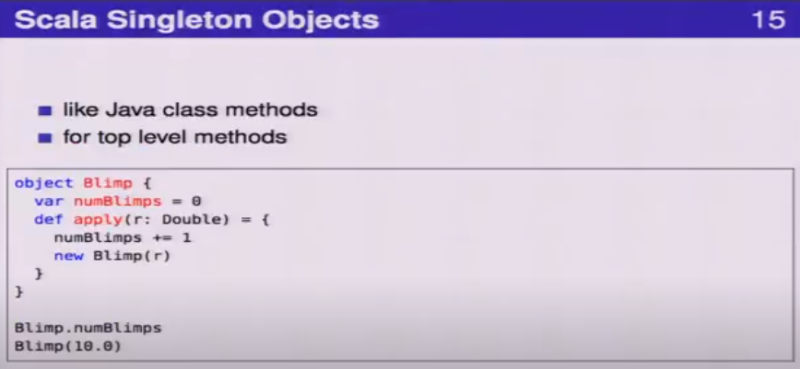
1.5 Scala Object Oriented
https://www.youtube.com/watch?v=OPhFfNLcVsI&list=PLlu0CT-JnSasfpk8tq1ZDiE2G0AK1BhOg&index=2
Scala Singleton Object (14:15-15:50/1:05:46)

Slide 8
1.6 Scala Collection

Slide 9
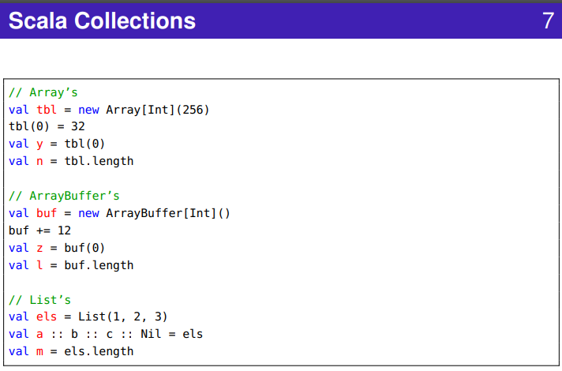
1.6 Scala Collection
https://www.youtube.com/watch?v=OPhFfNLcVsI&list=PLlu0CT-JnSasfpk8tq1ZDiE2G0AK1BhOg&index=2
Scala Collection (9:30-12:10/1:05:46)

Slide 10
1.7 Scala Iteration

Slide 11
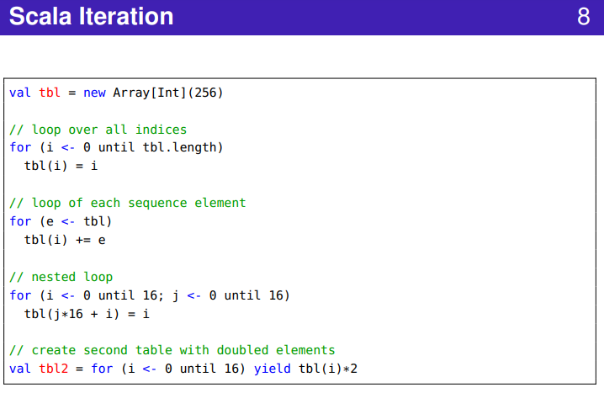
1.7 Scala Iteration
https://www.youtube.com/watch?v=OPhFfNLcVsI&list=PLlu0CT-JnSasfpk8tq1ZDiE2G0AK1BhOg&index=2
Scala Iteration (13:50-14:14/1:05:46)

Slide 12
1.8 Scala Console

Slide 13
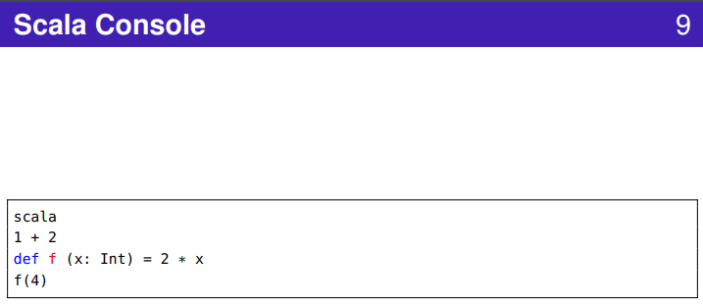
1.8 Scala Console
https://www.youtube.com/watch?v=OPhFfNLcVsI&list=PLlu0CT-JnSasfpk8tq1ZDiE2G0AK1BhOg&index=2
Scala Console (13:50-14:14/1:05:46)

Slide 14
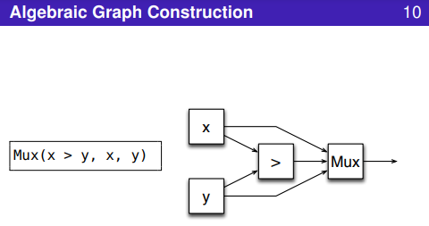
1.8 Scala Console
https://www.youtube.com/watch?v=OPhFfNLcVsI&list=PLlu0CT-JnSasfpk8tq1ZDiE2G0AK1BhOg&index=2
Scala Console (13:50-14:14/1:05:46)

Slide 15
1.9 Creating Component

Slide 16
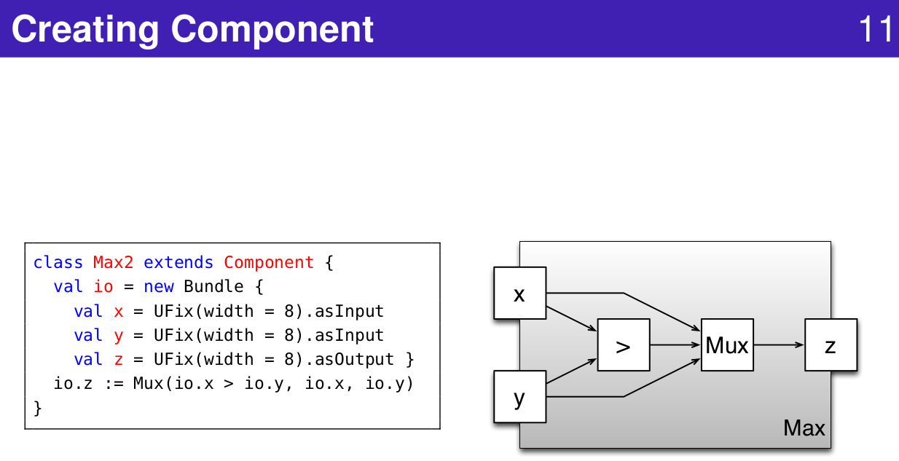
1.9 Creating Component
https://www.youtube.com/watch?v=OPhFfNLcVsI&list=PLlu0CT-JnSasfpk8tq1ZDiE2G0AK1BhOg&index=2
Creating Component (18:09-18:43/1:05:46)

Slide 17
1.10 Connect Component

Slide 18
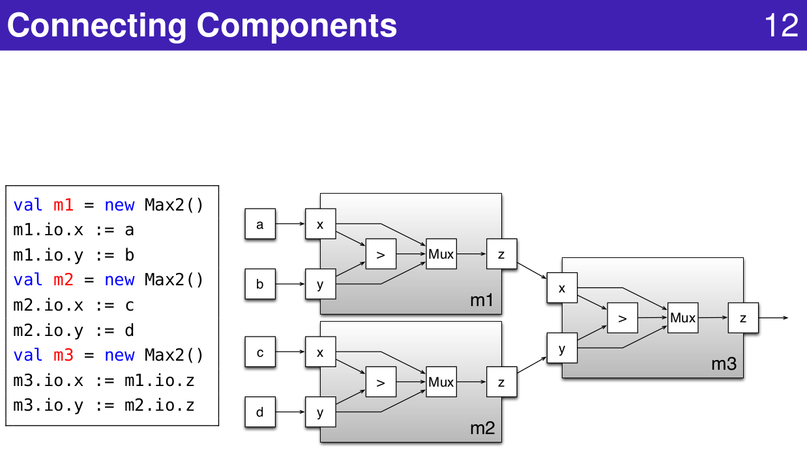
1.10 Connect Component
https://www.youtube.com/watch?v=OPhFfNLcVsI&list=PLlu0CT-JnSasfpk8tq1ZDiE2G0AK1BhOg&index=2
Connect Component (18:44-20:43/1:05:46)

Slide 19
End

