Slide 1

1.11 Define Construct Function

Slide 2
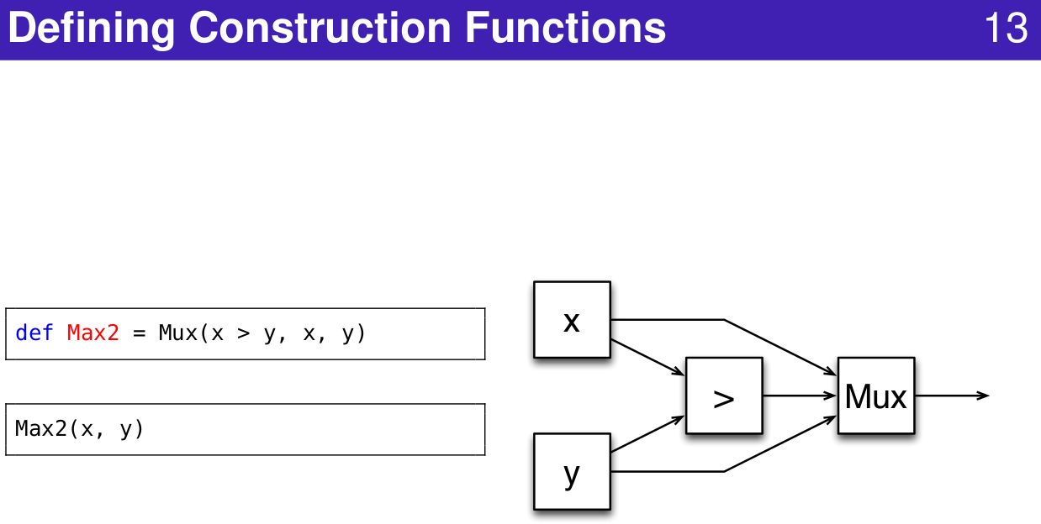
1.11 Define Construct Function
https://www.youtube.com/watch?v=OPhFfNLcVsI&list=PLlu0CT-JnSasfpk8tq1ZDiE2G0AK1BhOg&index=2
Define Construct Function (20:44-21:03/1:05:46)

Slide 3
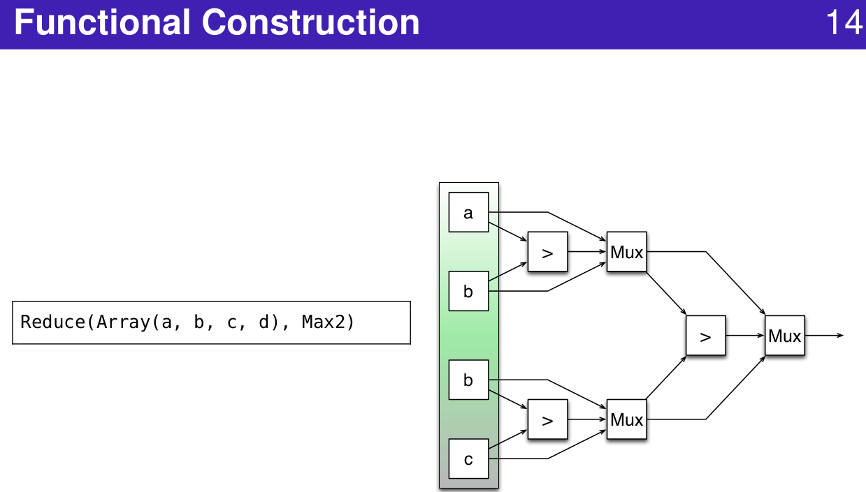
1.11 Define Construct Function
https://www.youtube.com/watch?v=OPhFfNLcVsI&list=PLlu0CT-JnSasfpk8tq1ZDiE2G0AK1BhOg&index=2
Function Construction (20:44-21:03/1:05:46)

Slide 4
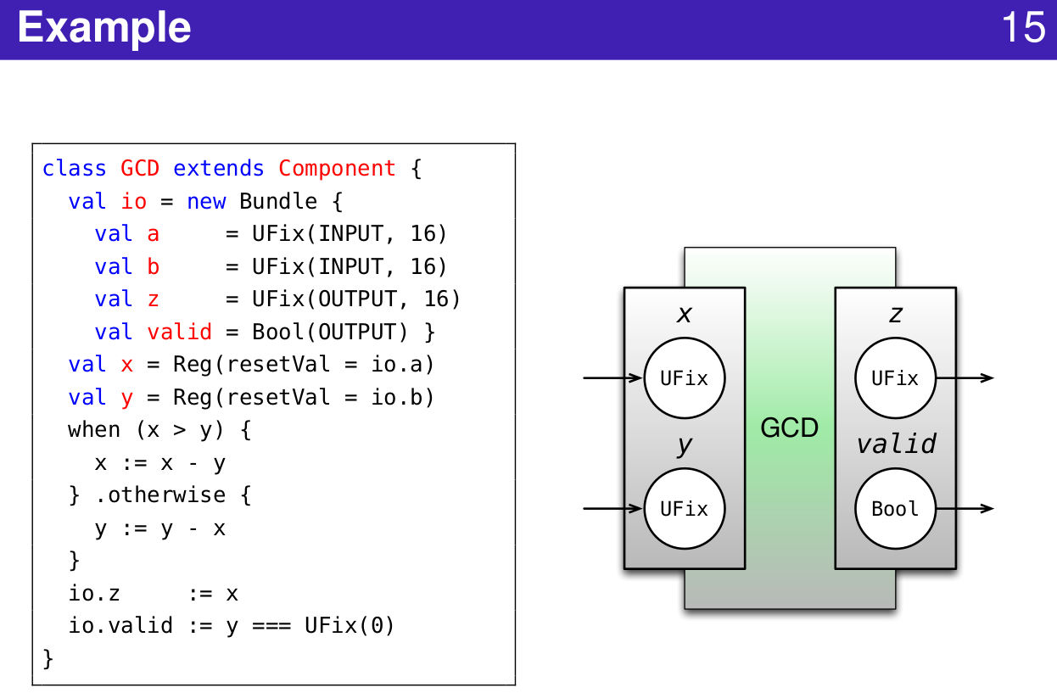
1.11 Define Construct Function
https://www.youtube.com/watch?v=OPhFfNLcVsI&list=PLlu0CT-JnSasfpk8tq1ZDiE2G0AK1BhOg&index=2
Example: Greatest Common Divisor (20:44-21:03/1:05:46)

Slide 5
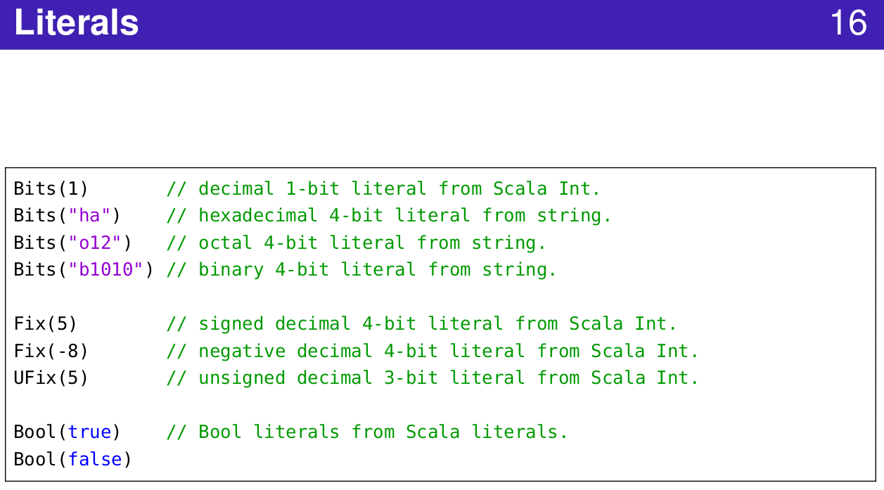
1.11 Define Construct Function
https://www.youtube.com/watch?v=OPhFfNLcVsI&list=PLlu0CT-JnSasfpk8tq1ZDiE2G0AK1BhOg&index=2
Literals (20:44-21:03/1:05:46)

Slide 6
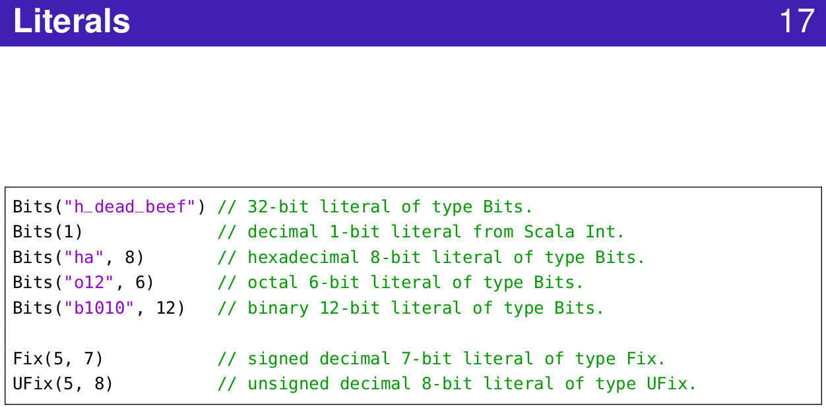
1.11 Define Construct Function
https://www.youtube.com/watch?v=OPhFfNLcVsI&list=PLlu0CT-JnSasfpk8tq1ZDiE2G0AK1BhOg&index=2
Literals (20:44-21:03/1:05:46)

Slide 7
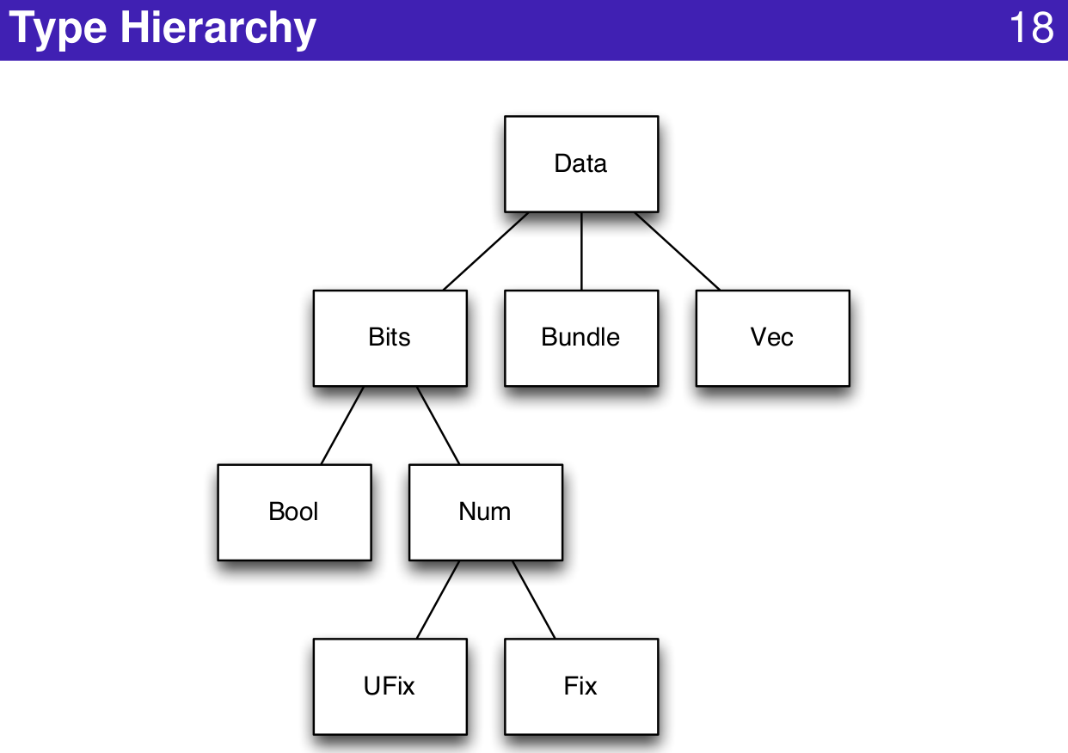
1.11 Define Construct Function
https://www.youtube.com/watch?v=OPhFfNLcVsI&list=PLlu0CT-JnSasfpk8tq1ZDiE2G0AK1BhOg&index=2
Type Hierarchy (20:44-21:03/1:05:46)

Slide 8
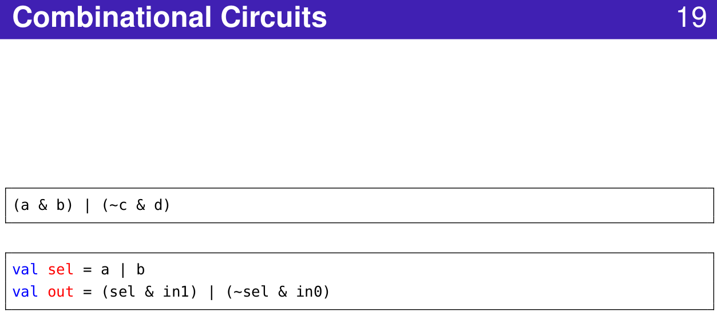
1.11 Define Construct Function
https://www.youtube.com/watch?v=OPhFfNLcVsI&list=PLlu0CT-JnSasfpk8tq1ZDiE2G0AK1BhOg&index=2
Combinational Circuit (20:44-21:03/1:05:46)

Slide 9
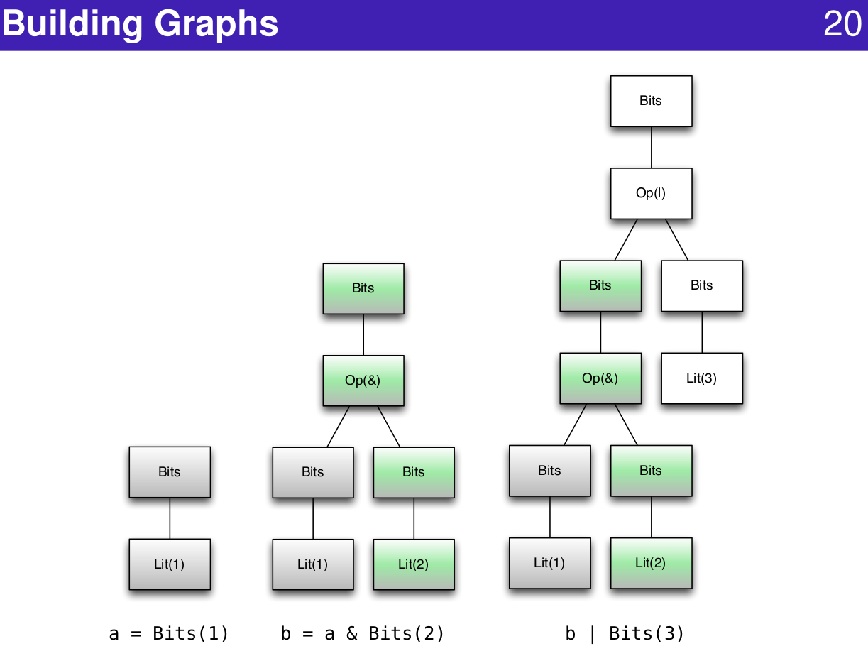
1.11 Define Construct Function
https://www.youtube.com/watch?v=OPhFfNLcVsI&list=PLlu0CT-JnSasfpk8tq1ZDiE2G0AK1BhOg&index=2
Building Graph (20:44-21:03/1:05:46)

Slide 10
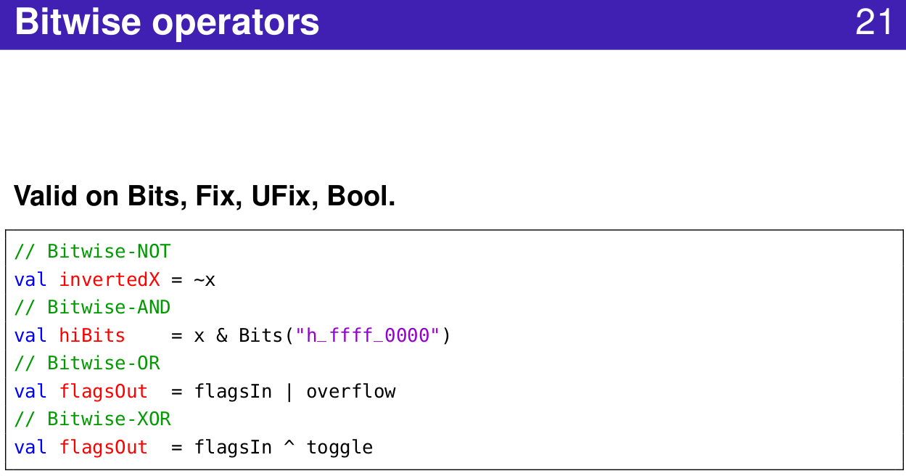
1.11 Define Construct Function
https://www.youtube.com/watch?v=OPhFfNLcVsI&list=PLlu0CT-JnSasfpk8tq1ZDiE2G0AK1BhOg&index=2
Bitwise Operator (20:44-21:03/1:05:46)

Slide 11
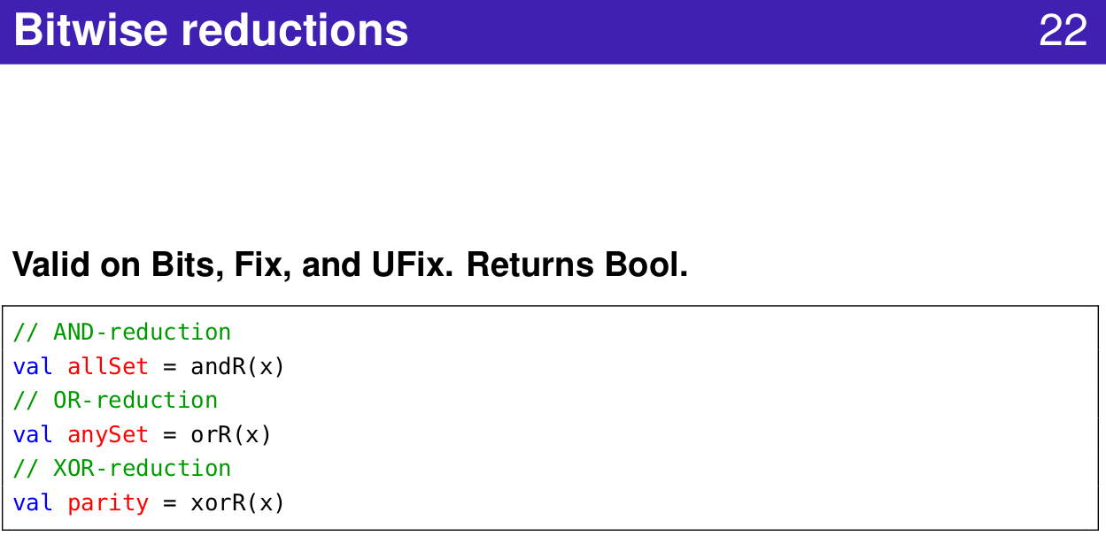
1.11 Define Construct Function
https://www.youtube.com/watch?v=OPhFfNLcVsI&list=PLlu0CT-JnSasfpk8tq1ZDiE2G0AK1BhOg&index=2
Bitwise Reduction (20:44-21:03/1:05:46)

Slide 12
End

