Slide 1

5 Counter
Peter H. Chen

Slide 2
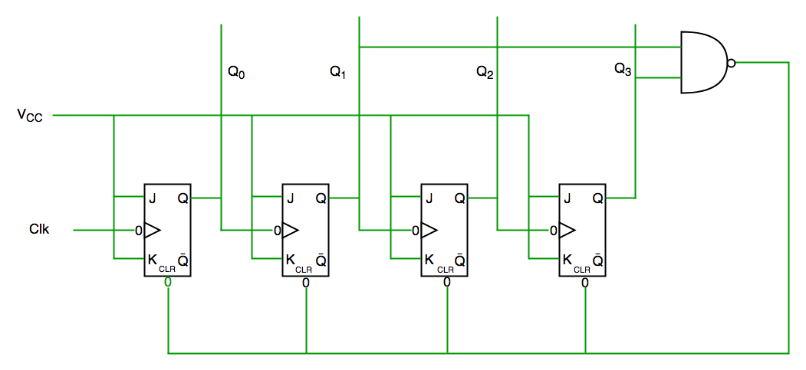
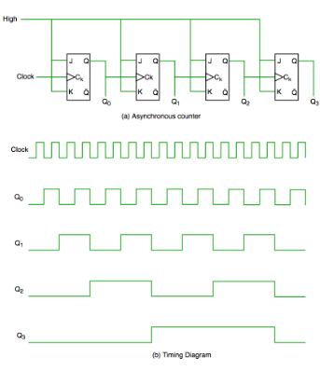
5 Counter
https://github.com/ucb-bar/chisel-tutorial?tab=readme-ov-file
Counter
Digital Counter Schematic and Timing Diagram.

Slide 3
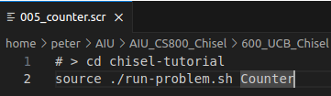
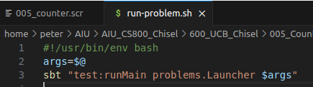
5 Counter
https://github.com/ucb-bar/chisel-tutorial?tab=readme-ov-file
Counter
1. > source ./run-problem.sh Counter
2. run-problem.sh
> args = $@
> sbt “test:runMain problems.Launcher $args
1
2

Slide 4
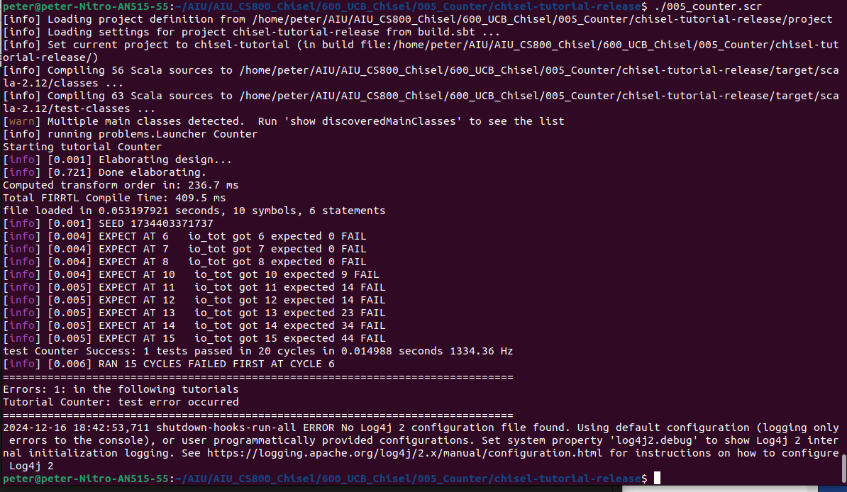
5 Counter
https://github.com/ucb-bar/chisel-tutorial?tab=readme-ov-file
Counter
Test Counter
Will check the FAIL results later on.

Slide 5
End

