Slide 1

24 XLS: GPU Synthesis
Peter H. Chen

Slide 2
24 XLS: GPU Synthesis
https://www.youtube.com/watch?v=TOJ8QWuEec8&list=PLfrN7RIcMe6g2LBRJLTHTdhyj5s8ag0Rg&index=24
XLS: GPU Synthesis (0:00-0:54/1:02:41)
We discuss the OpenTimer based on ”Taskflow: A General-purpose Task-parallel Programming System”, by Dr. Tsung-Wei Huang.
1. Taskflow is used for Parallel Programming.
2. OpenTimer used for STA (Static Timing Analysis).
References:
1. https://taskflow.github.io/
2. https://tsung-wei-huang.github.io/papers/2022-tcad-taskflow.pdf
3. https://tsung-wei-huang.github.io/
4. https://github.com/OpenTimer/OpenTimer
5. https://tsung-wei-huang.github.io/papers/tcad21-ot2.pdf (C.-H. Chiu, T.-W. Huang, et al, “OpenTimer V2: A New Parallel Incremental Timing Analysis Engine,” IEEE TCAD, vol 40, no. 4. pp. 776-789, April 2021.)

Slide 3
24.1 Main Point

Slide 4
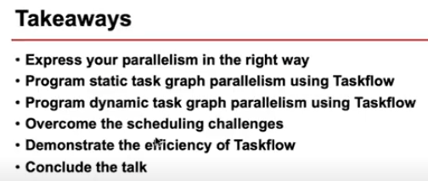
24.1 Main Point
https://www.youtube.com/watch?v=TOJ8QWuEec8&list=PLfrN7RIcMe6g2LBRJLTHTdhyj5s8ag0Rg&index=24
Main Point (0:55-1:40/1:02:41)
Topics:
1. Run Taskflow for Parallel task in easy way
2. STG (Static Task Graph)
3. DTG (Dynamic Task Graph): DTG (Dynamic Task Graph) can cut the run time of STG (Static Task Graph).
4. Task Scheduling: Break down the circuit design into million of task and millions of path dependencies.
5. Taskflow efficiency: Compare Taskflow vs. OpenMP with OpenTimer for STA (Static Timing Analysis)
6. Conclusion

Slide 5
End

