Slide 1

5 Bit Width Inference
Peter H. Chen

Slide 2
5 Bit Width Inference
https://github.com/ucb-bar/chisel-tutorial/wiki/The-Basics
Bit Width Inference
If you don't explicitly specify the width of a value in Chisel, the Chisel compiler will infer the bit width for you based on the inputs that define the value.
Note:
In the FullAdder definition, the widths for a_xor_b, a_and_b, b_and_cin, and a_and_cin are never specified anywhere.
However, based on how the input is computed, Chisel will correctly infer each of these values are one bit wide since each of their inputs are the results of bitwise operations applied to one bit operands.

Slide 3
5.1 Chisel Code

Slide 4
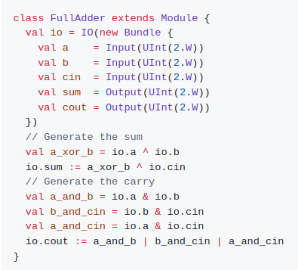
5.1 Chisel Code
https://github.com/ucb-bar/chisel-tutorial/wiki/The-Basics
Chisel Code
Left hand side code is two bits Full Adder. Right hand side is one bit FullAdder.
We can change 1.W into 2.W and run the same simulation.

Slide 5
5.2 Generated Verilog Code

Slide 6
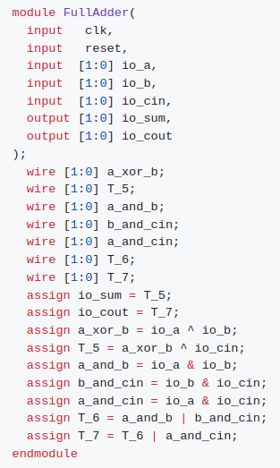
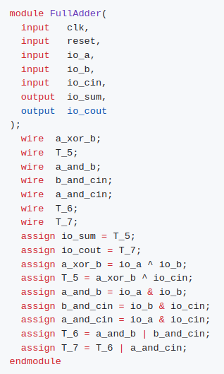
5.2 Generated Verilog Code
https://github.com/ucb-bar/chisel-tutorial/wiki/The-Basics
Generate Verilog Code
1. Left hand side code: Quick propose Verilog Code.
2. Right hand side: The improved Chisel Verilog Generated Code with vector format. infer each of the intermediate values a_xor_b, a_and_b, b_and_cin, and a_and_cin are two bits wide. An inspection of the Verilog code correctly shows that Chisel inferred each of the intermediate wires in the calculation to be 2 bits wide.
2
1

Slide 7
End

