Slide 1

2 Basics
Peter H. Chen

Slide 2
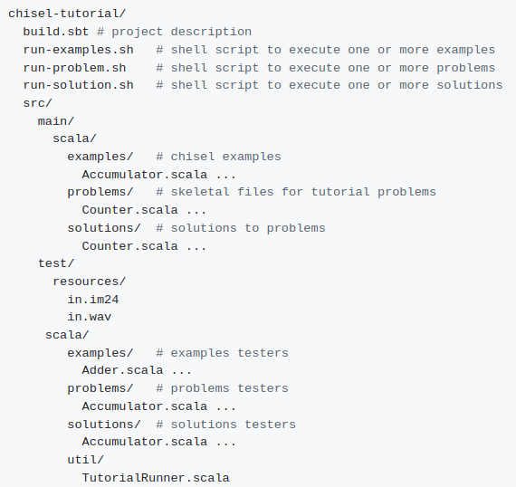
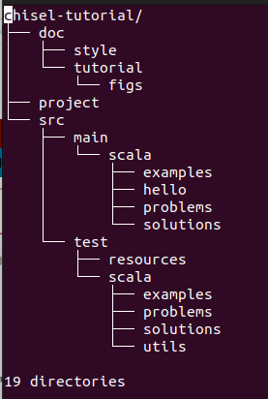
2 Basics
https://github.com/ucb-bar/chisel-tutorial/wiki/The-Basics
Basics
Below is the files/directory structure of Chisel (Constructing Hardware in Scala Language).
> sudo apt-get install tree
> tree -d chisel-tutorial > chisel_dir.log
> vim chisel_dir.log

Slide 3
2 Basics
https://github.com/ucb-bar/chisel-tutorial/wiki/The-Basics
Basics
There are:
1. Three scripts: run-problem.sh, run-solution.sh, and run-examples.sh
2. Two directories main and directory test.
3. Chisel source files are problems, and solutions directories.
4. The problems contains the UC Berkeley class assignment to be implemented.
5. The solutions contains the solution of the problems.
6. The examples are more complicate examples.
2.4. build.sbt file contains the build configuration information used to specify what version of Chisel to make your project.

Slide 4
2.1 GCD Example
Peter H. Chen

Slide 5
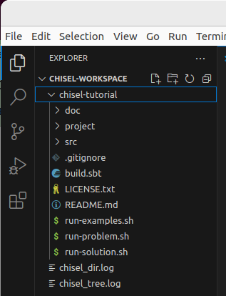
2.1 GCD Example
https://github.com/ucb-bar/chisel-tutorial/wiki/The-Basics
GCD Example
We will go through the GCD Example in Chisel.
1. chisel-tutorial > code
2. We are at chisel-tutorial directory.
1
2

Slide 6
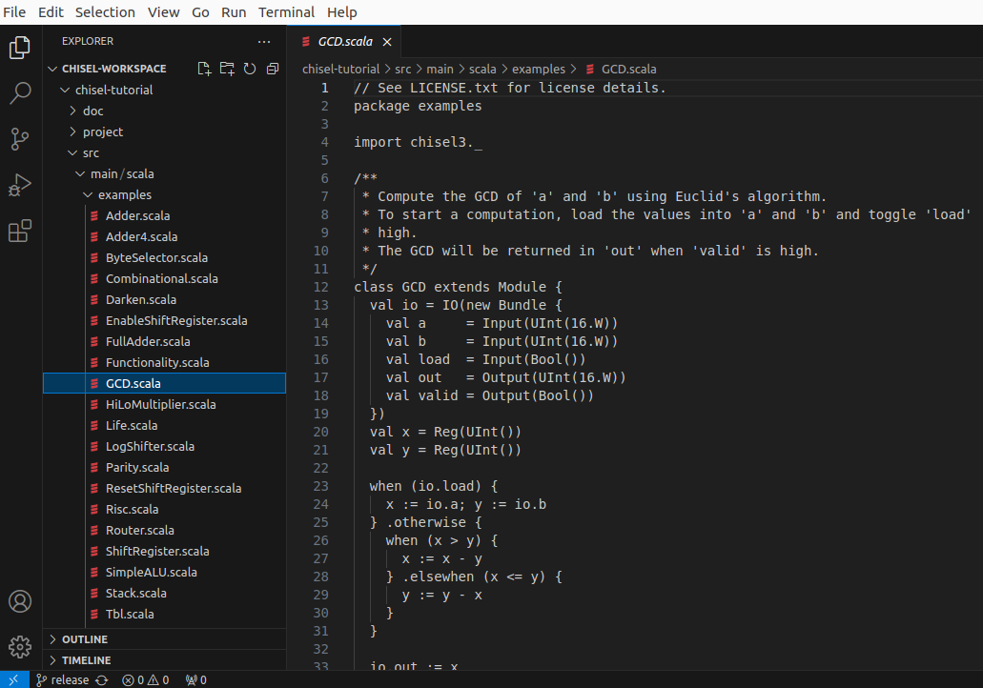
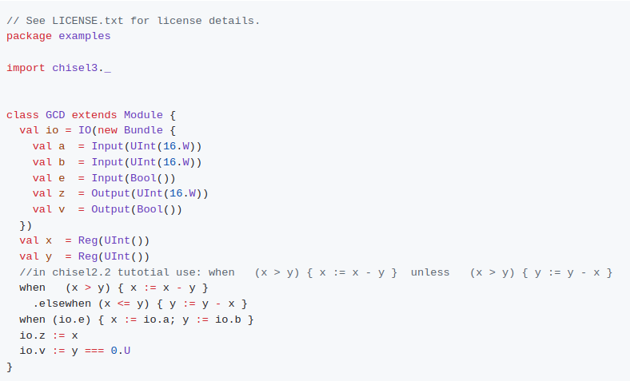
2.1 GCD Example
https://github.com/ucb-bar/chisel-tutorial/wiki/The-Basics
GCD Example
Below, we open GCD.scala in src/main/scala/examples.
Here is the code of GCD (Greatest Common Divisor) which return the greatest common divisor of input a and b.

Slide 7
2.1.1 Import Chisel Library

Slide 8
2.1.1 Import Chisel Library
https://github.com/ucb-bar/chisel-tutorial/wiki/The-Basics
Import Chisel Library
1. First we need to import the chisel library
> import chisel3._:
2. After we import Chisel library, we can define the Scala class and inherit the Module.
3. We can write the code similar to Verilog Module.
1
2
3

Slide 9
2.1.2 io Object and IO Class

Slide 10
2.1.2 io Object and IO Class
https://github.com/ucb-bar/chisel-tutorial/wiki/The-Basics
Io Object and IO Class
1. In the Scala Class, we creates the io object with IO Class:
> val io = IO(new Bundle{…})
1

Slide 11
2.1.3 Bundle () Macro

Slide 12
2.1.3 Bundle () Macro
https://github.com/ucb-bar/chisel-tutorial/wiki/The-Basics
Bundle () Macro
1. The Bundle() is a Macro/Function,
2. Below, we new Bundle (…). The Bundle (...) takes several arguments as part of its construction.
3. We define each parameter with a specified type (UInt, Bool, etc.), a bit width, and wrapped into a direction (either Input or Output). If a bit width is not specified, Chisel will infer the appropriate bit width for you (in this case default to 1). The io Bundle is essentially a constructor for the component interface.
1
2
3

Slide 13
2.1.4 Compute GCD

Slide 14

2.1.4 Compute GCD
https://github.com/ucb-bar/chisel-tutorial/wiki/The-Basics
Compute GCD
1. Computer the actual GCD computation for the module. The register declarations for x and y tell Chisel to treat x and y as registers of type UInt().
1

Slide 15
2.1.2.2 when/.elsewhen Statement

Slide 16
2.1.2.2 when/.elsewhen Statement
https://github.com/ucb-bar/chisel-tutorial/wiki/The-Basics
When /.elsewhen Statement
1. The when is a Spark statement. The when is a infinity loop when the condition is true. In hardware this is basically a multiplexer selecting the values in the when block when the condition is true.
2. .elsewhen: is the exit condition for when.
1
2

Slide 17
2.1.6 when vs. Verilog posedge

Slide 18
2.1.6 when vs. Verilog posedge
https://github.com/ucb-bar/chisel-tutorial/wiki/The-Basics
when vs. Verilog Posedge
1.when (io.0): The register on the left hand side of the expression, the assignment is executed on a positive clock edge if the condition is true. This is similar to how Verilog uses always @ (posedge clk) to specify synchronous logic.
1

Slide 19
2.1.7 Output Assignment

Slide 20
2.1.7 Output Assignment
https://github.com/ucb-bar/chisel-tutorial/wiki/The-Basics
when vs. Verilog Posedge
1. The output assignments for the computation for io.z and io.v.
One particular thing to notice is that, we do not have to specify the width of x and y in this example. This is because Chisel does the bit width inference for you and sets these values to their appropriate widths based on the computations they are executing.
1

Slide 21
2.1.2.5 Run GCD

Slide 22
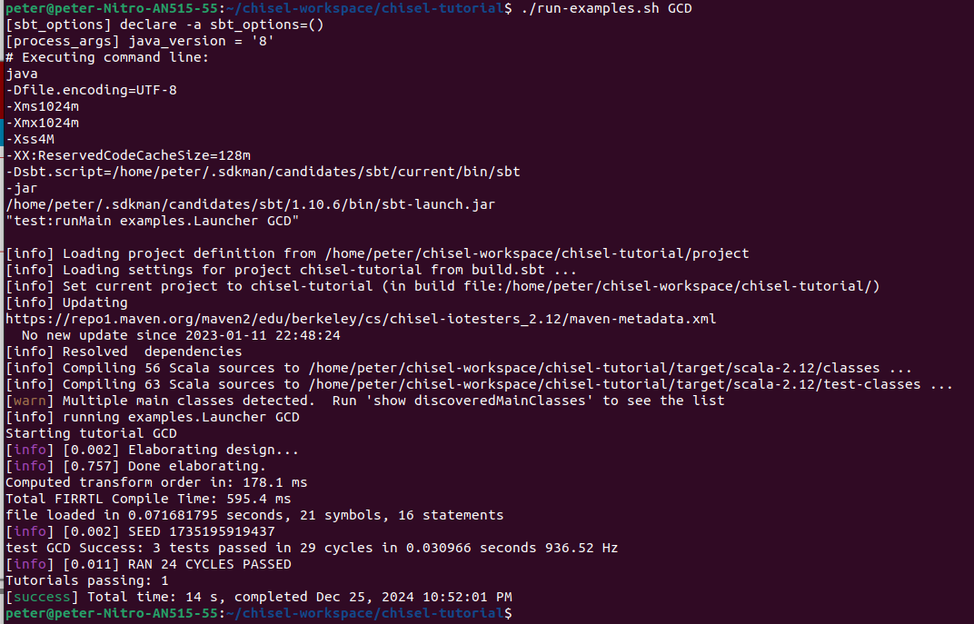
2.1.2.5 Run GCD
https://github.com/ucb-bar/chisel-tutorial/wiki/The-Basics
Run GCD
1. > run-examples GCD
This will generate the firrtl description of the circuit for the component defined in src/main/scala/examples/GCD.scala and use the firrtl interpreter to simulate it using the test harness defined in src/test/scala/examples/GCDTests.scala.
If the simulation succeeds, you should see some debug output followed by:

Slide 23
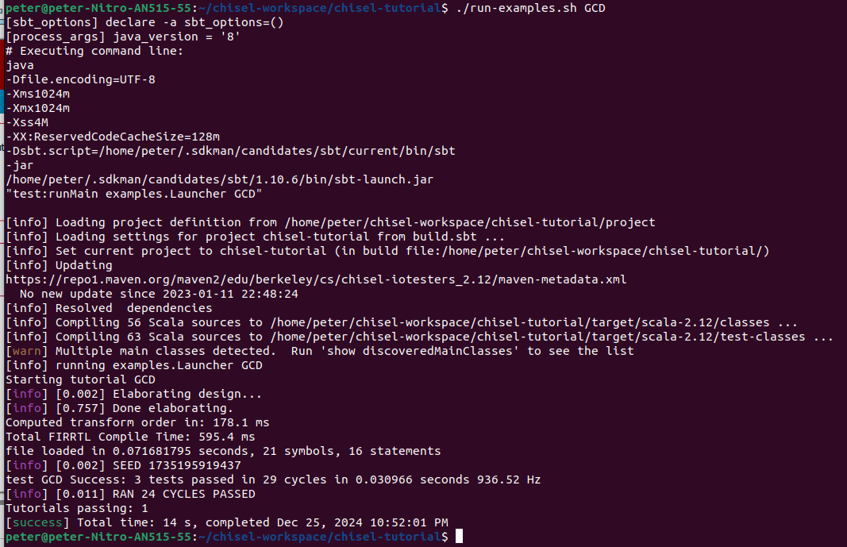

2.1.2.5 Run GCD
https://github.com/ucb-bar/chisel-tutorial/wiki/The-Basics
Run GCD
If the simulation succeeds, you should see some debug output followed by:

Slide 24
2.1.9 GCD fir File

Slide 25
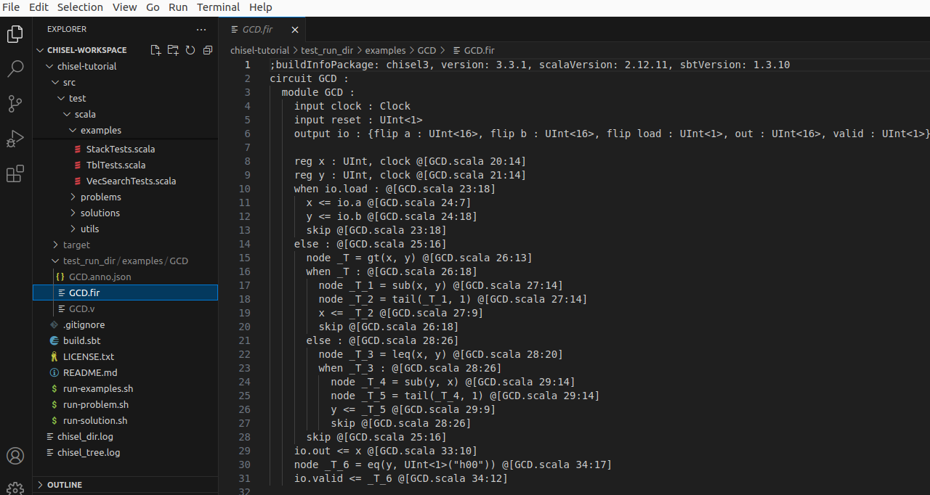
2.1.9 GCD fir File
https://github.com/ucb-bar/chisel-tutorial/wiki/The-Basics
GCD fir File
1. In addition to the debug output, the build also creates a
> test_run_dir/examples/GCD/GCD.fir file.
2. This fir file contains the firrtl definition of the GCD circuit and its tester. We will talk about this more later.
2
1

Slide 26
2.1.10 Generate Verilog

Slide 27
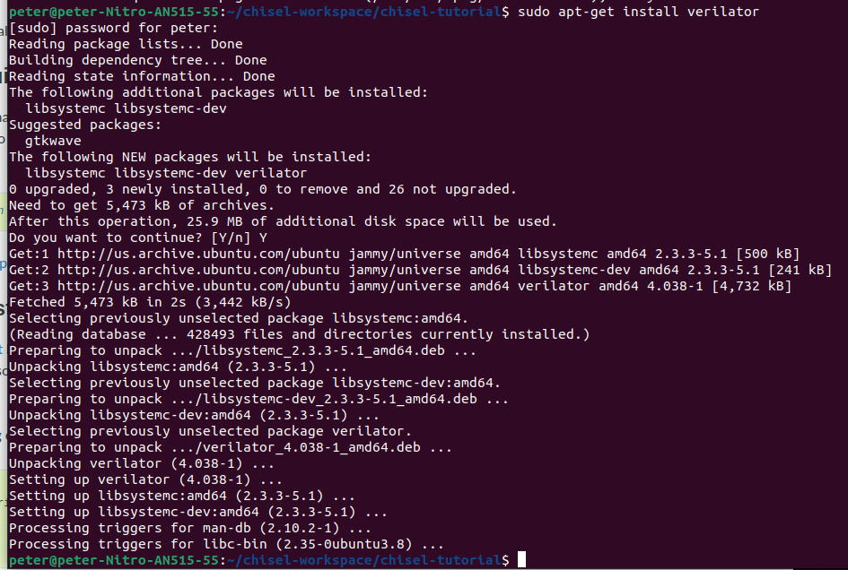
2.1.10 Generate Verilog
https://github.com/ucb-bar/chisel-tutorial/wiki/The-Basics
Generate Verilog
We need to install the Verilator to generate the Verilog.
> sudo apt-get install verilator
https://verilator.org/guide/latest/install.html

Slide 28
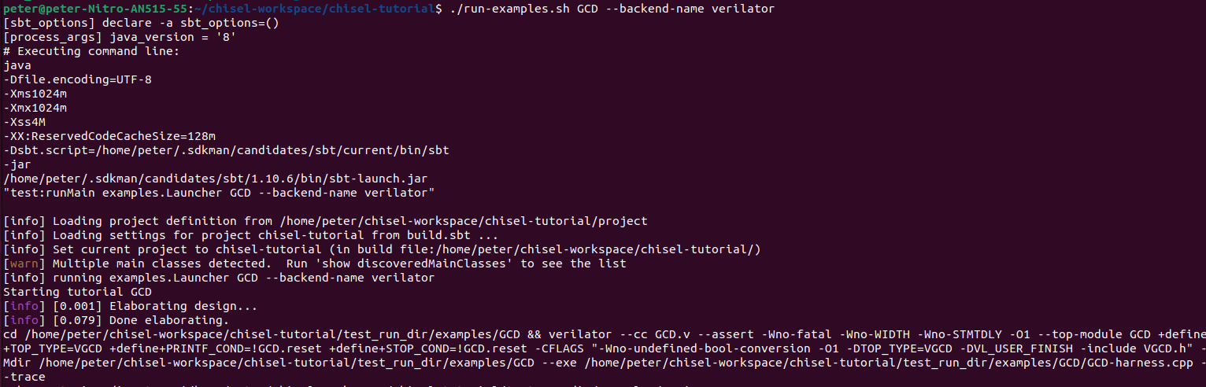
2.1.10 Generate Verilog
https://github.com/ucb-bar/chisel-tutorial/wiki/The-Basics
Generate Verilog
After we finished the simulation, we can generate FPGA and ASIC Verilog from the Scala sources.
1. The Verilog are used to construct a circuit. To do this, we use an environment variable to specify a different tester backend:
> ./run-examples.sh GCD --backend-name verilator
2. This will instruct the tester driver to generate Verilog output and use Verilator to generate a C++ simulation from the generated Verilog for the specified Chisel component. When the Verilog generation finishes, you should see a [success] message similar to the one you saw after running the firrtl-interpreter backend.
1
2

Slide 29
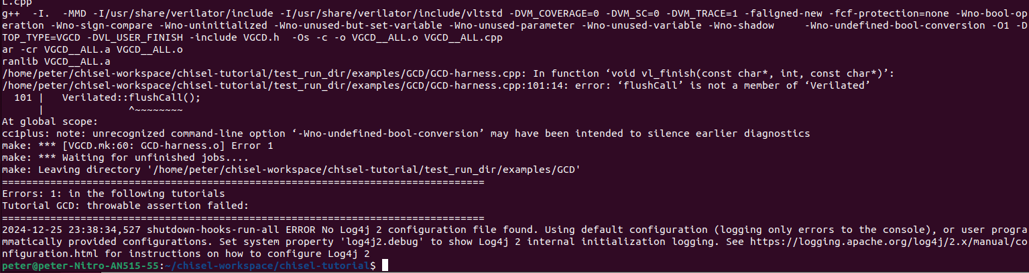
2.1.10 Generate Verilog
https://github.com/ucb-bar/chisel-tutorial/wiki/The-Basics
Generate Verilog
Note:
1. There is error message when generating the VCD (Value Change Dump).
1

Slide 30
2.1.11 Verify Verilog

Slide 31
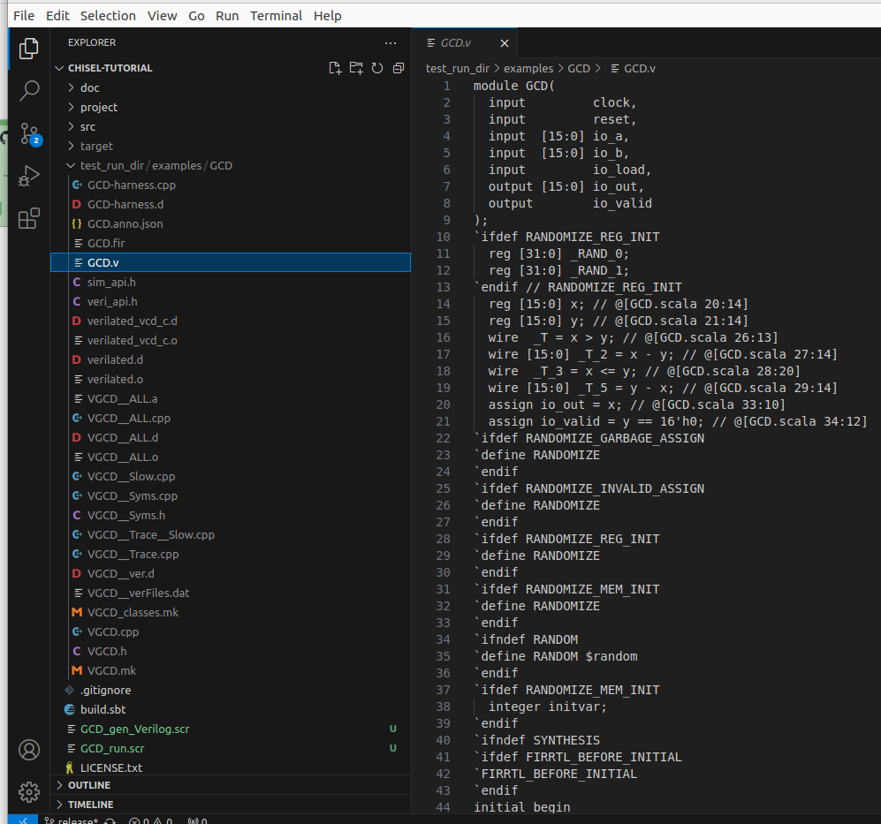
2.1.11 Verify Verilog
https://github.com/ucb-bar/chisel-tutorial/wiki/The-Basics
Verify Verilog
If you look in the test_run_dir/examples/GCD/ directory, you will see quite a few additional files, notably:
1. GCD.v - Verilog representation of the Chisel circuit,
2. GCD.vcd - waveform dump of the circuit signals during the simulation.
The Verilog source is roughly divided into three parts:
Module declaration with input and outputs
Temporary wire and register declaration used for holding intermediate values
Register assignments in always @ (posedge clk)
You can use gtkwave to view the vcd dump.
1
2

Slide 32
2.1.12 gtkwave

Slide 33
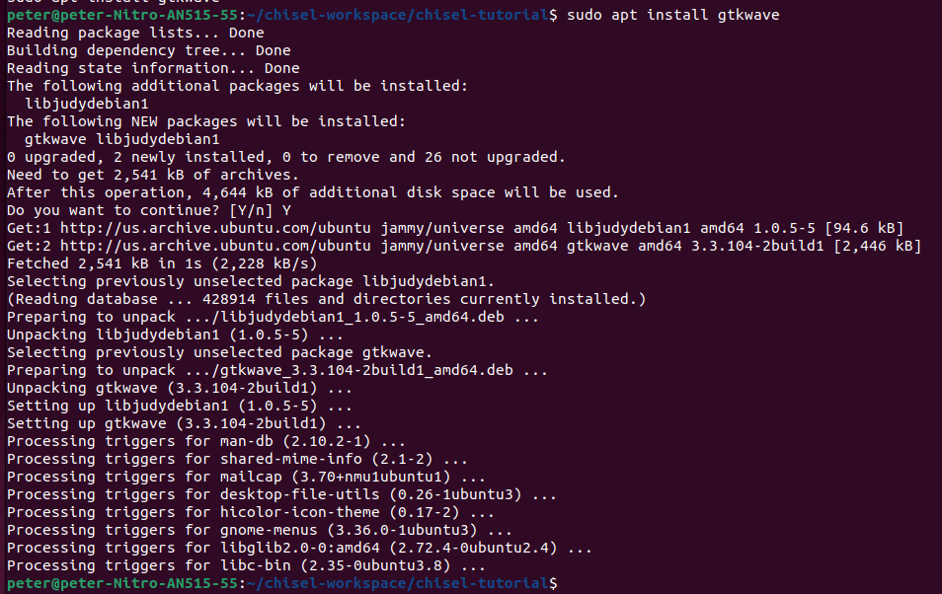
2.1.12 gtkwave
https://github.com/ucb-bar/chisel-tutorial/wiki/The-Basics
gtkwave
> sudo apt install gtkwave

Slide 34
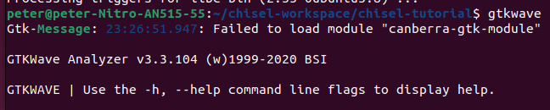
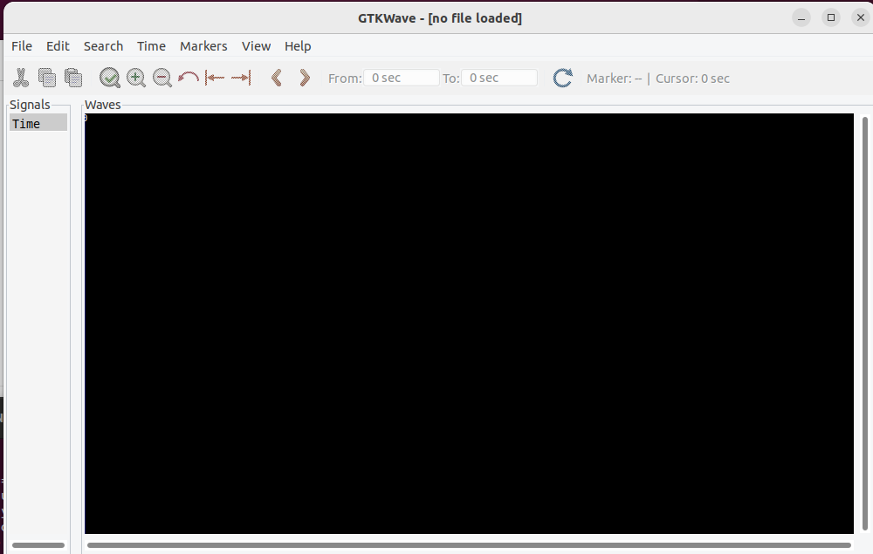
2.1.12 gtkwave
https://github.com/ucb-bar/chisel-tutorial/wiki/The-Basics
gtkwave
> gtkwave
You can use gtkwave to view the vcd dump.

Slide 35
2.1.12 gtkwave
https://github.com/ucb-bar/chisel-tutorial/wiki/The-Basics
Gtkwave
> gtkwave
Below is gtkwave GUI.

Slide 36
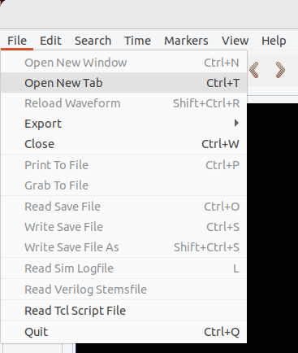
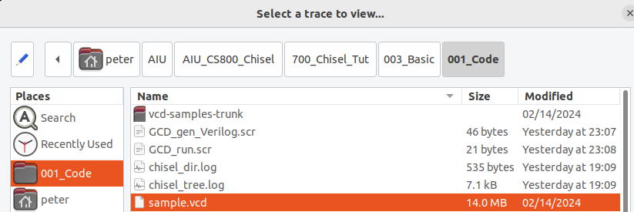
2.1.12 gtkwave
1
https://github.com/ucb-bar/chisel-tutorial/wiki/The-Basics
Gtkwave
Because the verilator has error in VCD dump, instead, we download the sample.vcd dumped from google search.
1. File > Open New Tab
2. Browse the 001_Code directory
3. Select sample.vcd to display.
2
3

Slide 37
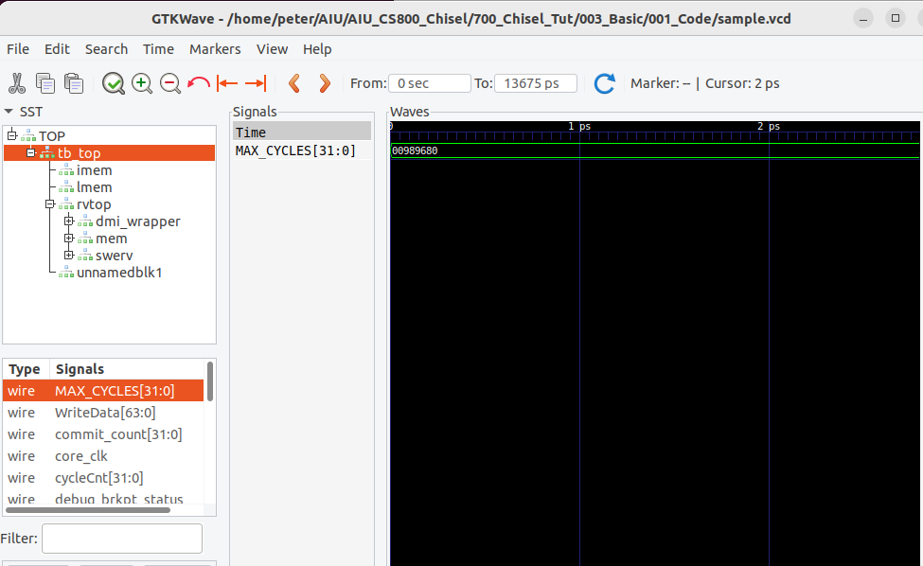
2.1.12 gtkwave
https://github.com/ucb-bar/chisel-tutorial/wiki/The-Basics
Gtkwave
1. Select wire MAX_CYCLES[31:0]
2. Drag and drop wire MAX_CYCLES[31:0] into the canvas to see the waveform.
2
1

Slide 38
2.2 Full Adder

Slide 39
2.2 Full Adder
https://github.com/ucb-bar/chisel-tutorial/wiki/The-Basics
Full Adder
Constructing Full Adder blocks in Chisel is easy.
When you declare a val in Scala, it creates a node that represents the data that it is assigned to.
As long as the value is not assigned to be a register type (explained later), this tells the Chisel compiler to treat the value as wire.
Therefore, any number of these values can be connected and manipulated to produce the value that we want.

Slide 40
2.2.1 Full Adder

Slide 41
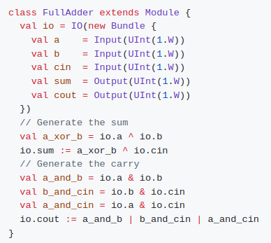
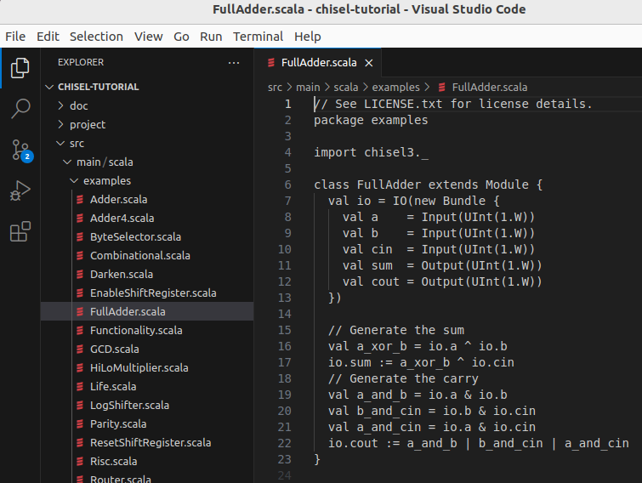
2.2.1 Full Adder
https://github.com/ucb-bar/chisel-tutorial/wiki/The-Basics
Full Adder
Suppose we want to construct a single full adder.
A full adder takes two inputs a and b, and a carry in cin and produces a sum and carry out cout.
The Chisel source code for our full adder will look something like:

Slide 42
2.2.1 Full Adder
https://github.com/ucb-bar/chisel-tutorial/wiki/The-Basics
Full Adder
Where:
cout is defined as a combinational function of inputs a, b, and cin.
Note:
In order to access the input values from the io bundle, you need to first reference io since the input and output values belong to the io bundle.
The |, &, and ^ operators correspond to bitwise OR, AND, and XOR operations respectively.

Slide 43
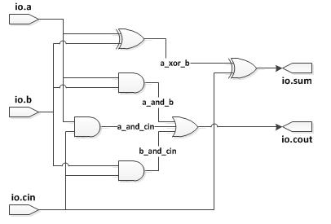
2.2.1 Full Adder
https://github.com/ucb-bar/chisel-tutorial/wiki/The-Basics
Full Adder
The corresponding wires for each of these values is shown below in Figure Full Adder Circuit. You will notice that each val corresponds to exactly one of the wires.

Slide 44
2.2.2 Full Adder Simulation

Slide 45
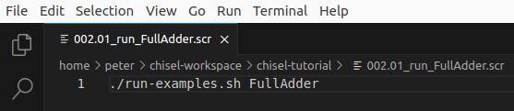
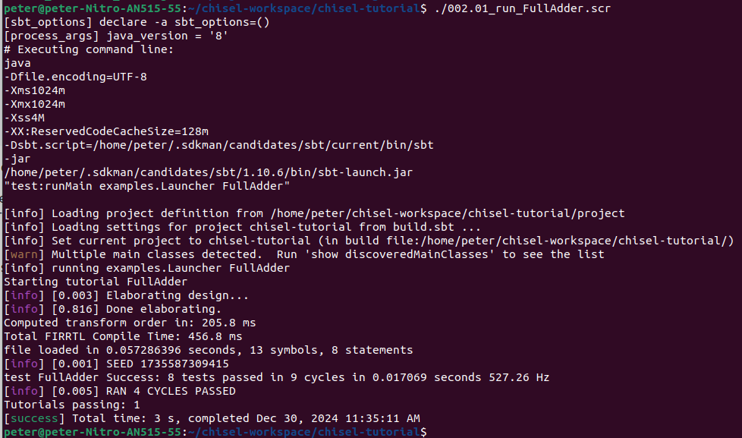
2.2.2 Full Adder Simulation
https://github.com/ucb-bar/chisel-tutorial/wiki/The-Basics
Full Adder Simulation
> ./run-exmaples.sh FullAdder
or
> ./002.01_run_FullAdder.scr

Slide 46
2.2.3 Generate Full Adder Verilog

Slide 47
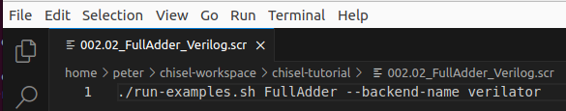
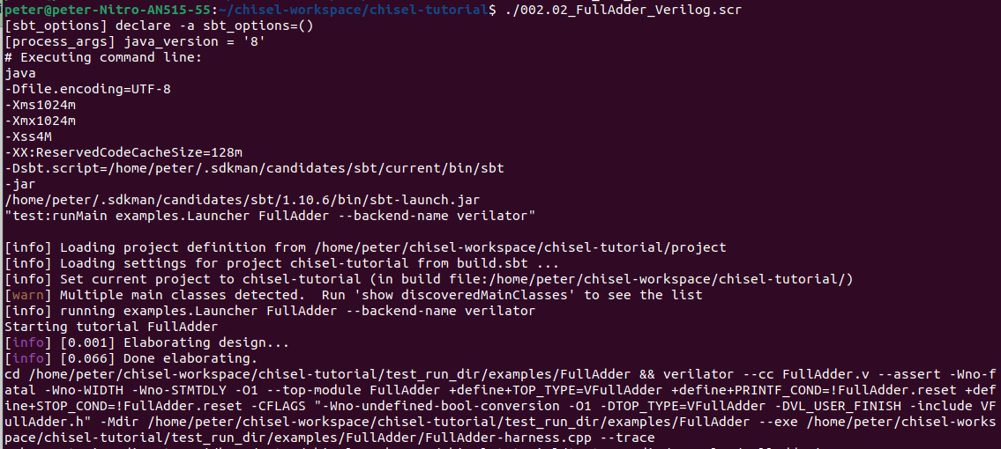
2.2.3 Generate Full Adder Verilog
https://github.com/ucb-bar/chisel-tutorial/wiki/The-Basics
Generate Full Adder Verilog
> ./run-exmaples.sh FullAdder --backend-name verilator
or
> ./002.03_FullAdder_Verilog.scr
Note:
There is error in verilator verification. Will check later on.

Slide 48
2.3 Bit Width Inference

Slide 49
2.3 Bit Width Inference
https://github.com/ucb-bar/chisel-tutorial/wiki/The-Basics
Bit Width Inference
If you don't explicitly specify the width of a value in Chisel, the Chisel compiler will infer the bit width for you based on the inputs that define the value.
Note:
In the FullAdder definition, the widths for a_xor_b, a_and_b, b_and_cin, and a_and_cin are never specified anywhere.
However, based on how the input is computed, Chisel will correctly infer each of these values are one bit wide since each of their inputs are the results of bitwise operations applied to one bit operands.

Slide 50
2.3.1 Chisel Code

Slide 51
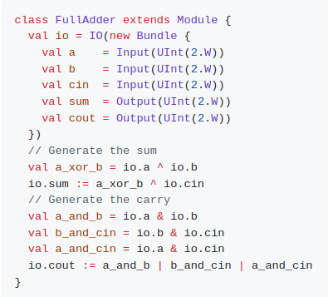
2.3.1 Chisel Code
https://github.com/ucb-bar/chisel-tutorial/wiki/The-Basics
Chisel Code
Left hand side code is two bits Full Adder. Right hand side is one bit FullAdder.
We can change 1.W into 2.W and run the same simulation.

Slide 52
2.3.2 Generated Verilog Code

Slide 53
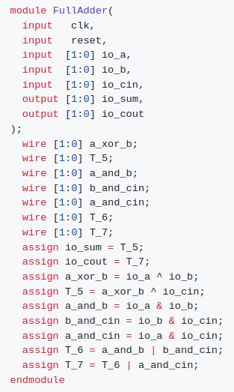
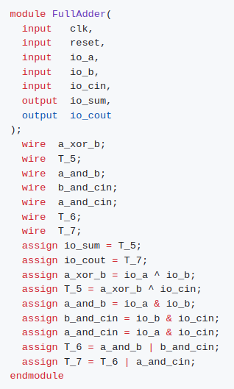
2.3.2 Generated Verilog Code
https://github.com/ucb-bar/chisel-tutorial/wiki/The-Basics
Generate Verilog Code
1. Left hand side code: Quick propose Verilog Code.
2. Right hand side: The improved Chisel Verilog Generated Code with vector format. infer each of the intermediate values a_xor_b, a_and_b, b_and_cin, and a_and_cin are two bits wide. An inspection of the Verilog code correctly shows that Chisel inferred each of the intermediate wires in the calculation to be 2 bits wide.
2
1

Slide 54
2.4 Register

Slide 55

2.4 Register
https://github.com/ucb-bar/chisel-tutorial/wiki/The-Basics
Register
1. Unlike Verilog, specifying a register in Chisel tells the compiler to actually generate a positive edge triggered register.
2. In this section, we explore how to instantiate registers in Chisel by constructing a shift register.
3. In Chisel, when you instantiate a register there are several ways to specify the connection of the input to a register.
4. As shown in the GCD example, you can "declare" the register and assign what it's input is connected to in a when... block or you can simply pass the value that the register is clocking as a parameter to the register.
5. If we choose to pass a next value to the register on construction using the next named parameter, or the specialized register constructor RegNext, it will clock the new value every cycle unconditionally:

Slide 56
2.4.1 when Block

Slide 57
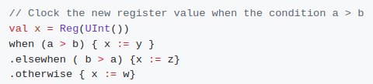
2.4.1 when Block
https://github.com/ucb-bar/chisel-tutorial/wiki/The-Basics
when Block
If we only want to update if certain conditions are met we use a when block to indicate that the registers are only updated when the condition is satisfied:
It is important to note that when using the conditional method, the values getting assigned to the input of the register match the type and bitwidth of the register you declared.
In the unconditional register assignment, we do not need to do this as Chisel will infer the type and width from the type and width of the input value.

Slide 58
2.4.2 Unconditional Register Update

Slide 59
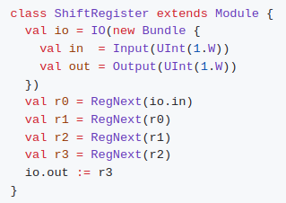
2.4.2 Unconditional Register Update
https://github.com/ucb-bar/chisel-tutorial/wiki/The-Basics
Unconditional Register Update
1. Suppose we want to construct a basic 4 bit shift register that takes a serial input in and generates a serial output out.
2. For this first example we won't worry about a parallel load signal and will assume the shift register is always enabled. We also will forget about the register reset signal.
If we instantiate and connect each of these 4 registers explicitly, our Chisel code will look something like:

Slide 60
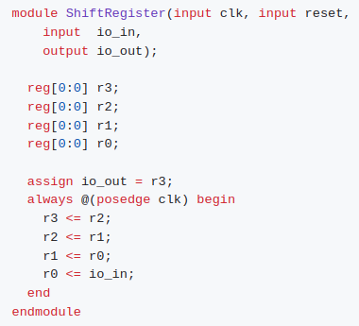
2.4.2 Unconditional Register Update
https://github.com/ucb-bar/chisel-tutorial/wiki/The-Basics
Unconditional Register Update
If we take a look at the generated Verilog, we will see that Chisel did indeed map our design to a shift register.
One thing to notice is that the clock signal and reset signals are implicitly attached to our design.

Slide 61
2.4.3 Conditional Register Update

Slide 62
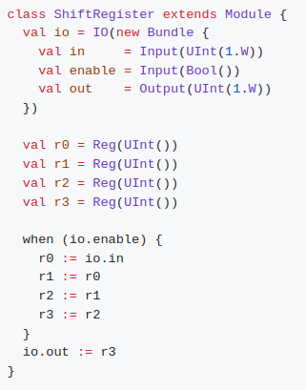
2.4.3 Conditional Register Update
https://github.com/ucb-bar/chisel-tutorial/wiki/The-Basics
Conditional Register Update
As mentioned earlier, Chisel allows you to conditionally update a register (use an enable signal) using the when, .elsewhen, .otherwise block.
Suppose we add an enable signal to our shift register, that allows us to control whether data is shift in and out on a given cycle depending on an enable input signal.
The new shift register now looks like:
Note:
It is not necessary to specify an .otherwise condition as Chisel will correctly infer that the old register value should be preserved otherwise.

Slide 63
2.4.4 Register Reset

Slide 64
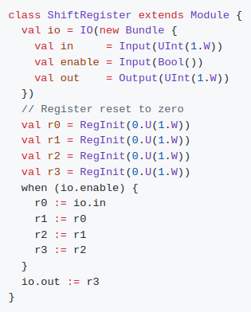
2.4.4 Register Reset
https://github.com/ucb-bar/chisel-tutorial/wiki/The-Basics
Register Reset
Chisel allows you to specify a synchronous reset to a certain value by specifying an additional parameter when you first declare them.
In our shift register, let's add a reset capability that resets all the register values to zero synchronously.
To do this we need to provide our register declarations a little more information using the init parameter, or using the specialized constructor RegInit, with what value we want on a synchronous reset:

Slide 65
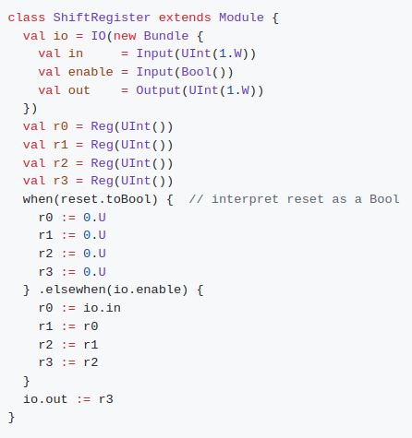
2.4.4 Register Reset
https://github.com/ucb-bar/chisel-tutorial/wiki/The-Basics
Register Reset
Note that reset value can actually be any value, simply replace the zeros and width to appropriate values.
Chisel also has an implicit global reset signal that you can use in a when block.
The reset signal is conveniently called reset and does not have to be declared, but in order to treat it as a Bool, you need to add the toBool cast. The shift register using this implicit global reset now looks like:

Slide 66
2.4.4 Register Reset
https://github.com/ucb-bar/chisel-tutorial/wiki/The-Basics
Register Reset
Below Scala code will generate slightly different looking Verilog source code but will still function the same as the previous implementation of the shift register with reset.

Slide 67
2.4.5 Sequential Circuit

Slide 68
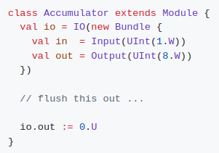
2.4.5 Sequential Circuit
https://github.com/ucb-bar/chisel-tutorial/wiki/The-Basics
Sequential Circuit
The following exercises can be found in your $TUT_DIR/src/main/scala/problems/ folder.
We will find that some parts of the tutorial files have been completed for you and the section that we need to complete is indicated in the file.
The solutions to each of these exercises can be found in the $TUT_DIR/src/main/scala/solutions/ folder.
The first tutorial problem is to write a sequential circuit that sums in values. You can find the template in $TUT_DIR/src/main/scala/problems/Accumulator.scala including a stubbed out version of the circuit:

Slide 69

2.4.5 Sequential Circuit
https://github.com/ucb-bar/chisel-tutorial/wiki/The-Basics
Sequential Circuit
and a complete tester that confirms that you have successfully designed the circuit in $TUT_DIR/src/test/scala/problems/Accumulator.scala.
Run:
This should fail until you complete the circuit implementing the accumulator.
Edit the src/main/scala/problems/Accumulator.scala source file and execute the run-problem.sh shell script until your circuit passes the tests.

Slide 70
End

