Slide 1

6 Encapsulation
Peter H. Chen

Slide 2
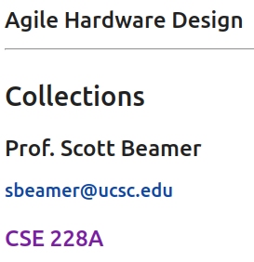
6 Encapsulation
https://www.youtube.com/watch?v=DI1G6WAIdI0&list=PLfrN7RIcMe6g2LBRJLTHTdhyj5s8ag0Rg&index=6
Encapsulation (0:00-0:30/1:05:15)
We have done the Verilog, Combinational Logic, Sequential Logic, finite state machine, parameterization, stronger types.
Today, we discuss Chisel Encapsulation.
We will talk about several Factory Design Pattern of Chisel Library:
  Class Counter: Chisel Hardware Library
  Class Bundle: struct in C/C++.
  Bundle Composition, etc.

Slide 3
6 Encapsulation
https://www.youtube.com/watch?v=DI1G6WAIdI0&list=PLfrN7RIcMe6g2LBRJLTHTdhyj5s8ag0Rg&index=6
Encapsulation (0:31-0:47/1:05:15)
Q: What is Scala Encapsulation?
Ans: Encapsulation are Scala Object-Oriented Programming for data hiding and methods overloading in a Scala/Chisel class.
Topics:
1. Setup: jupyter notebook, select scala, and run cells
2. Recursive in Scala/Chisel.
3. Bundles (struct in C/C++) and Modules are two common Chisel Libraries. Bundles are in in Chisel IO. Modules are used in Chisel Inheritance.
4. Factor Methods are predefined design pattern. We look the Class Counter and Class Bundle Examples.
7. Scala/Chisel have Option with optional data type.

Slide 4
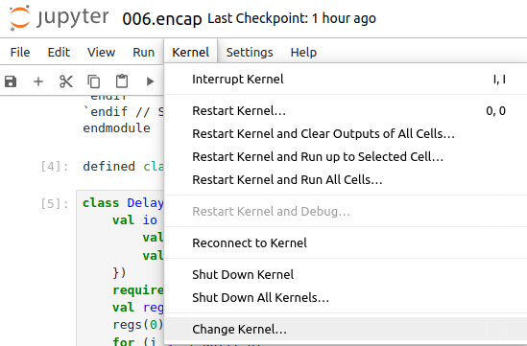
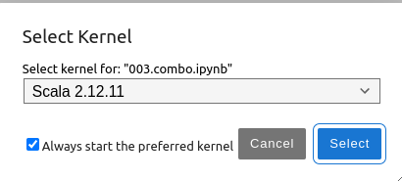
6 Encapsulation
https://www.youtube.com/watch?v=DI1G6WAIdI0&list=PLfrN7RIcMe6g2LBRJLTHTdhyj5s8ag0Rg&index=6
Encapsulation (0:47-0:48/1:05:15)
We discuss Chisel Collection.
> jupyter notebook 006.combo.ipynb > Kernel > Change Kernel … > Select Scala2.21.22
> Run All Cells

Slide 5
6.1 Plan

Slide 6
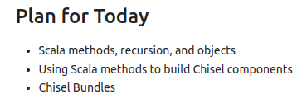
6.1 Plan
https://www.youtube.com/watch?v=DI1G6WAIdI0&list=PLfrN7RIcMe6g2LBRJLTHTdhyj5s8ag0Rg&index=6
Plan (0:49-1:07/1:05:15)
We will discuss:
a. Scala method, recursion, and objects
b. Use Scala methods to build Chisel components
c. Chisel Bundles

Slide 7
6.2 Import Chisel Library

Slide 8
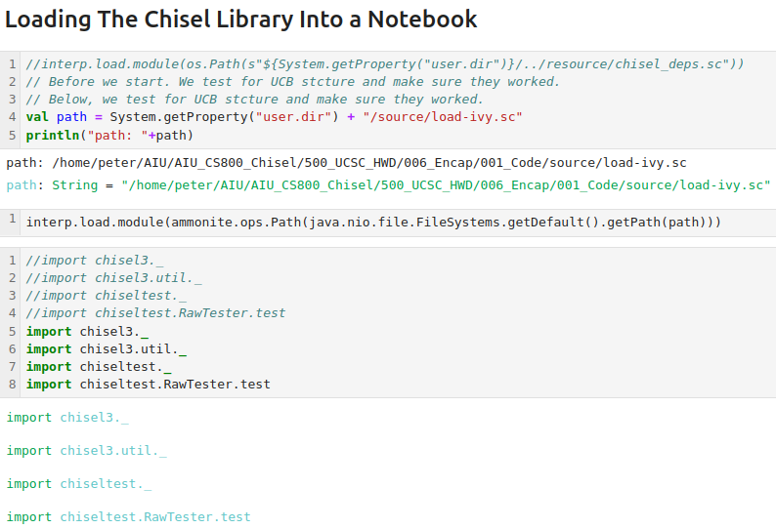
6.2 Import Chisel Library
https://www.youtube.com/watch?v=DI1G6WAIdI0&list=PLfrN7RIcMe6g2LBRJLTHTdhyj5s8ag0Rg&index=6
Import Chisel Library (1:07-1:11/1:05:15)

Slide 9
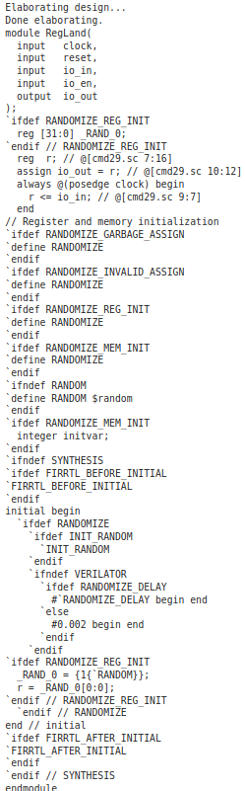
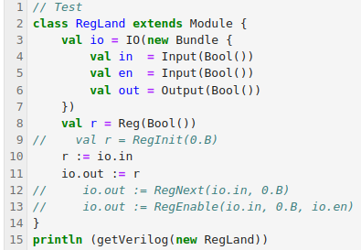
6.2 Import Chisel Library
https://www.youtube.com/watch?v=DI1G6WAIdI0&list=PLfrN7RIcMe6g2LBRJLTHTdhyj5s8ag0Rg&index=6
Import Chisel Library (1:12-1:13/1:05:15)
Test

Slide 10
6.3 Scala Method

Slide 11
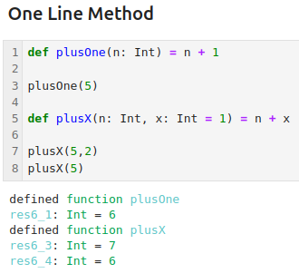
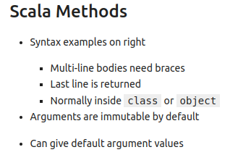
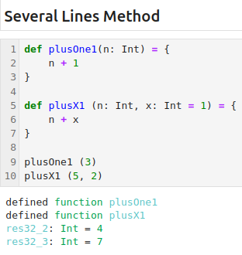
6.3 Scala Method
https://www.youtube.com/watch?v=DI1G6WAIdI0&list=PLfrN7RIcMe6g2LBRJLTHTdhyj5s8ag0Rg&index=6
Scala Method (1:14-2:13/1:05:15)
Below, we define plusOne method.
The method plusOne () is an one line method.
We can break it into several lines.

Slide 12
6.4 Recursive Scala Method

Slide 13
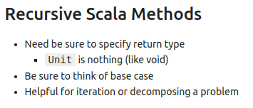
6.4 Recursive Scala Method
https://www.youtube.com/watch?v=DI1G6WAIdI0&list=PLfrN7RIcMe6g2LBRJLTHTdhyj5s8ag0Rg&index=6
Recursive Scala Method (2:14-4:20/1:05:15)
Recursive return Unit.
Q: What is difference between Unit and Nothing?
Ans:
1. Unit: Unit is same as void. Now if a function returns Unit, it means that it doesn't return anything and continue next.
2. Nothing: Nothing means the end of execution. If a function returns Nothing, means literally nothing it returns, not even the execution flow.
3. Example:
> fun main() {
> unitFun()
> println("after unit")
> nothingFun()
> println("after nothing")
> }
> fun nothingFun (): Nothing {
> println("inside nothing")
> throw Exception()
}
> fun unitFun (): Unit {
println("inside unit")
}
https://stackoverflow.com/questions/13539822/whats-the-difference-between-unit-and-nothing

Slide 14
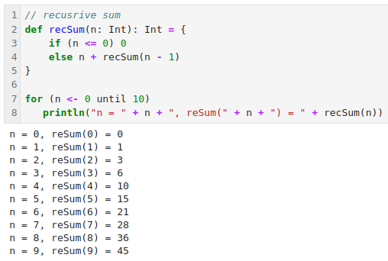
6.4 Recursive Scala Method
https://www.youtube.com/watch?v=DI1G6WAIdI0&list=PLfrN7RIcMe6g2LBRJLTHTdhyj5s8ag0Rg&index=6
Recursive Scala Method (4:21-7:00/1:05:15)
Example:
Recursive Sum, recSum ()

Slide 15
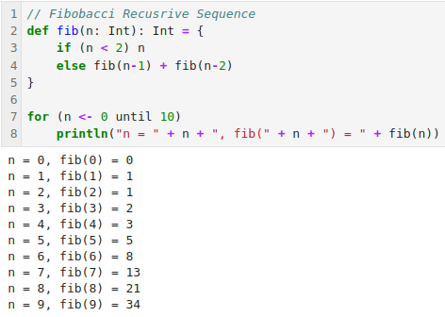
6.4 Recursive Scala Method
https://www.youtube.com/watch?v=DI1G6WAIdI0&list=PLfrN7RIcMe6g2LBRJLTHTdhyj5s8ag0Rg&index=6
Recursive Scala Method (7:01-8:20/1:05:15)
Recursive function for Fibonacci.

Slide 16
6.5 Chisel Component

Slide 17
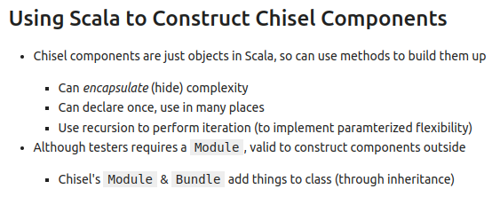
6.5 Chisel Component
https://www.youtube.com/watch?v=DI1G6WAIdI0&list=PLfrN7RIcMe6g2LBRJLTHTdhyj5s8ag0Rg&index=6
Chisel Component (8:21-9:59/1:05:15)
Chisel component hide/encapsulate the complexity.
More readable
Tester Construct component outside.

Slide 18
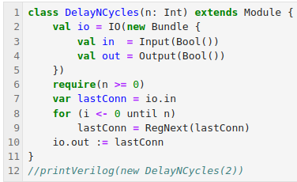
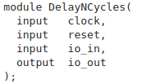
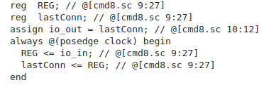
6.5 Chisel Component
https://www.youtube.com/watch?v=DI1G6WAIdI0&list=PLfrN7RIcMe6g2LBRJLTHTdhyj5s8ag0Rg&index=6
Chisel Component (10:00-11:40/1:05:15)
Previous DelayNCycles ()

Slide 19
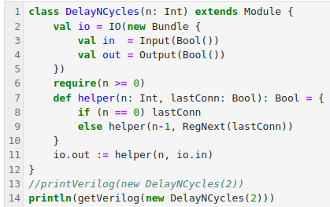
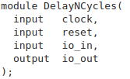
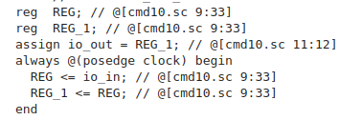
6.5 Chisel Component
https://www.youtube.com/watch?v=DI1G6WAIdI0&list=PLfrN7RIcMe6g2LBRJLTHTdhyj5s8ag0Rg&index=6
Chisel Component (10:41-11:55/1:05:15)
Add helper function for DelayNCycles (). We have extra register name REG_1.

Slide 20
6.6 Scala Object

Slide 21
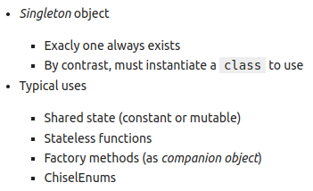
6.6 Scala Object
https://www.youtube.com/watch?v=DI1G6WAIdI0&list=PLfrN7RIcMe6g2LBRJLTHTdhyj5s8ag0Rg&index=6
Scala Object (11:56-12:30/1:05:15)
Singleton Object
Typical use with ChiselEnum

Slide 22
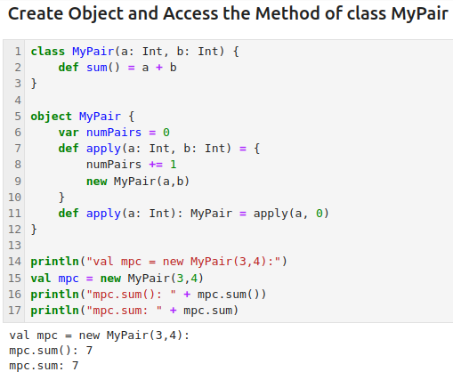
6.6 Scala Object
https://www.youtube.com/watch?v=DI1G6WAIdI0&list=PLfrN7RIcMe6g2LBRJLTHTdhyj5s8ag0Rg&index=6
Scala Object (12:31-15:30/1:05:15)
Create Object and access the object method.

Slide 23
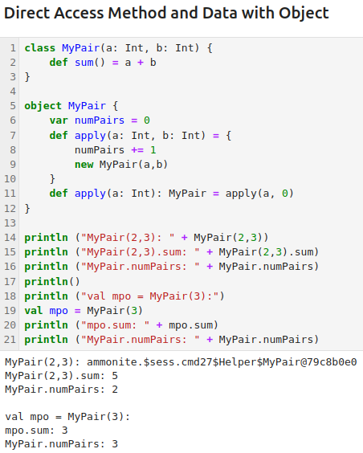
6.6 Scala Object
https://www.youtube.com/watch?v=DI1G6WAIdI0&list=PLfrN7RIcMe6g2LBRJLTHTdhyj5s8ag0Rg&index=6
Scala Object (15:31-21:22/1:05:15)
MyPair (2, 3) is an object pointer to access the object method and data.

Slide 24
6.7 Factory Method w/o Module

Slide 25
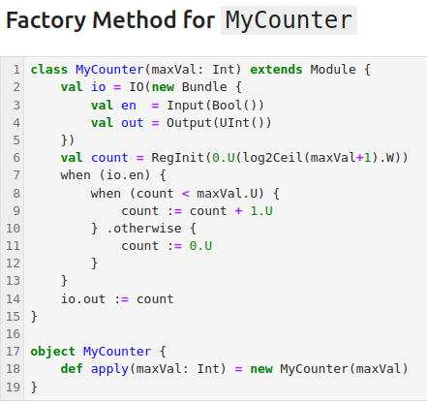

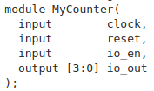
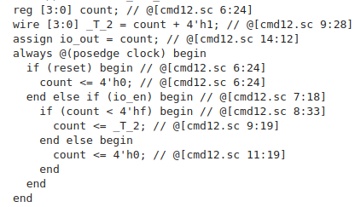
6.7 Factory Method
https://www.youtube.com/watch?v=DI1G6WAIdI0&list=PLfrN7RIcMe6g2LBRJLTHTdhyj5s8ag0Rg&index=6
Factory Method (21:23-25:46/1:05:15)
The factory method is a pre-design pattern that creates objects without specifying the exact class of the object.
We have pre-design class and we define an object to create the object with pre-design class.

Slide 26
6.7 Factory Method w/o Module

Slide 27
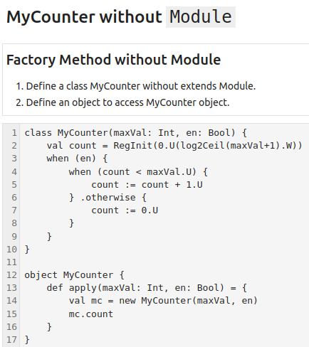
6.7 Factory Method w/o Module
https://www.youtube.com/watch?v=DI1G6WAIdI0&list=PLfrN7RIcMe6g2LBRJLTHTdhyj5s8ag0Rg&index=6
Factory Method w/o Module (25:47-28:20/1:05:15)
We create the Factory Method:
1. Create a class MyCounter without extends Module
2. Create an object to apply MyCounter Object.
3. We separate out the IO into separate codes.

Slide 28
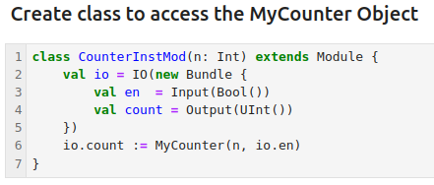
6.7 Factory Method w/o Module
https://www.youtube.com/watch?v=DI1G6WAIdI0&list=PLfrN7RIcMe6g2LBRJLTHTdhyj5s8ag0Rg&index=6
Factory Method w/o Module (28:21-31:30/1:05:15)
1. Because we do not have Module in the MyCounter, we define high level class CounterIntMod() with extends Module().

Slide 29
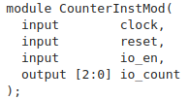
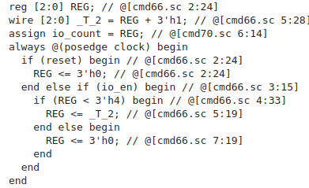
6.7 Factory Method w/o Module
https://www.youtube.com/watch?v=DI1G6WAIdI0&list=PLfrN7RIcMe6g2LBRJLTHTdhyj5s8ag0Rg&index=6
Factory Method w/o Module (31:31-32:10/1:05:15)
We can generate the Verilog Hardware code.

Slide 30
6.8 Chisel Counter

Slide 31
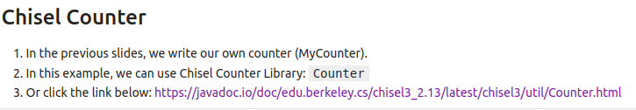
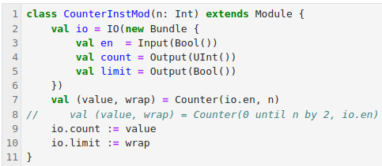
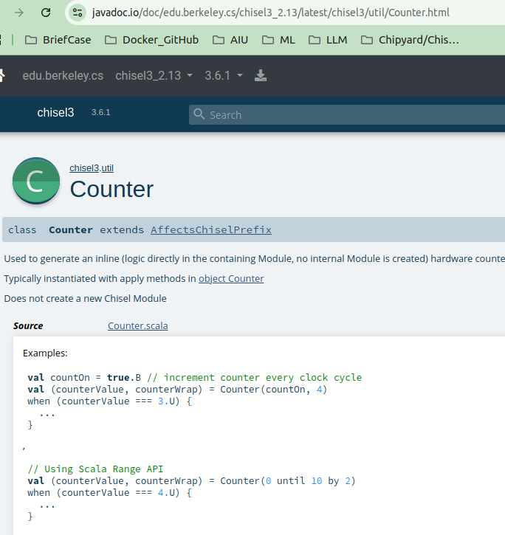
6.8 Chisel Counter
https://www.youtube.com/watch?v=DI1G6WAIdI0&list=PLfrN7RIcMe6g2LBRJLTHTdhyj5s8ag0Rg&index=6
Chisel Counter (32:11-33:30/1:05:15)
Chisel defines Counter. We can use the Chisel Library Counter.

Slide 32
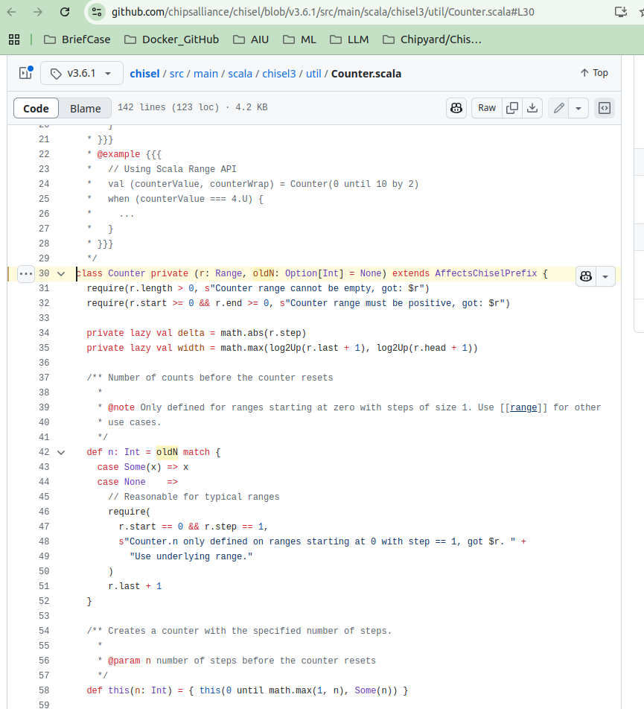
6.8 Chisel Counter
https://www.youtube.com/watch?v=DI1G6WAIdI0&list=PLfrN7RIcMe6g2LBRJLTHTdhyj5s8ag0Rg&index=6
Chisel Counter (33:31-36:30/1:05:15)
Chisel Counter Library source code.
Below is the complete/complicated source code of Counter Class Design Pattern from Chisel Library.

Slide 33

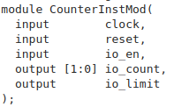
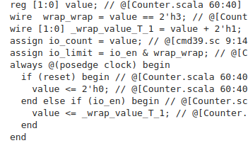
6.8 Chisel Counter
https://www.youtube.com/watch?v=DI1G6WAIdI0&list=PLfrN7RIcMe6g2LBRJLTHTdhyj5s8ag0Rg&index=6
Chisel Counter (36:31-38:27/1:05:15)
Generate Hardware Verilog.

Slide 34
6.9 Chisel Bundle

Slide 35
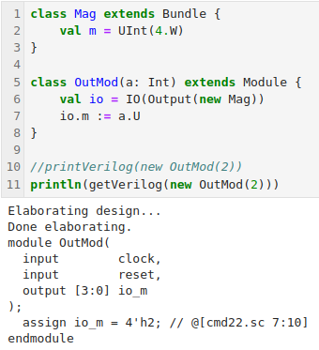
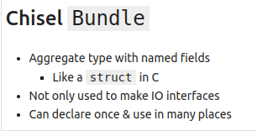
6.9 Chisel Bundle
https://www.youtube.com/watch?v=DI1G6WAIdI0&list=PLfrN7RIcMe6g2LBRJLTHTdhyj5s8ag0Rg&index=6
Chisel Bundle (38:28-40:40/1:05:15)
Chisel Bundle = struct in C++.
We use Bundle for IO.

Slide 36
6.10 Bundle Composition

Slide 37
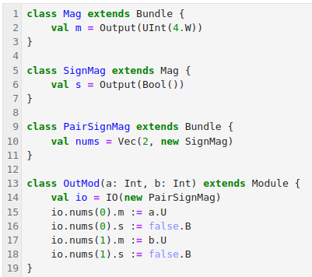
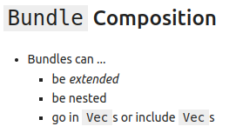
6.10 Bundle Composition
https://www.youtube.com/watch?v=DI1G6WAIdI0&list=PLfrN7RIcMe6g2LBRJLTHTdhyj5s8ag0Rg&index=6
Bundle Composition (40:41-41:30/1:05:15)
Bundle can be extended, nested, inside Vecs, include Vecs.
If we want to do the negative sign with magnitude, how to do that?
1. Generate two signed vectors
2. Generate sign
3. Generate Magnitude.
4. Assign number to magnitude
5. Assign sign to number.

Slide 38
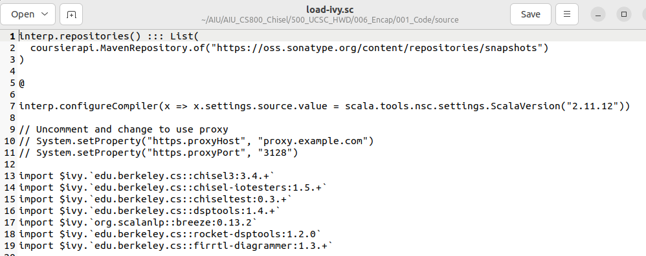
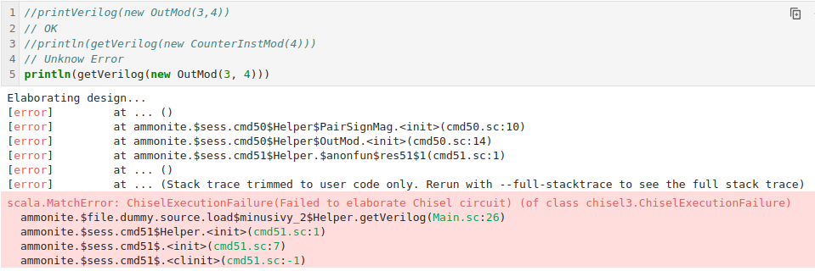
6.10 Bundle Composition
https://www.youtube.com/watch?v=DI1G6WAIdI0&list=PLfrN7RIcMe6g2LBRJLTHTdhyj5s8ag0Rg&index=6
Bundle Composition (41:31-42:11/1:05:15)
Note:
1. I used is load-ivy.sc which configured for chisel version 3.4.
2. This Chisel version (3.4) has hardware generator has error.

Slide 39
6.11 CloneType

Slide 40
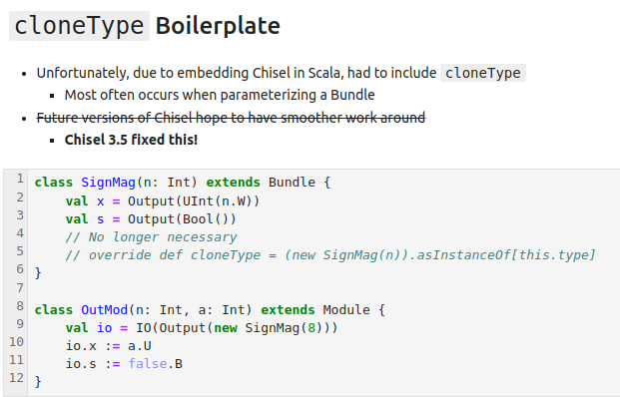
6.11 CloneType
https://www.youtube.com/watch?v=DI1G6WAIdI0&list=PLfrN7RIcMe6g2LBRJLTHTdhyj5s8ag0Rg&index=6
CloneType (42:12-43:03/1:05:15)
CloneType is required only for Chisel version before 3.5.

Slide 41
6.12 Bundle Hierarchy

Slide 42
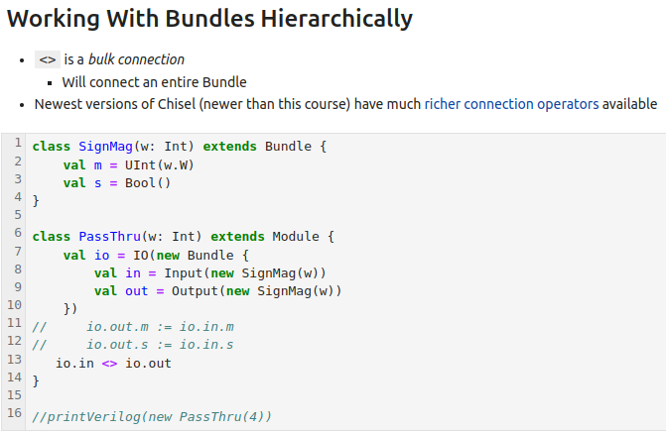
6.12 Bundle Hierarchy
https://www.youtube.com/watch?v=DI1G6WAIdI0&list=PLfrN7RIcMe6g2LBRJLTHTdhyj5s8ag0Rg&index=6
Bundle Hierarchy (43:04-45:49/1:05:15)
Bundle Hierarchy: <> Operator
Bundle hierarchy creates nested bundles.
Bundle hierarchy is used to see the organization of complex data structures and module interfaces using bundles as building blocks.

Slide 43
6.13 Bundle Wire

Slide 44
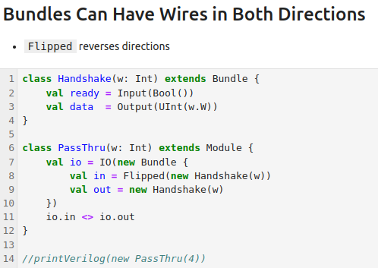
6.13 Bundle Wire
https://www.youtube.com/watch?v=DI1G6WAIdI0&list=PLfrN7RIcMe6g2LBRJLTHTdhyj5s8ag0Rg&index=6
Bundle Wire (45:50-48:51/1:05:15)
Bundle (struct C/C++) Wire can be used input and output direction.
We can flip the direction of input and output.

Slide 45
6.14 Scala Option

Slide 46
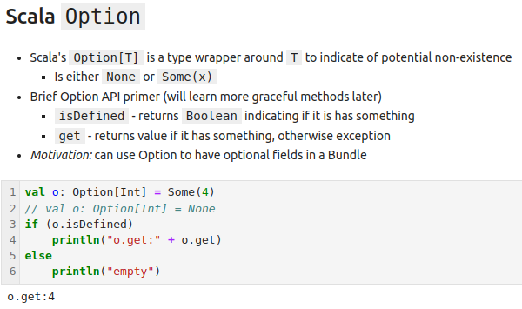
6.14 Scala Option
https://www.youtube.com/watch?v=DI1G6WAIdI0&list=PLfrN7RIcMe6g2LBRJLTHTdhyj5s8ag0Rg&index=6
Scala Option (48:52-51:30/1:05:15)
Scala has option to pass any data type.

Slide 47
6.15 Chisel Option

Slide 48
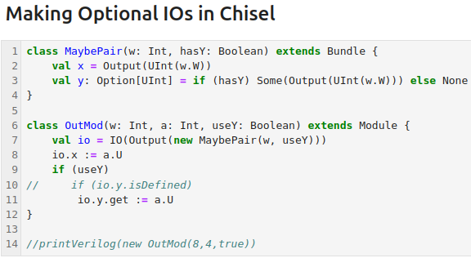
6.15 Chisel Option
https://www.youtube.com/watch?v=DI1G6WAIdI0&list=PLfrN7RIcMe6g2LBRJLTHTdhyj5s8ag0Rg&index=6
Chisel Option (51:31-1:02:23/1:05:15)
We can extend the Scala Option into Chisel Bundle/Module.

Slide 49
6.16 Scala Tablulate

Slide 50
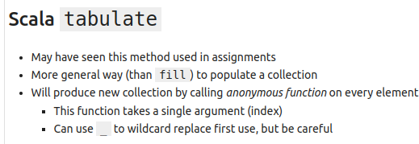
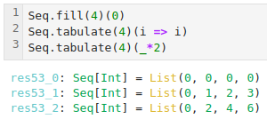
6.16 Scala Tablulate
https://www.youtube.com/watch?v=DI1G6WAIdI0&list=PLfrN7RIcMe6g2LBRJLTHTdhyj5s8ag0Rg&index=6
Scala Tabulate (1:02:24-1:04:00/1:05:15)
We can use
1. fill() to fill all zero.
2. tabulate() to fill in order, multiplication.

Slide 51
6.17 Summary

Slide 52
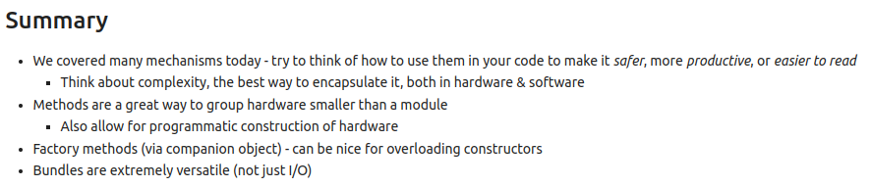
6.17 Summary
https://www.youtube.com/watch?v=DI1G6WAIdI0&list=PLfrN7RIcMe6g2LBRJLTHTdhyj5s8ag0Rg&index=6
Summary (1:04:01-1:05:15/1:05:15)
1. Methods are used to grouped in hardware
2. Factor Method are predefined design pattern.
3. Bundles (struct in C/C++) are flexible.

Slide 53
End

