Slide 1

5 Full Adder
Peter H. Chen

Slide 2
5 Full Adder
https://github.com/ucb-bar/chisel-tutorial/wiki/The-Basics
Full Adder
Constructing Full Adder blocks in Chisel is easy.
When you declare a val in Scala, it creates a node that represents the data that it is assigned to.
As long as the value is not assigned to be a register type (explained later), this tells the Chisel compiler to treat the value as wire.
Therefore, any number of these values can be connected and manipulated to produce the value that we want.

Slide 3
5.1 Full Adder

Slide 4
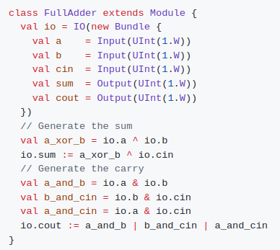
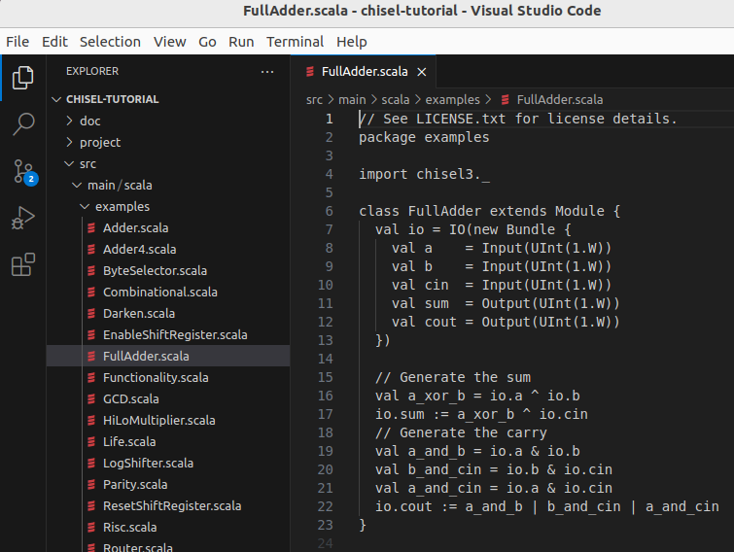
5.1 Full Adder
https://github.com/ucb-bar/chisel-tutorial/wiki/The-Basics
Full Adder
Suppose we want to construct a single full adder.
A full adder takes two inputs a and b, and a carry in cin and produces a sum and carry out cout.
The Chisel source code for our full adder will look something like:

Slide 5
5.1 Full Adder
https://github.com/ucb-bar/chisel-tutorial/wiki/The-Basics
Full Adder
Where:
cout is defined as a combinational function of inputs a, b, and cin.
Note:
In order to access the input values from the io bundle, you need to first reference io since the input and output values belong to the io bundle.
The |, &, and ^ operators correspond to bitwise OR, AND, and XOR operations respectively.

Slide 6
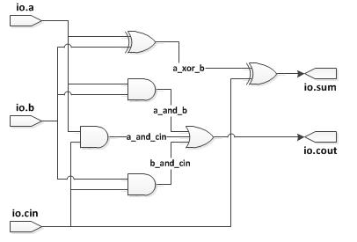
5.1 Full Adder
https://github.com/ucb-bar/chisel-tutorial/wiki/The-Basics
Full Adder
The corresponding wires for each of these values is shown below in Figure Full Adder Circuit. You will notice that each val corresponds to exactly one of the wires.

Slide 7
5.2 Full Adder Simulation

Slide 8
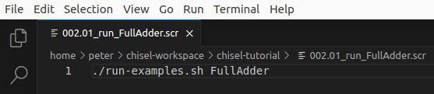
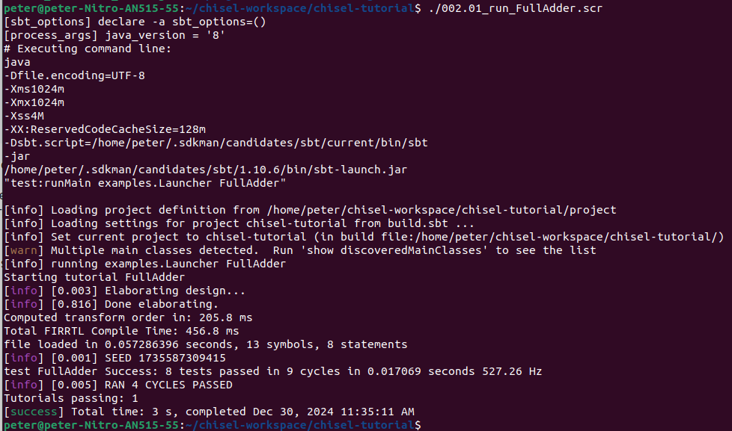
5.2 Full Adder Simulation
https://github.com/ucb-bar/chisel-tutorial/wiki/The-Basics
Full Adder Simulation
> ./run-exmaples.sh FullAdder
or
> ./002.01_run_FullAdder.scr

Slide 9
5.3 Generate Full Adder Verilog

Slide 10
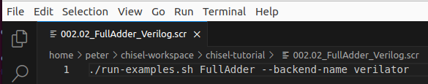
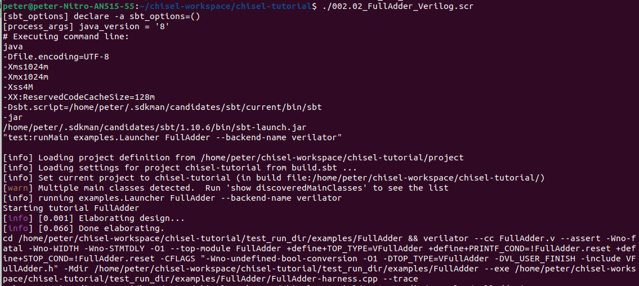
5.2 Genrate Full Adder Verilog
https://github.com/ucb-bar/chisel-tutorial/wiki/The-Basics
Generate Full Adder Verilog
> ./run-exmaples.sh FullAdder --backend-name verilator
or
> ./002.03_FullAdder_Verilog.scr
Note:
There is error in verilator verification. Will check later on.

Slide 11
End

