Slide 1

16 Physical Design and Memory Design
Peter H. Chen

Slide 2
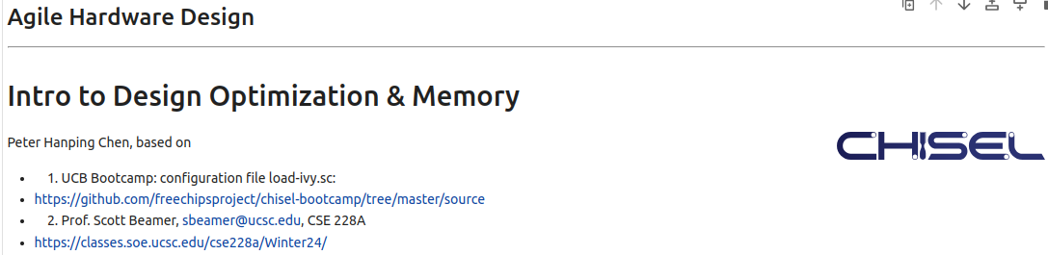
16 Physical Design and Memory Design
https://www.youtube.com/watch?v=GIW1GxIfwAU&list=PLfrN7RIcMe6g2LBRJLTHTdhyj5s8ag0Rg&index=16
Physical Design and Memory Design (0:00-0:01/57:23)
We used UCB bootcamp configuration file (load_ivy.sc)
source/load-ivy.sc (https://github.com/freechipsproject/chisel-bootcamp)

Slide 3
16 Physical Design and Memory Design
https://www.youtube.com/watch?v=GIW1GxIfwAU&list=PLfrN7RIcMe6g2LBRJLTHTdhyj5s8ag0Rg&index=16
Physical Design and Memory Design (0:02-0:45/57:23)
We discuss Physical Design Optimization and Memory Design
Topics:
1. Setup: jupyter notebook, select scala, and run cells.
2. Build Hardware by Chisel/Verilog
3. Physical Design Optimization: PAT (Power, Area, Timing)
4. Waterfall vs. Agile Design methodology
5. Little’s Law: measure latency, throughput, and parallelism
6. Memory Optimization: Banking, Bursty Averaging, Pipeline, and Double Buffer.

Slide 4
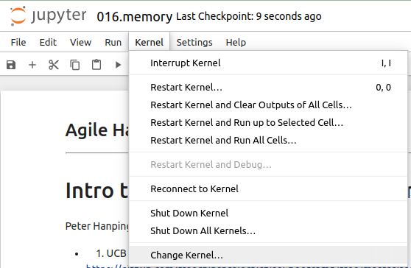
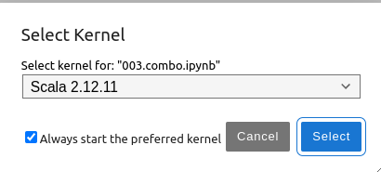
16 Physical Design and Memory Design
https://www.youtube.com/watch?v=GIW1GxIfwAU&list=PLfrN7RIcMe6g2LBRJLTHTdhyj5s8ag0Rg&index=16
Physical Design and Memory Design (0:03-1:08/57:23)
We discuss Chisel Collection.
> jupyter notebook 016.memory.ipynb > Kernel > Change Kernel … > Select Scala2.21.22
> Run All Cells

Slide 5
16.1 Plan

Slide 6
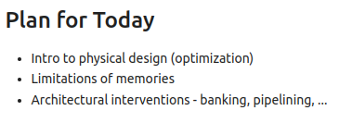
16.1 Plan
https://www.youtube.com/watch?v=GIW1GxIfwAU&list=PLfrN7RIcMe6g2LBRJLTHTdhyj5s8ag0Rg&index=16
Plan (1:09-1:25/57:23)
Today, we talk
1. Physical design optimization.
2. Memory limitation
3. Architectural intervention.

Slide 7
16.2 Why Optimize Physical Design?

Slide 8
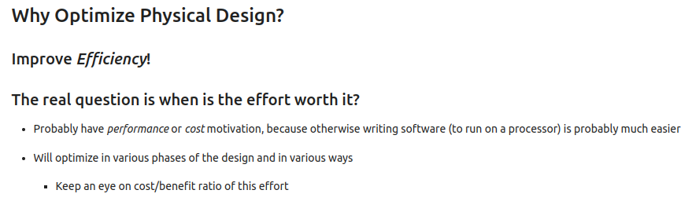
16.2 Why Optimize Physical Design?
https://www.youtube.com/watch?v=GIW1GxIfwAU&list=PLfrN7RIcMe6g2LBRJLTHTdhyj5s8ag0Rg&index=16
Why Optimize Physical Design? (1:26-3:48/57:23)
1. improve efficiency.
2. How much effort?
  2.1 Use Chisel to tune up Performance by software simulation
  2.2 Optimize the architecture

Slide 9
16.3 What Metrics to Measure?

Slide 10
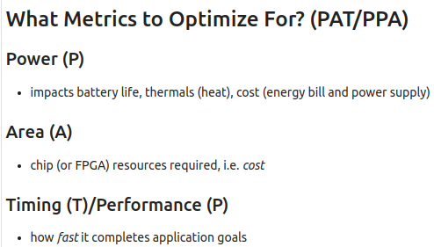
16.3 What Metrics to Measure?
https://www.youtube.com/watch?v=GIW1GxIfwAU&list=PLfrN7RIcMe6g2LBRJLTHTdhyj5s8ag0Rg&index=16
What Metrics to Measure? (3:49-5:58/57:23)
We have three metrics (PAT or PPA) for optimization, P: Power, A: Area, T: Timing/P: Performance
It is hard to optimize all three at the same time. In the most of the time, we have to pick up the one has the highest priority to meet.
Q: We 10 selects cache register L1: 1KB – 521KB; 10 selects in L2 = 1M - 32M; 10 selects in L3 = 8M - 256M. How many test we for have?
Ans: 10 (L1 cache) x 10 (L2 cache) x 10 (L3 cache) = 1K tests. If we consider 10 select in GPU VRAM (Video RAM), 10 memory, 10 number of CPU, then we have 1K x 10 x 10 x 10 = 1 M tests. We can see the number of test quickly grow exponential from 1K to 1M, called NP(Non-polynomial)-Hard.
There are tools, such as, hyper-mapper, open-tuner, etc. find the optimization solution (one of the best solutions) for us, however, there is not guarantee to find the best.
We can pick the timing as the highest priority and then area or power as the secondary priority.

Slide 11
16.4 Target/Goal for Optimization

Slide 12
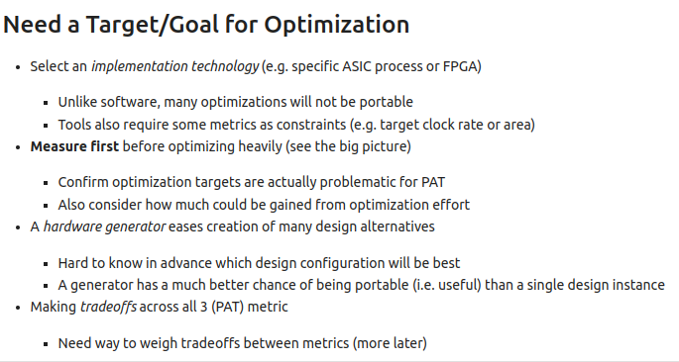
16.4 Target/Goal for Optimization
https://www.youtube.com/watch?v=GIW1GxIfwAU&list=PLfrN7RIcMe6g2LBRJLTHTdhyj5s8ag0Rg&index=16
Target/Goal for Optimization (5:59-17:36/57:23)
1. Select ASIC or FPGA
2. Run simulation before optimization.
3. Generate Verilog/hardware
4. Find the optimization for PAT (or PPA).
5. External IO/TPU for AI accelerator can be put into the optimization constraint.
6. Chisel has Logic Optimization. It is different from PAT (pr PPA).

Slide 13
16.5 Software/Chip Design Difference

Slide 14
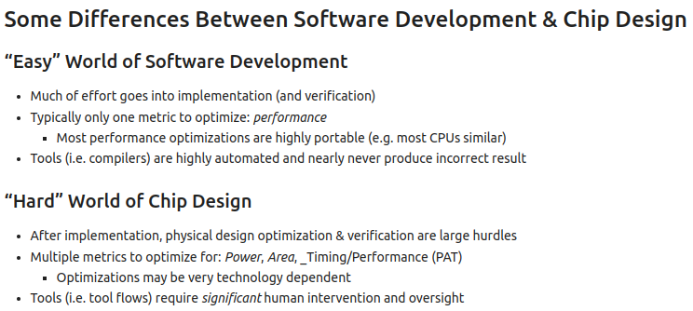
16.5 Software/Chip Design Difference
https://www.youtube.com/watch?v=GIW1GxIfwAU&list=PLfrN7RIcMe6g2LBRJLTHTdhyj5s8ag0Rg&index=16
Software/Chip Design Difference (17:37-22:20/57:23)
1. In software development, we spend most time in verification, one-dimensional (timing performance), and CAD tools automation.
2. After software development, we do the hard chip development, we spend most time in multi-dimensional physical design optimization for PAT (Power, Area, Timing Performance)/constraints optimization, layout design, LVS (Logic vs. Schematic), DRC (Design Rule Check) verification, post-layout simulation/optimization.

Slide 15
16.6 Hardware Design Philosophy

Slide 16

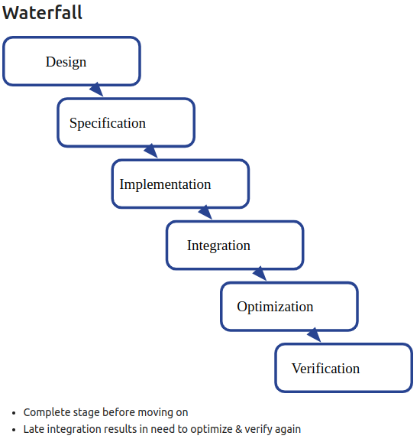
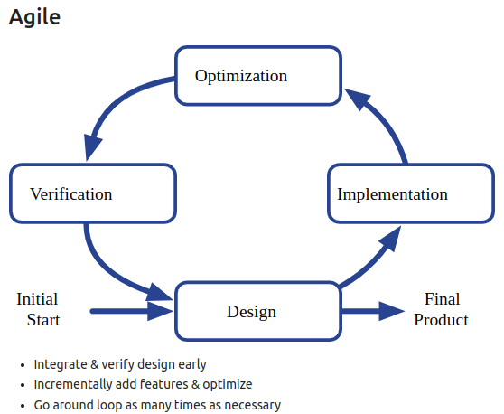
16.6 Hardware Design Philosophy
https://www.youtube.com/watch?v=GIW1GxIfwAU&list=PLfrN7RIcMe6g2LBRJLTHTdhyj5s8ag0Rg&index=16
Hardware Design Philosophy (22:21-23:11/57:23)
We have two design philosophies:
1. Waterfall/cascade (old way): Complete one phase before move to next.
2. Agile (new way): Integrate design, implement, optimize, and verification together and incremental upgrade.

Slide 17
16.7 Chip Design Flow

Slide 18
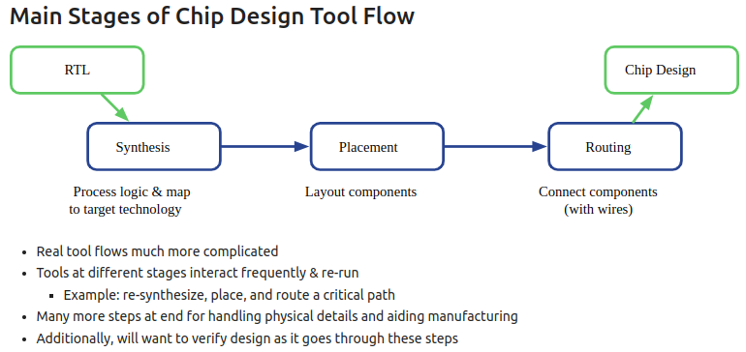
16.7 Chip Design Flow
https://www.youtube.com/watch?v=GIW1GxIfwAU&list=PLfrN7RIcMe6g2LBRJLTHTdhyj5s8ag0Rg&index=16
Chip Design Flow (23:12-25:10/57:23)
Main stages of chip design flow:
1. RTL, 2, Synthesis, 3. Placement, 4. Routing, 5. Chip Design (Critical path, RC extraction, Timing Analysis, LVS, DRC, etc.)
We have iteration in re-synthesis, placement, route, etc.

Slide 19
16.8 Memory

Slide 20
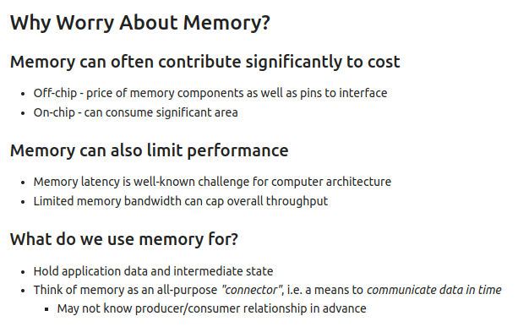
16.8 Memory
https://www.youtube.com/watch?v=GIW1GxIfwAU&list=PLfrN7RIcMe6g2LBRJLTHTdhyj5s8ag0Rg&index=16
Memory (25:11-29:34/57:23)
Why do we worry about memory?
1. Cost: Off-chip: DDR (Double Data Rate) memory on motherboard (price sensitive), On-Chip Memory: CPU-chip (area sensitive)
2. Performance: latency time, throughput
3. Why do we need memory? store data, producer/consumer

Slide 21
16.9 Memory Terminology

Slide 22
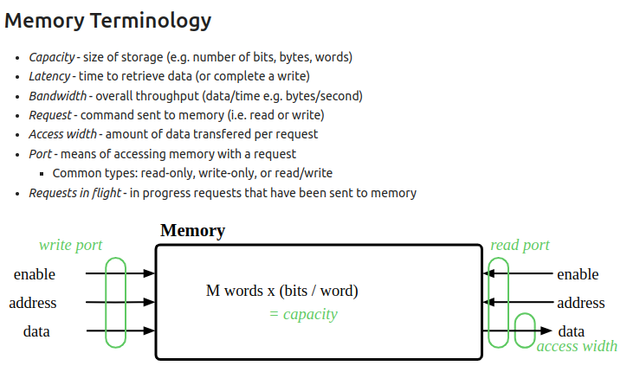
16.9 Memory Terminology
https://www.youtube.com/watch?v=GIW1GxIfwAU&list=PLfrN7RIcMe6g2LBRJLTHTdhyj5s8ag0Rg&index=16
Memory Terminology (29:35-32:33/57:23)
1. Capacity: Size of memory
2. Latency: time to retrieve data
3. Bandwidth: Throughput (data/time)
4. request: Command Read/Write sent to memory
5. Access Width: Amount of data per request
6. Port: read, write, data port to access memory
7. Request in flight: Process command
8. SRAM: fast static logic latch memory. D-RAM: refresh capacitor memory.

Slide 23
16.10 Little’s Law

Slide 24
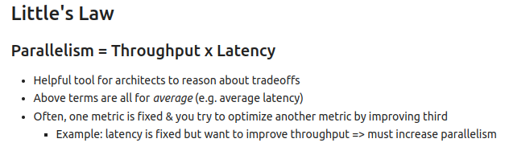
16.10 Little’s Law
https://www.youtube.com/watch?v=GIW1GxIfwAU&list=PLfrN7RIcMe6g2LBRJLTHTdhyj5s8ag0Rg&index=16
Little’s Law (32:34-33:51/57:23)
Q. What is “Little's Law”?
Ans: Little’s Law is q queueing system:
L = λ * W
Where:
  L = The average number of items in a queuing system
  λ = Average arrival rate
  W = Average time an item spends in the system

Slide 25
16.11 Memory Constraint

Slide 26
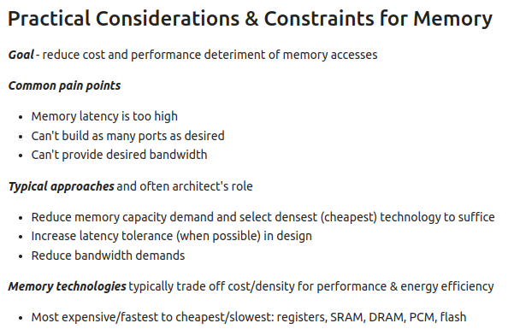
16.11 Memory Constraint
https://www.youtube.com/watch?v=GIW1GxIfwAU&list=PLfrN7RIcMe6g2LBRJLTHTdhyj5s8ag0Rg&index=16
Memory Constraint (33:52-36:37/57:23)
1. Reduce cost
2. Improve Performance (Reduce latency time)
3. Memory technology: SRAM, DRAM, PCM (Pulse Width Modulation), Flash (e.g., USB Data store in C-MOS).

Slide 27
16.12 Banking Memory

Slide 28
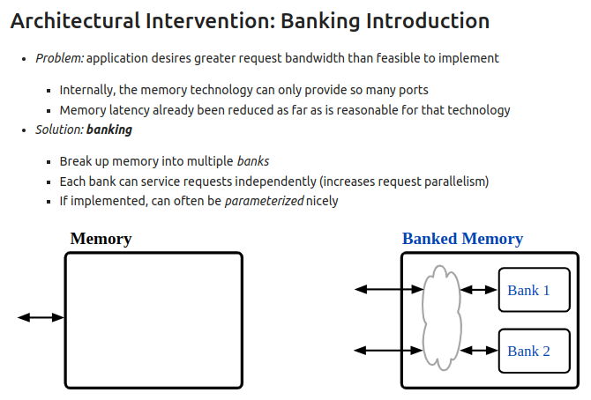
16.12 Banking Memory
https://www.youtube.com/watch?v=GIW1GxIfwAU&list=PLfrN7RIcMe6g2LBRJLTHTdhyj5s8ag0Rg&index=16
Banking Memory (36:38-38:41/57:23)
For multiple requests, we need a banking memory to store different requests for parallelism (multi-task processing).

Slide 29
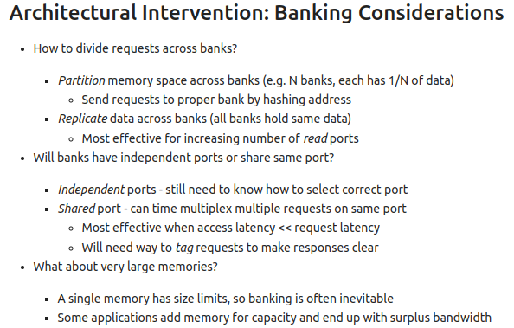
16.12 Banking Memory
https://www.youtube.com/watch?v=GIW1GxIfwAU&list=PLfrN7RIcMe6g2LBRJLTHTdhyj5s8ag0Rg&index=16
Banking Memory (38:42-42:59/57:23)
Banking Memories Issues:
1. Divide request for banking memory
2. Independent/shared Port: If we have two ports, one for read, one for write for the same memory address, we can use Chisel to verify the read/write operation.
3. Non-Banking memory vs. Banking Memory

Slide 30
16.13 Bursty Application Averaging

Slide 31
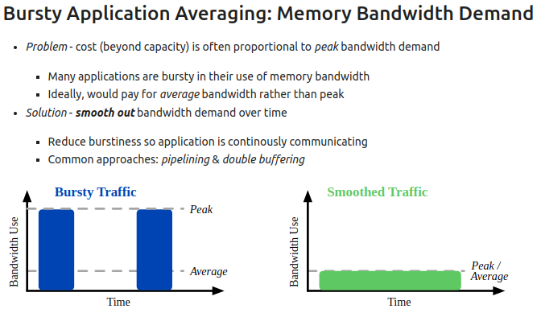
16.13 Bursty Application Averaging
https://www.youtube.com/watch?v=GIW1GxIfwAU&list=PLfrN7RIcMe6g2LBRJLTHTdhyj5s8ag0Rg&index=16
Bursty Application Averaging (43:00-44:45/57:23)
1. We have bursty application in memory
2. Split the burst into multi-tasking and several banks of memory.
s

Slide 32
16.14 Read/Write Application

Slide 33
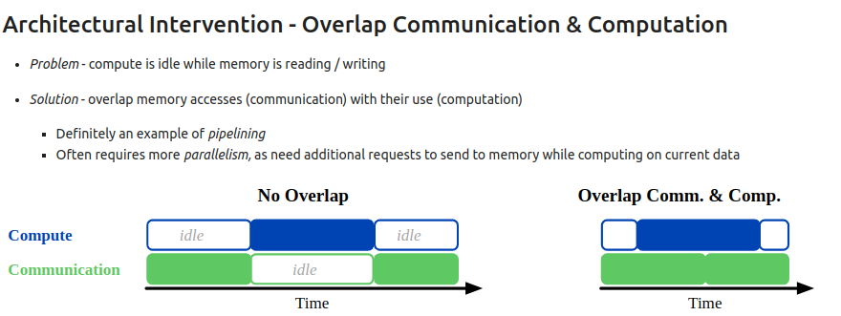
16.14 Read/Write Application
https://www.youtube.com/watch?v=GIW1GxIfwAU&list=PLfrN7RIcMe6g2LBRJLTHTdhyj5s8ag0Rg&index=16
Read/Write Application (43:00-45:54/57:23)
1. We have read/write pipeline application in memory.
2. Use pipeline to handle read/write application.

Slide 34
16.14 Read/Write Application

Slide 35
16.14 Read/Write Application
https://www.youtube.com/watch?v=GIW1GxIfwAU&list=PLfrN7RIcMe6g2LBRJLTHTdhyj5s8ag0Rg&index=16
Read/Write Application (43:00-45:54/57:23)
1. We have read/write pipeline application in memory.
2. Use pipeline to handle read/write application.

Slide 36
16.15 Double Buffer

Slide 37
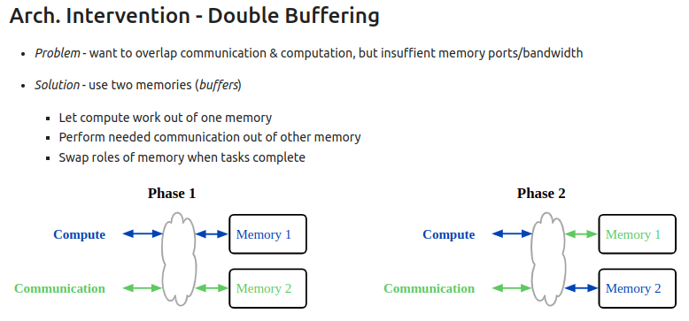
16.15 Double Buffer
https://www.youtube.com/watch?v=GIW1GxIfwAU&list=PLfrN7RIcMe6g2LBRJLTHTdhyj5s8ag0Rg&index=16
Double Buffer (45:55-47:00/57:23)
1. We have overlap application, one for computation and one for display.
2. We use double buffers (two memories) to swap the task when the computation is done.

Slide 38
16.16 Memory Example

Slide 39
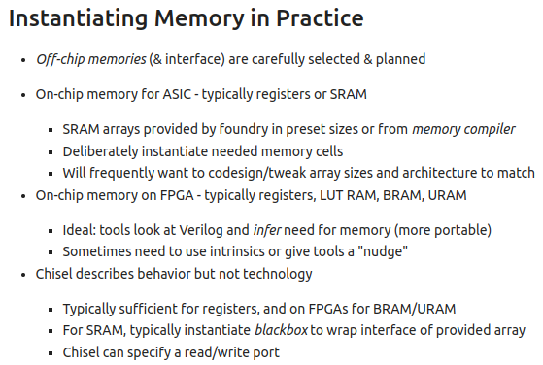
16.16 Memory Example
https://www.youtube.com/watch?v=GIW1GxIfwAU&list=PLfrN7RIcMe6g2LBRJLTHTdhyj5s8ag0Rg&index=16
Memory Example (47:01-54:16/57:23)
1. Off-Chip Memory: Motherboard memory
2. On-Chip Memory in CPU: Register, Cache memory.
3. On-Chip Memory for ASIC: Register, SRAM.
4. On-Chip Memory for FPGA: Register, LUT RAM (Look Up Table RAM), BRAM (Block RAM), URAM (Unified RAM). Simulate on AMD Vivado.
5. Chisel are used to describe behavoir, not perfect for technology which used in physical design/tool. Chisel are perfect used for register, SRAM, read/write port memory design.

Slide 40
16.17 Summary

Slide 41
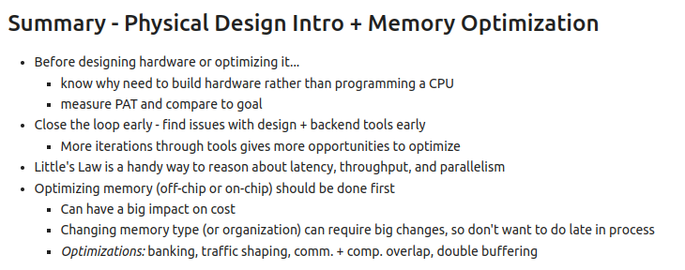
16.17 Summary
https://www.youtube.com/watch?v=GIW1GxIfwAU&list=PLfrN7RIcMe6g2LBRJLTHTdhyj5s8ag0Rg&index=16
Summary (54:17-57:23/57:23)
1. Build Hardware by Chisel/Verilog
2. Physical Design Optimization: PAT (Power, Area, Timing)
3. Waterfall vs. Agile Design methodology
4. Little’s Law: measure latency, throughput, and parallelism
5. Memory Optimization: Banking, Bursty Averaging, Pipeline, Double Buffer,

Slide 42
End

