Slide 1

12.11 Improve Scaladoc
Peter H. Chen

Slide 2
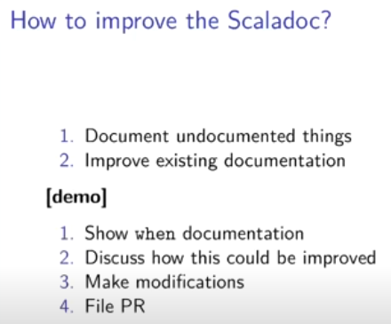
12.11 Improve Scaladoc
https://www.youtube.com/watch?v=ddariAPH6us&list=PLlu0CT-JnSasfpk8tq1ZDiE2G0AK1BhOg&index=12
Improve Scaladoc (42:02-44:52/1:05:33)

Slide 3
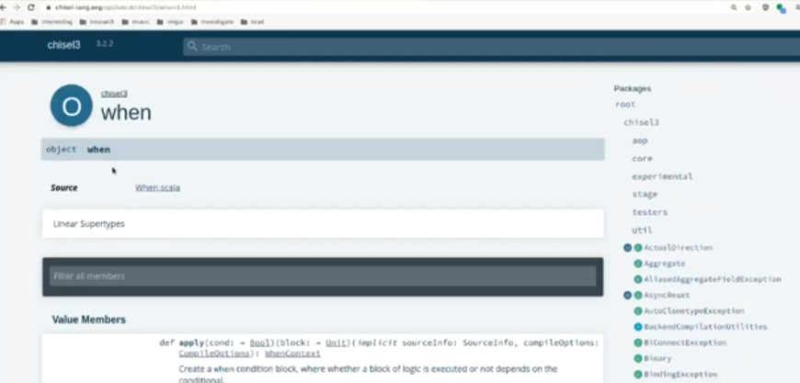
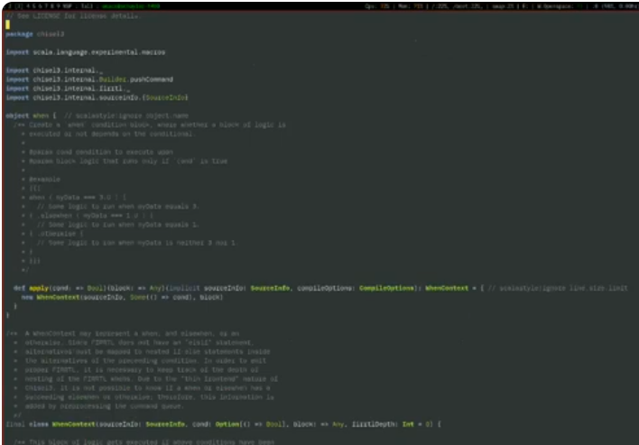
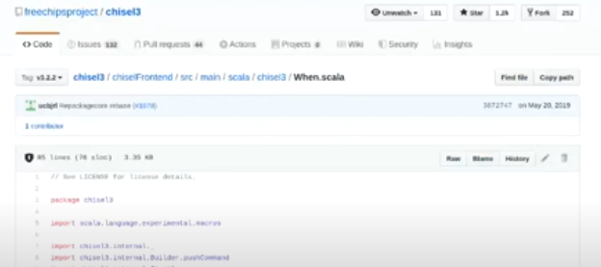
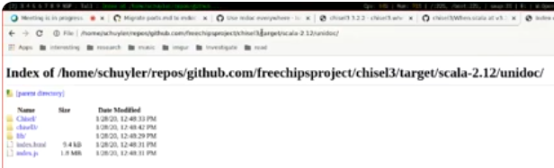
12.11 Improve Scaladoc
https://www.youtube.com/watch?v=ddariAPH6us&list=PLlu0CT-JnSasfpk8tq1ZDiE2G0AK1BhOg&index=12
Improve Scaladoc (44:41-48:05/1:05:33)

Slide 4
12.12 Write Test

Slide 5

12.12 Write Test
https://www.youtube.com/watch?v=ddariAPH6us&list=PLlu0CT-JnSasfpk8tq1ZDiE2G0AK1BhOg&index=12
Write Test (48:06-48:30/1:05:33)

Slide 6
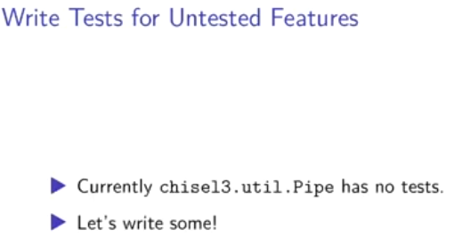
12.12 Write Test
https://www.youtube.com/watch?v=ddariAPH6us&list=PLlu0CT-JnSasfpk8tq1ZDiE2G0AK1BhOg&index=12
Write Test (48:31-49:30/1:05:33)

Slide 7
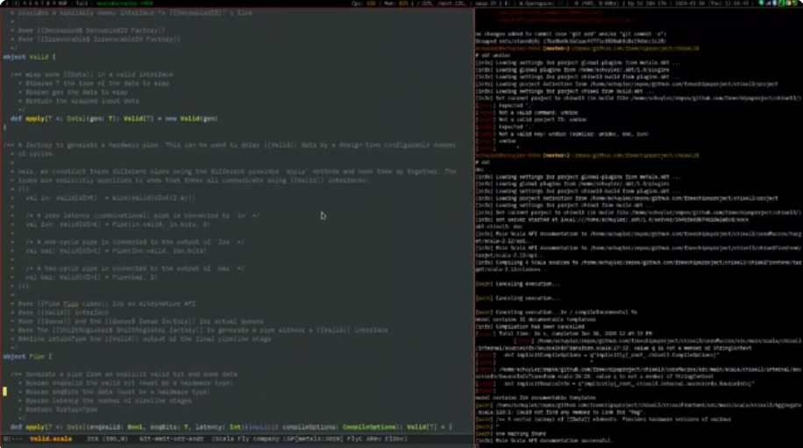
12.12 Write Test
https://www.youtube.com/watch?v=ddariAPH6us&list=PLlu0CT-JnSasfpk8tq1ZDiE2G0AK1BhOg&index=12
Write Test (48:31-49:28/1:05:33)
Device under test

Slide 8
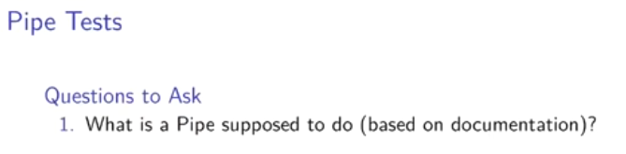
12.12 Write Test
https://www.youtube.com/watch?v=ddariAPH6us&list=PLlu0CT-JnSasfpk8tq1ZDiE2G0AK1BhOg&index=12
Write Test (49:29-49:56/1:05:33)

Slide 9
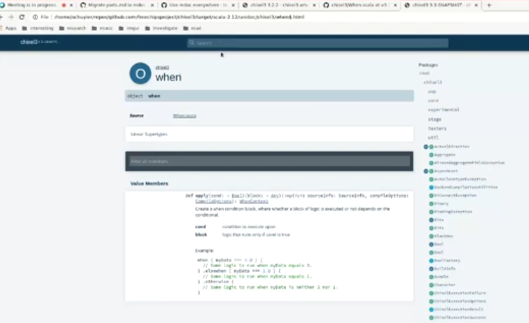
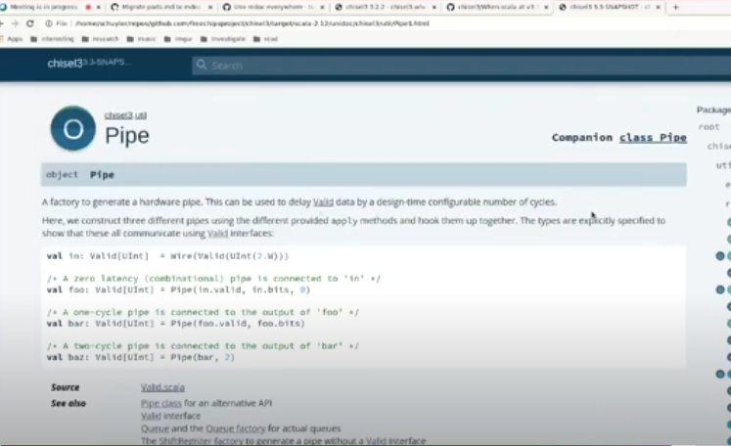
12.12 Write Test
https://www.youtube.com/watch?v=ddariAPH6us&list=PLlu0CT-JnSasfpk8tq1ZDiE2G0AK1BhOg&index=12
Write Test (49:57-51:30/1:05:33)

Slide 10
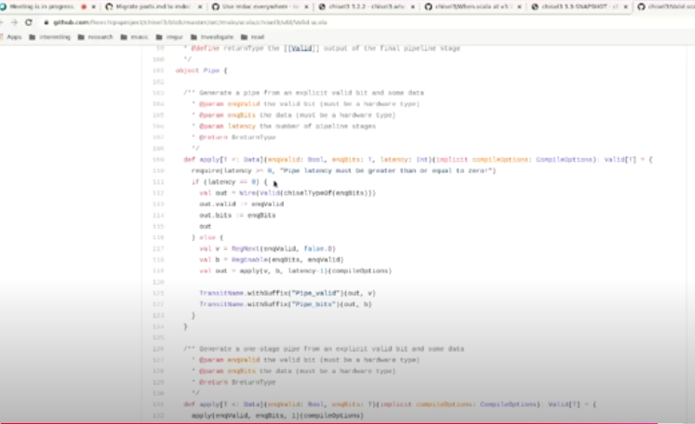
12.12 Write Test
https://www.youtube.com/watch?v=ddariAPH6us&list=PLlu0CT-JnSasfpk8tq1ZDiE2G0AK1BhOg&index=12
Write Test (51:31-51:56/1:05:33)

Slide 11
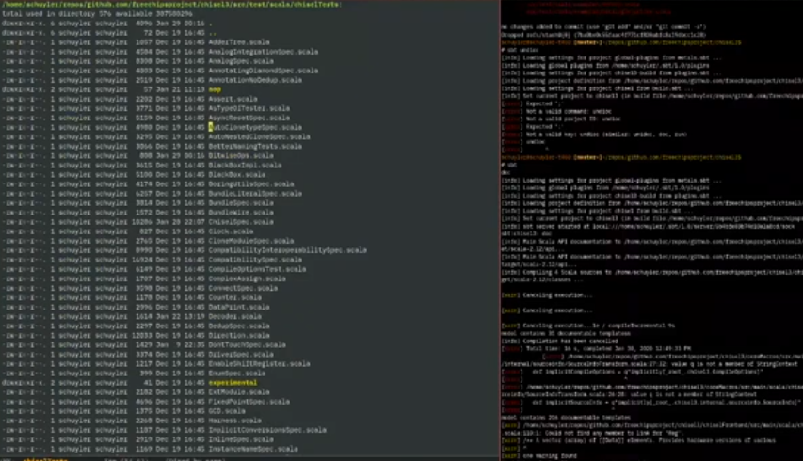
12.12 Write Test
https://www.youtube.com/watch?v=ddariAPH6us&list=PLlu0CT-JnSasfpk8tq1ZDiE2G0AK1BhOg&index=12
Write Test (51:57-57:34/1:05:33)
All different tests.

Slide 12
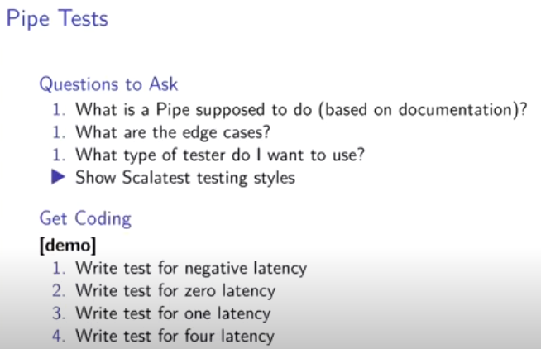
12.12 Write Test
https://www.youtube.com/watch?v=ddariAPH6us&list=PLlu0CT-JnSasfpk8tq1ZDiE2G0AK1BhOg&index=12
Write Test (57:35-58:26/1:05:33)
All different tests.

Slide 13
12.13 Chisel Standard Library

Slide 14
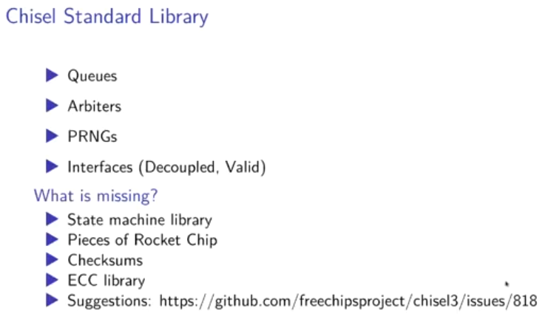
12.13 Chisel Standard Library
https://www.youtube.com/watch?v=ddariAPH6us&list=PLlu0CT-JnSasfpk8tq1ZDiE2G0AK1BhOg&index=12
Chisel Standard Library (58:27-1:05:33/1:05:33)
.
9

Slide 15
End

