Slide 1

4.06 Rocket Core
Peter H. Chen

Slide 2
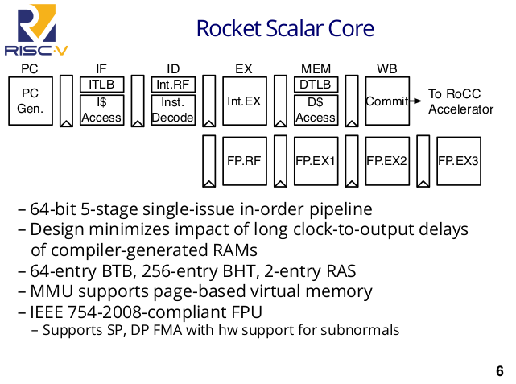
4.06 Rocket Core
https://www.youtube.com/watch?v=Ir3h3qWcNlg&list=PLlu0CT-JnSasfpk8tq1ZDiE2G0AK1BhOg&index=4
Rocket Core (5:43-7:20/41:08)
1. Rocket Core is a 64-bit, 5 stage, single-issue, in order pipe.
2. It is designed very carefully to minimize the impact of long clock to Q output delays of compiler generate RAM. We minimize the latency with branch prediction.
3. We deploy the 64-entry BTB (Branch Target Buffer), 256-entry BHT (Branch History Table), 2-entry RAS (Row Address Strobe). These number are tunable.
4. MMU (Memory Management Unit) page-based virtual memory. All the instruction cache and data cache are virtually index physical tagged.
5. Rocket Scala core also sup[port IEEE 754-2008-compliant FPU (Floating Point Unit): It support SP (Single Precision), DP (Double Precision) FMA (Fast Memory Access), a fuse multiplier/adder with hardware support for sub-normal.
Note:
All the instructions used here are submitted to RoCC (Rock Core) Accelerator.

Slide 3
4.07 ARM Cortex-A5 vs RISCV Rocket

Slide 4
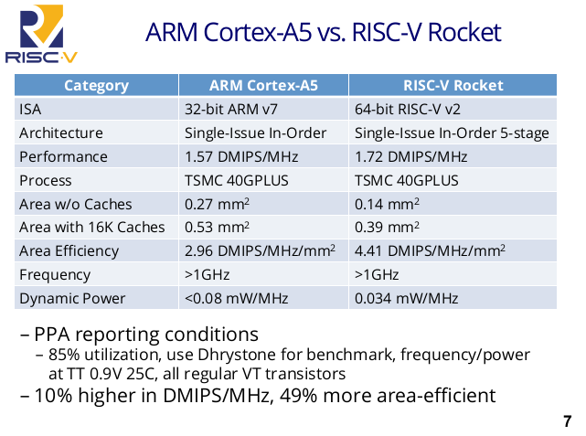
4.07 ARM Cortex-A5 vs RISCV Rocket
https://www.youtube.com/watch?v=Ir3h3qWcNlg&list=PLlu0CT-JnSasfpk8tq1ZDiE2G0AK1BhOg&index=4
ARM Cortex-A5 Core vs RISCV Rocket Core (7:21-9:00/41:08)
How do we compare RISCV Rocket Core to ARM Cortex-A5 Core?
Drystone is used to benchmark the performance of two cores.
Area is half
Power is half,

Slide 5
4.08 HTIF (Host-Target Interface)

Slide 6
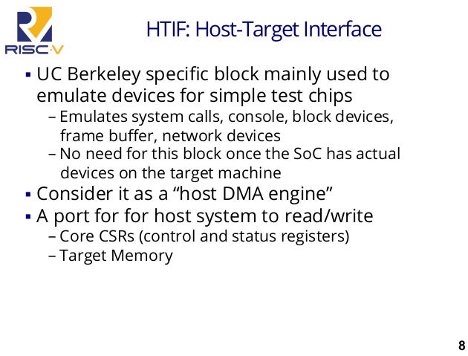
4.08 HTIF (Host-Target Interface)
https://www.youtube.com/watch?v=Ir3h3qWcNlg&list=PLlu0CT-JnSasfpk8tq1ZDiE2G0AK1BhOg&index=4
HTIF (Host-Target Interface) (9:01-9:33/41:08)
UC Berkeley mainly use emulate device and network devices to test SoC chips.
HTIF supports the core control, status registers, and target memory.

Slide 7
4.09 Import Interface in Rocket Chip

Slide 8
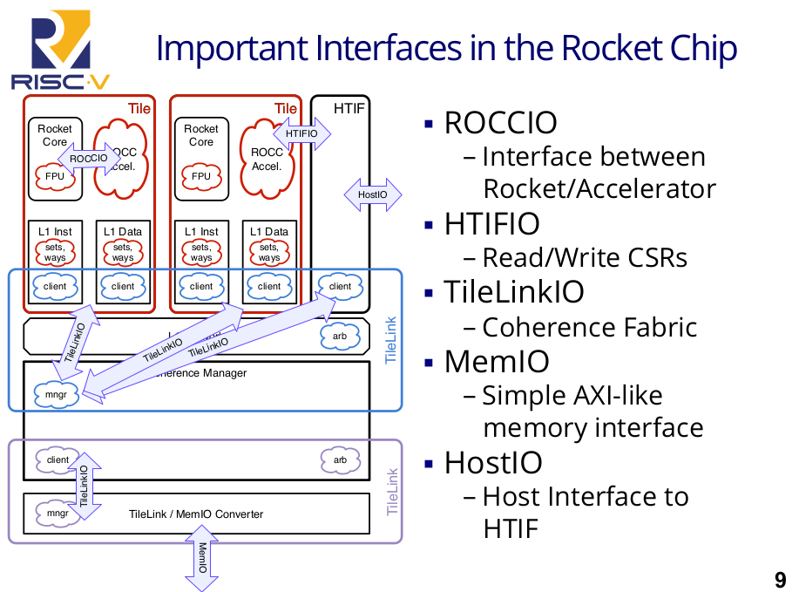
4.09 Import Interface in Rocket Chip
https://www.youtube.com/watch?v=Ir3h3qWcNlg&list=PLlu0CT-JnSasfpk8tq1ZDiE2G0AK1BhOg&index=4
Import Interface in Rocket Chip (9:34-11:40/41:08)
Below are 5 important interfaces of Rocket Chip:
1. ROCCIO (Rocket Core IO), 2. HTIFIO (Host Interface IO), 3. TileLinkIO (Tile Link IO), 4. MemIO (Memory IO), 5. HostIO (Host IO).

Slide 9
4.10 TileLinkIO

Slide 10
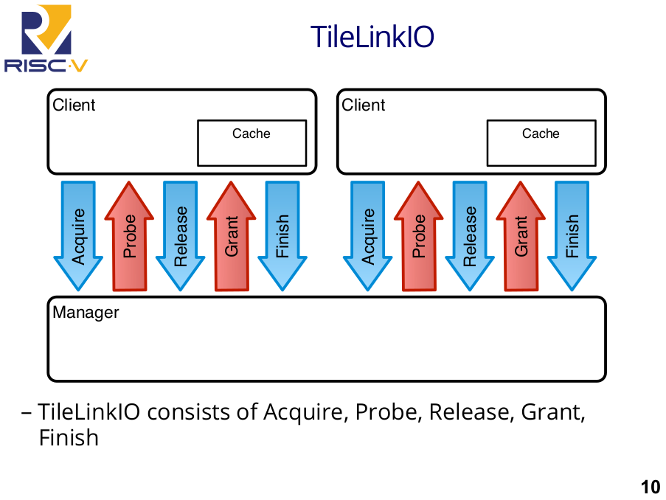
4.10 TileLinkIO
https://www.youtube.com/watch?v=Ir3h3qWcNlg&list=PLlu0CT-JnSasfpk8tq1ZDiE2G0AK1BhOg&index=4
TileLinkIO (11:41-13:33/41:08)
TileLinkIO: Client handshake with Manager, the request put in the single FIFO queue.
For example, client want a cache. Assume that there is no dirty copy in to cache line.
Below is the client and manager protocol:
1. Acquire: Client ask for memory, 2. Manger Probe memory line, 3. Client Release dirty data, 4. Manager Grant, 5. Client Finish: Acknowledgment.

Slide 11
End

