Slide 1

4.11 UncachedTileLinkIO
Peter H. Chen

Slide 2
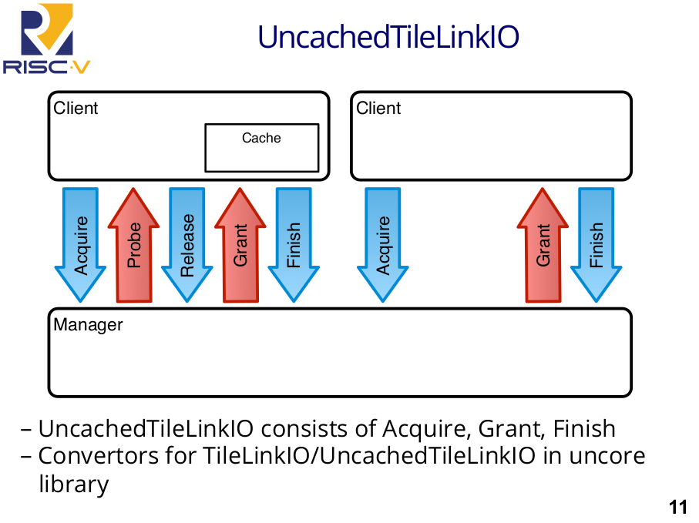
4.11 UncachedTileLinkIO
https://www.youtube.com/watch?v=Ir3h3qWcNlg&list=PLlu0CT-JnSasfpk8tq1ZDiE2G0AK1BhOg&index=4
UncachedTileLinkIO (13:34-14:39/41:08)
After the client clean the dirty copy in the cache line. The client/manager do not need probe/release.
For UncachedTileLinkIO only consists of Acquire, Grant, Finish.
The converters for TileLinkIO/UncachedTileLinkIO are in the UnCore library.

Slide 3
4.12 MemIO

Slide 4
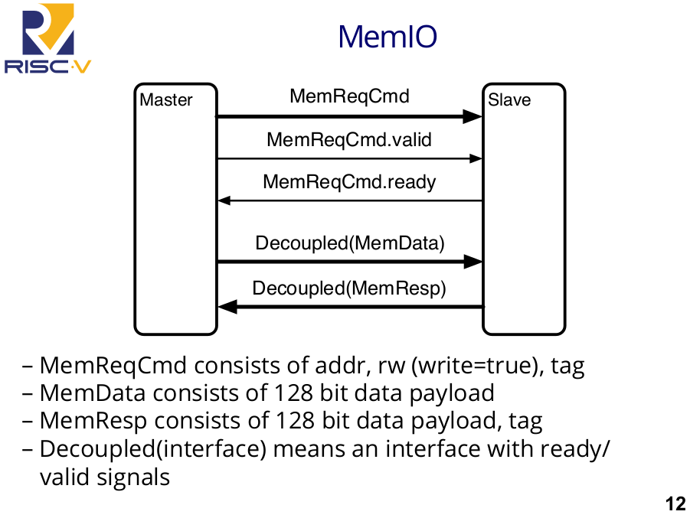
4.12 MemIO
https://www.youtube.com/watch?v=Ir3h3qWcNlg&list=PLlu0CT-JnSasfpk8tq1ZDiE2G0AK1BhOg&index=4
MemIO (14:40-15:58/41:08)
In MemIO, the master is simply the read/write command. There is a memory request command and it is decoupled. Below, we have have one of the decoupled interfaces. The valid is from left to right. The ready is from right to left. The transaction Data happened when it is ready and valid.
1. The MemReqCmd (memory request command) consist of address of cache line, read/write bit, write TRUE indicates it is a write, and there is a tag.
2. MemData consists of 128 data payload.
3. If Master send MemReqCmd = STORE to the slave, the slave will assume that there is 4-bits of MemData (Mem0ry Data) coming.
4. If Master send MemReqCmd = LOAD to the slave, the slave MemResp (Member Response with 128 bit data payload. The response data include a tag data).
5. Decoupled (interface) means there is a interface data include ready/valid signal.

Slide 5
4.13 ROCCIO

Slide 6
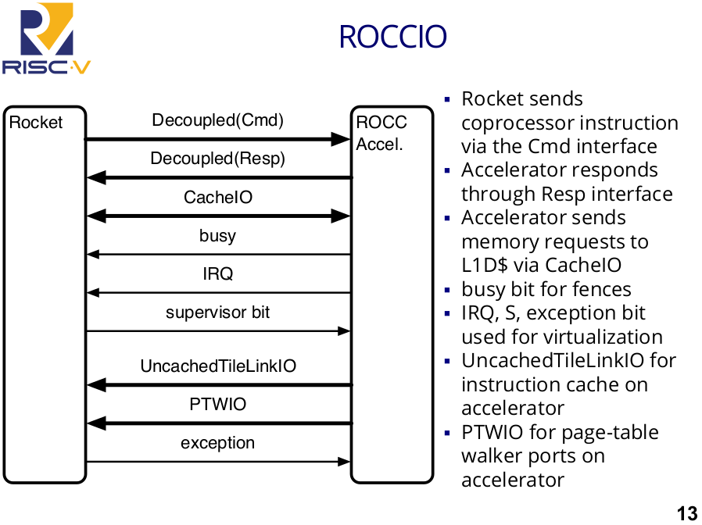
4.13 ROCCIO
https://www.youtube.com/watch?v=Ir3h3qWcNlg&list=PLlu0CT-JnSasfpk8tq1ZDiE2G0AK1BhOg&index=4
ROCCIO (15:59-18:07/41:08)
In ROCCIO (Rocket Core IO), on the left, there is a Rocket processor. On the right is the Accelerator.
Once the Rocket Processor fetches a instruction, it will move all the way to the commit stage, commit, and push it to the Rocket Accelerator.
The accelerator has a port to the memory which goes through this cache IO. Cache IO send, load, and store to Rocket L1 Data Cache. There is a busy bit going from Accelerator to Rocket.
There is a supervisor bit from Rocket Core to Accelerator.
There is PTWIO (Page Table Walker IO) for you to put some table structure in your accelerator.

Slide 7
4.14 HTIFIO

Slide 8
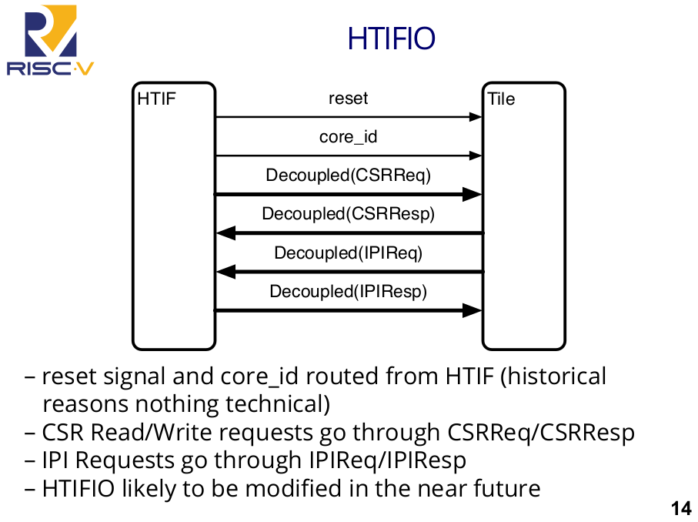
4.14 HTIFIO
https://www.youtube.com/watch?v=Ir3h3qWcNlg&list=PLlu0CT-JnSasfpk8tq1ZDiE2G0AK1BhOg&index=4
HTIFIO (18:08-19:25/41:08)
In HTIFIO (Historical Tile Interface IO), there is a reset signal from the HT to Tile and the core_id indicating which core core the specific Tile number.
There is a CSR (Control and Status Register) read/write interface for HT request the tile and the CSR response.
HTIFIO will be modified in future.

Slide 9
4.15 Rocket Chip C++ Emulator

Slide 10
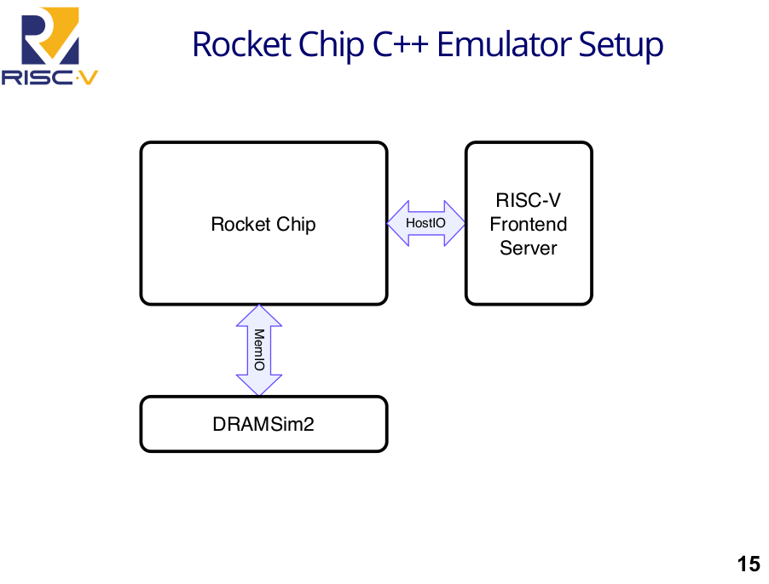
4.15 Rocket Chip C++ Emulator
https://www.youtube.com/watch?v=Ir3h3qWcNlg&list=PLlu0CT-JnSasfpk8tq1ZDiE2G0AK1BhOg&index=4
Rocket Chip C++ Emulator Setup (19:26-20:40/41:08)
Here, we discuss how the Rocket Chip connected to the outside world.
Below is Rocket Chip C++ Emulator setup.
Rocket Chip has HostIO to the frontend server and MemIO interface to DRAM memory.
The DRAMsim is the open source.
User write the code in the frontend will reset the core the start run.

Slide 11
End

