Slide 1

4.16 FPGA Setup
Peter H. Chen

Slide 2
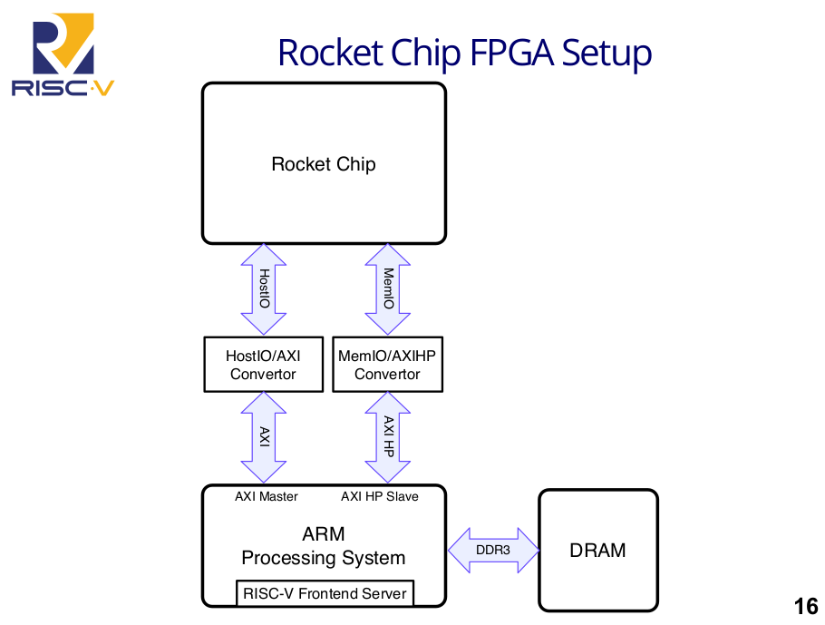
4.16 FPGA Setup
https://www.youtube.com/watch?v=Ir3h3qWcNlg&list=PLlu0CT-JnSasfpk8tq1ZDiE2G0AK1BhOg&index=4
Rocket Chip FPGA Setup (20:41-21:46/41:08)
To setup FPGA, the Rocket Chip needs to connect HostIO and MemIO.
In FPGA, we need ARM Processing System for Ethernet IP and memory IP.
So, we build a HostIO/AXI converter and connect to AXI (Advanced exTensible Interface) Master on ARM core and we build a MemIO/AXIHP (AXI High Performance) Converter. We run ARM server on ARM processing system on Zen.

Slide 3
4.17 Test Chip Setup

Slide 4
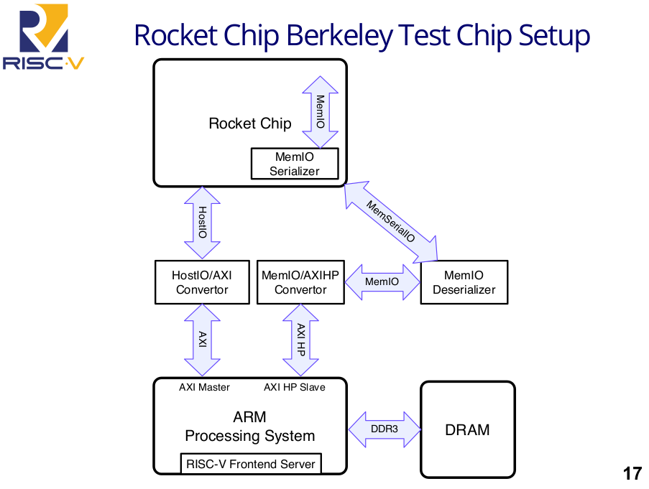
4.17 Test Chip Setup
https://www.youtube.com/watch?v=Ir3h3qWcNlg&list=PLlu0CT-JnSasfpk8tq1ZDiE2G0AK1BhOg&index=4
Rocket Chip Berkeley Test Chip Setup (21:47-22:48/41:08)
Below is UC Berkeley Test Chip Setup. We 128 bit interface come our of chip.
The test chip add serial and deserial interface.
Rocket Chip have MemIO Serializer to make serial interface. In the MemIO Deserializer, we make parallel interface.

Slide 5
4.18 SoC Setup

Slide 6
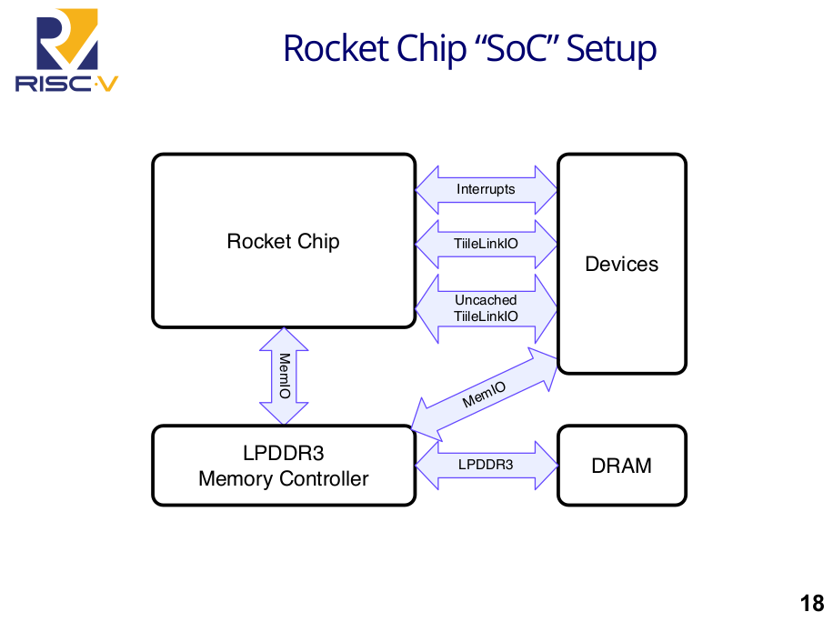
4.18 SoC Setup
https://www.youtube.com/watch?v=Ir3h3qWcNlg&list=PLlu0CT-JnSasfpk8tq1ZDiE2G0AK1BhOg&index=4
Rocket Chip SoC Setup (22:49-23:43/41:08)
Below is the SoC Setup with complete IO Devices and Memory.

Slide 7
4.19 Why Rocket Chip Generator?

Slide 8
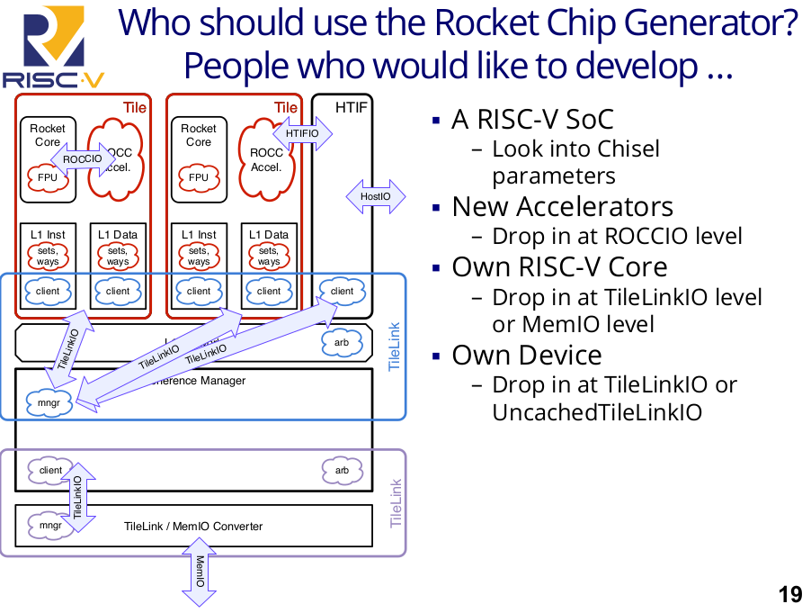
4.19 Why Rocket Chip Generator?
https://www.youtube.com/watch?v=Ir3h3qWcNlg&list=PLlu0CT-JnSasfpk8tq1ZDiE2G0AK1BhOg&index=4
Why Rocket Chip Generator? (23:44-25:37/41:08)
People who develop RISCV SoC will look at the Chisel Parameter.
User need to tune parameters for your RISCV SoC application, new ROCCIO (Rocket Core IO/ accelerator), RISCV Core (TileLinkIO/MemIO), new Device (TileLinkIO/UncachedTileLinkIO).

Slide 9
4.20 New Features

Slide 10
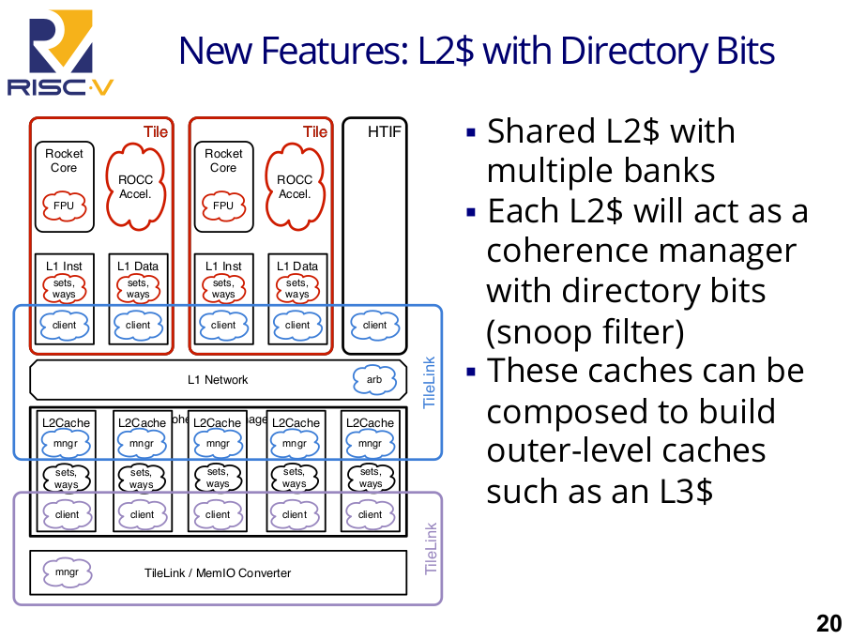
4.20 New Features
https://www.youtube.com/watch?v=Ir3h3qWcNlg&list=PLlu0CT-JnSasfpk8tq1ZDiE2G0AK1BhOg&index=4
New Features (25:38-26:50/41:08)
There are new features for Rocket Chip.
Below we see the L2$ (L2 Cache) and L2$ act as coherence manager.
We can compose the outer level cache, such as, L3$ (Cache).

Slide 11
End

