Slide 1

4 Instantiate Module
Peter H. Chen

Slide 2
4 Instantiate Module
https://github.com/ucb-bar/chisel-tutorial/wiki/Instantiating-Modules
Instantiate Model
Chisel instantiates module and hierarchy.
In Chisel, instantiating a Module class is the equivalent to instantiating a module in Verilog.
To do the instantiation, we use a scala call to Module to create module.
We assign value so that we can reference its input and outputs. We also need to connect the inputs and outputs.

Slide 3
4.1 Adder4
Peter H. Chen

Slide 4
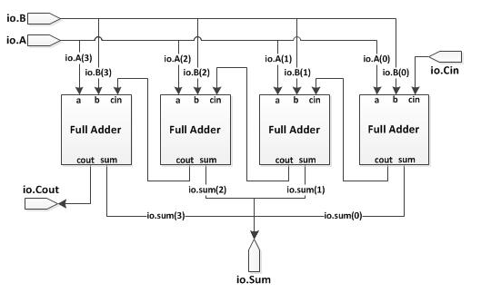
4.1 Adder4
https://github.com/ucb-bar/chisel-tutorial/wiki/Instantiating-Modules
Adder4
In below Figure 1, we construct a 4-bit adder using multiple copies of the FullAdder module.

Slide 5
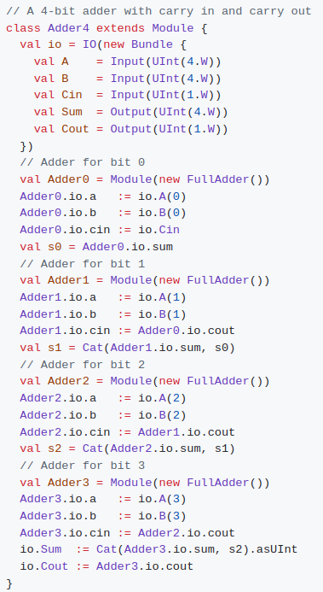
4.1 Adder4
https://github.com/ucb-bar/chisel-tutorial/wiki/Instantiating-Modules
1
Adder4
The Chisel source code is shown on the right.
Note:
1. We have IO includes three inputs (A, B, Cin) and two outputs (Sum and Cout).
2. When referencing each module I/O we must first reference io that contains the ports for the I/Os.
3. All assignments to the module I/Os use a reassignment operator :=.
4. When instantiating modules, it is important to make sure that you connect all the input and output ports.
5. If a port is not connected, the Chisel compiler may optimize away portions of your design that it finds unnecessary due to the unconnected ports and throw errors or warnings.
2
3

Slide 6
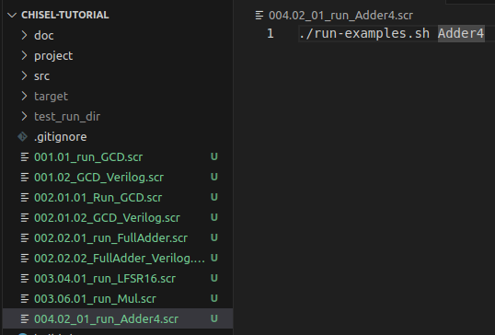
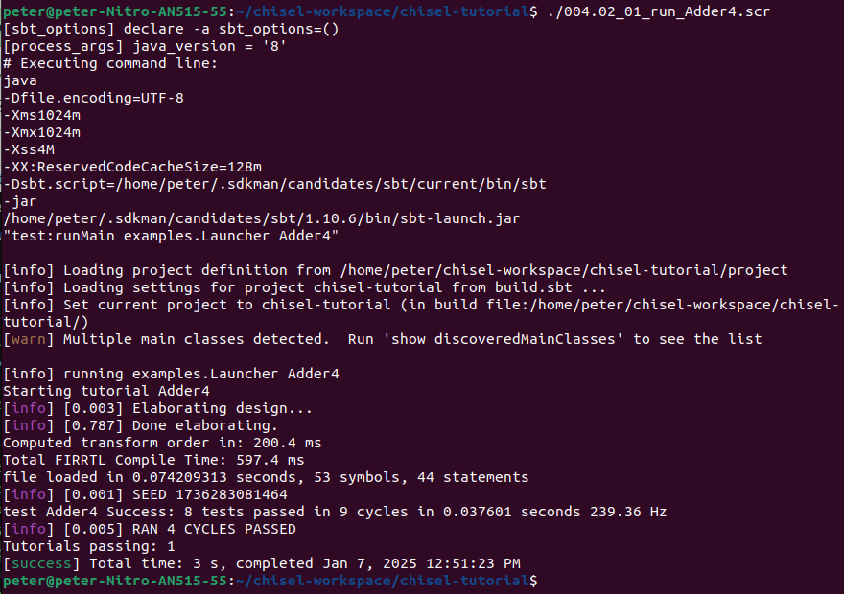
4.1 Adder4
1
https://github.com/ucb-bar/chisel-tutorial/wiki/Instantiating-Modules
Adder4
1. > ./004.02_01_run_Adder4.scr
>> ./run-examples.sh Adder4
2. Result
2

Slide 7
4.2 Vec Class

Slide 8
4.1 Vec Class
https://github.com/ucb-bar/chisel-tutorial/wiki/Instantiating-Modules
Vec Class
The Vec class allows you to create an indexable vector in Chisel which can be filled with any expression that returns a chisel data type.
The general syntax for a Vec declaration is given by:
Where <number of elements> corresponds to how long the vector is and <data type> corresponds to what type of class the vector contains.

Slide 9


4.2 Vec Class
https://github.com/ucb-bar/chisel-tutorial/wiki/Instantiating-Modules
Vec Class
If we want to define a register of vector...
In order to assign to a particular value of the Vec, we simply assign the target value to the vector at a specified index.
For instance, if we wanted to assign a UInt value of zero to the first register in the above example, the assignment would look like:

Slide 10


4.2 Vec Class
https://github.com/ucb-bar/chisel-tutorial/wiki/Instantiating-Modules
Vec Class
To access a particular element in the vector at some index, we specify the index of the vector.
For example, to extract the 5th element of the register vector in the above example and assign it to some value reg5, the assignment would look like:
The syntax for the Vec class is slightly different when instantiating a vector of modules.
When instantiating a vector of modules the data type that is specified in the {} braces is slightly different than the usually primitive types.
To specify a vector of modules, we use the io bundle when specifying the type of the vector. For example, in order to specify a Vec with 16 modules, say FullAdders in this case, we would use the following declaration:
Note:
We use the keyword new in the vector definition before the module name FullAdder. For how to actually access the io on the vector modules, refer to the next section.

Slide 11
4.3 Simple Vec Shift Register

Slide 12
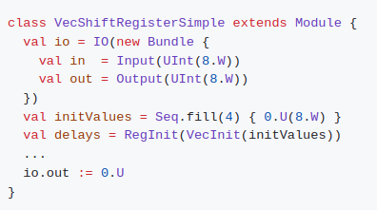
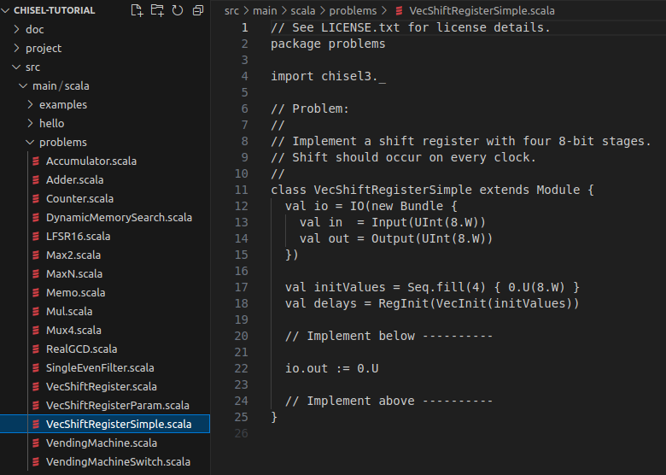
4.3 Simple Vec Shift Register
https://github.com/ucb-bar/chisel-tutorial/wiki/Instantiating-Modules
Simple Vec Shift Reg
The next assignment is to construct a simple bit shift register.
1. Below is the code template from $TUT_DIR/src/main/scala/problems/VecShiftRegisterSimple.scala.
2. Here, out is a four cycle delayed copy of values on in.
1
2
1
2

Slide 13
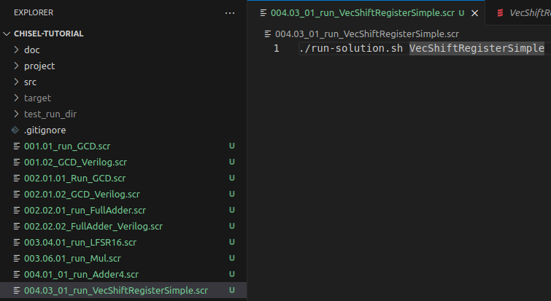
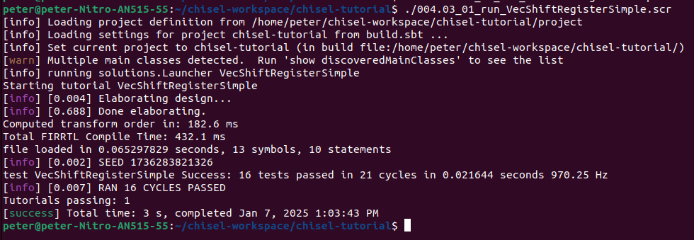
4.3 Simple Vec Shift Register
https://github.com/ucb-bar/chisel-tutorial/wiki/Instantiating-Modules
Simple Vec Shift Reg
1. > ./004.03_01_run_vecShiftRegisterSimple.scr
>> ./run-solution.sh VecShiftRegisterSimple
2. Result
1
2

Slide 14
4.4 Parameterization

Slide 15
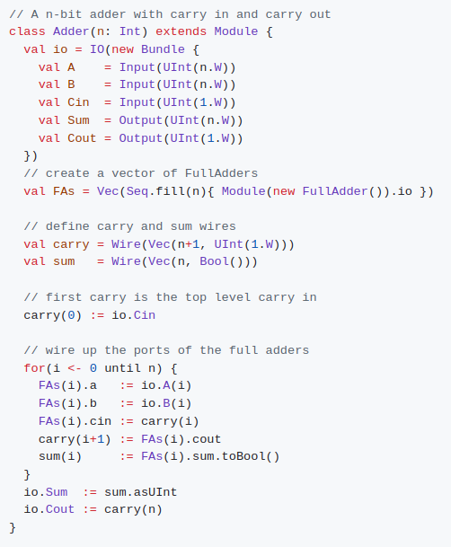
4.4 Parameterization
https://github.com/ucb-bar/chisel-tutorial/wiki/Instantiating-Modules
Parameterization
1. In the Adder example, we explicitly instantiated four different copies of a FullAdder and wired up the ports.
2. Suppose we want to generalize this structure to an n-bit adder. Like Verilog, Chisel allows you to pass parameters to specify certain aspects of your design. In order to do this, we add a parameter in the Module declaration to our Chisel definition.
3. For a carry ripple adder, we would like to parametrize the width to some integer value n as shown on the right.

Slide 16
4.4 Parameterization
https://github.com/ucb-bar/chisel-tutorial/wiki/Instantiating-Modules
3
Parameterization
Note:
In this example, we keep track of the sum output in a Vec of Bools. This is because Chisel does not support bit assignment directly. Thus in order to get the n-bit wide sum in this example, we use an n-bit wide Vec of Bools and then cast it to a UInt().
2. The modules are instantiated in a Vec class which allows us to iterate through each module when assigning the ports connections to each FullAdder. This is similar to the generate statement in Verilog. However, you will see in more advanced tutorials that Chisel can offer more powerful variations.
3. Instantiating a parametrized module is very similar to instantiating an unparametrized module except that we must provide arguments for the parameter values.
2
1

Slide 17


4.4 Parameterization
https://github.com/ucb-bar/chisel-tutorial/wiki/Instantiating-Modules
Parameterization
Note:
For instance, if we wanted to instantiate a 4-bit version of the Adder module we defined above, it would look like:
We can also instantiate the Adder by explicitly specifying the value of its parameter n like the this:

Slide 18

4.4 Parameterization
https://github.com/ucb-bar/chisel-tutorial/wiki/Instantiating-Modules
Parameterization
We can explicitly specify the parameter values in any order:
All of the above definitions pass the same parameters to the FIFO module.
Note:
When you explicitly assign the parameter values, they can occur in any order you want such as the definition for fifo3.

Slide 19
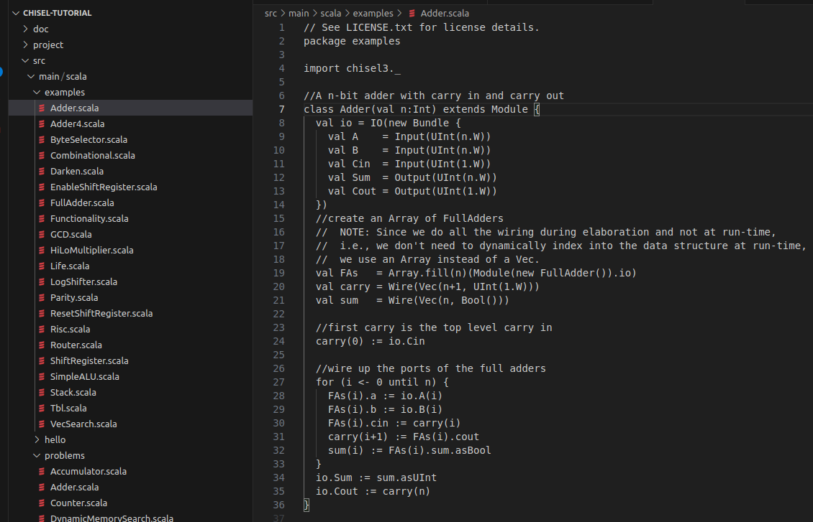
4.4 Parameterization
https://github.com/ucb-bar/chisel-tutorial/wiki/Instantiating-Modules
Parameterization
For parametrization the width to some integer value n, we Chisel code is located as src/main/scala/examples/Adder.scala:

Slide 20
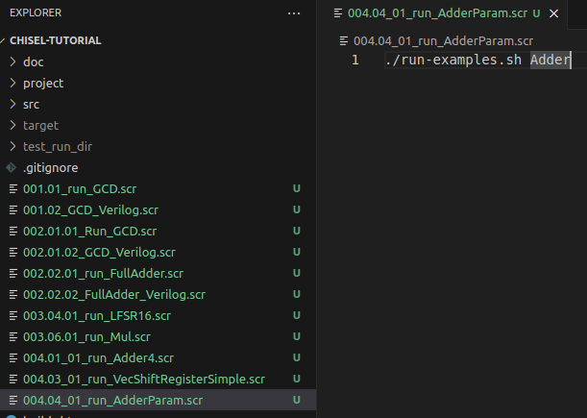
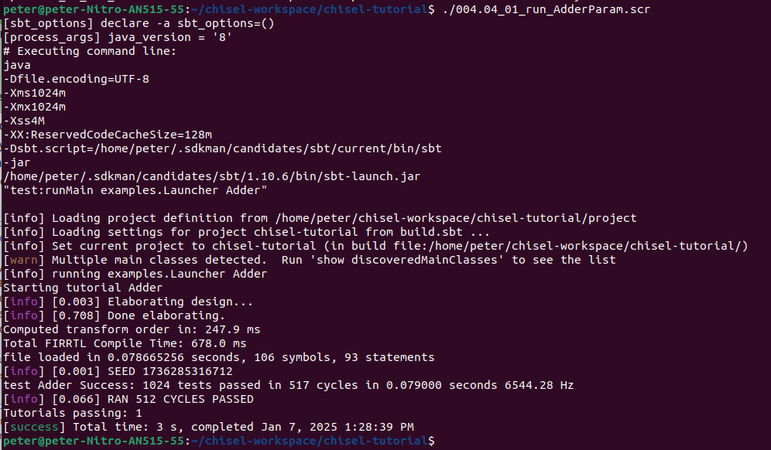
4.4 Parameterization
1
https://github.com/ucb-bar/chisel-tutorial/wiki/Instantiating-Modules
Parameterization
1. > ./004.04_01_run_AdderParm.scr
>> ./run-examples.sh Adder
2. Result
2

Slide 21
4.5 Primitive

Slide 22
4.4 Parameterization
https://github.com/ucb-bar/chisel-tutorial/wiki/Instantiating-Modules
Primitive
1. Like other HDL, Chisel provides some very basic primitives.
2. These are constructs that are built in to the Chisel compiler and come for free.
3. The Reg, UInt, and Bundle classes are such primitives that have already been covered.
4. Unlike Module instantiations, primitive do not require explicit connections of their io ports to use.
5. Other useful primitive types include the Mem and Vec classes which will be discussed in a more advanced tutorial.

Slide 23

4.4 Parameterization
https://github.com/ucb-bar/chisel-tutorial/wiki/Instantiating-Modules
Primitive
Below, we only explore the use of the Mux primitive.
The Mux Class
1. The Mux primitive is a two input multiplexer.
2. In order to use the Mux we first need to define the expected syntax of the Mux class.
3. As with any two input multiplexer, it takes three inputs and one output.
4. Two of the inputs correspond to the data values A and B that we would like to select which can be any width and data type as long as they are the same.
5. The first input select, which is a Bool type, determines which one to output.
6. A select value of true will output the value A, while a select value of false will pass B.
Note:
1. If A=10, B=14, and select was true, the value of out would be assigned 10.
2. Here, we use the Mux primitive type for abstraction. We do not need to implement the internal logic of multiplexer.

Slide 24
4.6 Parameterized Width of Adder

Slide 25
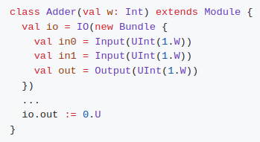
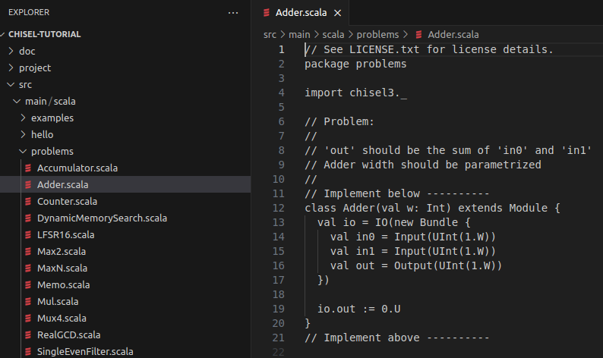
4.6 Parameterized Width of Adder
https://github.com/ucb-bar/chisel-tutorial/wiki/Instantiating-Modules
Parameterized Width of Adder
We have the below assignment:
1. Construct an adder with a parameterized width using the pre-built in addition operator +.
2. Specification: $TUT_DIR/src/main/scala/problems/Adder.scala.
Below is the code of specification.
3. Note:
The val is added to the width parameter value to allow the width to be accessible from the tester as a field of the adder module object.

Slide 26
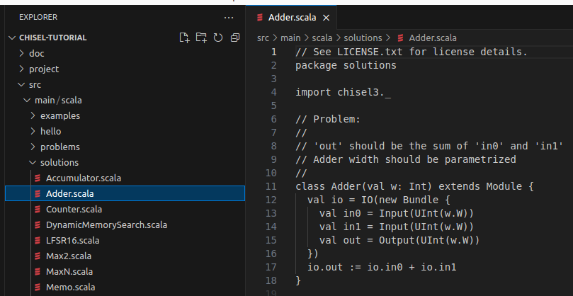
4.6 Parameterized Width of Adder
https://github.com/ucb-bar/chisel-tutorial/wiki/Instantiating-Modules
Parameterized Width of Adder
Here, out is sum of w width unsigned inputs in0 and in1.
Implement Solution: $TUT_DIR/src/main/scala/solutions/Adder.scala.

Slide 27
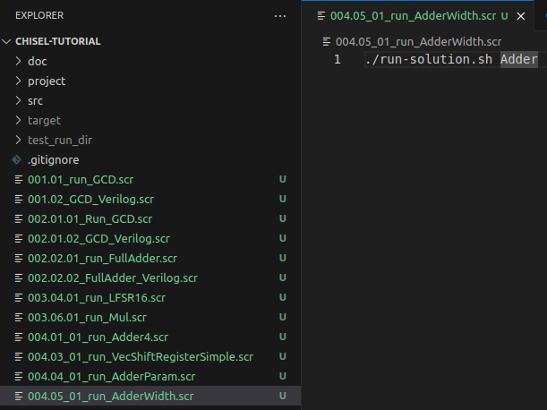
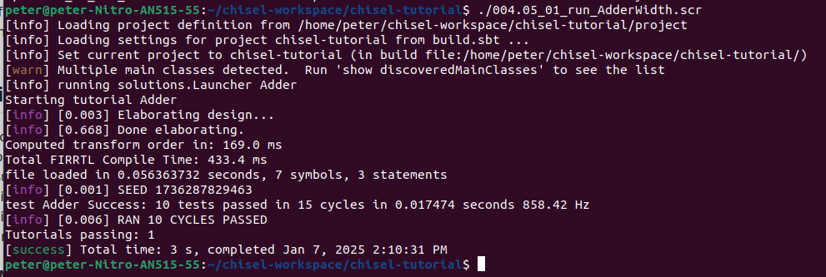
4.6 Parameterized Width of Adder
1
https://github.com/ucb-bar/chisel-tutorial/wiki/Instantiating-Modules
Parameterized Width of Adder
1. ./004.05_01_run_AdderWidth.sh
>> ./run-solution.sh Adder
2. Result
2

Slide 28
End

