Slide 1

4.2 Traverse AST
Peter H. Chen

Slide 2
4.2 Traverse AST
https://github.com/freechipsproject/chisel-bootcamp
Traverse AST
We discuss Scala/Chisel AST Traverse
Topics:

Slide 3
4.1.1 Setup

Slide 4
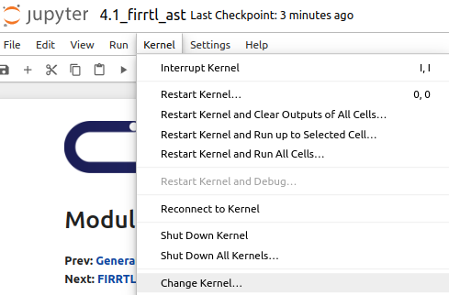
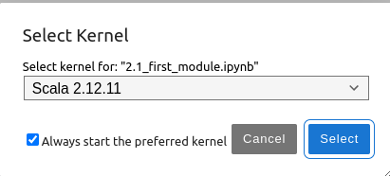
4.1.1 Setup
https://github.com/freechipsproject/chisel-bootcamp
Setup
1. Change folder to chisel-bootcamp. If you want to work on your working space, copy image folder and source folder to your working directory.
> cd chisel-bootcamp
2. Start Jupyter notebook
> jupyter notebook 4.1_firrtl_ast.ipynb
3. Select the scala interpreter: > Kernel > Change Kernel… >Scala 2.12.11
3

Slide 5
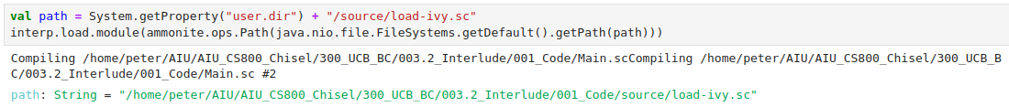
4.1.1 Setup
https://github.com/freechipsproject/chisel-bootcamp
Setup
1. Scala uses maven to setup path to with for source folder for Scala Libraries and get Scala Property.

Slide 6
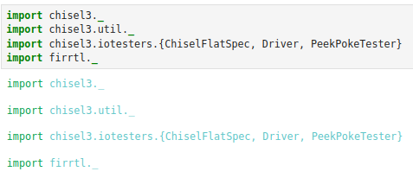
4.1.1 Setup
https://github.com/freechipsproject/chisel-bootcamp
Setup
1. import chisel3 library, utility, tester harness (horse controller), firrtl, etc.

Slide 7
End

