Slide 1

7.1 Chisel Bootcamp: Introduction
Peter H. Chen

Slide 2
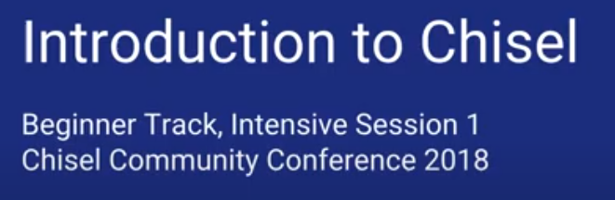
7.1 Chisel Bootcamp: Introduction
https://www.youtube.com/watch?v=OhMuPQcyynY&list=PLlu0CT-JnSasfpk8tq1ZDiE2G0AK1BhOg&index=7
Chisel Bootcamp: Introduction (0:00-0:01/1:20:22)
1. Chisel project github location
2. eDSL (embedded Domain Specific Language): chisel is a language embedded in Scala
3. Scala has both OOD and function programming fit the hardware design
4. Verilog is a behavioral model simulation language. Chisel is not a behavioral model. Chisel create the actual circuit.
5. Functional programming can create circuit, parameterization, high level order, passing lambda function
7. GitHub examples: modules, combination logic, sequential logic, asynchronous circuit, analog/mixed signal block, digital block, compiler framework, test bench, FPGA, ASIC RTL Verilog generation
https://github.com/freechipsproject/chisel-bootcamp

Slide 3
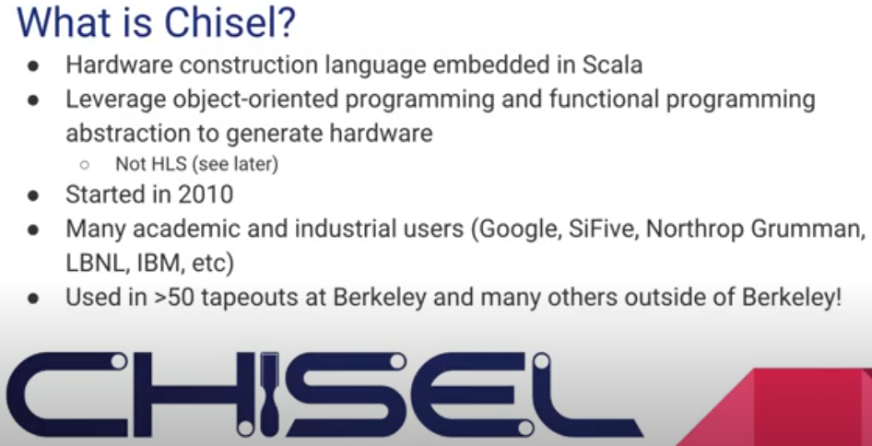
7.1 Chisel Bootcamp: Introduction
https://www.youtube.com/watch?v=OhMuPQcyynY&list=PLlu0CT-JnSasfpk8tq1ZDiE2G0AK1BhOg&index=7
Chisel Introduction (0:02-0:22/1:20:22)

Slide 4
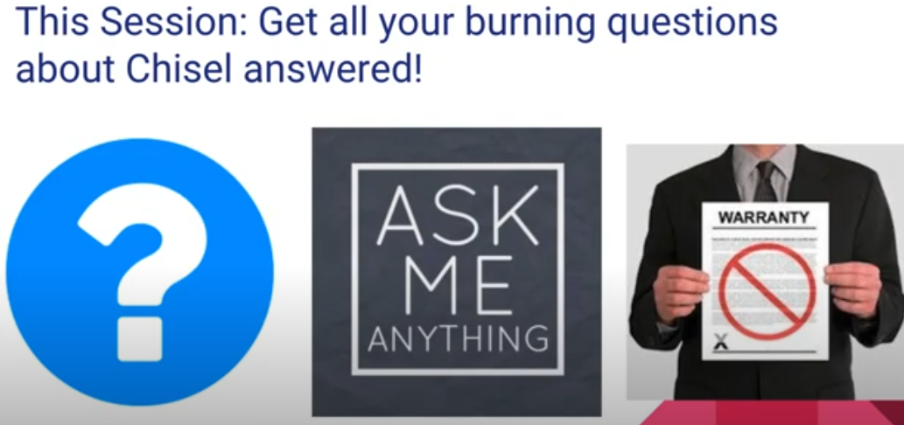
7.1 Chisel Bootcamp: Introduction
https://www.youtube.com/watch?v=OhMuPQcyynY&list=PLlu0CT-JnSasfpk8tq1ZDiE2G0AK1BhOg&index=7
Chisel Introduction (0:02-1:22/1:20:22)
Presenter: Chuck Mark Lee, Chisel Support

Slide 5
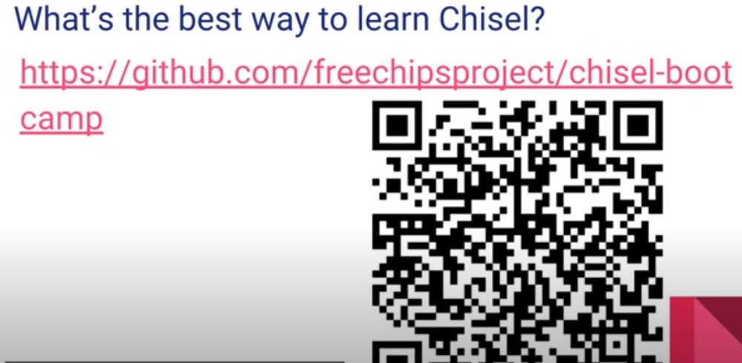
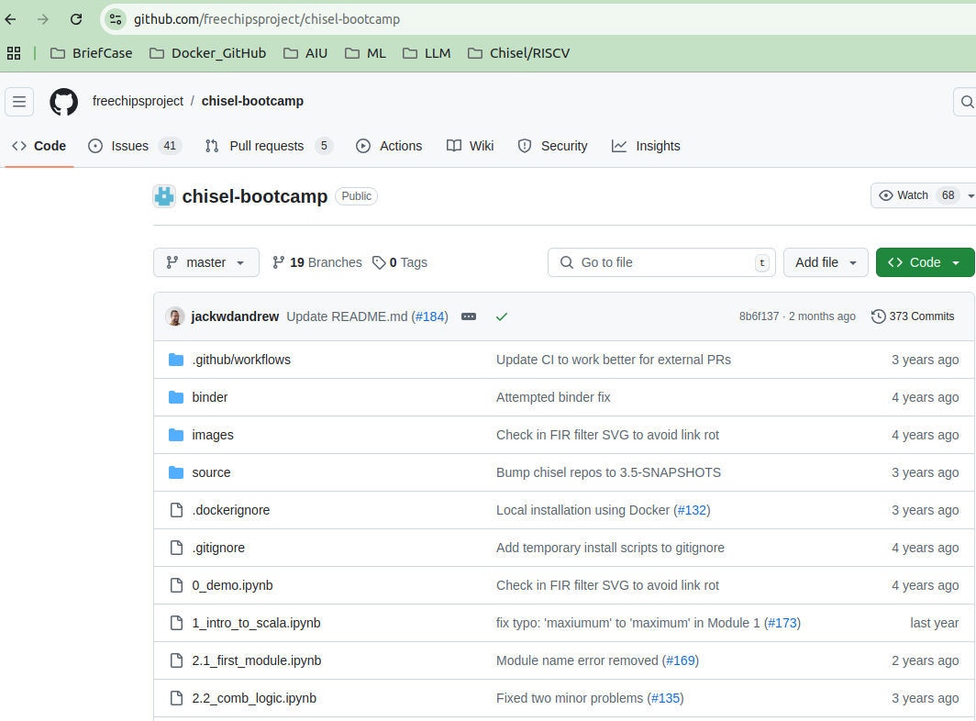
7.1 Chisel Bootcamp: Introduction
https://www.youtube.com/watch?v=OhMuPQcyynY&list=PLlu0CT-JnSasfpk8tq1ZDiE2G0AK1BhOg&index=7
Chisel Introduction (1:23-2:22/1:20:22)
https://github.com/freechipsproject/chisel-bootcamp

Slide 6
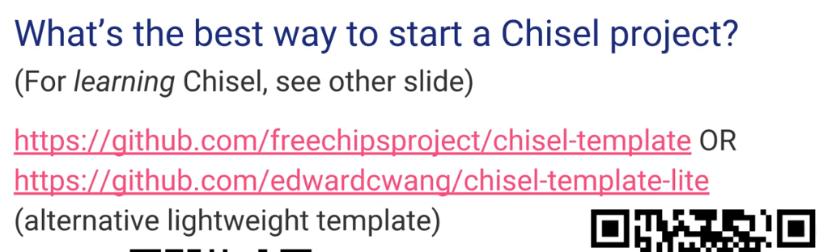
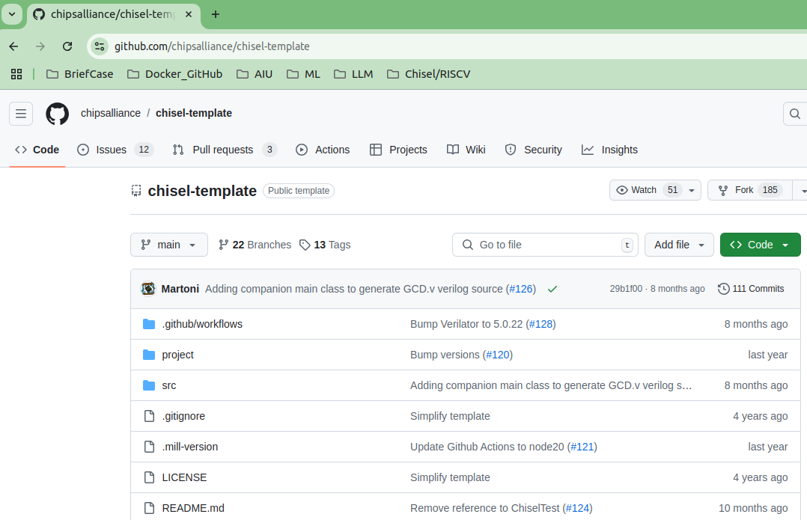
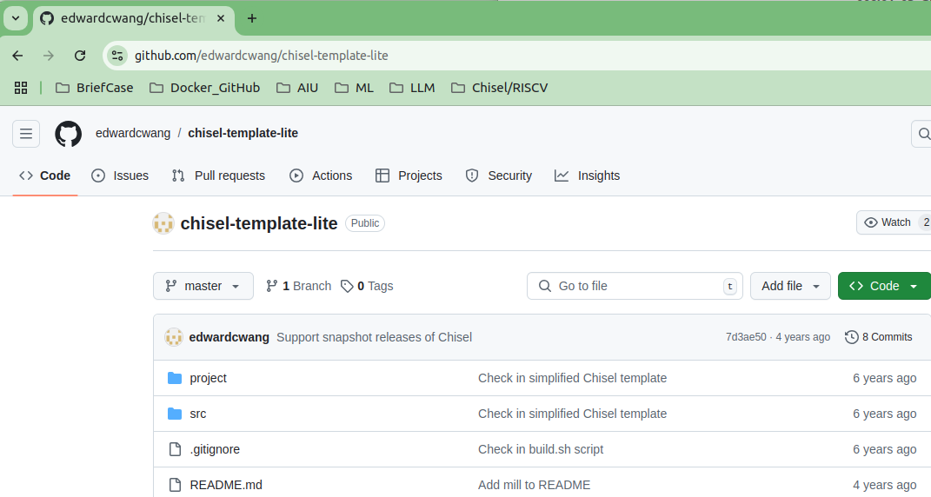
7.1 Chisel Bootcamp: Introduction
https://www.youtube.com/watch?v=OhMuPQcyynY&list=PLlu0CT-JnSasfpk8tq1ZDiE2G0AK1BhOg&index=7
Chisel Introduction (2:23-3:11/1:20:22)
Best way is to start with template.
https://github.com/freechipsproject/chisel-template
https://github.com/edwardcwang/chisel-template-lite

Slide 7
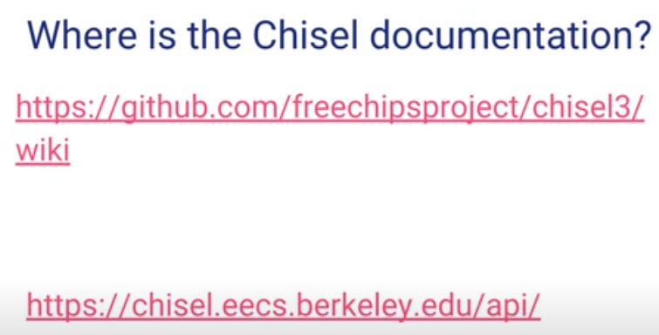
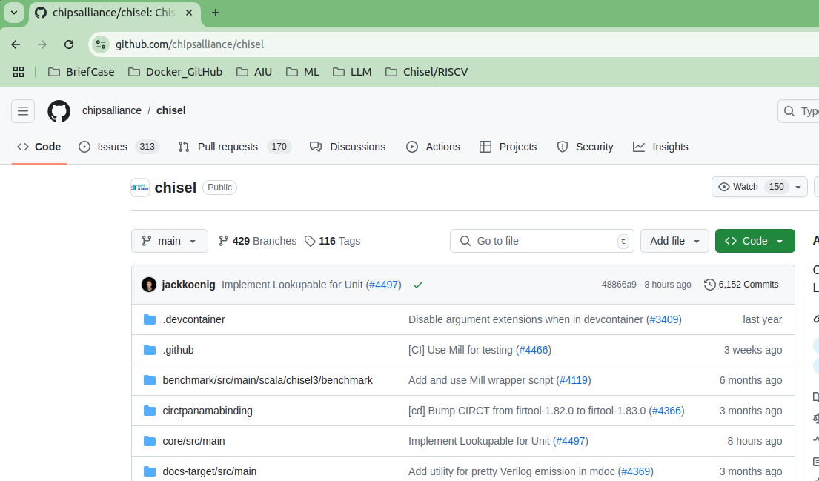
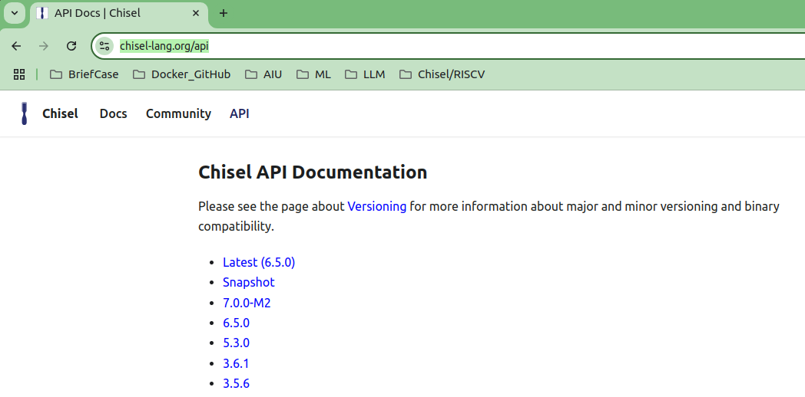
7.1 Chisel Bootcamp: Introduction
https://www.youtube.com/watch?v=OhMuPQcyynY&list=PLlu0CT-JnSasfpk8tq1ZDiE2G0AK1BhOg&index=7
Chisel Introduction (3:12-3:40/1:20:22)
Chisel Documentation
https://github.com/freechipsproject/chisel3/wiki
https://chisel.eecs.berkeley.edu/api

Slide 8
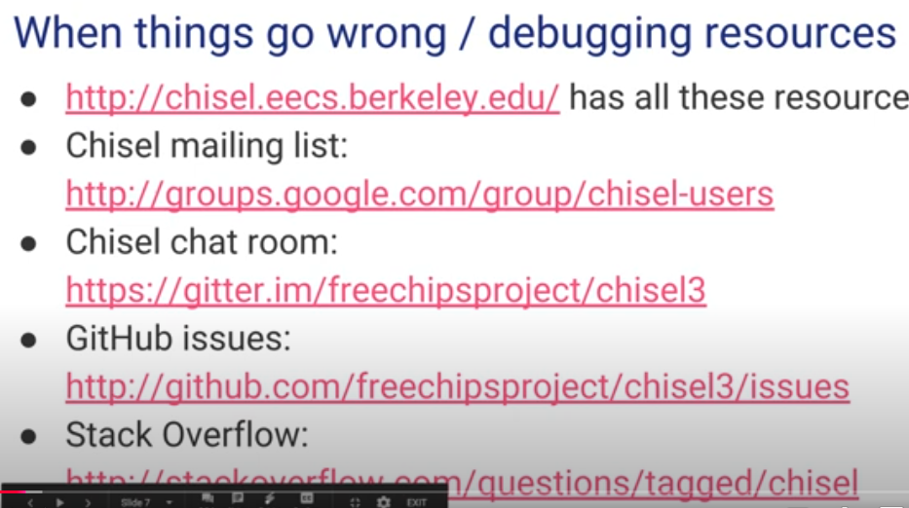
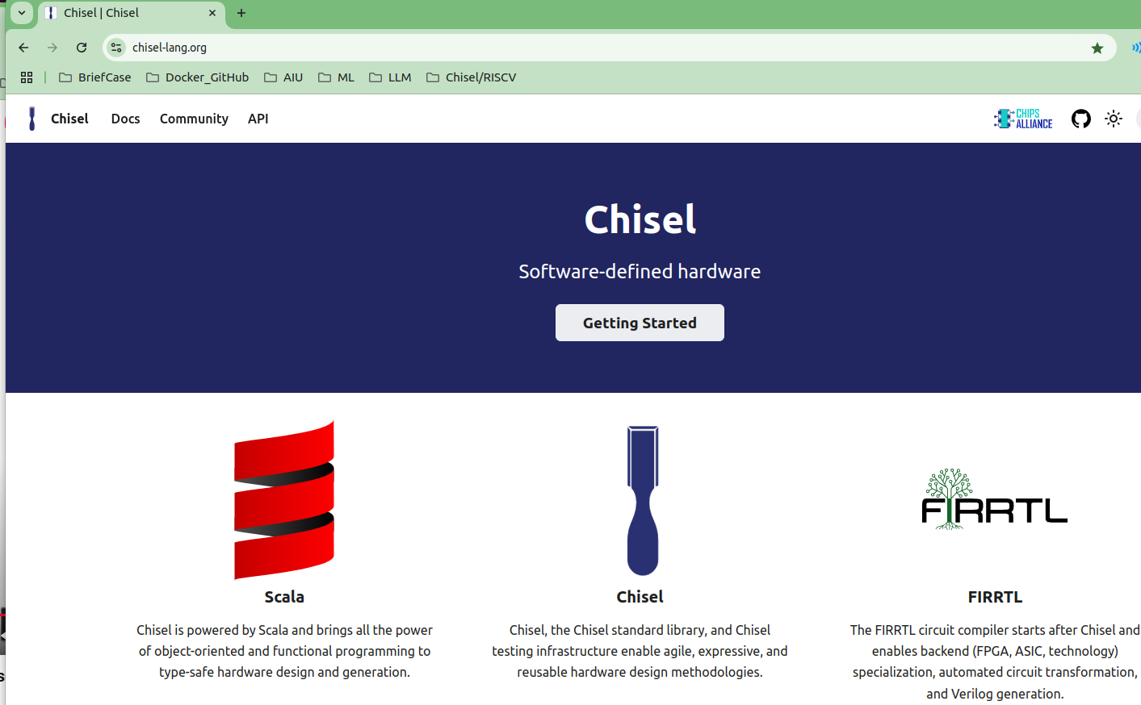
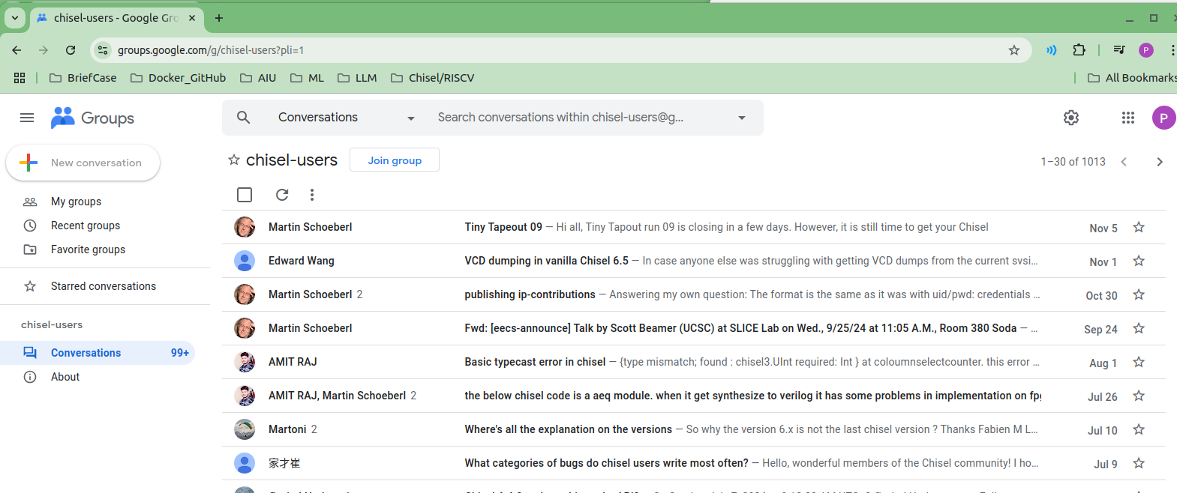
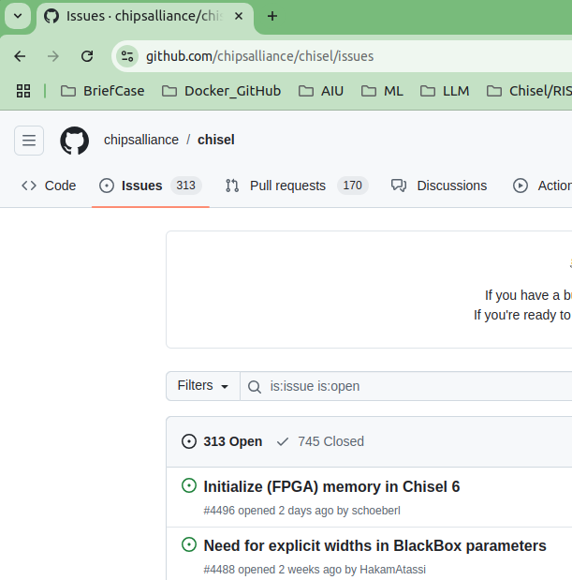
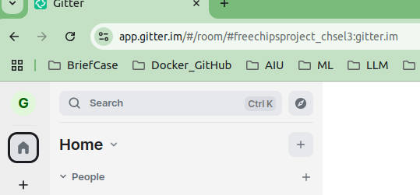
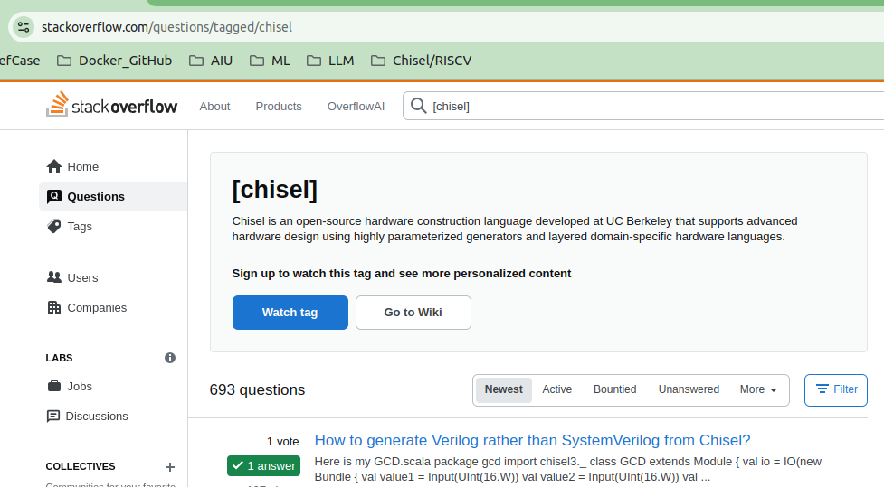
7.1 Chisel Bootcamp: Introduction
https://www.youtube.com/watch?v=OhMuPQcyynY&list=PLlu0CT-JnSasfpk8tq1ZDiE2G0AK1BhOg&index=7
Chisel Introduction (3:12-4:41/1:20:22)
Debugging
1. https://chisel.eecs.berkeley.edu/
2. mailing list: https://groups.google.com/group/chisel-users
3. chat room: https://gitter.im/freechipsproject/chsel3
4. issues: http:/github/com/freechipsproject/chisel3/issues
5. stack overflow: http://stackoverflow.com/questions/tagged/chisel
4
2
1
3
5

Slide 9
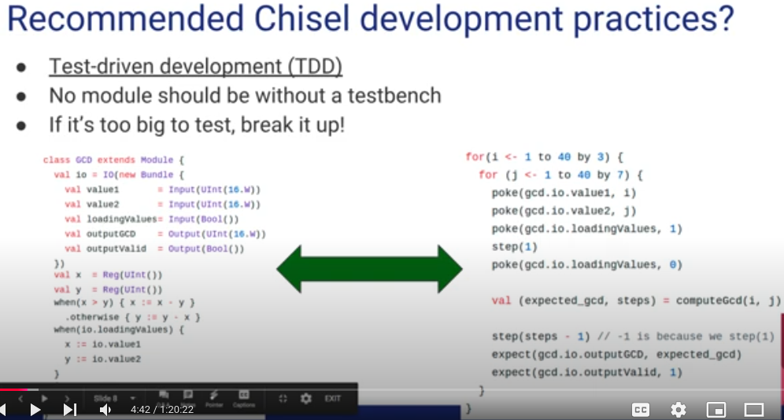
7.1 Chisel Bootcamp: Introduction
https://www.youtube.com/watch?v=OhMuPQcyynY&list=PLlu0CT-JnSasfpk8tq1ZDiE2G0AK1BhOg&index=7
Chisel Introduction (4:42-5:16/1:20:22)
Development practice
1. TDD:
2. testbench
3. small task

Slide 10
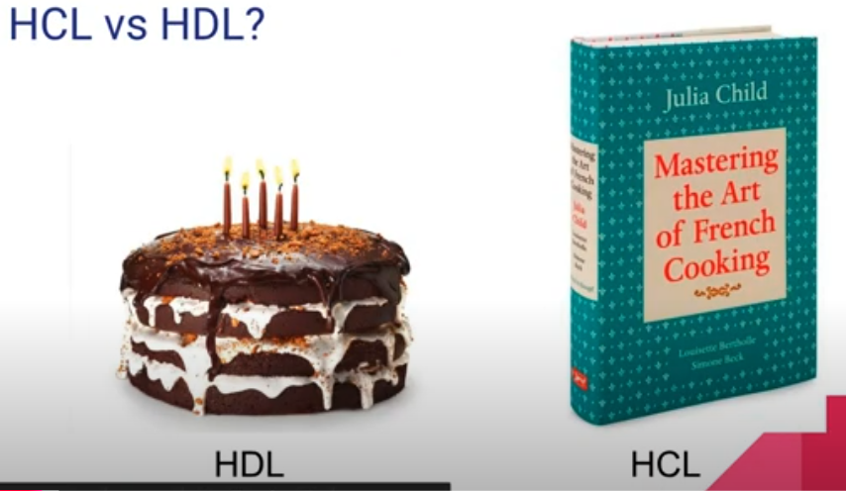
7.1 Chisel Bootcamp: Introduction
https://www.youtube.com/watch?v=OhMuPQcyynY&list=PLlu0CT-JnSasfpk8tq1ZDiE2G0AK1BhOg&index=7
Chisel Introduction (5:17-6:05/1:20:22)
HDL (Hardware Design Language): Build cake with some environment and translate into that cake; HDL constructs map directly to specific hardware parts.
HCL (Hardware Construction Language): Use some guide and translate into cake; User code constructs an Internal Representation (IR), which can then be directly translated into HDL.

Slide 11
End

