Slide 1

7.11 eDSL
Peter H. Chen

Slide 2
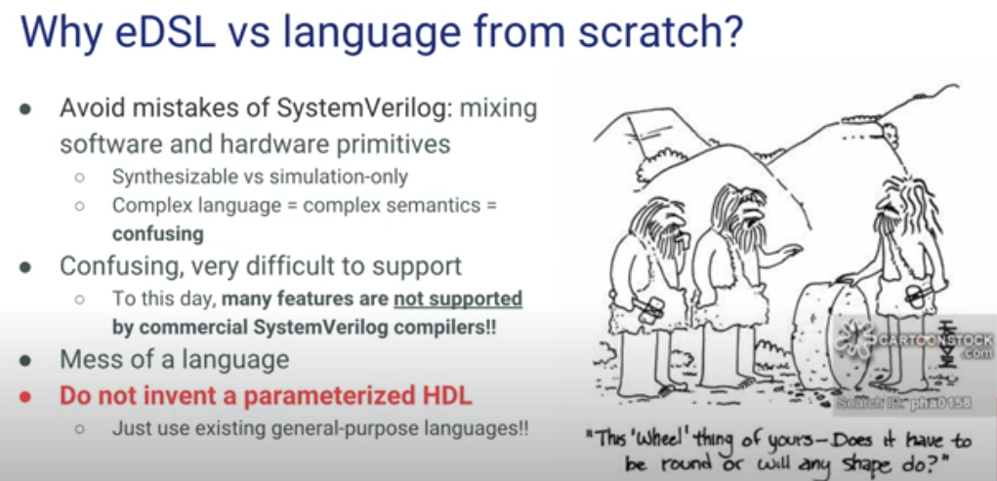
7.11 eDSL
https://www.youtube.com/watch?v=OhMuPQcyynY&list=PLlu0CT-JnSasfpk8tq1ZDiE2G0AK1BhOg&index=7
eDSL (6:06-6:35/1:20:22)
Why eDSL? eDSL is “Embedded to Domain Specific Language,” that is, Chisel is a language but it is embedded in the Scala language.
eDSL gives you full access to all the capabilities of Scala which is a very modern language.
We developed design based on modern language Scala, then translate into HDL (Hardware Design Language).
Do not invent parameterized based on HDL, such as SystemVerilog. SystemVerilog is a mess-up language which is mixed software and hardware language, very confusing and difficult to support.

Slide 3
7.11 eDSL

Slide 4
7.11 eDSL
https://www.youtube.com/watch?v=OhMuPQcyynY&list=PLlu0CT-JnSasfpk8tq1ZDiE2G0AK1BhOg&index=7
eDSL (6:06-6:35/1:20:22)
Why eDSL? eDSL is “Embedded to Domain Specific Language,” that is, Chisel is a language but it is embedded in the Scala language.
eDSL gives you full access to all the capabilities of Scala which is a very modern language.
We developed design based on modern language Scala, then translate into HDL (Hardware Design Language).
Do not invent parameterized based on HDL, such as SystemVerilog. SystemVerilog is a mess-up language which is mixed software and hardware language, very confusing and difficult to support.

Slide 5
7.12 Chisel vs RISCV Relation

Slide 6
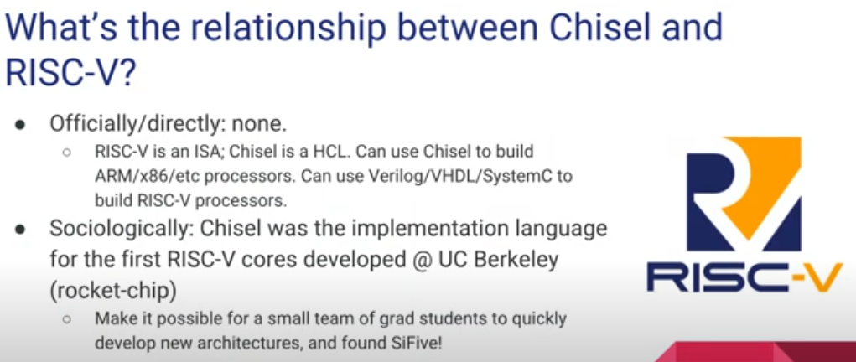
7.12 Chisel vs RISCV Relation
https://www.youtube.com/watch?v=OhMuPQcyynY&list=PLlu0CT-JnSasfpk8tq1ZDiE2G0AK1BhOg&index=7
Chisel vs RISCV Relation (6:36-7:23/1:20:22)
No relation: Chisel is HCL (Hardware Construction Language). RISCV is ISA (Instruction Set Architecture).
Relation: Chisel is HCL/Scala to in implement the RISCV/Rocket Chip.

Slide 7
7.13 Chisel Support FPGA?

Slide 8
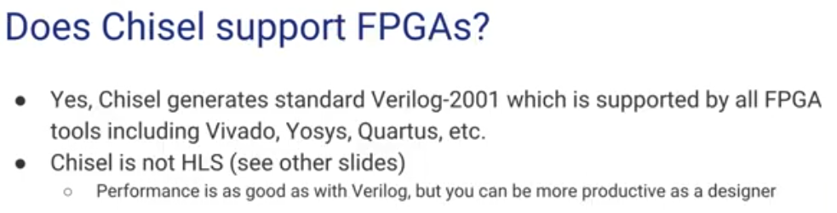
7.13 Chisel Support FPGA?
https://www.youtube.com/watch?v=OhMuPQcyynY&list=PLlu0CT-JnSasfpk8tq1ZDiE2G0AK1BhOg&index=7
Chisel Support FPGA? (7:24-8:16/1:20:22)
Yes.
FPGA (Field Programmable Gate Array): Xilinx was acquired by AMD. Altera was acquired by Intel.
Chisel generates/support FPGA: (AMD/Xilinx Vivado, Open Source Yosys (Yosys Open SYnthesis Suite), Intel/Altera Quartus, etc).

Slide 9
7.14 Why Scala?

Slide 10
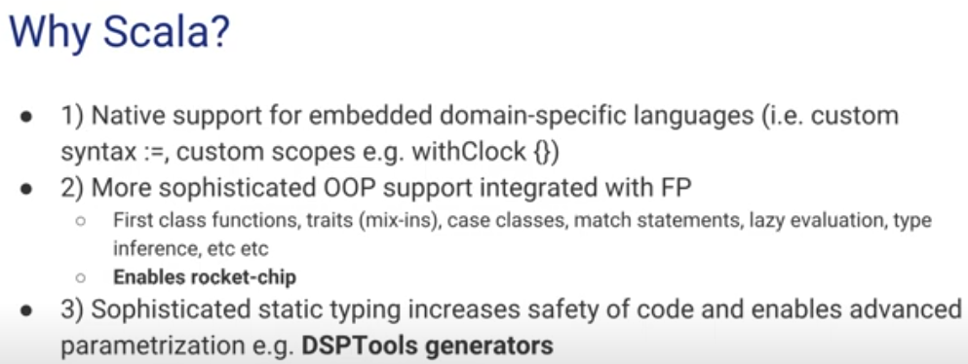
7.14 Why Scala?
https://www.youtube.com/watch?v=OhMuPQcyynY&list=PLlu0CT-JnSasfpk8tq1ZDiE2G0AK1BhOg&index=7
Why Scala? (8:17-15:34/1:20:22)
Scala is portmanteau (混成词) of Scalable and Language.
Scala is an embedded domain-specific languages.
Scala embedded Python, Java, C++, etc. It has OOD (Objected Oriented Design) and Functional Programming. It is a better language than C++ and Java.
Scala enables parameterization, for example, DSPTools (Digital Signal Processing Tools) generators for parameterized code generation.

Slide 11
7.15 Why sbt?

Slide 12
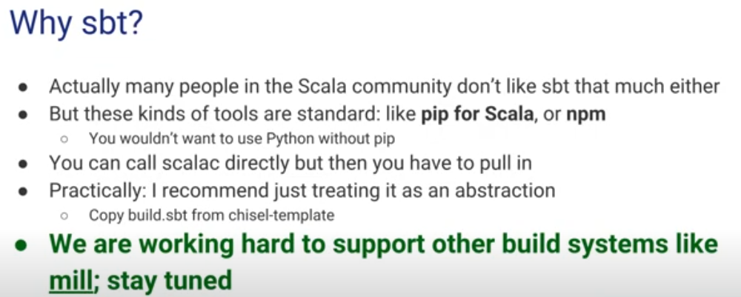
7.15 Why sbt?
https://www.youtube.com/watch?v=OhMuPQcyynY&list=PLlu0CT-JnSasfpk8tq1ZDiE2G0AK1BhOg&index=7
Why sbt? (15:35-25:26/1:20:22)
1. sbt (source build tools) for Scala Language and Maven Java.
2. sbt is similar to pip (Python Installation Package, pip2 for Python2, Pip3 for Python3) for Python or npm (Node Package Manager) for JavaScript and NodeJS.
3. Right now, sbt is hard to replaced by pip or npm. We use sbt to run the unit test.

Slide 13
7.16 Why Synthesizable by Construction?

Slide 14
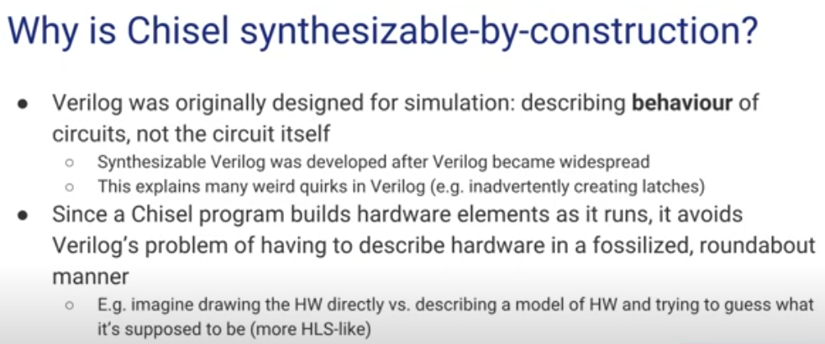
7.16 Why Synthesizable by Construction?
https://www.youtube.com/watch?v=OhMuPQcyynY&list=PLlu0CT-JnSasfpk8tq1ZDiE2G0AK1BhOg&index=7
Why Chisel is Synthesizable by Construction? (25:27-28:20/1:20:22)
Chisel is Synthesizable by construction as opposed to Verilog.
1. Verilog: Verilog is a simulation language. Verilog is described by the Behavioral model of Circuit, not the circuit itself. Synthesize Verilog is a subset of Verilog itself.
2. Chisel: Chisel build the hardware circuit itself. There is no circuit model in Scala. Instead of infer from the behavioral model, Scale write the circuit itself. Therefore, Chisel construct the circuit itself and always Synthesizable.
Verilog describe the Hardware Model by HLS (High-Level Synthesis) and Chisel build the hardware circuit without behavioral model.

Slide 15
7.16 Why Synthesizable by Construction?

Slide 16
7.16 Why Synthesizable by Construction?
https://www.youtube.com/watch?v=OhMuPQcyynY&list=PLlu0CT-JnSasfpk8tq1ZDiE2G0AK1BhOg&index=7
Why Chisel is Synthesizable by Construction? (25:27-28:20/1:20:22)
Chisel is Synthesizable by construction as opposed to Verilog.
1. Verilog: Verilog is a simulation language. Verilog is described by the Behavioral model of Circuit, not the circuit itself. Synthesize Verilog is a subset of Verilog itself.
2. Chisel: Chisel build the hardware circuit itself. There is no circuit model in Scala. Instead of infer from the behavioral model, Scale write the circuit itself. Therefore, Chisel construct the circuit itself and always Synthesizable.
Describe the Hardware Model by HLS (High-Level Synthesis)

Slide 17
7.17 Chisel is not HLS

Slide 18
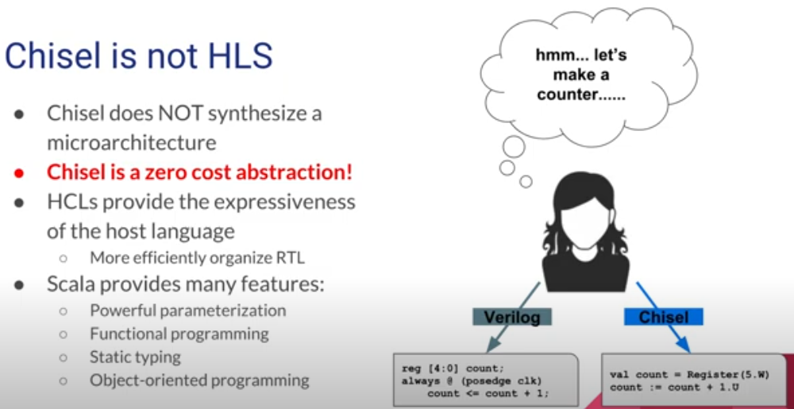
7.17 Chisel is not HLS
https://www.youtube.com/watch?v=OhMuPQcyynY&list=PLlu0CT-JnSasfpk8tq1ZDiE2G0AK1BhOg&index=7
Chisel is not HLS (28:21-32:17/1:20:22)
Chisel is not HLS (High-Level Synthesis) from Model. Chisel construct the circuit itself. There is no circuit model in Chisel. Chisel uses the functional programming to construct the hardware element. The Function itself construct the the circuit. There is no while loop.
Chisel is not the sequence Verilog/C programming. Verilog/C Program has memory, sequential semantics, and while loop. These are HLS (High-Level Synthesis).

Slide 19
7.18 Chisel: Compiler Framework

Slide 20
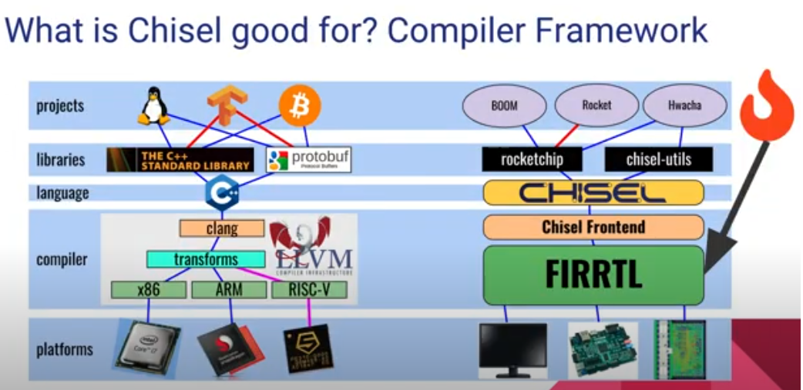
7.18 Chisel: Compiler Framework
https://www.youtube.com/watch?v=OhMuPQcyynY&list=PLlu0CT-JnSasfpk8tq1ZDiE2G0AK1BhOg&index=7
Chisel: Compiler Framework (32:18-32:26/1:20:22)
Chisel Compiler Framework.

Slide 21
7.19 Chisel Language Feature

Slide 22
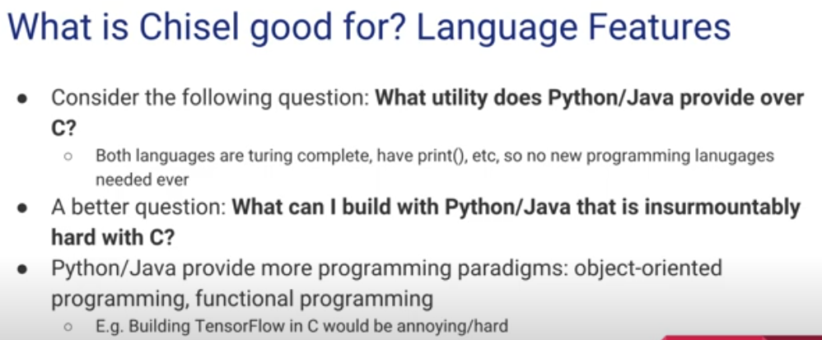
7.19 Chisel Language Feature
https://www.youtube.com/watch?v=OhMuPQcyynY&list=PLlu0CT-JnSasfpk8tq1ZDiE2G0AK1BhOg&index=7
Chisel Language Feature (32:27-43:09/1:20:22)
Chisel Language Feature better than C:
1. complete language, such as, print()
2. OOD: Inheritance
3. Functional Programming without loop: Parameterization, instantiation, Higher Order function, Lambda function, etc.

Slide 23
7.20 Chisel Support Multi-Clock

Slide 24
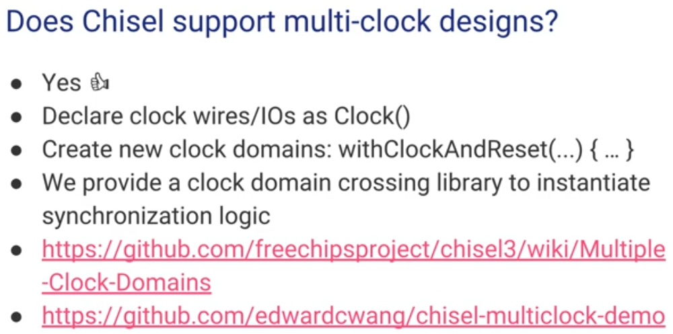
7.20 Chisel Support Multi-Clock
https://www.youtube.com/watch?v=OhMuPQcyynY&list=PLlu0CT-JnSasfpk8tq1ZDiE2G0AK1BhOg&index=7
Chisel Language Feature (43:10-45:15/1:20:22)
Chisel Support Multi-Clock

Slide 25
End

