Slide 1

7.21 Chisel Asynchronous Reset
Peter H. Chen

Slide 2
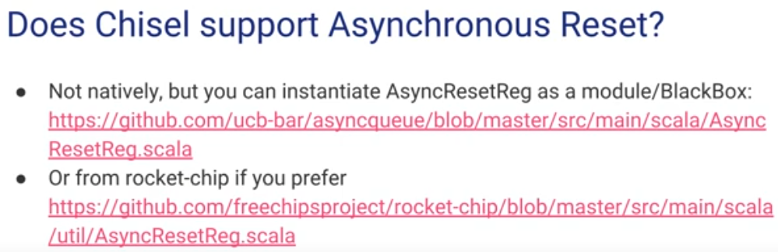
7.21 Chisel Asynchronous Reset
https://www.youtube.com/watch?v=OhMuPQcyynY&list=PLlu0CT-JnSasfpk8tq1ZDiE2G0AK1BhOg&index=7
Chisel Asynchronous Reset (45:16-46:48/1:20:22)
Chisel Support Asynchronous Reset, latch, etc.

Slide 3
7.22 Test Multi-Clock Module

Slide 4
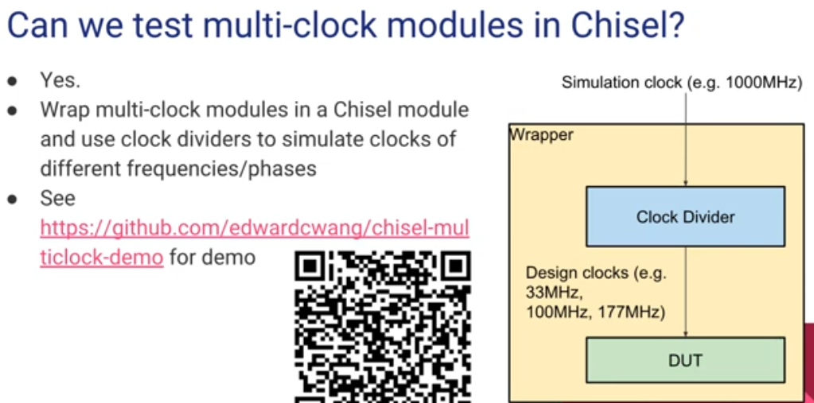
7.22 Test Multi-Clock Module
https://www.youtube.com/watch?v=OhMuPQcyynY&list=PLlu0CT-JnSasfpk8tq1ZDiE2G0AK1BhOg&index=7
Test Multi-Clock Module (46:49-51:04/1:20:22)
Chisel Support Asynchronous Reset, latch,

Slide 5
7.23 Chisel Project Example

Slide 6
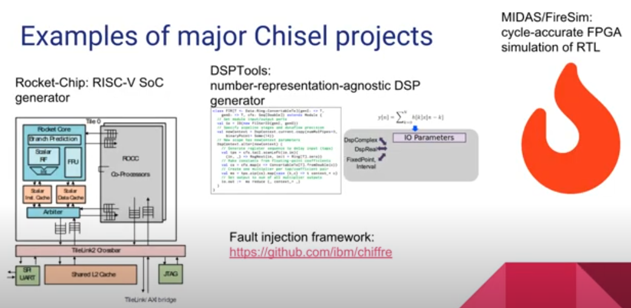
7.23 Chisel Project Example
https://www.youtube.com/watch?v=OhMuPQcyynY&list=PLlu0CT-JnSasfpk8tq1ZDiE2G0AK1BhOg&index=7
Chisel Project Example (51:05-51:32/1:20:22)
Rocket Chip:
1. RISCV SoC Generator,
2. DSPTools: DSP Generator
3. FPGA/FireSim: Cycle accurate FPGA simulation of RTL

Slide 7
7.24 What is Chisel Good For?

Slide 8
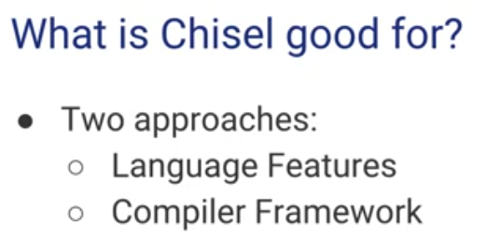
7.24 What is Chisel Good For?
https://www.youtube.com/watch?v=OhMuPQcyynY&list=PLlu0CT-JnSasfpk8tq1ZDiE2G0AK1BhOg&index=7
What is Chisel Good For? (51:33-51:49/1:20:22)
1. Language Features: OOD, Functional Programming
2. Compiler Framework: RISCV + LLVM

Slide 9
7.25 Chisel Compatible with Verilog/VHDL?

Slide 10
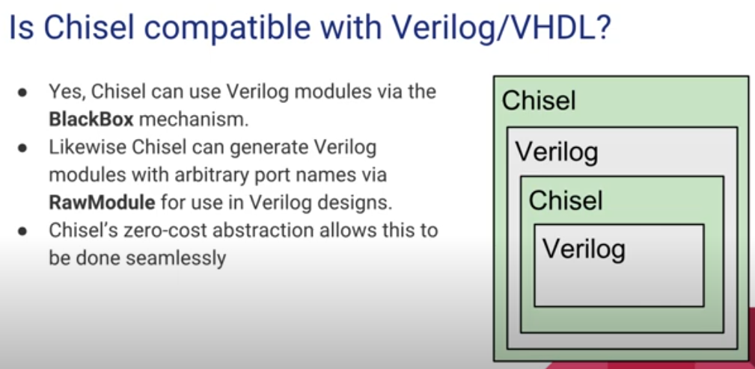
7.25 Chisel Compatible with Verilog/VHDL?
https://www.youtube.com/watch?v=OhMuPQcyynY&list=PLlu0CT-JnSasfpk8tq1ZDiE2G0AK1BhOg&index=7
Chisel Compatible with Verilog/VHDL? (51:50-52:00/1:20:22)
Yes.
1. BlackBox mechanism: Verilog Module
2. RawModule: Port name

Slide 11
7.26 Analog/AMS Design

Slide 12
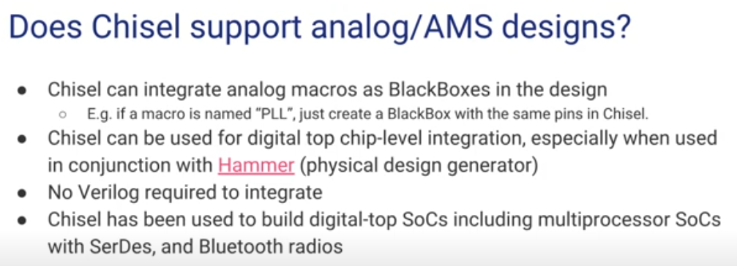
7.26 Analog/AMS Design
https://www.youtube.com/watch?v=OhMuPQcyynY&list=PLlu0CT-JnSasfpk8tq1ZDiE2G0AK1BhOg&index=7
Analog/AMS Design (52:01-57:09/1:20:22)
AMS (Analog-Mixed Signal Design)
1. BlackBox for analog:
2. Hammer: Physical Design Generator
3. Digital SoC block with SerDes and Bluetooth Radios

Slide 13
7.27 CDCs

Slide 14
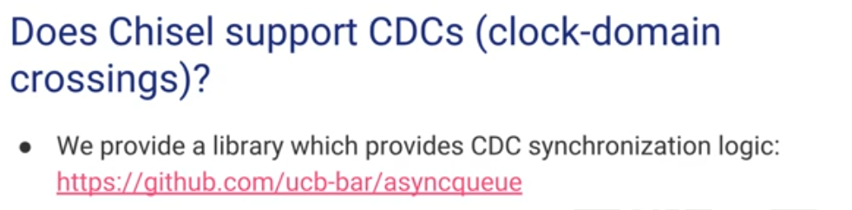
7.27 CDCs
https://www.youtube.com/watch?v=OhMuPQcyynY&list=PLlu0CT-JnSasfpk8tq1ZDiE2G0AK1BhOg&index=7
CDCs (57:10-1:01:09/1:20:22)
CDCs (Clock-Domain Crossings) synchronization logic.
There is two levels in Chisel:
1. Use the library (suer level)
2. develop library (Academic level)

Slide 15
7.28 Chisel Module

Slide 16
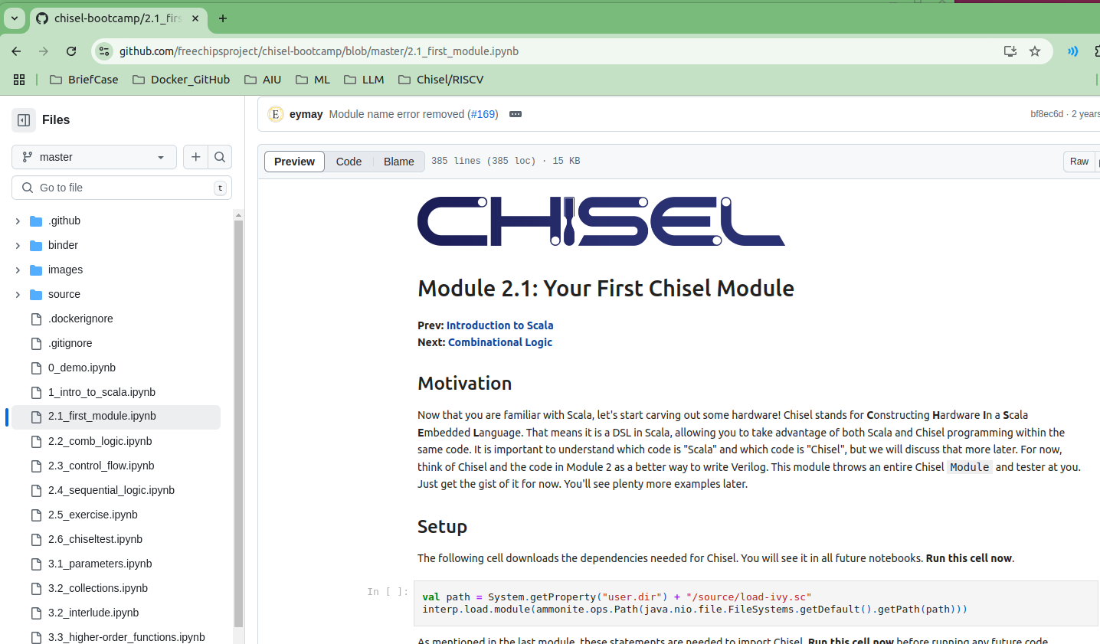
7.28 Chisel Module
https://www.youtube.com/watch?v=OhMuPQcyynY&list=PLlu0CT-JnSasfpk8tq1ZDiE2G0AK1BhOg&index=7
Chisel Module (1:01:10-1:04:19/1:20:22)
https://github.com/freechipsproject/chisel-bootcamp/blob/master/2.1_first_module.ipynb

Slide 17
7.29 Combinational Logic

Slide 18
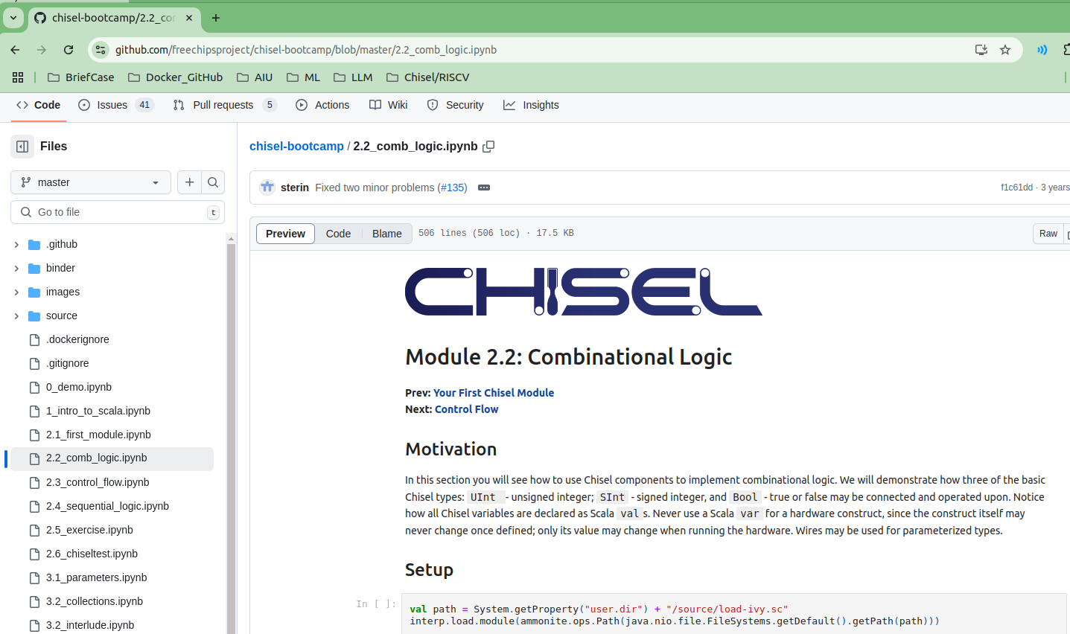
7.29 Combinational Logic
https://www.youtube.com/watch?v=OhMuPQcyynY&list=PLlu0CT-JnSasfpk8tq1ZDiE2G0AK1BhOg&index=7
Combinational Logic (1:04:20-1:05:01/1:20:22)
Operator, Adder, etc.
https://github.com/freechipsproject/chisel-bootcamp/blob/master/2.2_comb_logic.ipynb

Slide 19
7.30 Sequential Logic

Slide 20
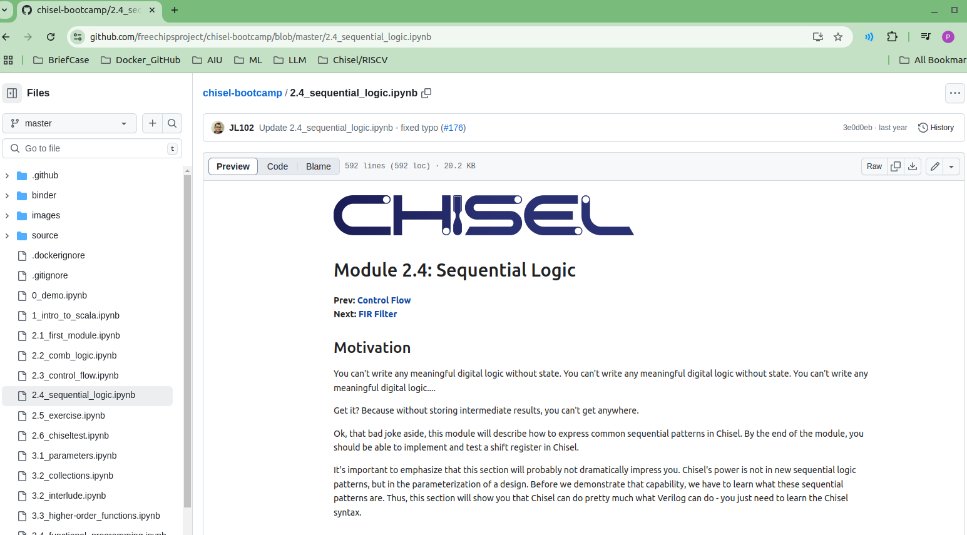
7.30 Sequential Logic
https://www.youtube.com/watch?v=OhMuPQcyynY&list=PLlu0CT-JnSasfpk8tq1ZDiE2G0AK1BhOg&index=7
Sequential Logic (1:05:02-1:05:21/1:20:22)
Registers, Explicit Clock.
https://github.com/freechipsproject/chisel-bootcamp/blob/master/2.4_sequential_logic.ipynb

Slide 21
End

