Slide 1

7.31 Compiler Framework
Peter H. Chen

Slide 2
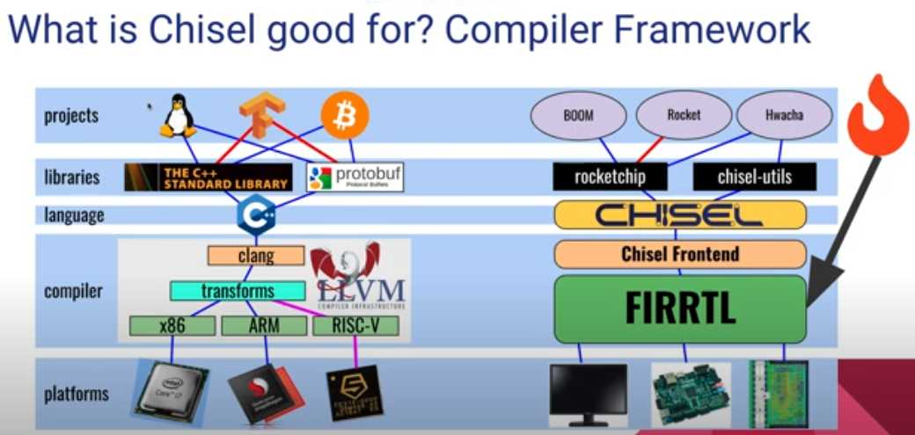
7.31 Compiler Framework
https://www.youtube.com/watch?v=OhMuPQcyynY&list=PLlu0CT-JnSasfpk8tq1ZDiE2G0AK1BhOg&index=7
Compiler Framework (1:05:22-1:14:21/1:20:22)
What is Chisel Good for? Compiler Framework.
Python, C Language, Different platform (x86, ARM, RISCV, FPGA), and ASIC RTL Verilog.
FIRRTL is a RTL compiler.

Slide 3
7.32 FIR Filter

Slide 4
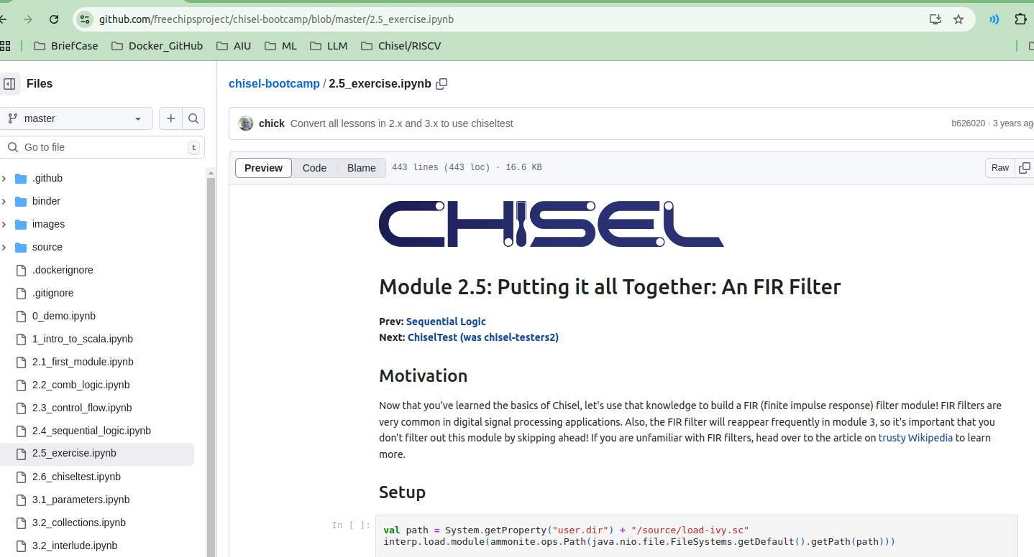
7.32 FIR Filter
https://www.youtube.com/watch?v=OhMuPQcyynY&list=PLlu0CT-JnSasfpk8tq1ZDiE2G0AK1BhOg&index=7
FIR Filter (1:14:22-1:18:21/1:20:22)
FIR Example

Slide 5
7.33 Test FIR Filter

Slide 6
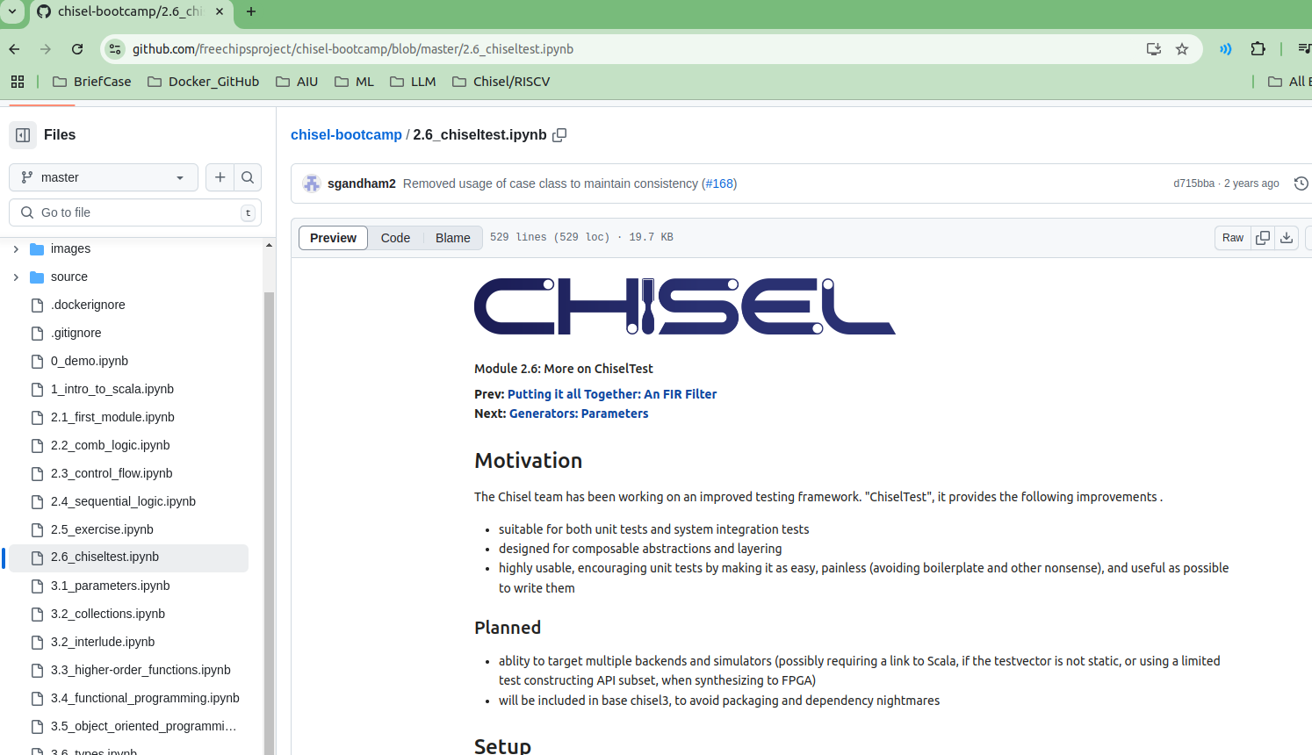
7.33 Test FIR Filter
https://www.youtube.com/watch?v=OhMuPQcyynY&list=PLlu0CT-JnSasfpk8tq1ZDiE2G0AK1BhOg&index=7
Test FIR Filter (1:18:22-1:20:22/1:20:22)
Test FIR Example

Slide 7
End

