Slide 1

11.1 Chisel Language
Peter H. Chen

Slide 2
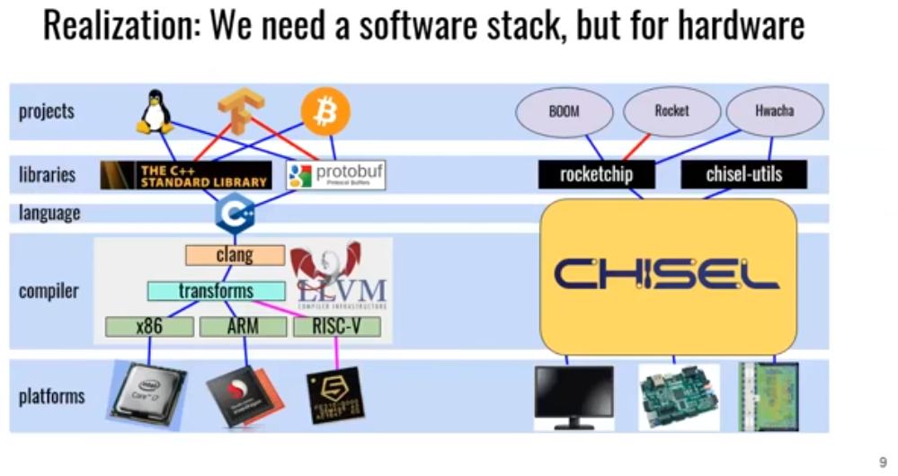
11.1 Chisel Language
https://www.youtube.com/watch?v=VU9XdMJqkeM&list=PLlu0CT-JnSasfpk8tq1ZDiE2G0AK1BhOg&index=11
Chisel Language (0:00-0:01/27:05)
Old Way Hardware design: Verilog
New way Hardware Design in Software Engineering:
1. Use Chisel embedded with Scala Programming (OOD + Functional Programming)
2. FIR (Finite Impulse Response) Recursive Moving Average Example: Input Number of Points, Weight, project, hardware libraries, Compiler (C, X86, ARM, RISCV, etc.), platform (Apple SoC, Qualcomm Processor, Intel/Altera FPGA, AMD/Xilinx, etc).

Slide 3
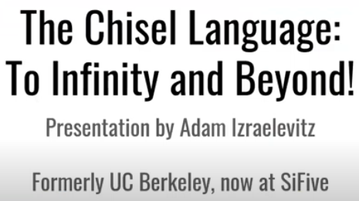
11.1 Chisel Language
https://www.youtube.com/watch?v=VU9XdMJqkeM&list=PLlu0CT-JnSasfpk8tq1ZDiE2G0AK1BhOg&index=11
Chisel Language (0:02-0:27/27:05)
The Chisel Language: To Infinity and Beyond.
Adam Izraelevitz is a PhD student at UC Berkeley. He worked Chisel/FIRRTL at the SiFive.

Slide 4
11.2 Old Way

Slide 5
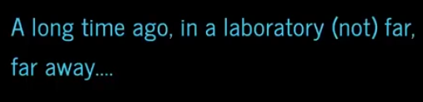
11.2 Old Way
https://www.youtube.com/watch?v=VU9XdMJqkeM&list=PLlu0CT-JnSasfpk8tq1ZDiE2G0AK1BhOg&index=11
Old Way (0:28-0:40/27:05)
Long time ago, lab is far away.

Slide 6
11.3 HDL Wars

Slide 7

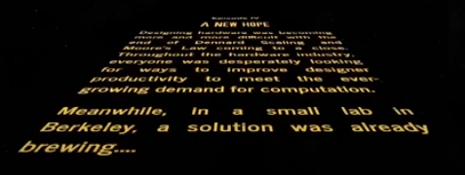
11.2 HDL Wars
https://www.youtube.com/watch?v=VU9XdMJqkeM&list=PLlu0CT-JnSasfpk8tq1ZDiE2G0AK1BhOg&index=11
HDL Wars (0:41-1:16/27:05)
We have HDL Wars.
HDL is Difficult. How do we solve very difficult design by HDL (Hardware Description Language).

Slide 8
11.4 Hardware Generator

Slide 9
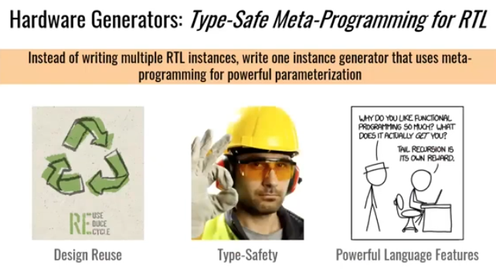
11.4 Hardware Generator
https://www.youtube.com/watch?v=VU9XdMJqkeM&list=PLlu0CT-JnSasfpk8tq1ZDiE2G0AK1BhOg&index=11
Hardware Generator (1:17-2:04/27:05)
How do we solve the very difficult HDL coding? One solution is to use “Hardware Generator”. The other way is to use type safe meta programming for RTL.
The idea is instead of writing multiple RTL on instances that all look similar, instead, we write one generator that is parameterized and we can generate multiple instances from this one generator.
If we do this way,
1. We need a lot of more design review.
2. We get type safety design using the powerful programming language.
3. Because we use modern programming language, we have more powerful language features.

Slide 10
11.5 Verilog Like Chisel

Slide 11
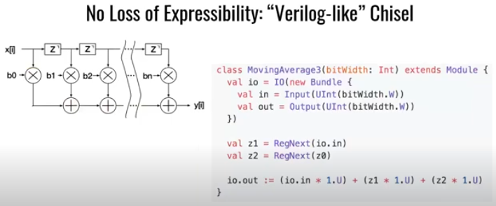
11.5 Verilog Like Chisel
https://www.youtube.com/watch?v=VU9XdMJqkeM&list=PLlu0CT-JnSasfpk8tq1ZDiE2G0AK1BhOg&index=11
Verilog Like Chisel (2:05-3:05/27:05)
We want to write a design without loss any loss of expressibility.
This means we can write Verilog Like Chisel so that we can control every MUX in the design and we can control every bit if we want to. Note that we can do the type optimization in the design.
Below example is a Chisel Module. It computes a moving average.
This is similar to FIR (Finite Impulse Response) Filter.
1. We have input, we shift the register the input in few cycles.
2. We do some computation: We multiple them and then adding together to get the moving output or the moving average.
This is the instance and we control everything.
1
2

Slide 12
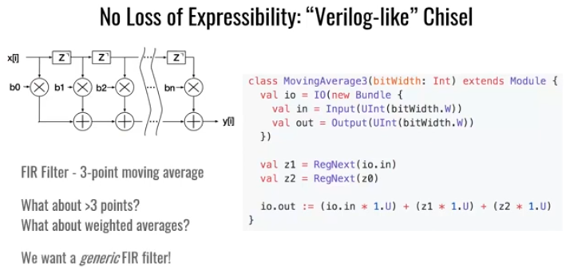
11.5 More Points/Weighted Average
https://www.youtube.com/watch?v=VU9XdMJqkeM&list=PLlu0CT-JnSasfpk8tq1ZDiE2G0AK1BhOg&index=11
More Points/Weighted Average (3:06-3:28/27:05)
1. This example is FIR for 3-point average.
2. How about more than 3-points average? How about Weighted Average?
3. What we really want is the generic FIR Filter, not a specific FIR Filter.
1
2
3

Slide 13
11.6 Chisel Parameterization

Slide 14
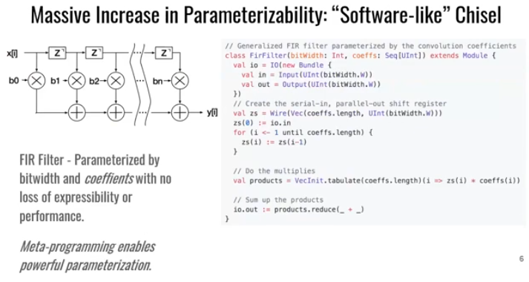
11.6 Chisel Parameterization
https://www.youtube.com/watch?v=VU9XdMJqkeM&list=PLlu0CT-JnSasfpk8tq1ZDiE2G0AK1BhOg&index=11
Chisel Parameterization (3:29-4:13/27:05)
This is more like a software like Chisel.
We add the additional layer for parameterization on top of our instance.
Here, we have this generic FIR Filter.
1. It is parameterized by the bit. We passed in a sequence of coefficients for FIR Filter.
2. Then, we can pass in the coefficients and construct all the register to do the delay.
3. We can iterative over the table.
4. Compute all the products.
5. Then, we reduce the and sum them all together.
1
2
3
4
5

Slide 15
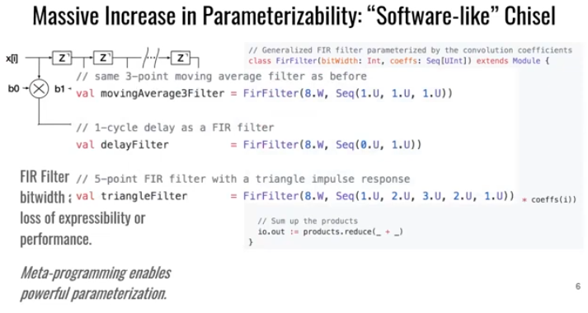
11.5 Generic Design Pattern
https://www.youtube.com/watch?v=VU9XdMJqkeM&list=PLlu0CT-JnSasfpk8tq1ZDiE2G0AK1BhOg&index=11
Generic Design Pattern (4:14-4:39/27:05)
Pass in points and Sequences of data into the Generic Pattern.
This is the power of chisel.
The generic generator generate the HDL for design patterns.

Slide 16
11.7 Improve Hardware Design Loop

Slide 17
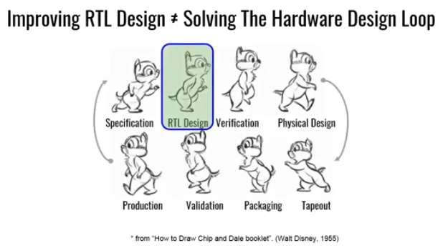
11.7 Improve Hardware Design Loop
https://www.youtube.com/watch?v=VU9XdMJqkeM&list=PLlu0CT-JnSasfpk8tq1ZDiE2G0AK1BhOg&index=11
Improve Hardware Design Loop (4:40-5:23/27:05)
Hardware Design Cycles:
1. Specification,
2. RTL Design,
3. Verification,
4. Physical Design,
5. Tapeout,
6. Packaging,
7. Validation,
8. Prediction,
We need more agile design approach which we need to tackle other aspect of loop.

Slide 18
11.8 Platform-Specific

Slide 19
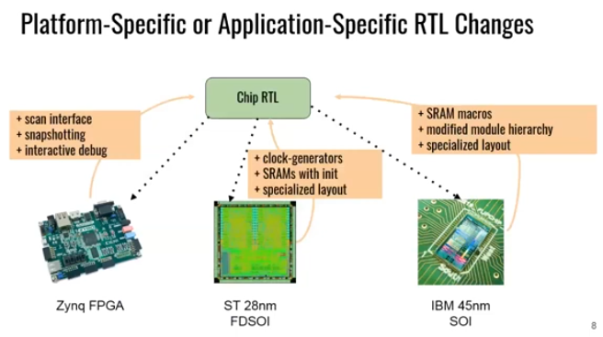
11.8 Platform-Specific
https://www.youtube.com/watch?v=VU9XdMJqkeM&list=PLlu0CT-JnSasfpk8tq1ZDiE2G0AK1BhOg&index=11
Platform-Specific (5:24-6:17/27:05)
Below, we have Platform-Specific or Application-Specific for RTL Changes.
In the design loop, we have chip RTL:
1. We try to emulate FPGA/RTL so that we can get long-running programs and analyze their performance.
2. We also want to tapeout same ASIC/RTL at the same time.
The FPGA/RTL and ASIC/RTL are different, for example, for ASIC/RTL, custom SRAMs, clock gates, specialized layout, process technology, etc., are all different. These all changes and back up into the chip RTL. It is hard to express a generator that works on all different underlying platforms. These differences will explode the parameters at the top.

Slide 20
11.9 Software Stack

Slide 21
11.9 Software Stack
https://www.youtube.com/watch?v=VU9XdMJqkeM&list=PLlu0CT-JnSasfpk8tq1ZDiE2G0AK1BhOg&index=11
Software Stack (6:18-7:08/27:05)
We need a software, not hardware, to realize different platforms.
The software is generic platform independent project. It can run on lots of different platforms and get specialized on the way down.
We need to compile these underlying platforms, each platform has their specialization.
As shown below diagram, the realization (实现), we know there are platforms, C++ Language, compiler (X86, ARM, RISCV), a set of libraries, and different projects (GNU-Linux, Tensorflow, Bitcoin, etc)
We have Chisel to integrate the realization.

Slide 22
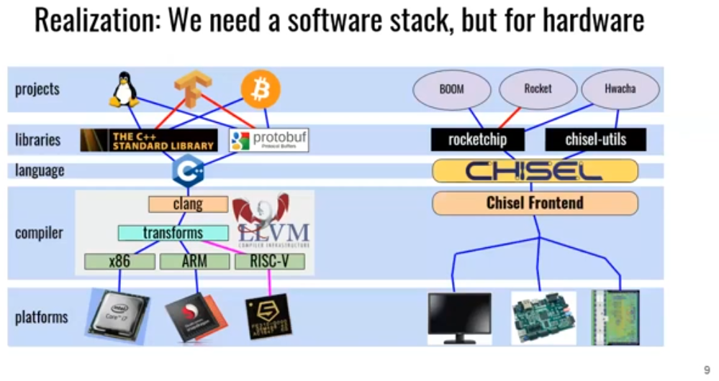
11.9 Software Stack
https://www.youtube.com/watch?v=VU9XdMJqkeM&list=PLlu0CT-JnSasfpk8tq1ZDiE2G0AK1BhOg&index=11
Software Stack (7:09-7:17/27:05)
We really need Chisel frontend for us. Chisel integrate all projects, libraries, languages, compiler for us.

Slide 23
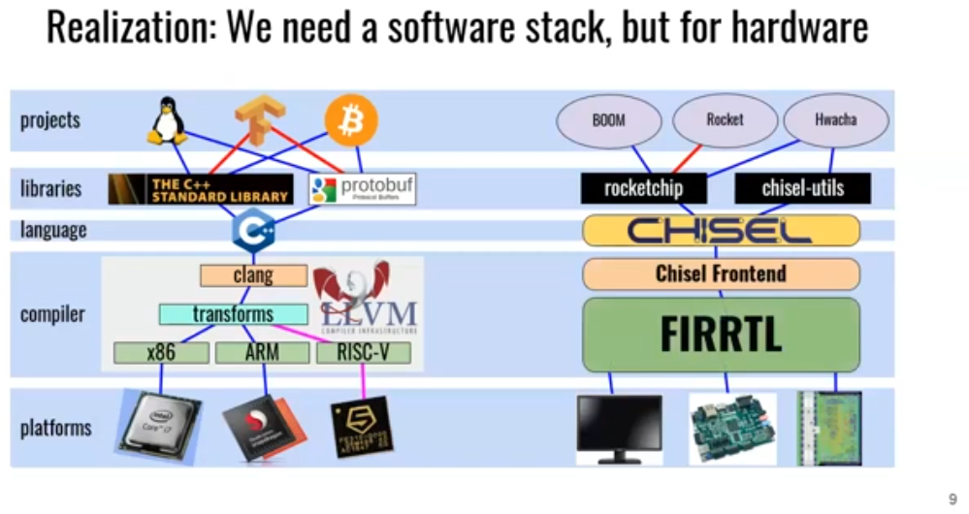
11.9 Software Stack
https://www.youtube.com/watch?v=VU9XdMJqkeM&list=PLlu0CT-JnSasfpk8tq1ZDiE2G0AK1BhOg&index=11
Software Stack (7:18-7:19/27:05)
The FIRRTL does more for RTL Transformation.

Slide 24
11.10 FIRRTL Specification

Slide 25
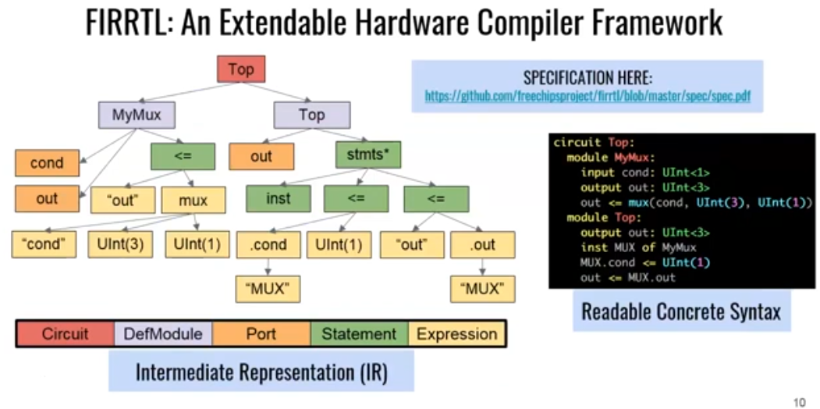
11.10 FIRRTL Specification
https://www.youtube.com/watch?v=VU9XdMJqkeM&list=PLlu0CT-JnSasfpk8tq1ZDiE2G0AK1BhOg&index=11
FIRRTL Specification (7:20-7:40/27:05)
FIRRTL (Flexible Intermediate Representation for Register Transfer Level) is an extendable hardware compiler framework.
FIRRTL is an AST (Abstract Syntax Tree) with readable concrete syntax.
Below is the Link of FIRRTL:
https://github.com/chipsalliance/firrtl

Slide 26
End

