Slide 1

11.11 FIRRTL
Peter H. Chen

Slide 2
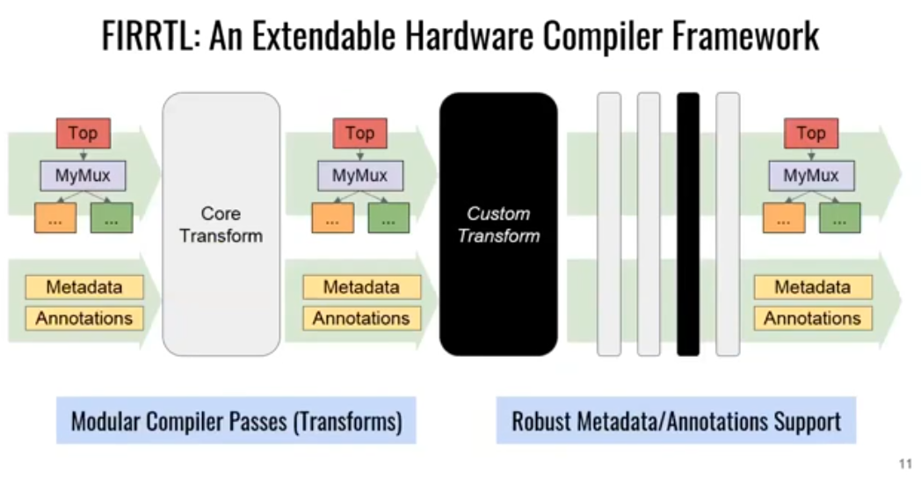
11.12 FIRRTL
https://www.youtube.com/watch?v=VU9XdMJqkeM&list=PLlu0CT-JnSasfpk8tq1ZDiE2G0AK1BhOg&index=11
FIRRTL (7:41-8:30/27:05)
How is the FIRRTL (Flexible Intermediate Representation for Register Transfer Level) work?
FIRRTL does different transformation. It contains the meta data for different pipelines,
We add custom transform for different products for your company.
All the circuits are visible and readable with concrete syntax.

Slide 3
11.12 Latest Chisel

Slide 4
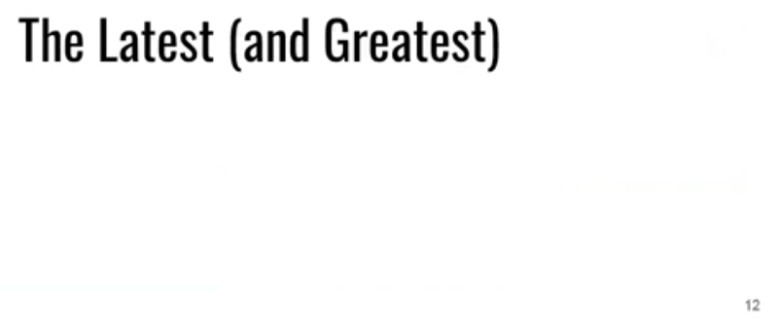
11.12 Latest Chisel
https://www.youtube.com/watch?v=VU9XdMJqkeM&list=PLlu0CT-JnSasfpk8tq1ZDiE2G0AK1BhOg&index=11
Latest Chisel (8:31-8:51/27:05)
We move on to the latest/greatest chisel.

Slide 5
11.13 Chisel Website

Slide 6
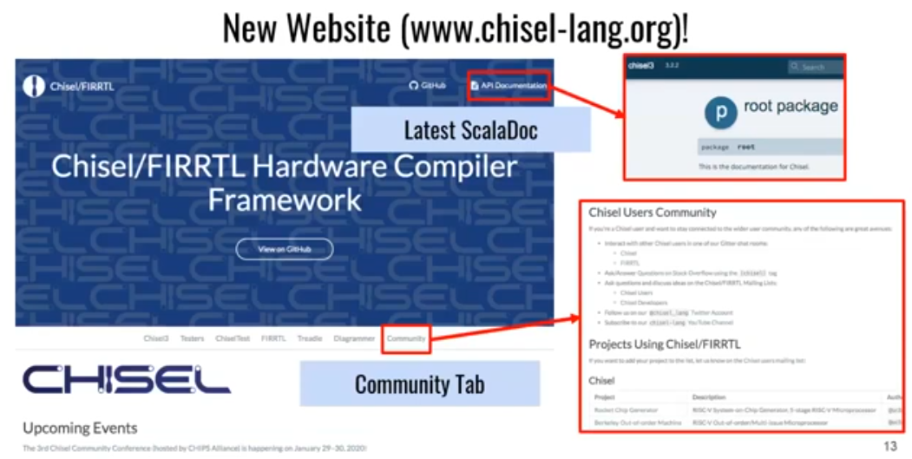
11.13 Chisel Website
https://www.youtube.com/watch?v=VU9XdMJqkeM&list=PLlu0CT-JnSasfpk8tq1ZDiE2G0AK1BhOg&index=11
Chisel Website (8:52-9:29/27:05)
Below is the latest chisel 3 website.
We have API and hardware libraries

Slide 7
11.14 Chip Alliance

Slide 8
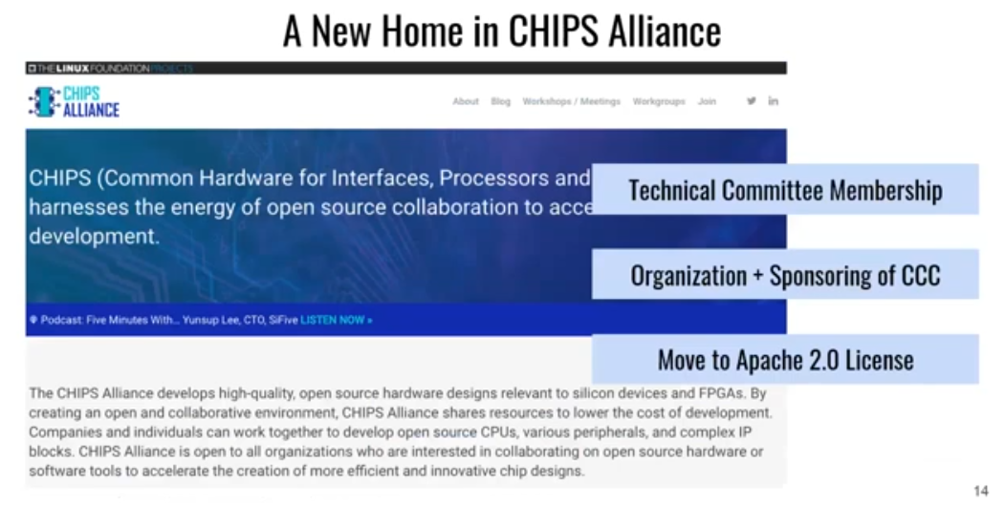
11.14 Chip Alliance
https://www.youtube.com/watch?v=VU9XdMJqkeM&list=PLlu0CT-JnSasfpk8tq1ZDiE2G0AK1BhOg&index=11
Chip Alliance (9:30-10:26/27:05)
Chip Alliance web site for diversified support from industries.

Slide 9
11.15 Release Methodology

Slide 10
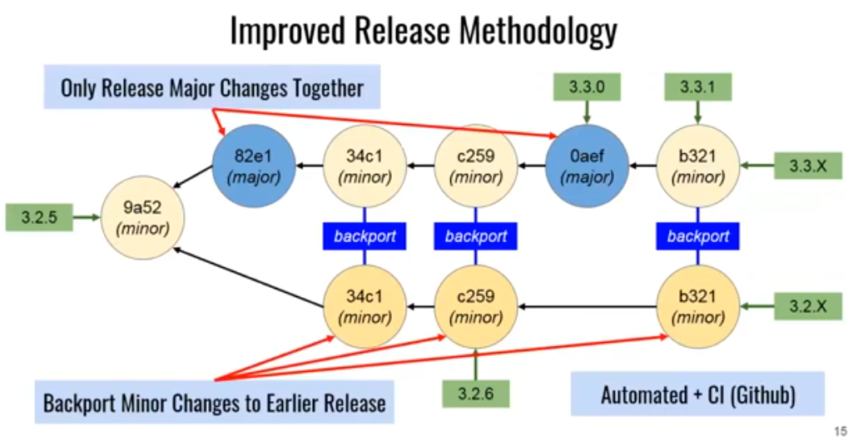
11.15 Release Methodology
https://www.youtube.com/watch?v=VU9XdMJqkeM&list=PLlu0CT-JnSasfpk8tq1ZDiE2G0AK1BhOg&index=11
Release Methodology (10:27-12:06/27:05)
We keep the backward compatibility, safety, stable, etc. for company to reply on.
The commit tree for master release and different release of chisel and FIRRTL. The API does not change.
We only do the bug fix and add API.

Slide 11
11.16 Community

Slide 12
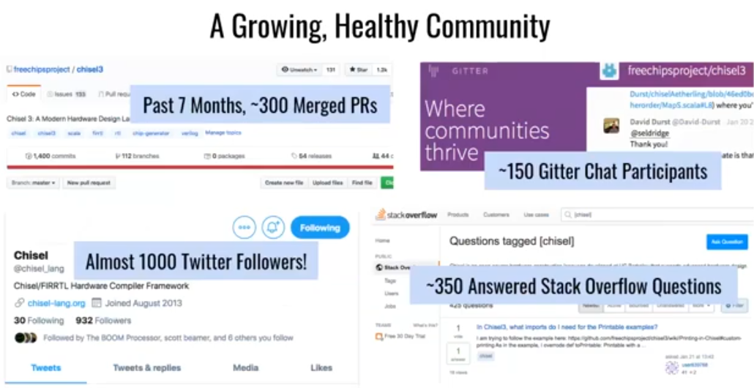
11.16 Community
https://www.youtube.com/watch?v=VU9XdMJqkeM&list=PLlu0CT-JnSasfpk8tq1ZDiE2G0AK1BhOg&index=11
Community (12:07-12:47/27:05)
.

Slide 13
11.17 Ecosystem

Slide 14
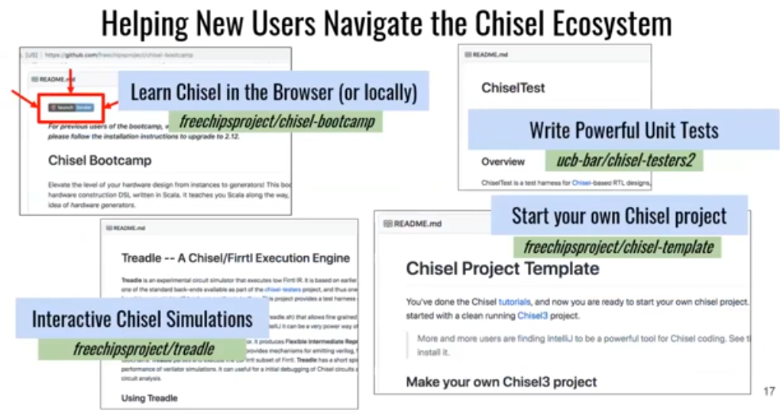
11.17 Ecosystem
https://www.youtube.com/watch?v=VU9XdMJqkeM&list=PLlu0CT-JnSasfpk8tq1ZDiE2G0AK1BhOg&index=11
Ecosystem (12:48-14:12/27:05)
https://github.com/freechipsproject/chisel-bootcamp

Slide 15
11.18 Clarify

Slide 16
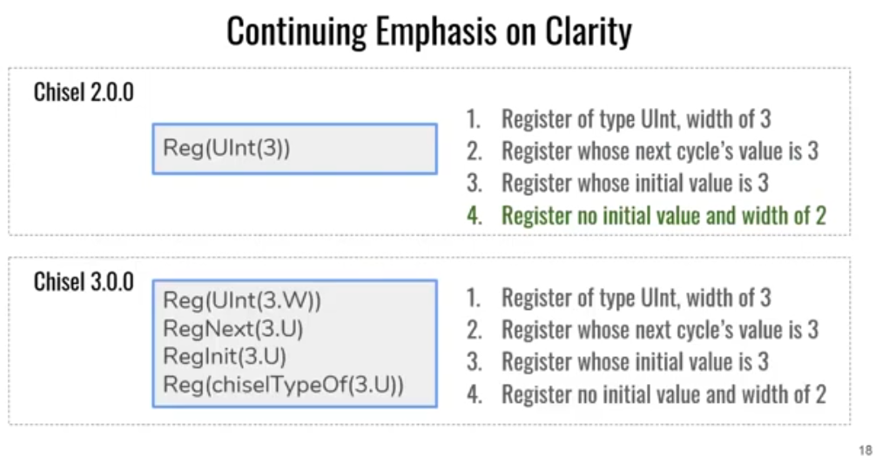
11.18 Clarify
https://www.youtube.com/watch?v=VU9XdMJqkeM&list=PLlu0CT-JnSasfpk8tq1ZDiE2G0AK1BhOg&index=11
Clarify (14:13-16:39/27:05)
In Chisel 2, Which one is the answer?
4. Register has no initial value and width of 2.
Declare a literal value 3 with width 2.
In Chisel 3, it is much clearly defined per specification.

Slide 17
11.19 GitHub Development

Slide 18
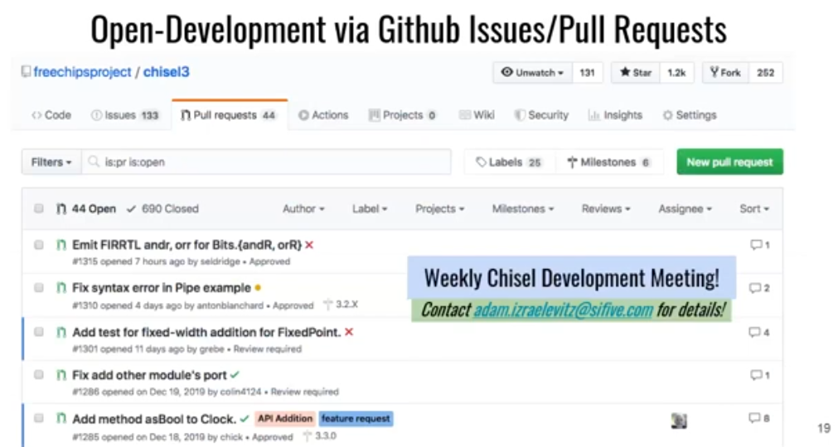
11.19 GitHub Development
https://www.youtube.com/watch?v=VU9XdMJqkeM&list=PLlu0CT-JnSasfpk8tq1ZDiE2G0AK1BhOg&index=11
GitHub Development (16:40-17:19/27:05)
Chisel is developed, integrated, and weekly meeting under the GitHub.

Slide 19
11.20 Ongoing Chisel Project

Slide 20
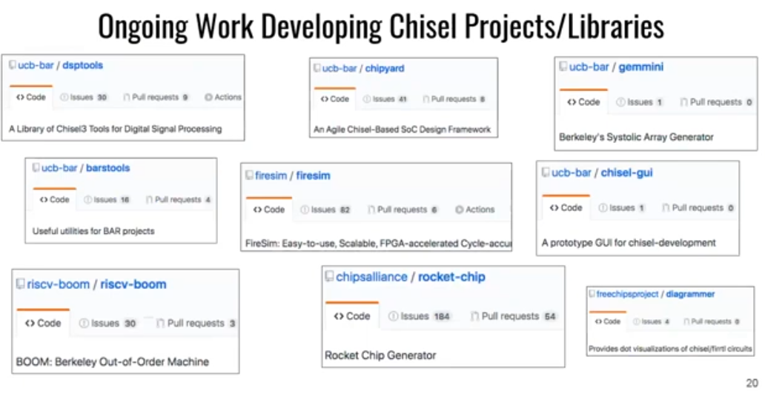
11.20 Ongoing Chisel Project
https://www.youtube.com/watch?v=VU9XdMJqkeM&list=PLlu0CT-JnSasfpk8tq1ZDiE2G0AK1BhOg&index=11
Ongoing Chisel Project (17:20-18:35/27:05)
Berkeley Focus projects: 1. DSP Tools, 2. Chip Yard, 3. Gem-mini, 4. Bars-tools, 5. Fire-sim, 6. chisel-GUI, 7. RISCV Boom, 8. Rocket-Chip: SoC, 9. Diagrammer

Slide 21
End

