Slide 1

11.21 Promote Your Project
Peter H. Chen

Slide 2
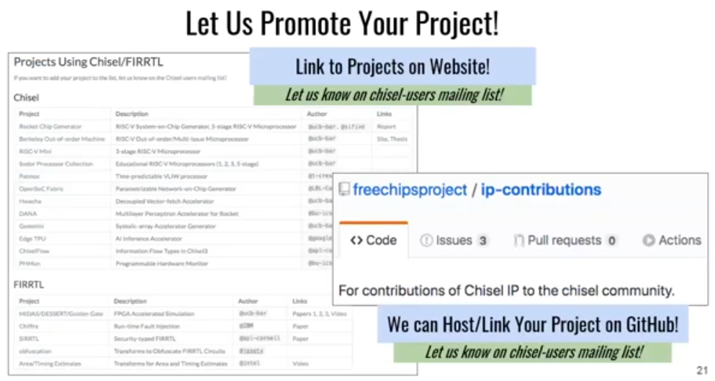
11.21 Promote Your Project
https://www.youtube.com/watch?v=VU9XdMJqkeM&list=PLlu0CT-JnSasfpk8tq1ZDiE2G0AK1BhOg&index=11
Promote Your Project (18:36-19:14/27:05)
Chisel can host your project on GitHub.
You can make IP Contribution, host your project with link.

Slide 3
11.22 Academic Impact

Slide 4
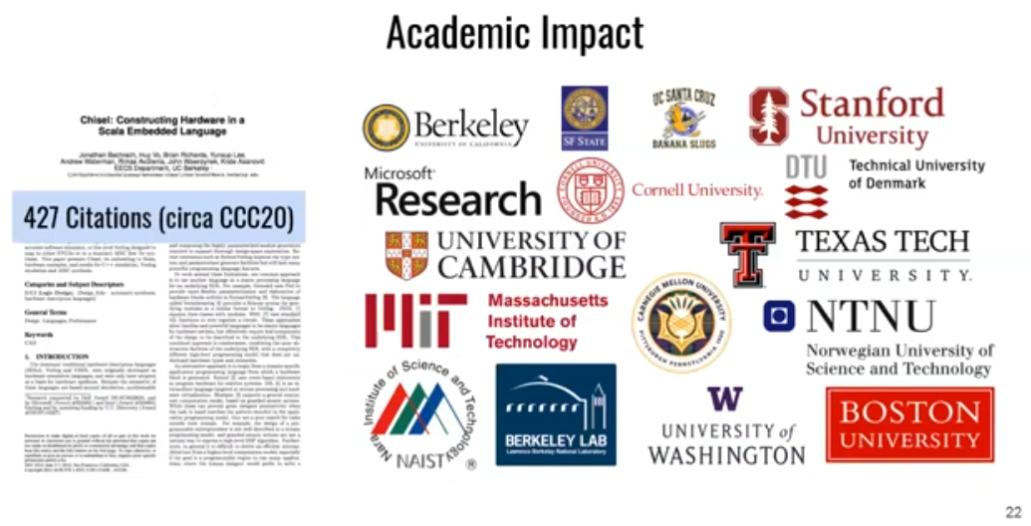
11.22 Academic Impact
https://www.youtube.com/watch?v=VU9XdMJqkeM&list=PLlu0CT-JnSasfpk8tq1ZDiE2G0AK1BhOg&index=11
Academic Impact (19:15-19:25/27:05)

Slide 5
11.23 CCC2020

Slide 6
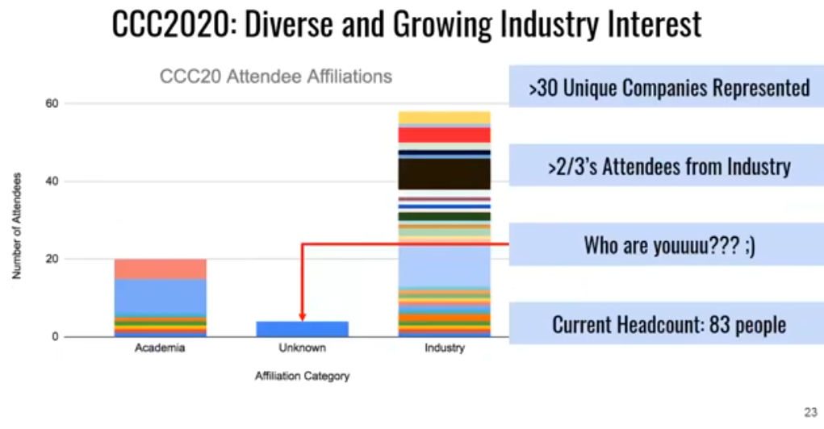
11.23 CCC2020
https://www.youtube.com/watch?v=VU9XdMJqkeM&list=PLlu0CT-JnSasfpk8tq1ZDiE2G0AK1BhOg&index=11
CCC2020 (19:26-19:51/27:05)

Slide 7
11.24 New Features

Slide 8

11.24 New Features
https://www.youtube.com/watch?v=VU9XdMJqkeM&list=PLlu0CT-JnSasfpk8tq1ZDiE2G0AK1BhOg&index=11
New Features (19:52-19:56/27:05)

Slide 9
11.25 FIRRTL Modularity

Slide 10
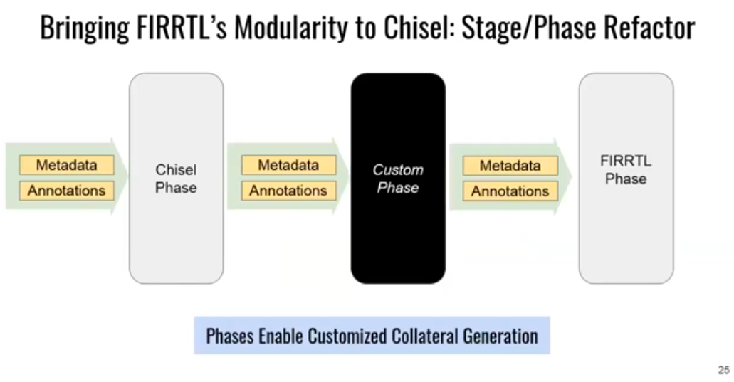
11.25 FIRRTL Modularity
https://www.youtube.com/watch?v=VU9XdMJqkeM&list=PLlu0CT-JnSasfpk8tq1ZDiE2G0AK1BhOg&index=11
FIRRTL (19:57-21:13/27:05)
Chisel Phase, Custom Phase, FIRRTL Phase: Add Custom Phase.

Slide 11
11.26 Post Elaboration

Slide 12
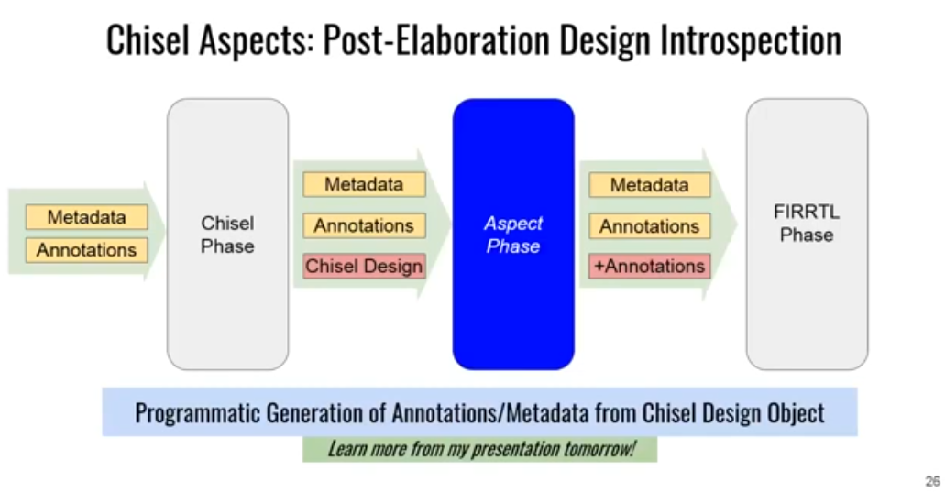
11.26 Post Elaboration
https://www.youtube.com/watch?v=VU9XdMJqkeM&list=PLlu0CT-JnSasfpk8tq1ZDiE2G0AK1BhOg&index=11
Post Elaboration (21:14-21:57/27:05)
In Chisel aspect, Custom Phase is an “Aspect Phase”.

Slide 13
11.27 Inject Custom Transform

Slide 14
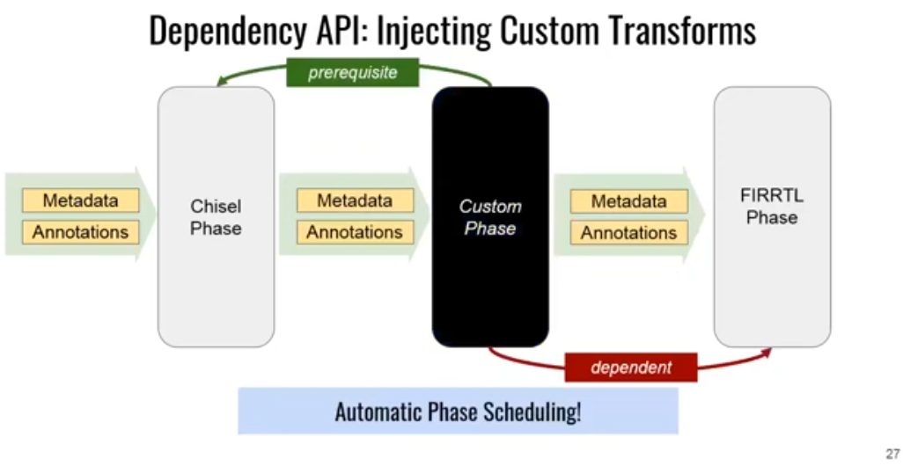
11.27 Inject Custom Transform
https://www.youtube.com/watch?v=VU9XdMJqkeM&list=PLlu0CT-JnSasfpk8tq1ZDiE2G0AK1BhOg&index=11
Inject Custom Transform (21:58-22:39/27:05)
Dependency API to inject custom Transform: Define the prerequisite of design, inject the design pattern and specification, such as, car pattern, different tire vendor, etc.

Slide 15
11.28 Latest Chisel Features

Slide 16
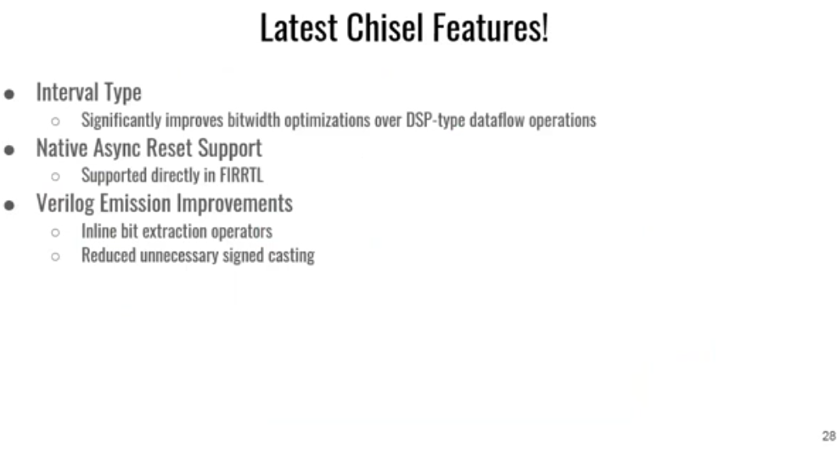
11.28 Latest Chisel Features
https://www.youtube.com/watch?v=VU9XdMJqkeM&list=PLlu0CT-JnSasfpk8tq1ZDiE2G0AK1BhOg&index=11
Latest Chisel Features (22:40-23:23/27:05)
DSP data flow, etc.

Slide 17
11.29 Future Direction

Slide 18

11.29 Future Direction
https://www.youtube.com/watch?v=VU9XdMJqkeM&list=PLlu0CT-JnSasfpk8tq1ZDiE2G0AK1BhOg&index=11
Future Direction (23:24-23:29/27:05)

Slide 19
11.30 Development Priority

Slide 20
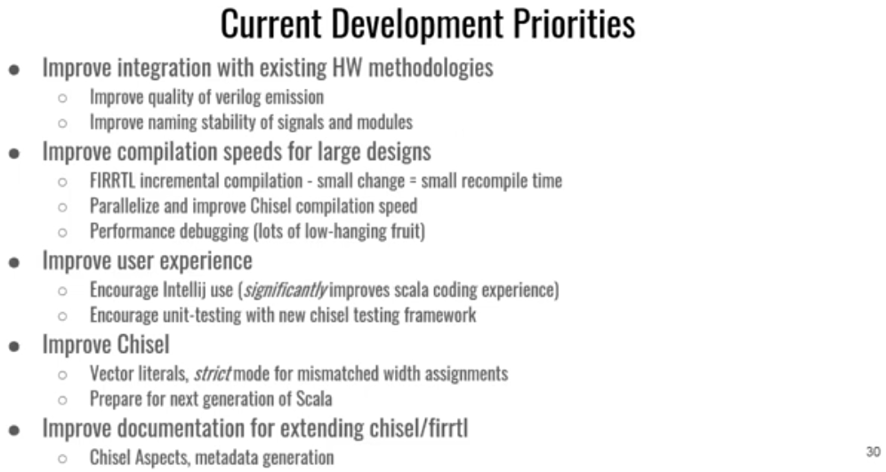
11.30 Development Priority
https://www.youtube.com/watch?v=VU9XdMJqkeM&list=PLlu0CT-JnSasfpk8tq1ZDiE2G0AK1BhOg&index=11
Development Priority (23:30-26:03/27:05)

Slide 21
End

