Slide 1

11.31 Chisel Trajectory
Peter H. Chen

Slide 2
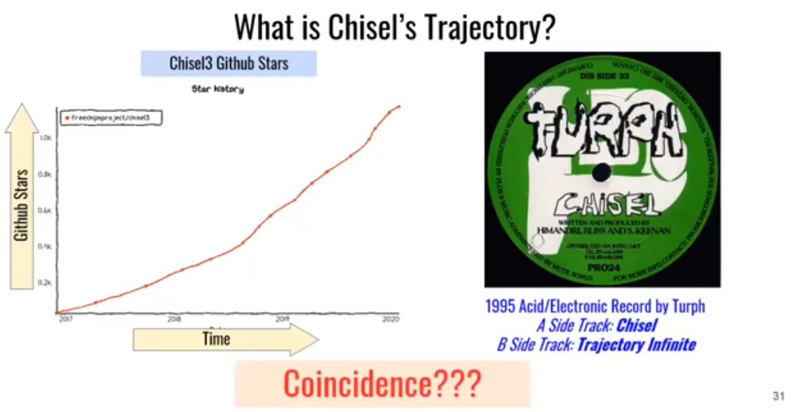
11.31 Chisel Trajectory
https://www.youtube.com/watch?v=VU9XdMJqkeM&list=PLlu0CT-JnSasfpk8tq1ZDiE2G0AK1BhOg&index=11
Chisel Trajectory (26:04-26:43/27:05)
GitHub Stars vs Time
B Side Track: Record is infinity by Turph?

Slide 3
11.32 Thank You

Slide 4

11.32 Thank You
https://www.youtube.com/watch?v=VU9XdMJqkeM&list=PLlu0CT-JnSasfpk8tq1ZDiE2G0AK1BhOg&index=11
Thanks You (26:44-27:05/27:05)

Slide 5
End

