Slide 1

4.1 FIRRTL Introduction
Peter H. Chen

Slide 2
4.1 FIRRTL Introduction
https://github.com/freechipsproject/chisel-bootcamp
FIRRTL Introduction
We discuss Scala/Chisel Types
Topics:
1. Setup: Select Scala Interpreter and Run.
2. What is FIRRTL? FIRRTL (Flexible Intermediate Representation of Register Transfer Level) is generated by the Chisel compiler. FIRRTL is an intermediate representation for synthesis of RTL (Register Transfer Level) Verilog). RTL Verilog is used for placement and route for TSMC to make chip.
3. What is FIRRTL AST? FIRRTL AST (Abstract Syntax Tree) is the data structure of FIRRTL.
4. Node: FIRRTL Node is part of the FIRRTL IR (Intermediate Representation).
5. Circuit: FIRRTL Circuit is the root of FIRRTL Node data structure
6. Module: FIRRTL Modules are the unit within FIRRTL.
7. Port: FIRRTL Port defines part of a Module's io, and has a name, direction (input or output), and type.
8. Statement: Describe the components in modules, such as, Register, Connection, FIRRTL Node, other statements.
9. Expression: Represent references for logical and arithmetic operations.
10. FIRRTL AST Example

Slide 3
4.1.1 Setup

Slide 4
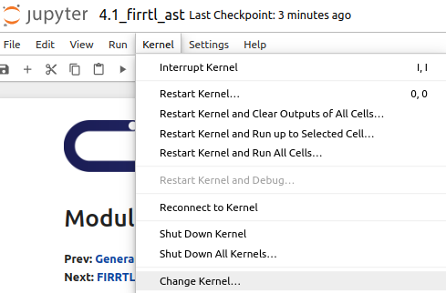
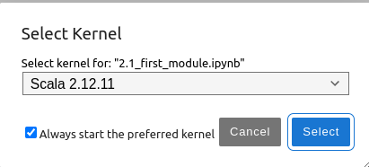
4.1.1 Setup
https://github.com/freechipsproject/chisel-bootcamp
Setup
1. Change folder to chisel-bootcamp. If you want to work on your working space, copy image folder and source folder to your working directory.
> cd chisel-bootcamp
2. Start Jupyter notebook
> jupyter notebook 4.1_firrtl_ast.ipynb
3. Select the scala interpreter: > Kernel > Change Kernel… >Scala 2.12.11
3

Slide 5
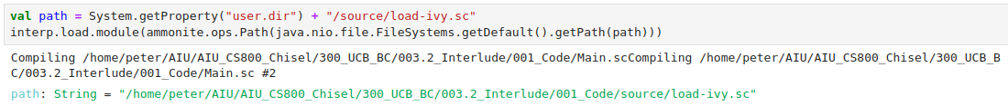
4.1.1 Setup
https://github.com/freechipsproject/chisel-bootcamp
Setup
1. Scala uses maven to setup path to with for source folder for Scala Libraries and get Scala Property.

Slide 6
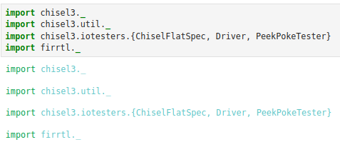
4.1.1 Setup
https://github.com/freechipsproject/chisel-bootcamp
Setup
1. import chisel3 library, utility, tester harness (horse controller), firrtl, etc.

Slide 7
4.1.2 What is FIRRTL?

Slide 8
4.1.2 What is FIRRTL?
https://github.com/freechipsproject/chisel-bootcamp
What is FIRRTL?
1. FIRRTL (Flexible Intermediate Representation of Register Transfer Level) is generated by the Chisel compiler. FIRRTL is an intermediate representation for synthesis of RTL (Register Transfer Level) Verilog. RTL Verilog is used for placement and route for TSMC to make chip.
2. FIRRTL compiler translates FIRRTL into circuit through a series of circuit-level transformations.
3. FIRRTL compiler will optimizes out unused signals.
4. Once the transformations are done, a RTL Verilog file is emitted and the build process is done.
5. When we execute a Chisel design, it run the Scala code to construct an instance of your generator with all Scala parameters.
6. Instead of directly emitting Verilog, Chisel emits an intermediate representation called FIRRTL.
7. FIRRTL (Flexible Internal Representation of RTL) represents the elaborated (parameter-resolved) RTL instance.
8. FIRRTL is serialized (converted to a String for writing to a file) and the serialized syntax is human readable.
9. Internally, however, it is not represented as a long string. Instead, it is a data structure organized as a tree of nodes, called an AST (Abstract Syntax Tree).
10. We will look at what is FIRRTL.

Slide 9
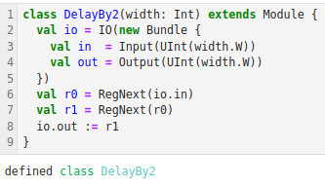
4.1.2 What is FIRRTL?
https://github.com/freechipsproject/chisel-bootcamp
What is FIRRTL?
1. First, we define a Chisel module.
2. In the module, we delays its input signal by two cycles.

Slide 10
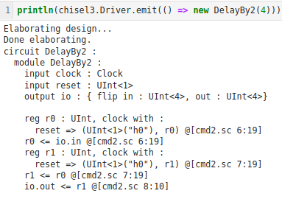
4.1.2 What is FIRRTL?
https://github.com/freechipsproject/chisel-bootcamp
What is FIRRTL?
1. Next, we elaborate it, serialize, and print out the FIRRTL it generates.
2. As we observe, the serialized FIRRTL looks very similar to:
  a. Our Chisel design
  b. All generator parameters resolved.
Chisel Design
FIRRTL

Slide 11
4.1.3 FIRRTL AST

Slide 12
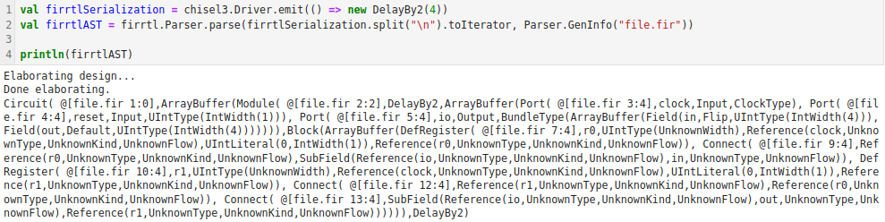
4.1.3 FIRRTL AST
https://github.com/freechipsproject/chisel-bootcamp
FIRRTL AST
1. FIRRTL AST (Abstract Syntax Tree) is the data structure of FIRRTL.
2. As mentioned earlier, the FIRRTL representation can be serialized as a String.
3. Internally, FIRRTL is a data structure called an AST (Abstract Syntax Tree).
4. The AST data structure is a tree of nodes, where one node can contain children nodes.
5. There are no cycles in this data structure.
6. We take a look at what the internal data structure looks like:

Slide 13
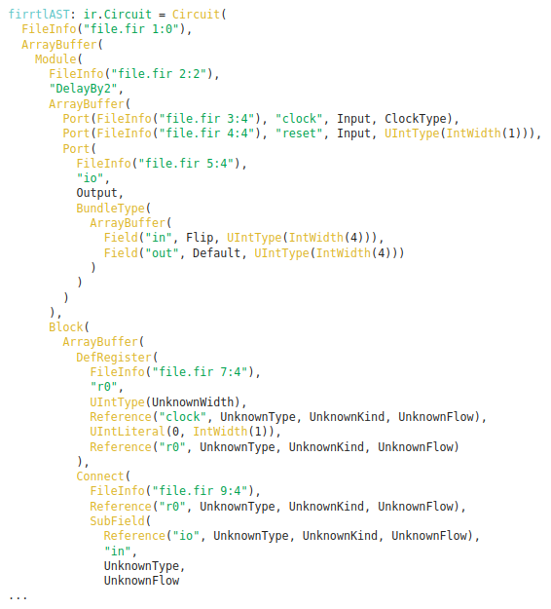
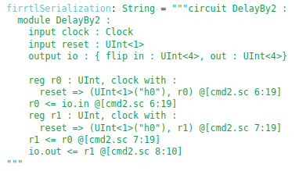
4.1.3 FIRRTL AST
https://github.com/freechipsproject/chisel-bootcamp
FIRRTL AST
1. The serialization of a data structure isn't as pretty, but you can see some of the classes and such that internally represent the RTL design.

Slide 14
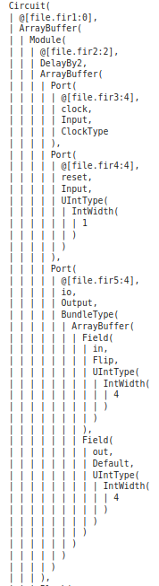
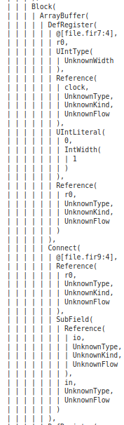
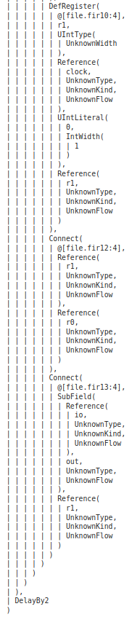
4.1.3 FIRRTL AST
https://github.com/freechipsproject/chisel-bootcamp
FIRRTL AST
1. We print pretty that up a bit to make it understandable.
2. This is the internal data structure that holds the FIRRTL AST.
3. FIRRTL AST is a tree structure whose root node is Circuit, which has 3 children:
  a. @[file.fir@2.0],
  b. ArrayBuffer, and
  c. cmd5WrapperHelperDelayBy2.

Slide 15
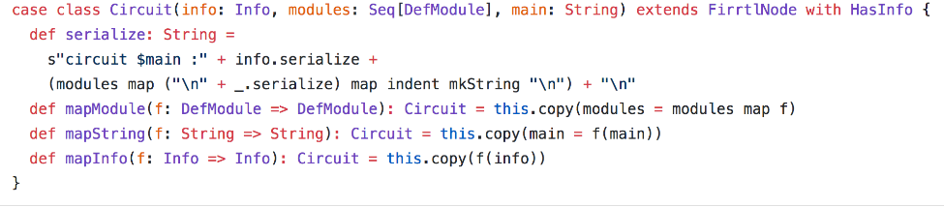
4.1.3 FIRRTL AST
https://github.com/freechipsproject/chisel-bootcamp
FIRRTL AST
1. The following is the definition of Circuit's actual Scala class that was serialized:Circuit case class.
2. We can see, it has three children nodes:
  a. info: Info,
  b. Modules: Seq[DefModule], and
  c. main: String.
3. Circuit extends FirrtlNode, of which all FIRRTL AST nodes must do.
2
3

Slide 16
4.1.3 FIRRTL AST
https://github.com/freechipsproject/chisel-bootcamp
FIRRTL AST
1. We Ignore the def mapXXXX functions for now.
1

Slide 17
4.1.3 FIRRTL AST
https://github.com/freechipsproject/chisel-bootcamp
FIRRTL AST
1. Many FIRRTL nodes contain an
  a. info: Info field, which the parser can either insert file information like line number and column number, or insert a NoInfo token.
  b. In this example, @[file.fir3:4] would refer to the FIRRTL file, line 3, column 4.

Slide 18
4.1.4 FIRRTL Node

Slide 19
4.1.4 FIRRTL Node
https://github.com/freechipsproject/chisel-bootcamp
FIRRTL Node
1. FIRRTL Node is part of the FIRRTL IR (Intermediate Representation) of a Verilog RTL circuit.
2. The FIRRTL IR is created by the Chisel compiler and used to translate Chisel source files into other representations, like Verilog.
3. Below, we discuss the FIRRTL nodes in detail.
4. This section describes common FirrtlNodes found:
https://github.com/chipsalliance/firrtl/blob/master-deprecated/src/main/scala/firrtl/ir/IR.scala
5. For more detail on components not mentioned here, please refer to The FIRRTL Specification:
https://github.com/chipsalliance/firrtl/tree/master-deprecated

Slide 20
4.1.5 Circuit

Slide 21
4.1.5 Circuit
https://github.com/freechipsproject/chisel-bootcamp
Circuit
1. Circuit is the root of FIRRTL Node data structure.
2. There is only one Circuit.
3. Circuit contains a list of module definitions and the name of the top-level module.
FirrtlNode Declaration
  > Circuit(info: Info, modules: Seq[DefModule], main: String)
Concrete Syntax
  > circuit Adder:
  > ... //List of modules
In-memory Representation
  > Circuit(NoInfo, Seq(...), "Adder"

Slide 22
4.1.6 Module

Slide 23
4.1.6 Module
https://github.com/freechipsproject/chisel-bootcamp
Module
1. FIRRTL Modules are the unit within FIRRTL.
2. Each Module has a name, and a list of ports, and a body containing its implementation.
FirrtlNode declaration
  > Module(info: Info, name: String, ports: Seq[Port], body: Stmt) extends DefModule
Concrete Syntax
  > module Adder:
  > ... // list of ports
  > ... // statements
In-memory representation
  > Module(NoInfo, "Adder", Seq(...), )

Slide 24
4.1.7 Port

Slide 25
4.1.7 Port
https://github.com/freechipsproject/chisel-bootcamp
Port
1. FIRRTL port defines part of a Module's io, and has a name, direction (input or output), and type.
FirrtlNode Declaration
  > class Port(info: Info, name: String, direction: Direction, tpe: Type)
Concrete Syntax
  input x: UInt
In-memory representation
  Port(NoInfo, "x", INPUT, UintType (UnknownWidth))

Slide 26
4.1.8 Statement

Slide 27
4.1.8 Statement
https://github.com/freechipsproject/chisel-bootcamp
Statement
A statement is used to describe the components within a module and how they interact. Below are some commonly used statements:
Block of Statements
  A group of statements. Commonly used as the body field in a Module declaration.
Wire Declaration
  A wire declaration, containing a name and type. It can be both a source (connected from) and a sink (connected *to").
FirrtlNode declaration
  > DefWire(info: Info, name: String, tpe: Type)
Concrete syntax
  wire w: UInt
In-memory Representation
  DefWire(NoInfo, "w", UintType(UnknownWidth))

Slide 28
4.1.8 Statement
https://github.com/freechipsproject/chisel-bootcamp
Statement
Register Declaration
  A register declaration, containing a name, type, clock signal, reset signal, and reset value.
FirrtlNode declaration
  DefRegister(info: Info, name: String, tpe: Type, clock: Expression, reset: Expression, init: Expression)
Connection
  Represents a directioned connection from a source to a sink. Note that it abides by last-connect-semantics, as described in Chisel.
FirrtlNode declaration
  Connect (info: Info, loc: Expression, expr: Expression)
Other Statements
  Other statement types like DefMemory, DefNode, IsInvalid, Conditionally, and others are omitted here;
  Please refer to firrtl/src/main/scala/firrtl/ir/IR.scala for more detail.

Slide 29
4.1.9 Expression

Slide 30
4.1.9 Expression
https://github.com/freechipsproject/chisel-bootcamp
Expression
Expressions represent references to declared components or logical and arithmetic operations. Below are some commonly used expressions:
Reference
A reference to a declared component, such as a wire, register, or port. It has a name and type field. Note that it does not contain a pointer to the actual declaration, but instead just contains the name as a String.
FirrtlNode declaration
  > Reference(name: String, tpe: Type)
DoPrim
An anonymous primitive operation, such as Add, Sub, or And, Or, or subword-selection (Bits). The type of operation is indicated by the op: PrimOp field. Note that the number of required arguments and constants are determined by the op.
FirrtlNode declaration
  > DoPrim(op: PrimOp, args: Seq[Expression], consts: Seq[BigInt], tpe: Type)
Other Expressions
Other expressions including SubField, SubIndex, SubAccess, Mux, ValidIf etc. are described in more detail in firrtl/src/main/scala/firrtl/ir/IR.scala and The FIRRTL Specification.

Slide 31
4.1.10 FIRRTL AST Example

Slide 32
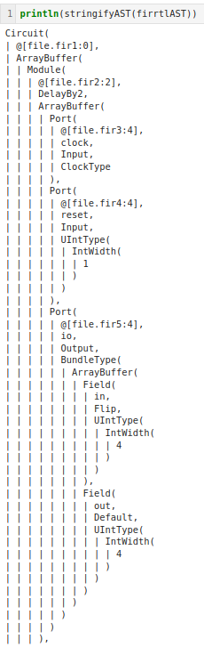
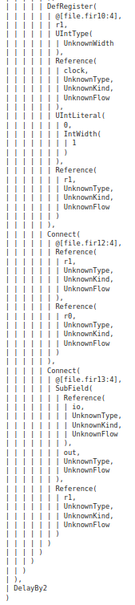
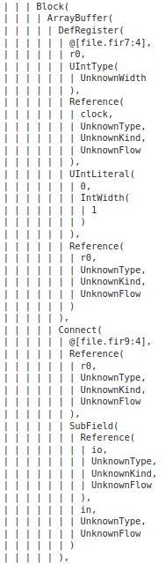
4.1.10 FIRRTL AST Example
https://github.com/freechipsproject/chisel-bootcamp
FIRRTL AST Example
1. After we go through the FIRRTL Node Description, we take a look again of the FIRRTL AST Example.
2. Now, the FIRRTL AST should make sense.
3. We will see discuss more about FIRRTL later on.

Slide 33
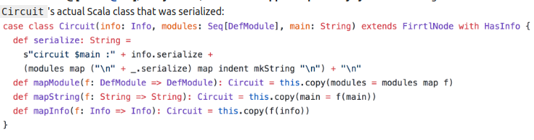
4.1.10 FIRRTL AST Example
https://github.com/freechipsproject/chisel-bootcamp
FIRRTL AST Example
1. This is the internal data structure that holds the FIRRTL AST.
2. It is a tree structure whose root node is Circuit, which has 3 children: @[file.fir@2.0], ArrayBuffer, and cmd5WrapperHelperDelayBy2. The following is the definition of

Slide 34
End

