Slide 1

5 Collection
Peter H. Chen

Slide 2
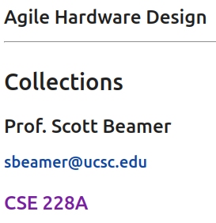
5 Collection
https://www.youtube.com/watch?v=48hI56w-zWI&list=PLfrN7RIcMe6g2LBRJLTHTdhyj5s8ag0Rg&index=5
Collection (0:00-0:30/54:27)
We have done the Verilog, Combinational Logic, Sequential Logic, finite state machine, parameterization, stronger types.
Today, we discuss Chisel Collections. We will talk about several components.

Slide 3
5 Collection
https://www.youtube.com/watch?v=48hI56w-zWI&list=PLfrN7RIcMe6g2LBRJLTHTdhyj5s8ag0Rg&index=5
Collection (0:31-0:47/54:27)
Scala Collection vs. Chisel Collection:
1. Scala collection library: Collections are containers. Those containers can be sequenced, linear sets of items like List, Tuple, Option, Map, etc.
2. Chisel collection library: Chisel collections (Vec, Mem) for hardware generation
Topics:
1. Setup: jupyter notebook, select scala, and run cells
2. Scala: Seq(), Range loop, for loop:
3. Delay N Cycles with for and val/var
4. Use for in Tester
5. Chisel Vec()
6. Vector Parameters in Port
7. ROM with VecInit()
8. Chisel Mem()
9. Register File: Implicit Port/Explicit Port
10. Parameterized Port

Slide 4
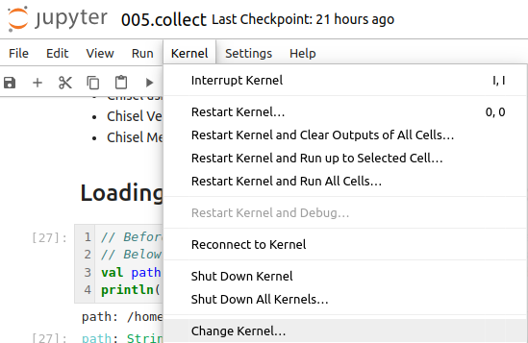
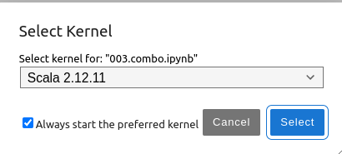
5 Collection
https://www.youtube.com/watch?v=48hI56w-zWI&list=PLfrN7RIcMe6g2LBRJLTHTdhyj5s8ag0Rg&index=5
Collection (0:47-0:48/54:27)
We discuss Chisel Collection.
> jupyter notebook 005.combo.ipynb > Kernel > Change Kernel … > Select Scala2.21.22
> Run All Cells

Slide 5
5.1 Plan

Slide 6
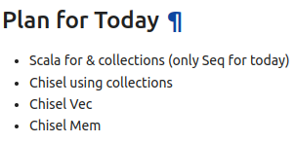
5.1 Plan
https://www.youtube.com/watch?v=48hI56w-zWI&list=PLfrN7RIcMe6g2LBRJLTHTdhyj5s8ag0Rg&index=5
Plan (0:49-1:09/54:27)
We will discuss:
a. Scala collection: Today, only Seq ()
b. Chisel Collection: Chisel Construction
c. Chisel Vec()
d. Chisel Mem()

Slide 7
5.2 Import Chisel Library

Slide 8
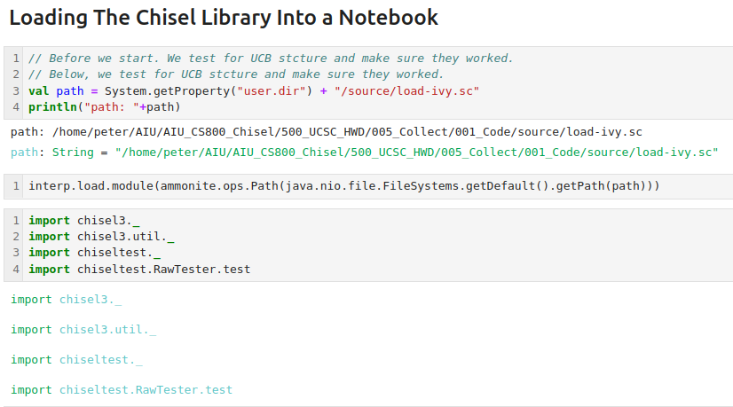
5.2 Import Chisel Library
https://www.youtube.com/watch?v=48hI56w-zWI&list=PLfrN7RIcMe6g2LBRJLTHTdhyj5s8ag0Rg&index=5
Import Chisel Library (1:10-1:11/54:27)

Slide 9
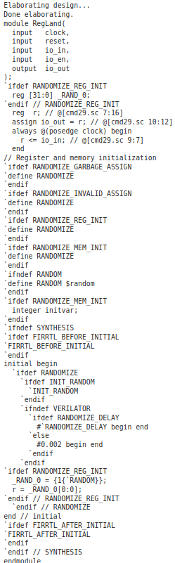
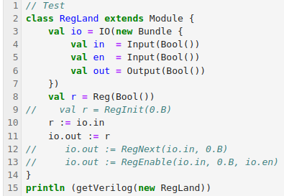
5.2 Import Chisel Library
https://www.youtube.com/watch?v=48hI56w-zWI&list=PLfrN7RIcMe6g2LBRJLTHTdhyj5s8ag0Rg&index=5
Import Chisel Library (1:12-1:15/54:27)
Test

Slide 10
5.3 Scala Seq

Slide 11
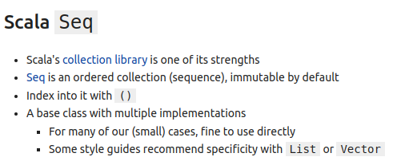
5.3 Scala Seq
https://www.youtube.com/watch?v=48hI56w-zWI&list=PLfrN7RIcMe6g2LBRJLTHTdhyj5s8ag0Rg&index=5
Scala Seq (1:16-1:41/54:27)
Seq() is short for Sequence.
Seq() is not only for a collection, it implies there is some sort of ordering.
It is N things and those things is associate with a unique index.
We have index with privacy.

Slide 12
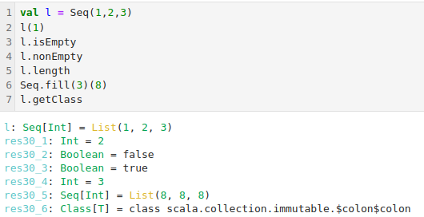
5.3 Scala Seq
https://www.youtube.com/watch?v=48hI56w-zWI&list=PLfrN7RIcMe6g2LBRJLTHTdhyj5s8ag0Rg&index=5
Scala Seq (1:42-5:00/54:27)
We can declare
> val l = Seq (1, 2, 3) # We can initiate a sequence of value. Seq() elements are immutable.
> var r = Seq (1, 2, 3) # Var is mutable.
> l(1) # We can access value of index 1: 2
> l.isEmpty # false: Scala Seq() has a lot of methods.
> l.nonEmpty # true
> l.length # 3
> Seq.fill (3)(8) # List (8, 8, 8)
> l.getClass # class scala.collection.immutable.$colon$colon

Slide 13
5.3 Scala Seq
https://www.youtube.com/watch?v=48hI56w-zWI&list=PLfrN7RIcMe6g2LBRJLTHTdhyj5s8ag0Rg&index=5
Scala Seq (5:01-5:14/54:27)
Q: Difference between Seq(), Vec(), and List()?
Ans: In Scala,
1. "Seq" is a broader term representing a sequence of elements,
2. "Vector" is a specific type of sequence that allows for fast random access to elements, such as, an array
3. "List" is another type of sequence that is optimized for efficient insertion and removal at the beginning, often implemented as a linked list, making random access slower compared to a Vector.
4. Vectors are better for quick lookup by index.
5. Lists are better for adding/removing elements.

Slide 14
5.4 Scala Range

Slide 15
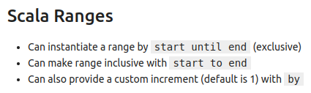
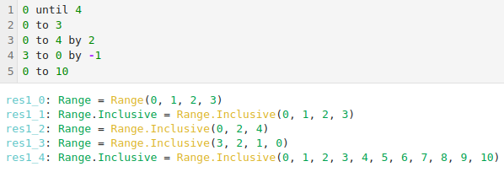
5.4 Scala Range
https://www.youtube.com/watch?v=48hI56w-zWI&list=PLfrN7RIcMe6g2LBRJLTHTdhyj5s8ag0Rg&index=5
Scala Range (5:15-6:10/54:27)
Scala Range is similar to Python. It loop for a range.
Range has until to the end. The until means will not to do that number.

Slide 16
5.5 Scala for

Slide 17
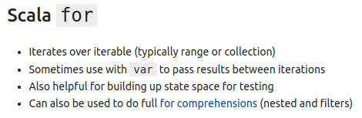
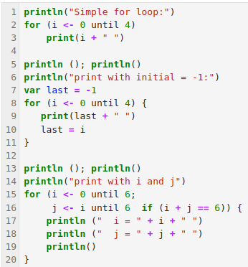
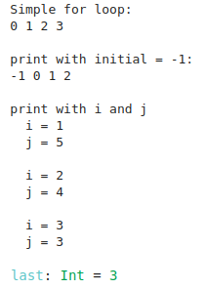
5.5 Scala for
https://www.youtube.com/watch?v=48hI56w-zWI&list=PLfrN7RIcMe6g2LBRJLTHTdhyj5s8ag0Rg&index=5
Scala for (6:11-8:48/54:27)
Scala Range is similar to Python. It loop for a range.
Range has until to the end. The until means will not to do that number.

Slide 18
5.6 Delay N Cycles with for

Slide 19
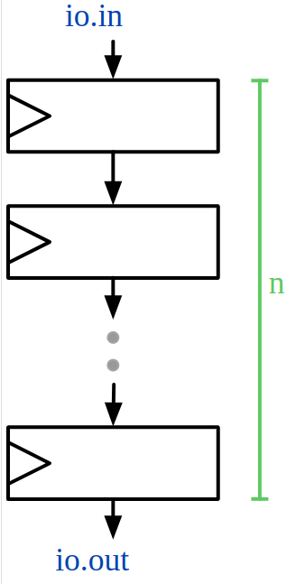
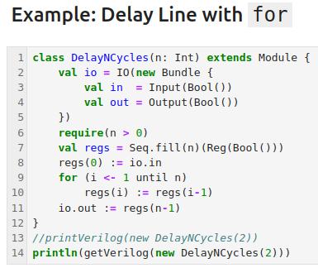
5.6 Delay N Cycles with for
https://www.youtube.com/watch?v=48hI56w-zWI&list=PLfrN7RIcMe6g2LBRJLTHTdhyj5s8ag0Rg&index=5
Delay N Cycles with for (8:49-11:00/54:27)
On the right diagram, we have n registers.
Below, we creates n registers (0 to n-1) with all type of Reg(Bool()). Assign all registers with zeros.
> val regs = Seq.fill (n) (Reg(Bool())) // 0, 1, 2, …, n-1
We assign inputs into register 0, i.e., regs(0).
> regs(0) := io.in
We assign registers 1 to n – 1 with registers 0 to n-2.
> for (i <- 1 until n)
> reg(i) := regs (i -1)
We put the registers 0 to n-1 to output.
> io.out := regs (n -1)

Slide 20
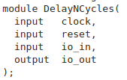
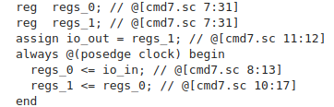
5.6 Delay N Cycles with for
https://www.youtube.com/watch?v=48hI56w-zWI&list=PLfrN7RIcMe6g2LBRJLTHTdhyj5s8ag0Rg&index=5
Delay N Cycles with for (11:01-11:48/54:27)
Generate Verilog with 2 delay cycles.
> println (get Verilog(new DelayNCycles(2))

Slide 21
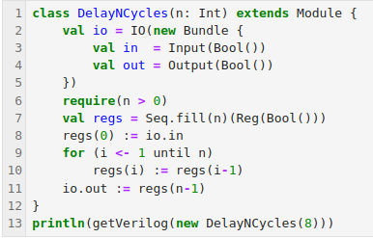
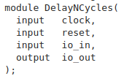
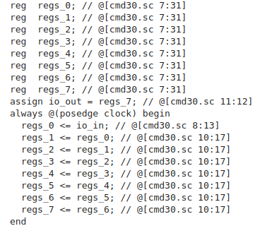
5.6 Delay N Cycles with for
https://www.youtube.com/watch?v=48hI56w-zWI&list=PLfrN7RIcMe6g2LBRJLTHTdhyj5s8ag0Rg&index=5
Delay N Cycles with for (11:49-13:58/54:27)
We can test for 8 cycles with parameter 8.
> println (get Verilog(new DelayNCycles(8))

Slide 22
5.7 Delay Line with for and var

Slide 23
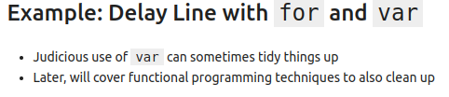
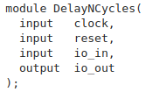
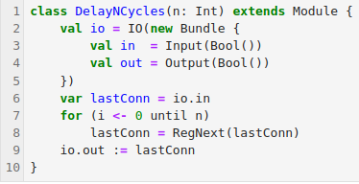
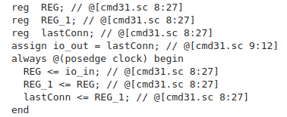
5.7 Delay Line with for and var
https://www.youtube.com/watch?v=48hI56w-zWI&list=PLfrN7RIcMe6g2LBRJLTHTdhyj5s8ag0Rg&index=5
Delay Line with for and var (13:59-16:01/54:27)
We do the for loop with var for lastConn.
The Verilog code is simpler.

Slide 24
5.8 Use for in Tester

Slide 25
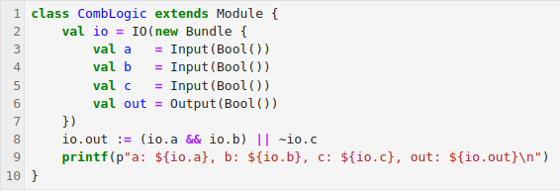
5.8 Use for in Tester
https://www.youtube.com/watch?v=48hI56w-zWI&list=PLfrN7RIcMe6g2LBRJLTHTdhyj5s8ag0Rg&index=5
Use for in Tester (16:02-18:00/54:27)
We do the for loop with var for lastConn.
The Verilog code is simpler.

Slide 26
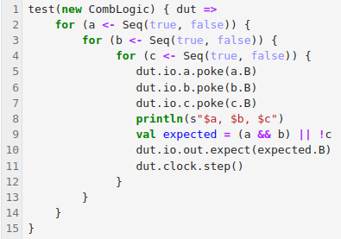
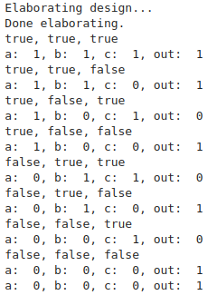
5.8 Use for in Tester
https://www.youtube.com/watch?v=48hI56w-zWI&list=PLfrN7RIcMe6g2LBRJLTHTdhyj5s8ag0Rg&index=5
Use for in Tester (18:01-19:30/54:27)
We print the result with for in test.

Slide 27
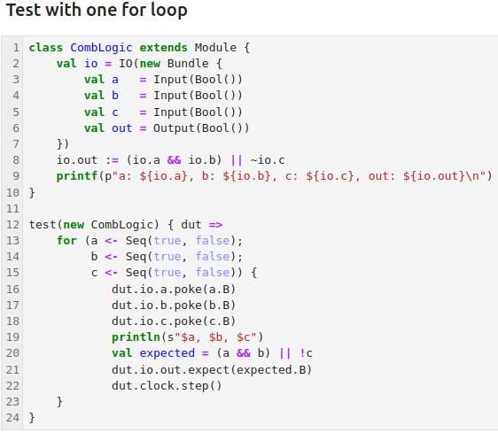
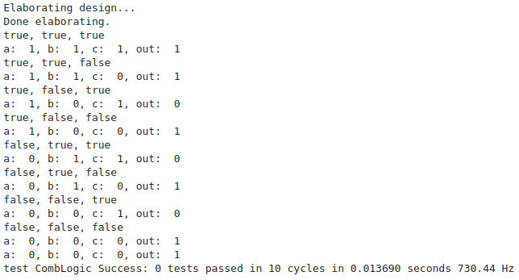
5.8 Use for in Tester
https://www.youtube.com/watch?v=48hI56w-zWI&list=PLfrN7RIcMe6g2LBRJLTHTdhyj5s8ag0Rg&index=5
Use one for loop (19:31-20:40/54:27)
We can simplified with one for loop. We can use three for loop to print the details between loops.

Slide 28
5.9 Chisel Vec

Slide 29
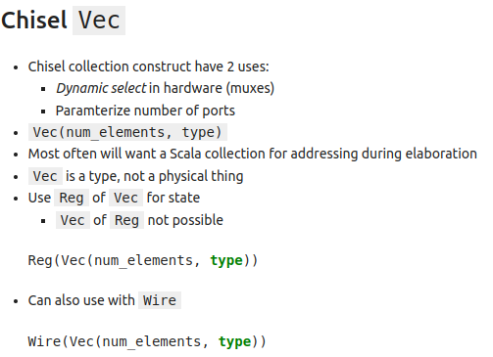
5.9 Chisel Vec
https://www.youtube.com/watch?v=48hI56w-zWI&list=PLfrN7RIcMe6g2LBRJLTHTdhyj5s8ag0Rg&index=5
Chisel Vec (20:41-24:00/54:27)
We have two uses in construction of Chisel collection
Vec and Reg are for state.
Wire can also use Vec.

Slide 30
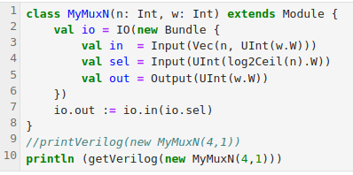
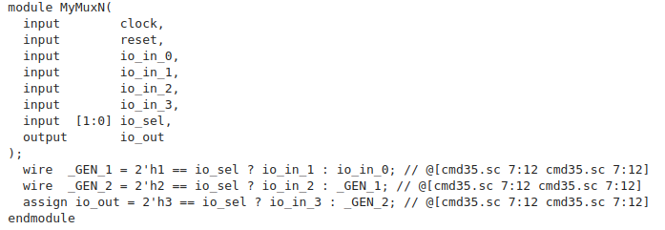
5.9 Chisel Vec
https://www.youtube.com/watch?v=48hI56w-zWI&list=PLfrN7RIcMe6g2LBRJLTHTdhyj5s8ag0Rg&index=5
Chisel Vec (24:01-27:42/54:27)
We have n = 4 registers and wire width = 1.

Slide 31
5.10 Vec Parameters for No of Port

Slide 32
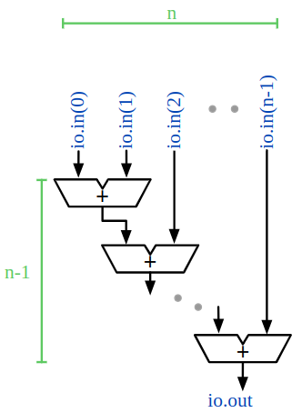
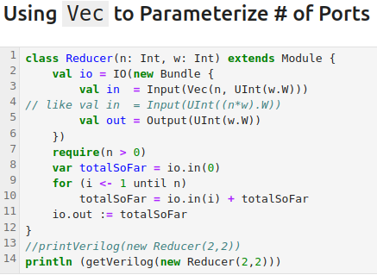
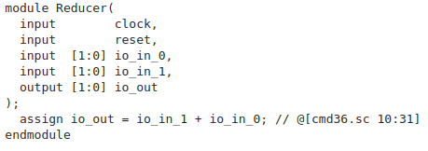
5.10 Vec Parameters for No of Port
https://www.youtube.com/watch?v=48hI56w-zWI&list=PLfrN7RIcMe6g2LBRJLTHTdhyj5s8ag0Rg&index=5
Vec Parameters for Number of Port (27:43-30:02/54:27)
We use Vec Parameters for number of ports

Slide 33
5.11 ROM with VecInit

Slide 34
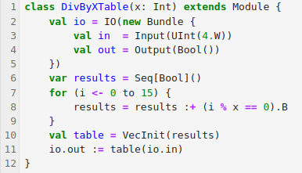
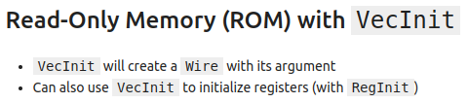
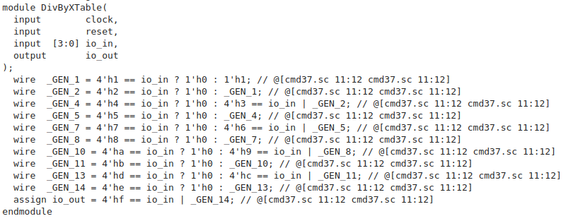
5.11 ROM with VecInit
https://www.youtube.com/watch?v=48hI56w-zWI&list=PLfrN7RIcMe6g2LBRJLTHTdhyj5s8ag0Rg&index=5
ROM with VecInit (30:03-39:34/54:27)
We read the table from ROM memory.
This memory is Divide by X table.
In the code, we can the adder (+) (i % x) in the result (which is the table of memory).

Slide 35
5.12 Chisel Mem

Slide 36
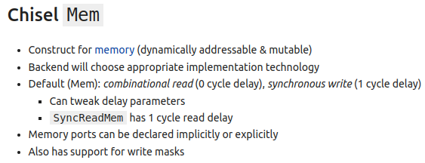
5.12 Chisel Mem
https://www.youtube.com/watch?v=48hI56w-zWI&list=PLfrN7RIcMe6g2LBRJLTHTdhyj5s8ag0Rg&index=5
Chisel Mem (39:35-42:41/54:27)
Chisel Mem is SRAM (static RAM). It is hardware latch memory.
Mem is Memory:
1. Combinational read (0 cycle delay) and
2. Synchronous write (1 cycle delay).

Slide 37
5.13 Register File: Implicit Ports

Slide 38
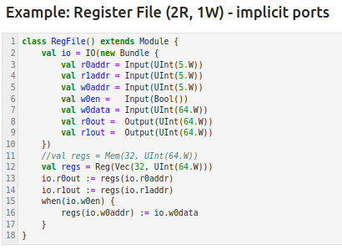
5.13 Register File: Implicit Ports
https://www.youtube.com/watch?v=48hI56w-zWI&list=PLfrN7RIcMe6g2LBRJLTHTdhyj5s8ag0Rg&index=5
Register File: Implicit Ports (42:43-44:30/54:27)
2 Read, 1 Write
We use Reg() to print huge amount of Verilog Code

Slide 39
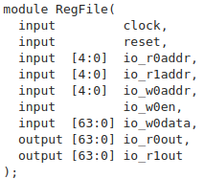
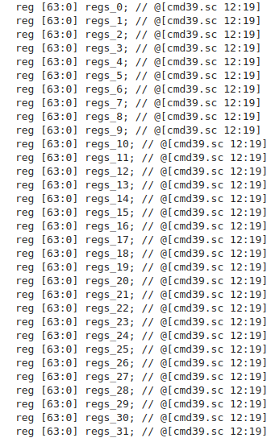
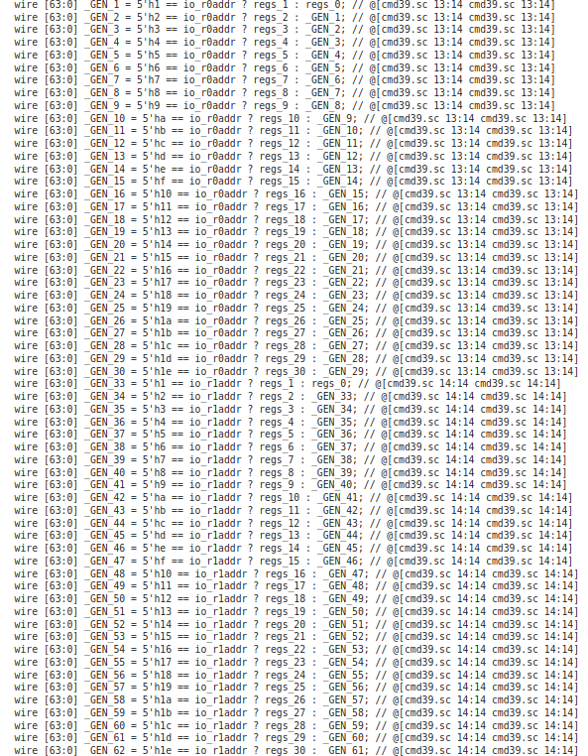
5.13 Register File: Implicit Ports
https://www.youtube.com/watch?v=48hI56w-zWI&list=PLfrN7RIcMe6g2LBRJLTHTdhyj5s8ag0Rg&index=5
Register File: Implicit Ports (44:31-45:00/54:27)
2 Read, 1 Write

Slide 40
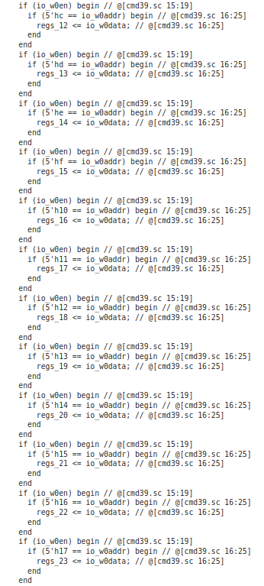
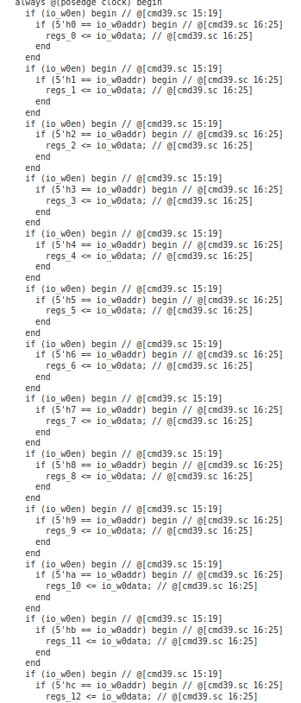
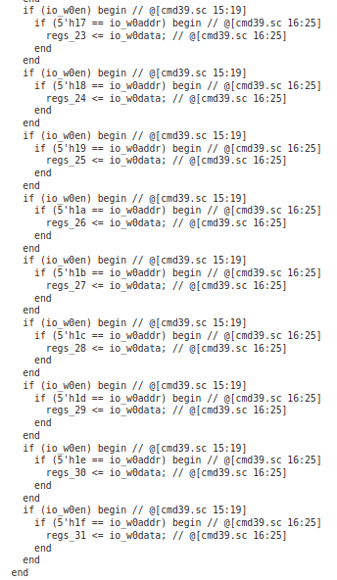
5.13 Register File: Implicit Ports
https://www.youtube.com/watch?v=48hI56w-zWI&list=PLfrN7RIcMe6g2LBRJLTHTdhyj5s8ag0Rg&index=5
Register File: Implicit Ports (45:01-47:09/54:27)
2 Read, 1 Write
d

Slide 41
5.14 Register File: Explicit Ports

Slide 42
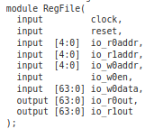
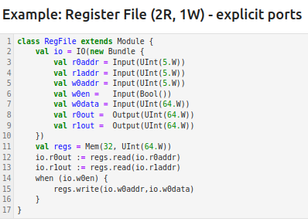
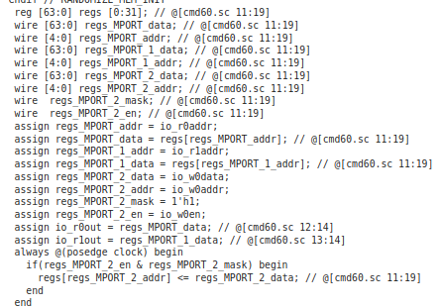
5.13 Register File: Explicit Ports
https://www.youtube.com/watch?v=48hI56w-zWI&list=PLfrN7RIcMe6g2LBRJLTHTdhyj5s8ag0Rg&index=5
Register File: Explicit Ports (47:10-47:19/54:27)
2 Read, 1 Write
We use Mem() to reduce the print size of Verilog in Vector [63:0] format.

Slide 43
5.15 Parameterized Ports

Slide 44



5.15 Parameterized Ports
https://www.youtube.com/watch?v=48hI56w-zWI&list=PLfrN7RIcMe6g2LBRJLTHTdhyj5s8ag0Rg&index=5
Parameterized Ports (47:20-50:00/54:27)

Slide 45
5.16 Summary of Chisel Collection

Slide 46

5.16 Summary of Chisel Collection
https://www.youtube.com/watch?v=48hI56w-zWI&list=PLfrN7RIcMe6g2LBRJLTHTdhyj5s8ag0Rg&index=5
Summary of Chisel Collection (50:01-54:27/54:27)

Slide 47
End

