Slide 1

3.1 Parameter
Peter H. Chen

Slide 2
3.1 Parameter
https://github.com/freechipsproject/chisel-bootcamp
Parameter
We discuss Chisel Standard Library: Interlude. Prelude is a standard library of Interfaces (Interoperability of RTL) and Generator for common use hardware blocks.
1.

Slide 3
3.2.1 Setup

Slide 4
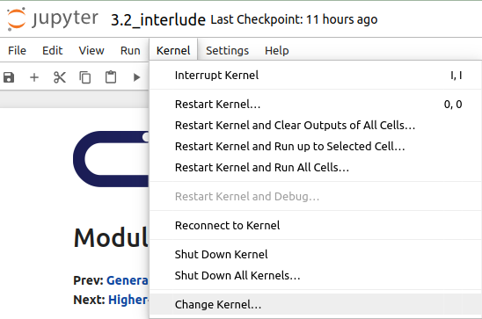
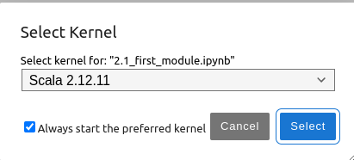
3.2.1 Setup
https://github.com/freechipsproject/chisel-bootcamp
Setup
1. Change folder to chisel-bootcamp. If you want to work on your working space, copy image folder and source folder to your working directory.
> cd chisel-bootcamp
2. Start Jupyter notebook
> jupyter notebook 3.2_interlude.ipynb
3. Select the scala interpreter: > Kernel > Change Kernel… >Scala 2.12.11
3

Slide 5
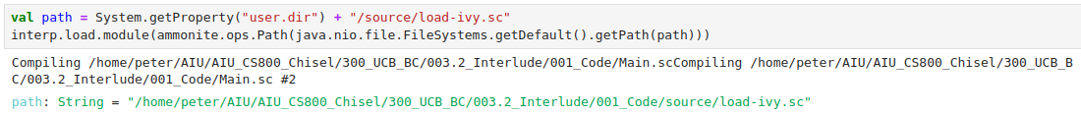
3.2.1 Setup
https://github.com/freechipsproject/chisel-bootcamp
Setup
1. Scala uses maven to setup path to with for source folder for Scala Libraries and get Scala Property.

Slide 6
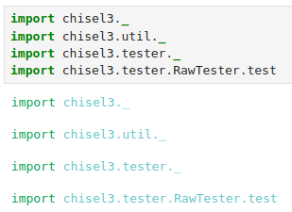
3.2.1 Setup
https://github.com/freechipsproject/chisel-bootcamp
Setup
1. import chisel3 library, utility, tester harness (horse controller), and test interface function.

Slide 7
3.2.2 Chisel API Command

Slide 8
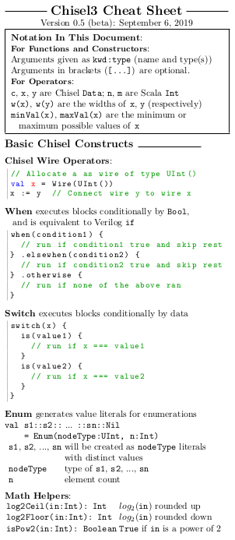
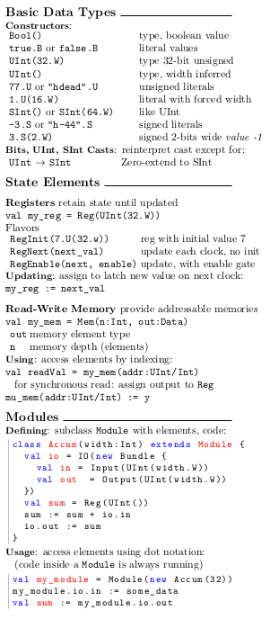
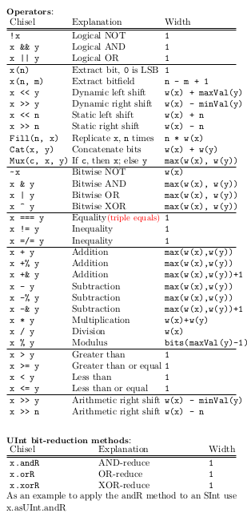
3.2.2 Chisel API Command
https://github.com/freechipsproject/chisel-bootcamp
Chisel API Command
1. The Chisel3 cheatsheet (https://users.cs.duke.edu/~lkw34/Chisel-Cheatsheet.pdf) summarize the major hardware construction APIs for standard library utilities.

Slide 9
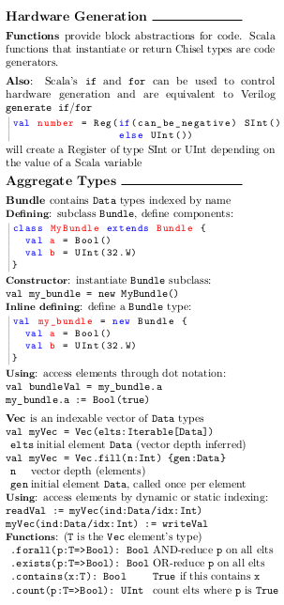
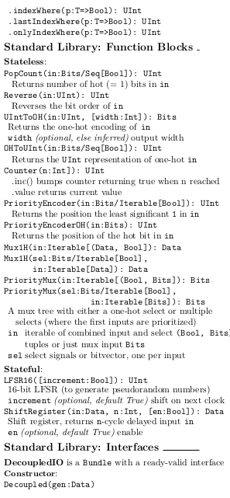
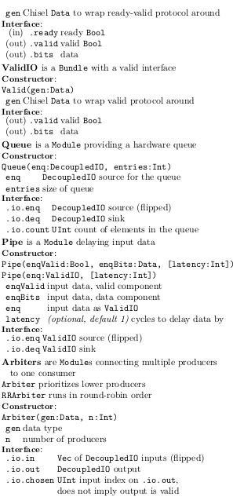
3.2.2 Chisel API Command
https://github.com/freechipsproject/chisel-bootcamp
Chisel API Command
1. The Chisel3 cheatsheet (https://users.cs.duke.edu/~lkw34/Chisel-Cheatsheet.pdf)

Slide 10
3.2.3 Decoupled Interface

Slide 11
3.2.3 Decoupled Interface
https://github.com/freechipsproject/chisel-bootcamp
Decoupled Interface
1. One of the commonly used interfaces provided by Chisel is DecoupledIO, providing a ready-valid interface for transferring data.
2. The idea is that the source drives the bits signal with the data to be transferred and the valid signal when there is data to be transferred.
3. The sink drives the ready signal when it is ready to accept data, and data is considered transferred when both ready and valid are asserted on a cycle.
4. This provides a flow control mechanism in both directions for data transfer, including a backpressure mechanism.
5. Note:
  a. The ready and valid should not be combinationally coupled. The ready and valid are unsynthesizable.
  b. The ready should only be dependent on whether the sink is able to receive data, and valid should only be dependent on whether the source has data.
  c. Only after the transaction (on the next clock cycle) can have the values update.

Slide 12

3.2.3 Decoupled Interface
https://github.com/freechipsproject/chisel-bootcamp
Decoupled Interface
Any Chisel data can be wrapped in a DecoupledIO (used as the bits field) as follows:
The above creates a new DecoupledIO Bundle with fields
  valid: Output(Bool)
  ready: Input(Bool)
  bits: Output(UInt(8.W))
Next, we will see some code examples and testcases that print the circuit state.
We will try to predict what will be printed before we run the tests.

Slide 13
3.2.4 Queue

Slide 14
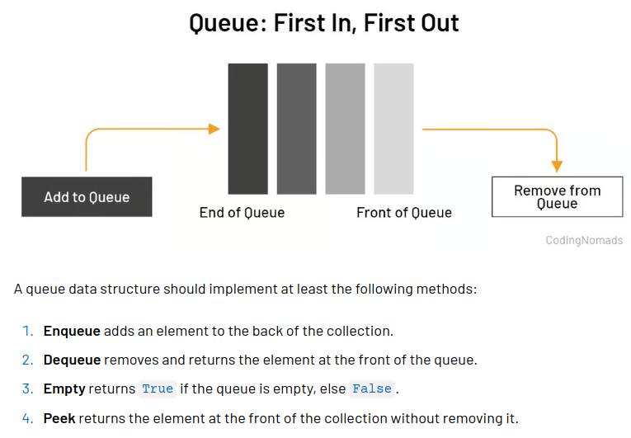
3.2.4 Queue
https://github.com/freechipsproject/chisel-bootcamp
Queue
1. Queue creates a FIFO (first-in, first-out) queue with Decoupled interfaces on both sides (input and output).
2. Queue can have backpressure (backflow) in Software Pipe (Same as water system pipe).
3. In Queue, both the data type and number of elements are configurable.
4. Poke (戳) in Queue: to put Data in the back of Queue.
5. Peek (窥视) in Queue: Get data from "front" of Queue.
6. Note:
  a. in the first few times, we print out the peeked value we call litValue on it.
  b. The peek function converts the chisel literal (litValue)that is returned into a BigInt.
  c. Later, we have similar calls. We do not call litValue to convert the literal into Integer. We can see extra information about the value peek returns, such as, the type and the width.
Poke
Peek

Slide 15
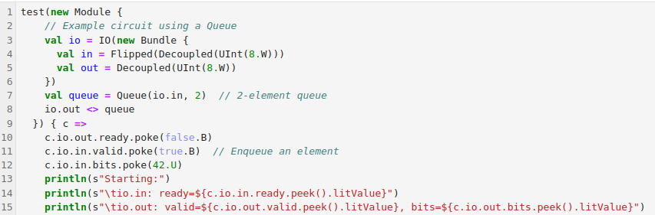

3.2.4 Queue
https://github.com/freechipsproject/chisel-bootcamp
Queue
Starting:
Poke:
1. in.ready (1)
2. out.valid (0)
3. out.bits (0)
Poke:
1. out.ready (0)
1. in.valid (1)
2. in.bits (42)
bits (42)
bits (0)

Slide 16
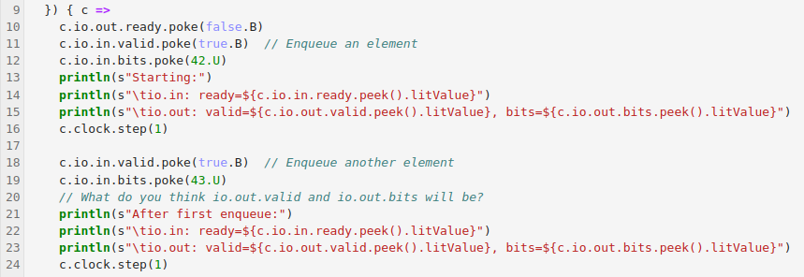
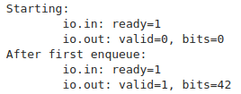
3.2.4 Queue
https://github.com/freechipsproject/chisel-bootcamp
Queue
After first enqueue:
Poke:
1. in.ready (1)
2. out.valid (1)
3. out.bits (42)
Poke:
1. in.valid (1)
2. in.bits (43)
in.bits (43)
in.bits (42)

Slide 17
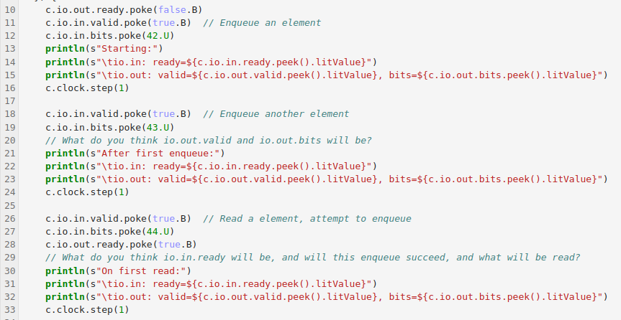
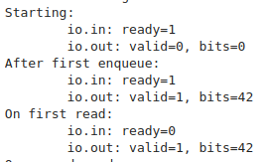
3.2.4 Queue
https://github.com/freechipsproject/chisel-bootcamp
Queue
On First Read:
Poke:
1. in.ready (0)
2. out.valid (1)
3. out.bits (42)
Poke:
1. in.valid (1)
2. in.bits (44)
3. out.ready (1)
bits (43)
bits (42)

Slide 18
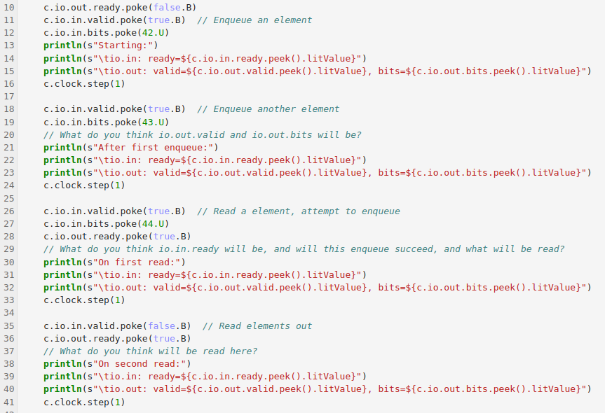
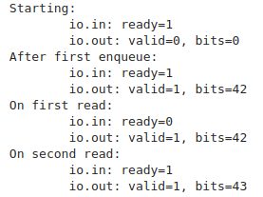
3.2.4 Queue
https://github.com/freechipsproject/chisel-bootcamp
Queue
On Second Read
Poke:
1. in.ready (1)
2. out.valid (1)
3. out.bits (43)
Poke:
1. in.valid (0)
2. out.ready (1)
bits (43)

Slide 19
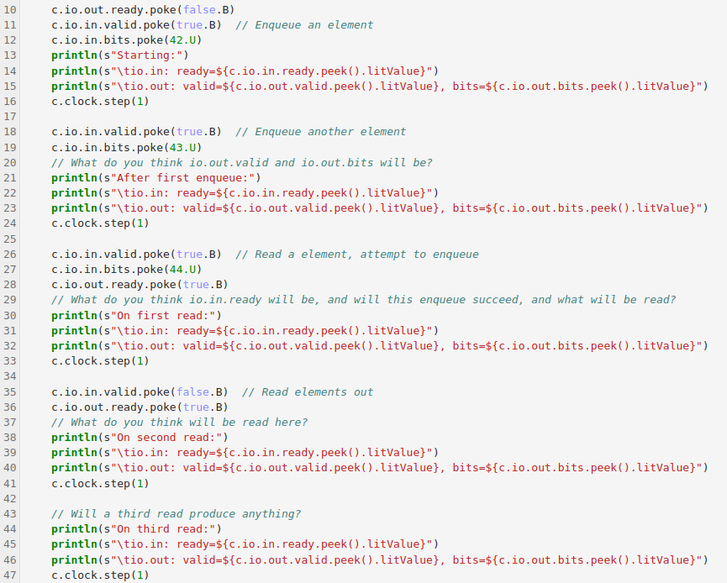
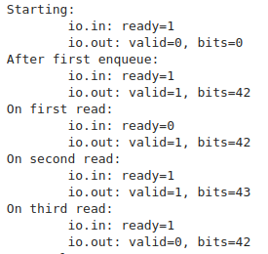
3.2.4 Queue
https://github.com/freechipsproject/chisel-bootcamp
Queue
On Third Read:
Poke:
1. in.ready (1)
2. out.valid (0)
3. out.bits (42)
Poke:
1. in.valid (0)
2. out.ready (1)
1. in.valid (0)
2. out.ready (1)
1. in.valid (0)
2. in.bits (42)

Slide 20
3.2.5 Arbiter

Slide 21
3.2.5 Arbiter
https://github.com/freechipsproject/chisel-bootcamp
Arbiter

Slide 22
End

