Slide 1

3.2 Chisel Standard Library
Peter H. Chen

Slide 2
3.2 Chisel Standard Library
https://github.com/freechipsproject/chisel-bootcamp
Chisel Standard Library
We discuss Chisel Standard Library for Interface, Function, and Utilities of Generator.
1. Setup: Select Scala for Jupyter Notebook and Run.
2. Chisel API Command: Cheat Sheet.
3. Interface DecoupledIO (): Use Interface DecoupledIO () to get the IO Data, such as, ready, valid, bits, etc.
4. Function Queue (): Use Library Queue() to do test.
5. Function Arbiter (): Use Library Arbiter() to do test.
6. Utility: There are some Misc Utility Function, such as, Bitwise Utility, One Hot Encoding, Mux, and Counter.
7. Utility Bitwise(): PopCount ()/Reverse ().
8. Utility One-Hot-Encoding: UInt to One-Hot / OneHot to UInt
9. Utility Mux(): Priority Mux and One Hot Mux.
10. Utility Counter(): The counter that can be incremented once every cycle, up to some specified limit, at which point it overflows.

Slide 3
3.2.1 Setup

Slide 4
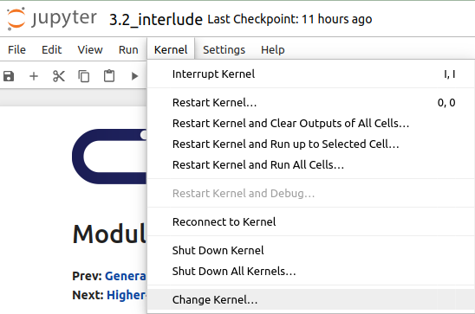
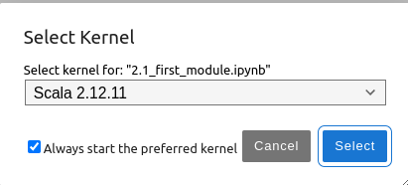
3.2.1 Setup
https://github.com/freechipsproject/chisel-bootcamp
Setup
1. Change folder to chisel-bootcamp. If you want to work on your working space, copy image folder and source folder to your working directory.
> cd chisel-bootcamp
2. Start Jupyter notebook
> jupyter notebook 3.2_interlude.ipynb
3. Select the scala interpreter: > Kernel > Change Kernel… >Scala 2.12.11
3

Slide 5
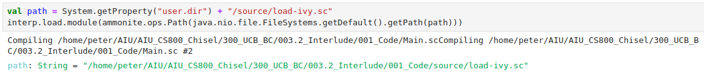
3.2.1 Setup
https://github.com/freechipsproject/chisel-bootcamp
Setup
1. Scala uses maven to setup path to with for source folder for Scala Libraries and get Scala Property.

Slide 6
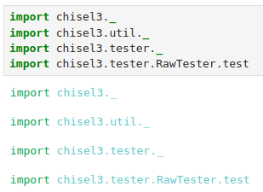
3.2.1 Setup
https://github.com/freechipsproject/chisel-bootcamp
Setup
1. import chisel3 library, utility, tester harness (horse controller), and test interface function.

Slide 7
3.2.2 Chisel API Command

Slide 8
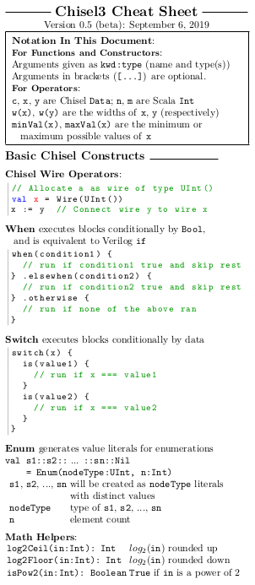
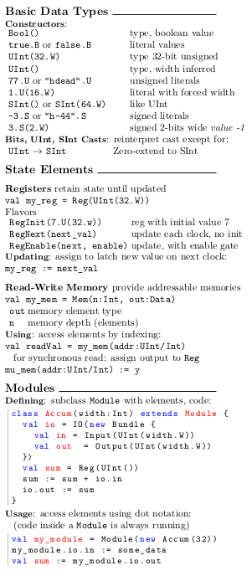
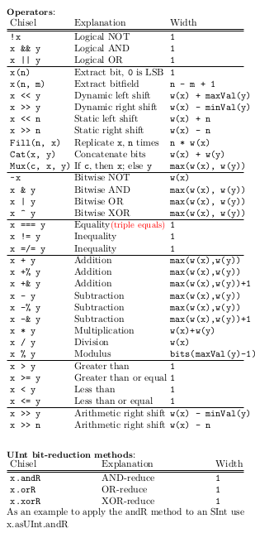
3.2.2 Chisel API Command
https://github.com/freechipsproject/chisel-bootcamp
Chisel API Command
1. The Chisel3 cheatsheet (https://users.cs.duke.edu/~lkw34/Chisel-Cheatsheet.pdf) summarize the major hardware construction APIs for standard library utilities.

Slide 9
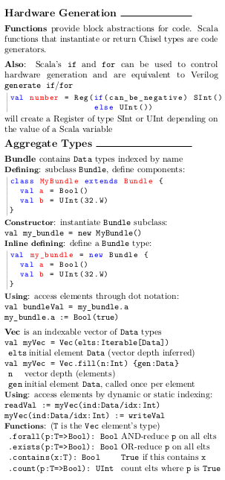
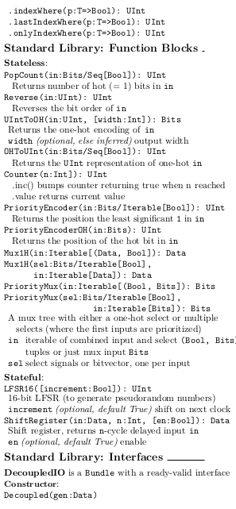
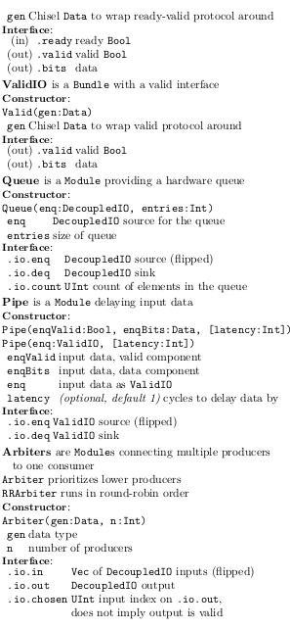
3.2.2 Chisel API Command
https://github.com/freechipsproject/chisel-bootcamp
Chisel API Command
1. The Chisel3 cheatsheet (https://users.cs.duke.edu/~lkw34/Chisel-Cheatsheet.pdf)

Slide 10
3.2.3 Decoupled Interface

Slide 11
3.2.3 Decoupled Interface
https://github.com/freechipsproject/chisel-bootcamp
Decoupled Interface
1. One of the commonly used interfaces provided by Chisel is DecoupledIO, providing a ready-valid interface for transferring data.
2. The idea is that the source drives the bits signal with the data to be transferred and the valid signal when there is data to be transferred.
3. The sink drives the ready signal when it is ready to accept data, and data is considered transferred when both ready and valid are asserted on a cycle.
4. This provides a flow control mechanism in both directions for data transfer, including a backpressure mechanism.
5. Note:
  a. The ready and valid should not be combinationally coupled. The ready and valid are unsynthesizable.
  b. The ready should only be dependent on whether the sink is able to receive data, and valid should only be dependent on whether the source has data.
  c. Only after the transaction (on the next clock cycle) can have the values update.

Slide 12

3.2.3 Decoupled Interface
https://github.com/freechipsproject/chisel-bootcamp
Decoupled Interface
Any Chisel data can be wrapped in a DecoupledIO (used as the bits field) as follows:
The above creates a new DecoupledIO Bundle with fields
  valid: Output(Bool)
  ready: Input(Bool)
  bits: Output(UInt(8.W))
Next, we will see some code examples and testcases that print the circuit state.
We will try to predict what will be printed before we run the tests.

Slide 13
3.2.4 Test Queue

Slide 14
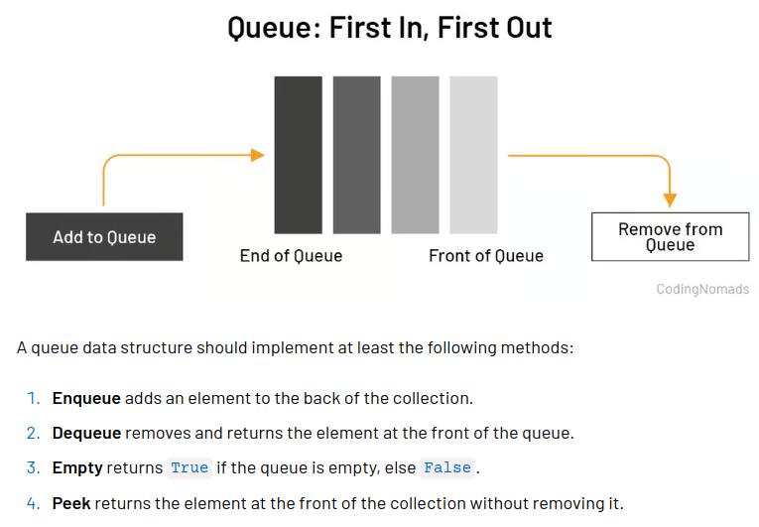
3.2.4 Test Queue
https://github.com/freechipsproject/chisel-bootcamp
Test Queue
1. Queue creates a FIFO (first-in, first-out) queue with Decoupled interfaces on both sides (input and output).
2. Queue can have backpressure (backflow) in Software Pipe (Same as water system pipe).
3. In Queue, both the data type and number of elements are configurable.
4. Poke (戳) in Queue: to put Data in the back of Queue.
5. Peek (窥视) in Queue: Get data from "front" of Queue.
6. Note:
  a. in the first few times, we print out the peeked value we call litValue on it.
  b. The peek function converts the chisel literal (litValue)that is returned into a BigInt.
  c. Later, we have similar calls. We do not call litValue to convert the literal into Integer. We can see extra information about the value peek returns, such as, the type and the width.
Poke
Peek

Slide 15
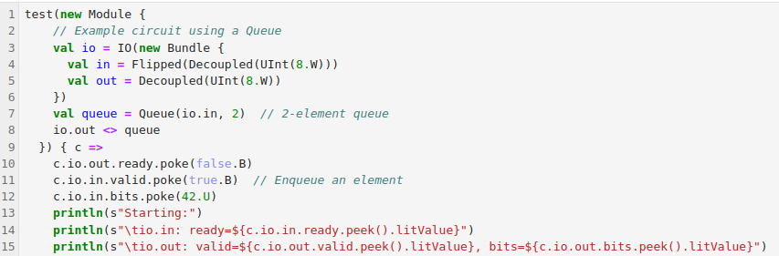

3.2.4 Test Queuee
https://github.com/freechipsproject/chisel-bootcamp
Test Queue
Starting:
Poke:
1. in.ready (1)
2. out.valid (0)
3. out.bits (0)
Poke:
1. out.ready (0)
1. in.valid (1)
2. in.bits (42)
bits (42)
bits (0)

Slide 16
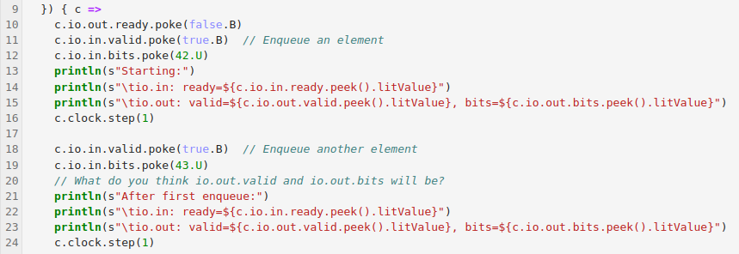
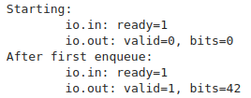
3.2.4 Test Queue
https://github.com/freechipsproject/chisel-bootcamp
Test Queue
After first enqueue:
Poke:
1. in.ready (1)
2. out.valid (1)
3. out.bits (42)
Poke:
1. in.valid (1)
2. in.bits (43)
in.bits (43)
in.bits (42)

Slide 17
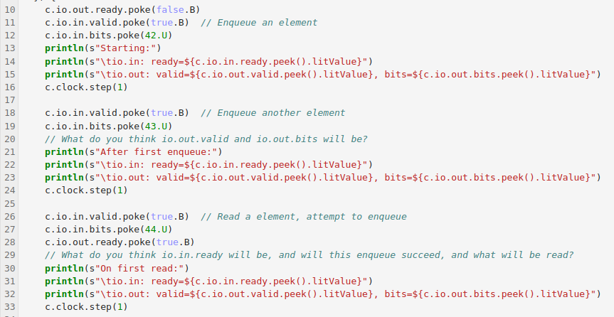
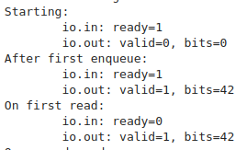
3.2.4 Test Queue
https://github.com/freechipsproject/chisel-bootcamp
Test Queue
On First Read:
Poke:
1. in.ready (0)
2. out.valid (1)
3. out.bits (42)
Poke:
1. in.valid (1)
2. in.bits (44)
3. out.ready (1)
bits (43)
bits (42)

Slide 18
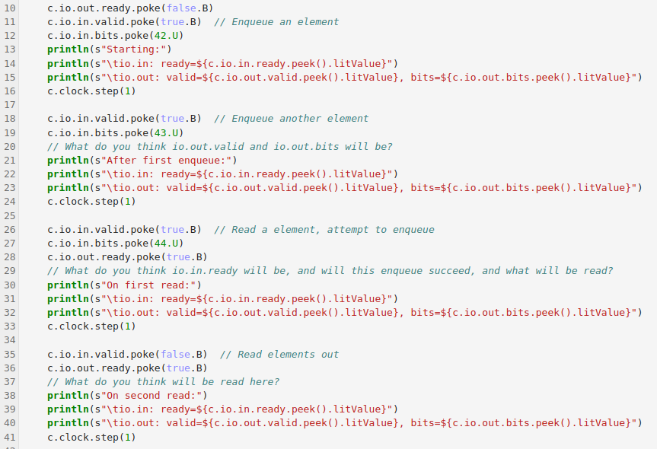
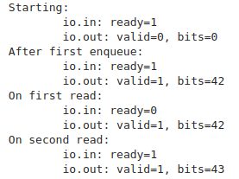
3.2.4 Test Queue
https://github.com/freechipsproject/chisel-bootcamp
Test Queue
On Second Read
Poke:
1. in.ready (1)
2. out.valid (1)
3. out.bits (43)
Poke:
1. in.valid (0)
2. out.ready (1)
bits (43)

Slide 19
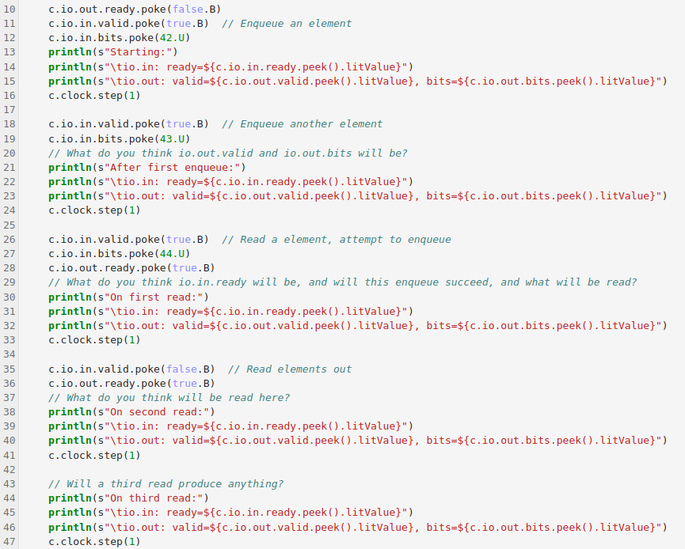
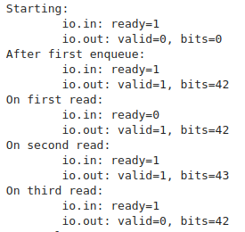
3.2.4 Test Queue
https://github.com/freechipsproject/chisel-bootcamp
Test Queue
On Third Read:
Poke:
1. in.ready (1)
2. out.valid (0)
3. out.bits (42)
Poke:
1. in.valid (0)
2. out.ready (1)
1. in.valid (0)
2. out.ready (1)
1. in.valid (0)
2. in.bits (42)

Slide 20
3.2.5 Test Arbiter

Slide 21
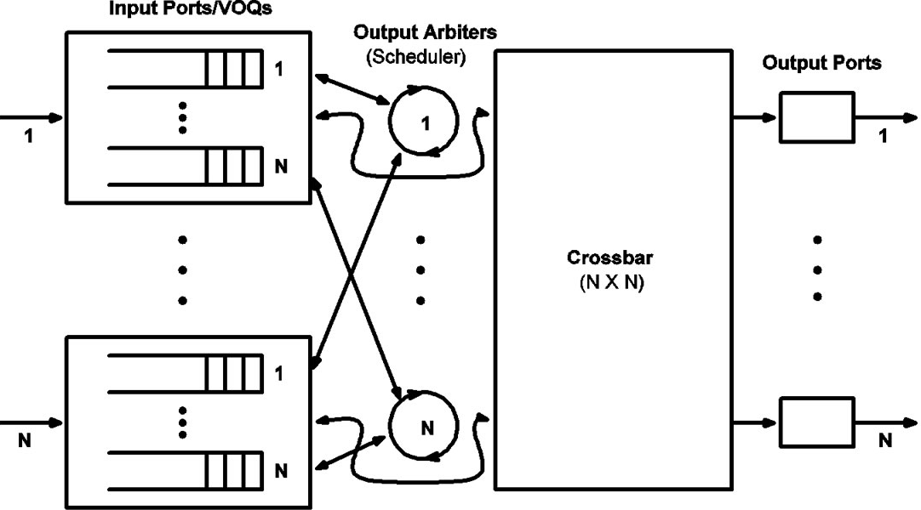
3.2.5 Test Arbiter
https://github.com/freechipsproject/chisel-bootcamp
Test Arbiter
Arbiters (仲裁者) route data from n DecoupledIO sources to one DecoupledIO sink with priority.
1. There are two types included in Chisel:
  a. Arbiter: prioritizes lower-index producers
  b. RRArbiter: runs in round-robin order
2. Note:
  a. Arbiter routing is implemented in combinational logic.
  b. Below example shows the use of the priority arbiter. We will also implement in the next section.
3. Below diagrams show switch fabrics with a distributed arbiters.
https://file.scirp.org/Html/3-9700140_468.htm

Slide 22
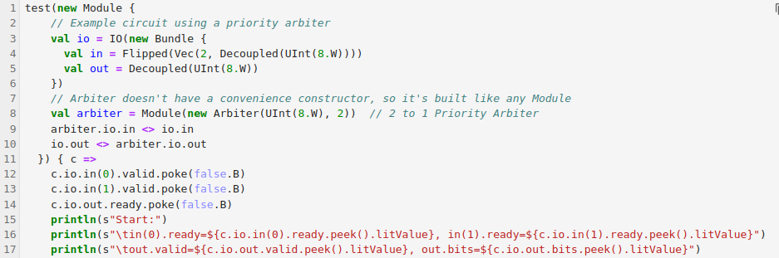

3.2.5 Test Arbiter
https://github.com/freechipsproject/chisel-bootcamp
Test Arbiter
Poke:
  a. in (0).valid(false), in(1).valid(false) // in(0).ready = 0, in(1).ready = 0
  b. out.ready (false)
Peek:
  a. in(0).ready: false, in(1).ready: false,
  b. out.ready: false, out.bits: 0

Slide 23
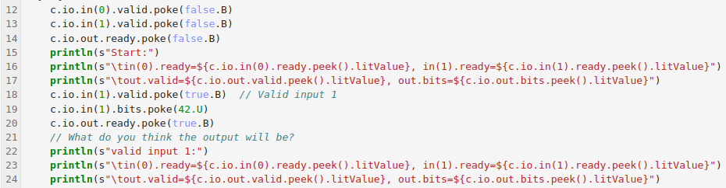
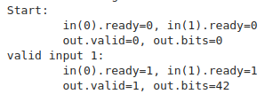
3.2.5 Test Arbiter
https://github.com/freechipsproject/chisel-bootcamp
Test Arbiter
Poke:
  a. in (1).valid(true), in(1).bits(42) // in(0).ready = 1 (??), in(1).ready = 1
  b. out.ready (true)
Peek:
  a. in(0).ready = 1 (??), in(1).ready = 1,
  b. out.ready: 1, out.bits: 42

Slide 24
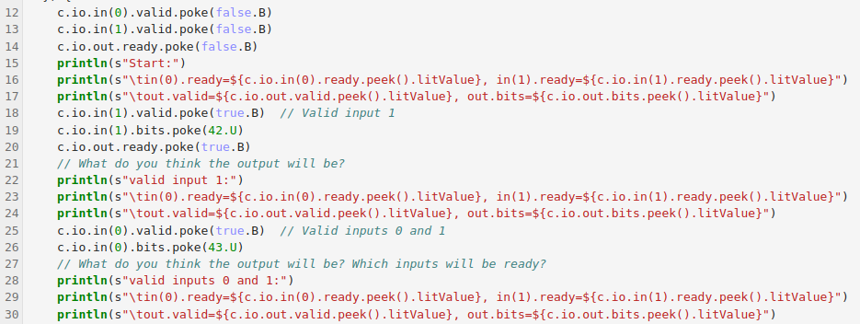
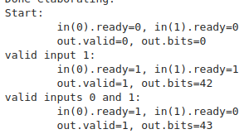
3.2.5 Test Arbiter
https://github.com/freechipsproject/chisel-bootcamp
Test Arbiter
Poke:
  a. in (0).valid(true), in(0).bits(43) // in(0).ready =1, in(1).ready = 0; we change in(0)
Peek:
  a. in(0).ready = 1, in(1).ready = 0,
  b. out.valid = 1, out.bits: 43

Slide 25
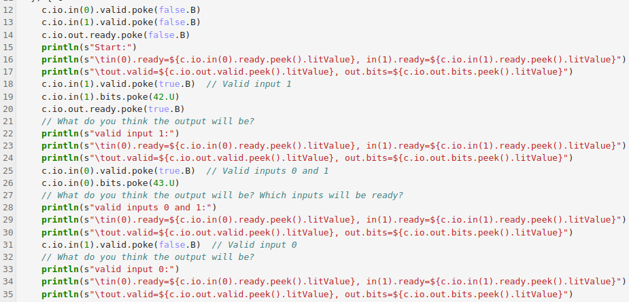
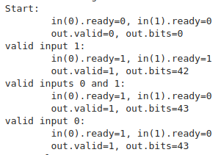
3.2.5 Test Arbiter
https://github.com/freechipsproject/chisel-bootcamp
Test Arbiter
Poke:
  a. in (1).valid(false) // in(0).ready =1, in(1).ready = 0
Peek:
  a. in(0).ready = 1, in(1).ready = 0,
  b. out.ready = 1, out.bits: 43

Slide 26
3.2.6 Utility: Misc Function Block

Slide 27
3.2.6 Utility: Misc Function Block
https://github.com/freechipsproject/chisel-bootcamp
Utility: Misc Function Block
Chisel Utils has some helpers that perform stateless functions.
1. Bitwise Utility: PopCount() and Reverse()
2. One Hot Encoding Utility: a. UInt to OneHot: UintToOH (), b. OneHot to UInt: OHToUInt ()

Slide 28
3.2.7 Bitwise Utility: PopCount/Reverse

Slide 29
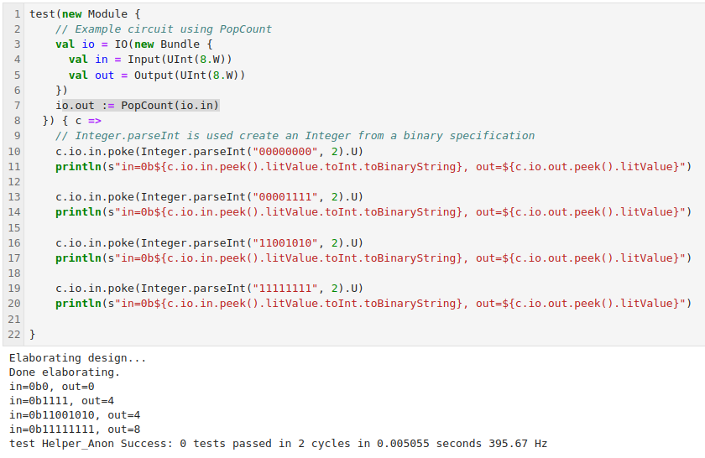
3.2.7 Bitwise Utility: PopCount/Reverse
https://github.com/freechipsproject/chisel-bootcamp
Bitwise Utilities: PopCount/Reverse
PopCount
PopCount returns the number of high (1) bits in the input as a UInt.

Slide 30
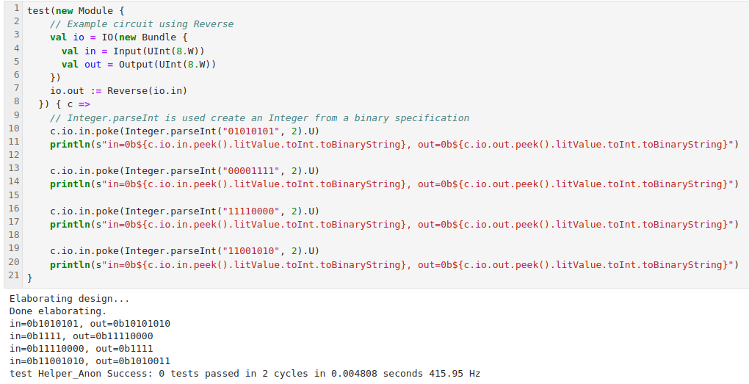
3.2.7 Bitwise Utility: PopCount/Reverse
https://github.com/freechipsproject/chisel-bootcamp
Bitwise Utilities: PopCount/Reverse
Reverse
Reverse returns the bit-reversed input.

Slide 31
3.2.8 Utility: One Hot Encoding

Slide 32
3.2.8 Utility: One Hot Encoding
https://github.com/freechipsproject/chisel-bootcamp
Utility: One Hot Encoding
1. OneHot is an encoding of integers where there is one wire for each value, and exactly one wire is high.
2. This allows the efficient creation of some functions, for example, muxes. However, behavior may be undefined if the one-wire-high condition is not held.
Below, two functions provide conversion between binary (UInt) and OneHot encoding, and are inverses of each other:
1. UInt to OneHot: UIntToOH ()
2. OneHot to UInt: OHToUInt ()

Slide 33
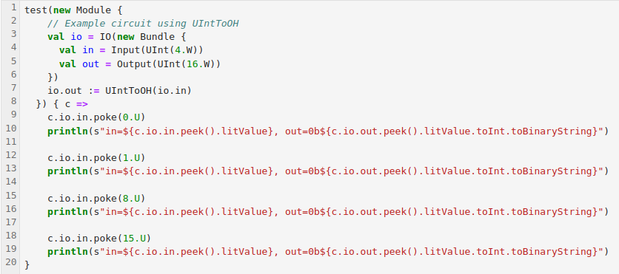
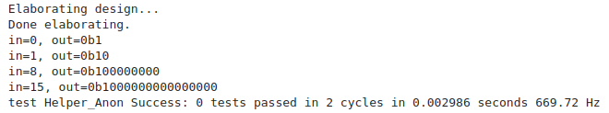
3.2.8 Utility: One Hot Encoding
https://github.com/freechipsproject/chisel-bootcamp
Example: UIntToOH ()

Slide 34
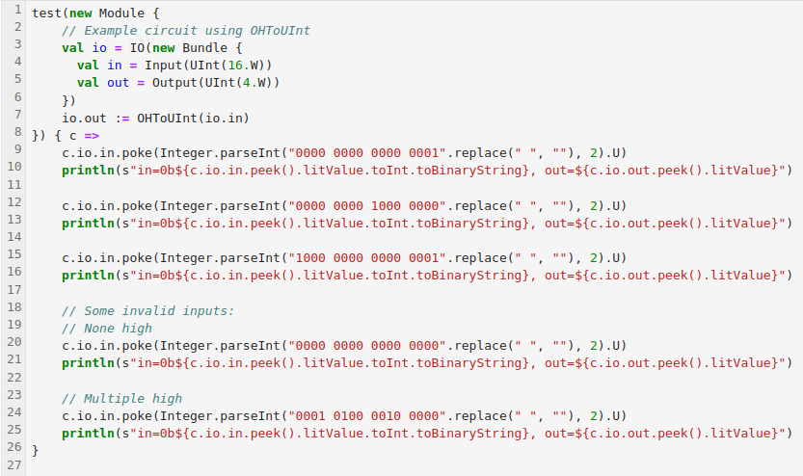
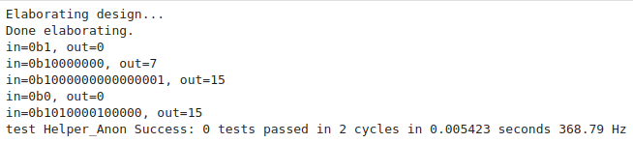
3.2.8 Utility: One Hot Encoding
https://github.com/freechipsproject/chisel-bootcamp
Example: OHToUInt ()

Slide 35
3.2.9 Muxes

Slide 36
3.2.9 Muxes
https://github.com/freechipsproject/chisel-bootcamp
Muxes
1. The muxes take in a list of values with select signals, and output the value associated with the lowest-index select signal.
2. The muxes can either take a list of (select: Bool, value: Data) tuples, or corresponding lists of selects and values as arguments.
3. For simplicity, below examples only show the second form.
4. Muxes is an Utility.
5. Priority Mux
  A PriorityMux outputs the value associated with the lowest-index asserted select signal.
6. OneHot Mux
  An Mux1H provides an efficient implementation when it is guaranteed that exactly one of the select signals will be high. Behavior is undefined if the assumption is not true.

Slide 37
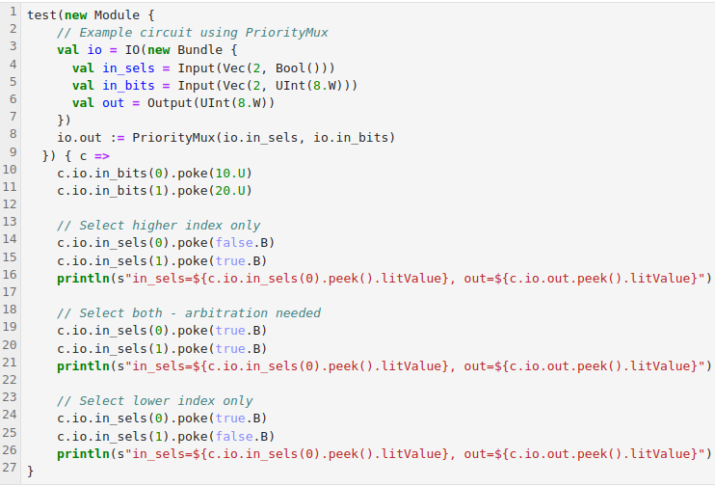
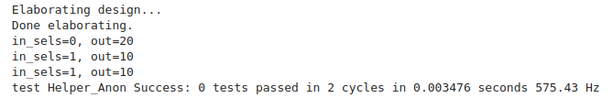
3.2.9 Muxes
https://github.com/freechipsproject/chisel-bootcamp
Priority Mux
A PriorityMux outputs the value associated with the lowest-index asserted select signal.

Slide 38
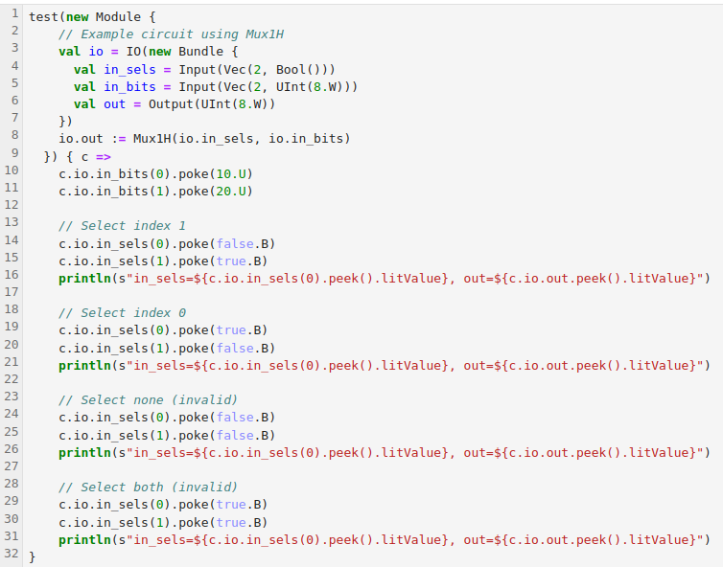
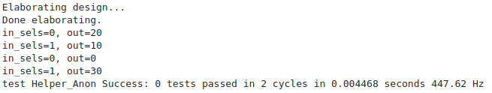
3.2.9 Muxes
https://github.com/freechipsproject/chisel-bootcamp
OneHot Mux
An Mux1H provides an efficient implementation when it is guaranteed that exactly one of the select signals will be high. Behavior is undefined if the assumption is not true.

Slide 39
3.2.10 Counter

Slide 40
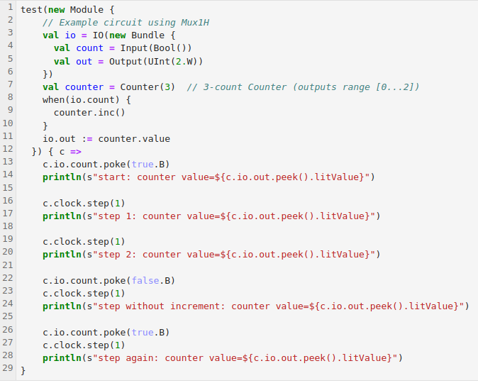
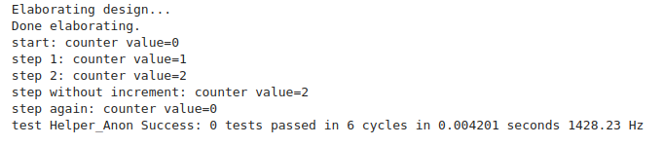
3.2.10 Counter
https://github.com/freechipsproject/chisel-bootcamp
Counter
1. The Utility Counter() is a counter that can be incremented once every cycle, up to some specified limit, at which point it overflows.
2. Count() is a Utility.

Slide 41
End

