Slide 1

3 Type and Operator

Slide 2
3 Type and Operator
https://github.com/ucb-bar/chisel-tutorial/wiki/Basic-Types-and-Operations
Type and Operator
We discuss the difference with examples between Scala (in src directory) vs. Verilog (in test_run directory) Type and Operator of Chisel.
1. UInt Class
2. Bit Concatenation
3. LFSR16 (Linear Feedback Shift Register) implementation
4. Bit Inference with UInt Operation:
5. Bool Class
6. Type Cast between Types

Slide 3
3.1 Chisel Assignment and Re-Assignment

Slide 4
3.1 Chisel Assignment and Re-Assignment
https://github.com/ucb-bar/chisel-tutorial/wiki/Basic-Types-and-Operations
Chisel Assignment and Re-Assignment
1. When we first define a value in Chisel, we use the = operator in order to tell Chisel to allocate the value for the first time.
2. On every subsequent reassignment to the value, we must use a := when reassigning the value.
3. Since we are constructing a digital circuit, the notion of reassignment does not make much sense since connections between circuit nodes only need to be specified once.
4. However, there are some cases when we will need to perform reassignment to a value in Chisel since it is compiled sequentially unlike Verilog.
5. Thus it may be necessary to perform reassignment when a value or connection is not known until later in the Chisel source.
6. A simple example of when reassignment is necessary is in the construction of the top level I/O for your module; the values of the output are not immediately known at the time of declaration.

Slide 5
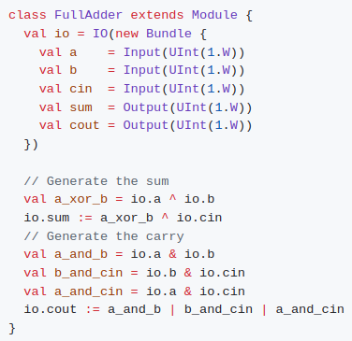
3.1 Chisel Assignment and Re-Assignment
https://github.com/ucb-bar/chisel-tutorial/wiki/Basic-Types-and-Operations
Chisel Assignment and Re-Assignment
1. Consider the simple FullAdder circuit from previous tutorial that determines the sum sum and carry out cout given two values a and b, and a carry in cin.
2. On the left example, we make sure to use the := reassignment for the io.sum and io.cout output values because we only know what their values are later in the code and not at the time of construction of the io Bundle.
3. All other values in this example use the = assignment operator since they need to be created.
4. In general, the rule of thumb is to use the reassignment operator := if the value already has been assigned by the = operator, otherwise the = operator should be used.
5. Note:
If you do not use the = or := operators correctly, you will get an error when you try to compile your design.

Slide 6
3.2 UInt Class

Slide 7
3.2 UInt Class
https://github.com/ucb-bar/chisel-tutorial/wiki/Basic-Types-and-Operations
UInt Class
1. In the previous examples we have been using the UInt type which is an unsigned integer as the type for all of our values.
2. For many of the basic computations in Chisel the UInt class is sufficient.

Slide 8
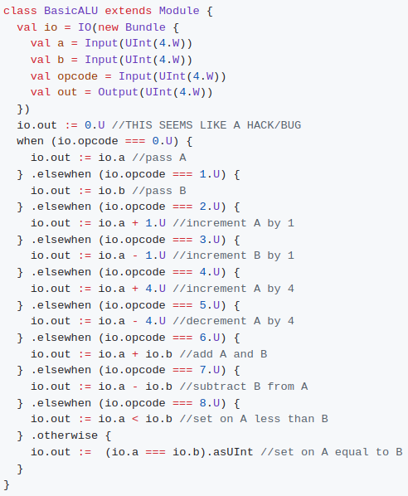
3.2 UInt Class
https://github.com/ucb-bar/chisel-tutorial/wiki/Basic-Types-and-Operations
UInt Class
1. The following example shows some of the commonly used UInt operations in the context of a simple ALU.
2. We ignore overflow and underflow in this example.
3. Note:
There are multiple reassignments to io.out inside a when block which indicates that the value of io.out can take many different values depending on the io.opcode in this example.

Slide 9

3.2 UInt Class
https://github.com/ucb-bar/chisel-tutorial/wiki/Basic-Types-and-Operations
UInt Class
Note:
In order to specify constants to add to our operands, we must also specify them as a UInt type as UInt operations on different type operands is not allowed.

Slide 10
3.3 Operator

Slide 11
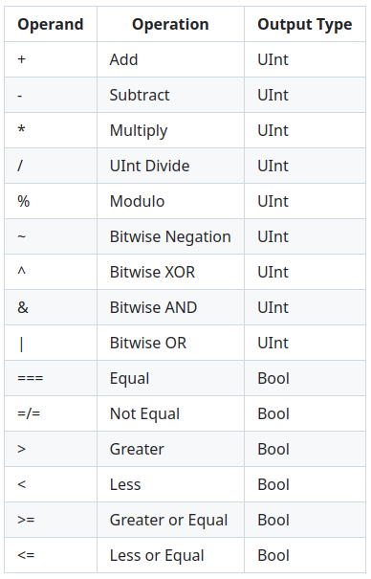
3.3 Operator
https://github.com/ucb-bar/chisel-tutorial/wiki/Basic-Types-and-Operations
Operator
A list of commonly used UInt operations is given in the table below:

Slide 12
3.4 Bit Extraction

Slide 13


3.4 Bit Extraction
https://github.com/ucb-bar/chisel-tutorial/wiki/Basic-Types-and-Operations
Bit Extraction
The UInt class allows you to extract bits based on their index of their representation.
Given an n bit wide value value we can extract the bits x through y (n > x > y >= 0) by simply doing the following:
Note:
1. The higher index is specified first in the argument list when extraction the bits.
2. The bits in the UInt are zero indexed so the highest bit that can be extracted from an n bit wide value is n-1.
If you just want to extract a single bit from the value, say bit x we simply need to specify a single index instead as follows:

Slide 14
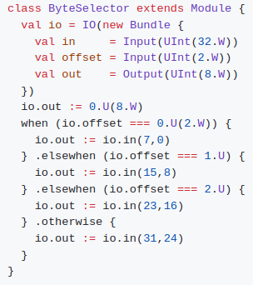
3.4 Bit Extraction
https://github.com/ucb-bar/chisel-tutorial/wiki/Basic-Types-and-Operations
Bit Extraction
A more concrete example of bit extraction in action is shown below.
In this example, based on the value of the offset, we would like to select a byte from a word which is a common operation when loading a byte from word addressed memories:

Slide 15
3.5 Bit Concatenation

Slide 16

3.5 Bit Concatenation
https://github.com/ucb-bar/chisel-tutorial/wiki/Basic-Types-and-Operations
Bit Concatenation
Chisel also allows you to easily concatenate bits together using Cat. Suppose you have a data bus that you would like to drive with two separate words A and B. In order to concatenate these two values together we simply say:
Note:
1. The first argument to Cat will be placed in the high part while the second argument gets the low part of bus.
2. Thus for this example bits 0 to 31 of bus correspond to B, while bits 32 to 63 correspond to A.

Slide 17
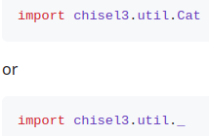
3.5 Bit Concatenation
https://github.com/ucb-bar/chisel-tutorial/wiki/Basic-Types-and-Operations
Bit Concatenation
Note:
Cat is implemented in the utility package, external to Chisel core. In order to make it available to your source code, you will need to instruct the Scala compiler to import its definition to import all the utility definitions:

Slide 18
3.6 LFSR16

Slide 19
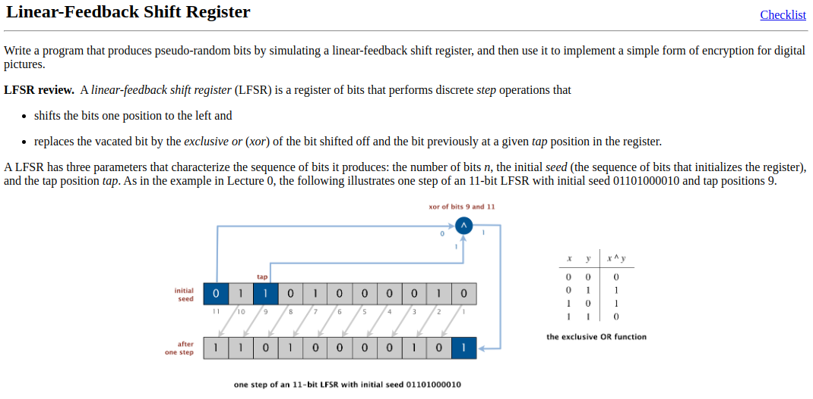
3.6 LFSR16
https://github.com/ucb-bar/chisel-tutorial/wiki/Basic-Types-and-Operations
LSFSR16 (16 bits Linear Feedback Shift Register)
What Linear Feedback Shift Register?
1. Shift Left one bit
2. Replace the vacate bit with XOR with shift out bit and tap position.
Below is 11 bit LFSR with initial seed “01101000010” and tap position 9. We take XOR for bit 11 and bit 9 and put in bit 1. We have passing parameter: number of bit, initial seed,m the tap position,
https://www.cs.princeton.edu/courses/archive/spr17/cos126/assignments/lfsr.html

Slide 20
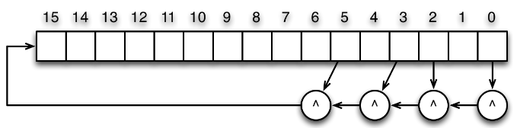
3.6 LFSR16
https://github.com/ucb-bar/chisel-tutorial/wiki/Basic-Types-and-Operations
LSFSR16 (16 bits Linear Feedback Shift Register)
Here, we write the circuit for a LSFSR16 (16-bit Linear Feedback Shift Register):
1. Shift one bit left
2. Take bit 15 and replace the with XOR (tap positions: 0, 2, 3, 5)

Slide 21
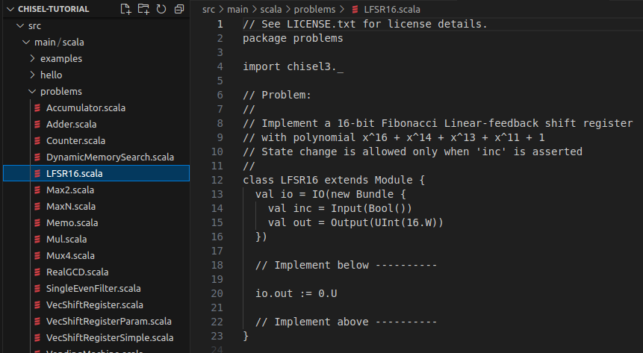
3.6 LFSR16
https://github.com/ucb-bar/chisel-tutorial/wiki/Basic-Types-and-Operations
LSFSR16 (16 bits Linear Feedback Shift Register)
In the problem directory (src/main/scala/problems/LFSR16.scala), we have:

Slide 22
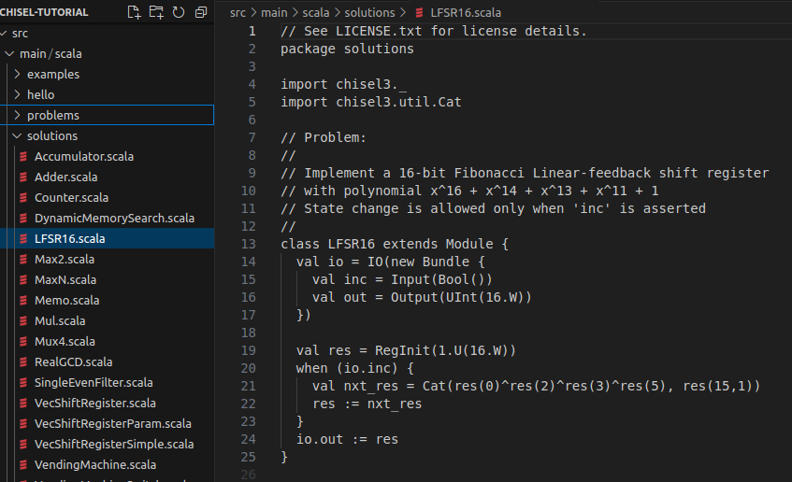
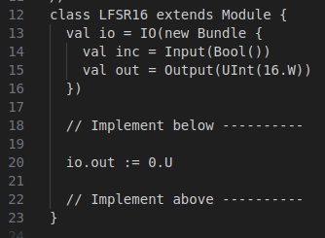
3.6 LFSR16
https://github.com/ucb-bar/chisel-tutorial/wiki/Basic-Types-and-Operations
LSFSR16 (16 bits Linear Feedback Shift Register)
In the problem directory (src/main/scala/problems/LFSR16.scala):
When io.inc is enable, then we do the Linear Feedback Shift:
1. XOR result = XOR (bit 0, bit1, bit 3, and bit 5).
2. Take bit 0 with XOR1 result and bit 1 to 15 with Cat() function. We concatenate bit 0 and bit 1-15.
3. Shift left.

Slide 23
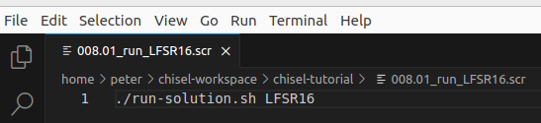
3.6 LFSR16
https://github.com/ucb-bar/chisel-tutorial/wiki/Basic-Types-and-Operations
LSFSR16 (16 bits Linear Feedback Shift Register)
After we add code for problem, the final code should be the same as the solution directory (src/main/scala/solutions/LFSR16.scala):
> ./002.5 01_run_LFSR16.scr
>> inside script, we ./run-solution.sh LFSR16

Slide 24
3.7 UInt Operation

Slide 25
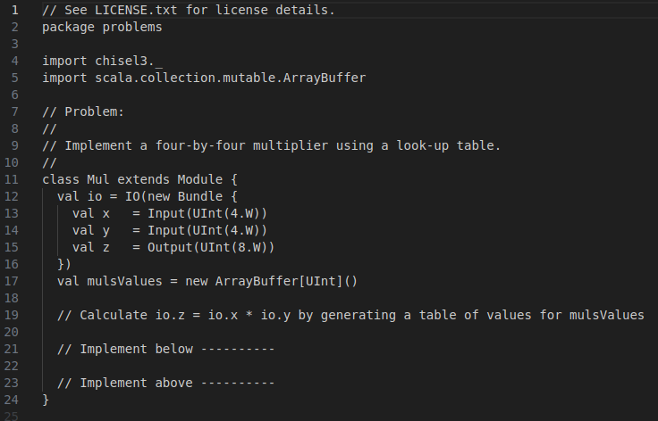
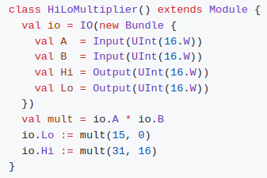
3.7 UInt Operation
https://github.com/ucb-bar/chisel-tutorial/wiki/Basic-Types-and-Operations
UInt Operation
For some operations such as addition and multiplication, that number of resulting bits of the computation can be greater than the number of bits for the operands.
Note:
1. On the left below example, we multiply two 16 bit numbers A and B together.
2. On the right below example is the 4 bits UC Berkeley class assignment for Multiplication (src/main/scala/problems/Mul.scale).
3. We need to implement the assignment.
1
2
3

Slide 26
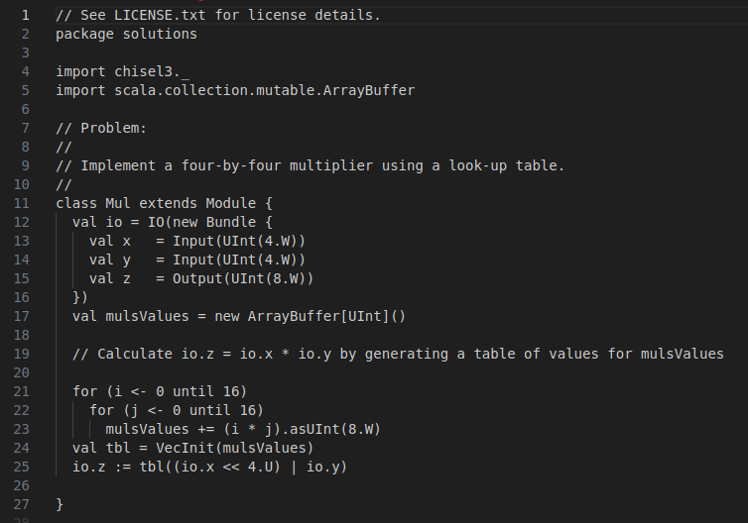
3.7 UInt Operation
https://github.com/ucb-bar/chisel-tutorial/wiki/Basic-Types-and-Operations
UInt Operation
Note:
1. The product of two 16 bit numbers is at worst 32 bits wide.
2. In this example, we never specify the width of the value mult anywhere in the Chisel source.
3. If we performed this in Verilog we would have had to specify the width beforehand.

Slide 27

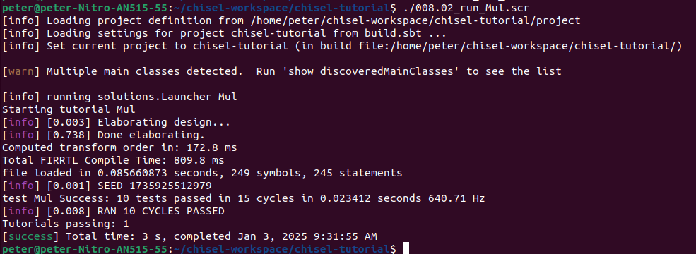
3.7 UInt Operation
https://github.com/ucb-bar/chisel-tutorial/wiki/Basic-Types-and-Operations
UInt Operation
> 002.5 02_run_Mul.scr
>> ./run-solution.sh Mul

Slide 28
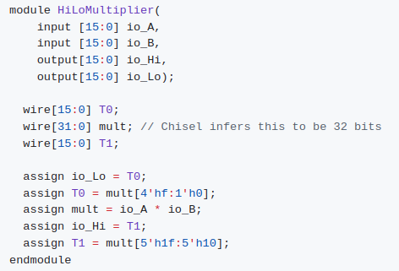
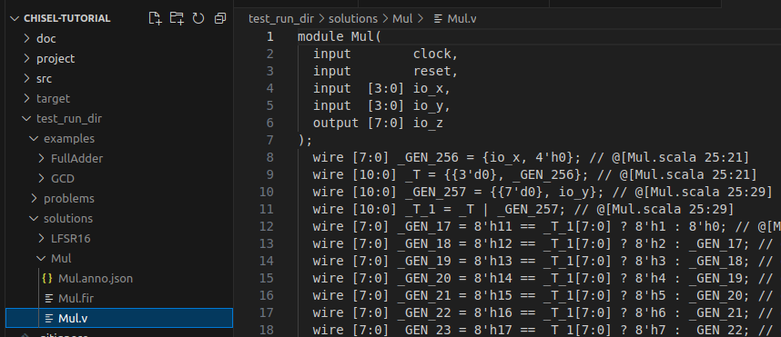
3.7 UInt Operation
https://github.com/ucb-bar/chisel-tutorial/wiki/Basic-Types-and-Operations
UInt Operation
1. One the left blow, look at the generated 16-bits Verilog for this example shows that Chisel correctly inferred the mult value to be 32 bits wide.
2. After we run 4-bits Mul.scala, we get the 4-bits Verilog (test_run_dir/solutions/Mul/Mul.v)
1
2

Slide 29
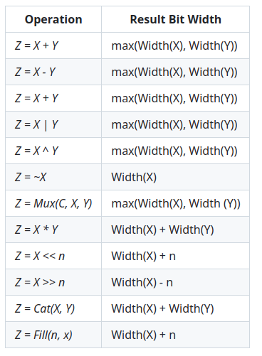
3.7 UInt Operation
https://github.com/ucb-bar/chisel-tutorial/wiki/Basic-Types-and-Operations
UInt Operation
1. As we get to more complicate designs, it will become more clear that bit inference in Chisel is a very powerful feature that makes constructing hardware more efficient.
2. A list of common bit inferences is shown on the right for commonly used operations:

Slide 30
3.8 Bool Class

Slide 31
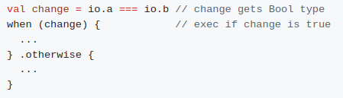

3.8 Bool Class
https://github.com/ucb-bar/chisel-tutorial/wiki/Basic-Types-and-Operations
Bool Class
1. The Bool class in Chisel is used to represent the result of logical expressions and takes either the values true or false.
2. These can be used in conditional statements such as when blocks.
We can instantiate a Bool value like this:
As shown in the BasicALU example, in order to use a Bool value as a UInt type and assign it to an output, a cast to UInt is required.

Slide 32
3.9 Type Casting

Slide 33
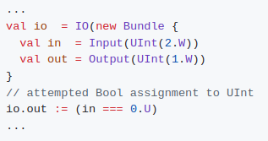
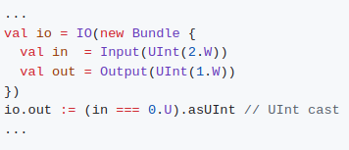
3.9 Type Casting
https://github.com/ucb-bar/chisel-tutorial/wiki/Basic-Types-and-Operations
Type Casting
When assigning values, it is required that you assign a value of the same type. For instance, if you try to assign a Bool type to an output value that is expecting a UInt type, you will get an error.
The correct way to perform the intended operation is to cast the resulting Bool type to a UInt using the asUInt cast. The correct Chisel code will look like:

Slide 34
3.9 Type Casting
https://github.com/ucb-bar/chisel-tutorial/wiki/Basic-Types-and-Operations
Type Casting
Some of the common casts that you may use are:
  AsUInt()
  AsSInt()
  AsBool()

Slide 35
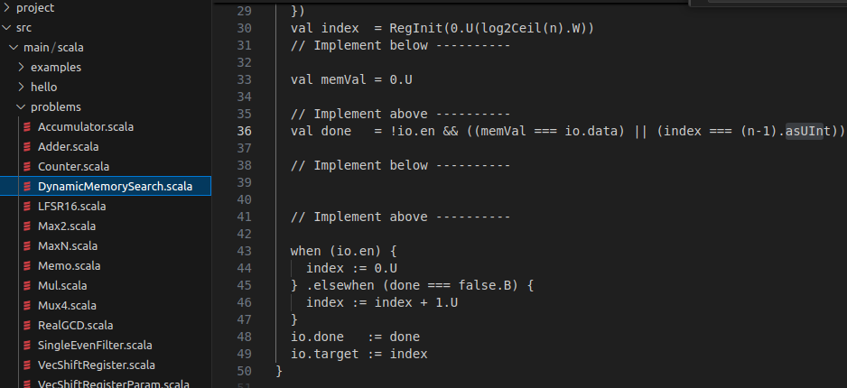
3.9 Type Casting
https://github.com/ucb-bar/chisel-tutorial/wiki/Basic-Types-and-Operations
Type Casting
Below, we can see type cast “(...).asUInt” example (src/main/scala/problem/DynamicMemorySearch.scala)

Slide 36
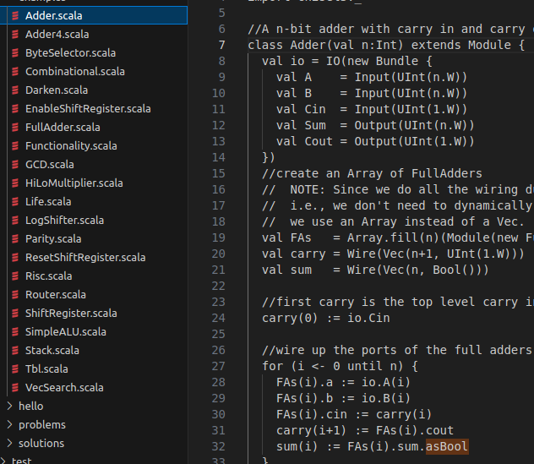
3.9 Type Casting
https://github.com/ucb-bar/chisel-tutorial/wiki/Basic-Types-and-Operations
Type Casting
Below, we can see type cast of “(...).asBool” example (src/main/scala/examples/Adder.scala),

Slide 37
End

