Slide 1

8 Arbitration
Peter H. Chen

Slide 2
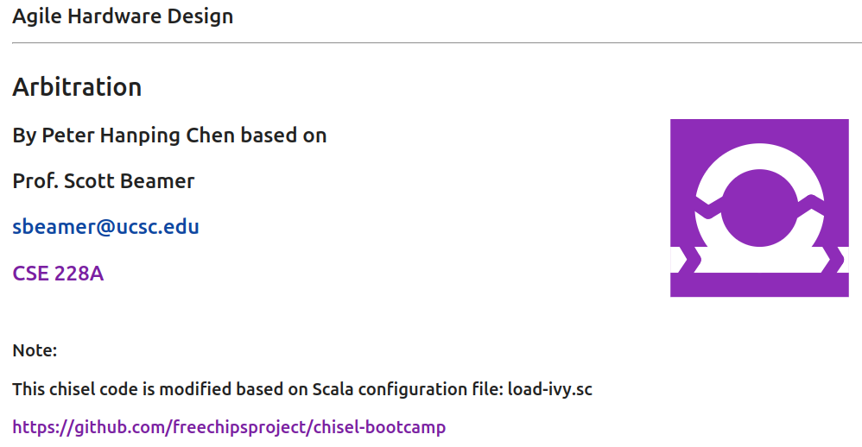
8 Arbitration
https://www.youtube.com/watch?v=itCgwjJdDIM&list=PLfrN7RIcMe6g2LBRJLTHTdhyj5s8ag0Rg&index=8
Arbitration (0:00-0:24/1:02:36)
Note: by Peter Hanping Chen
1. Why do I modify?
I cannot use configuration file (chisel_deps.sc) from Prof. Scott Beamer which have error in dependencies on my Ubuntu OS.
2. Instead, I used UCB bootcamp configuration file (load_ivy.sc) below.
Since load-ivy.sc is not 100% compatible in dependencies as chisel.deps.sc, I made some modification to make them work.
3. source/load-ivy.sc (https://github.com/freechipsproject/chisel-bootcamp)

Slide 3
8 Arbitration
https://www.youtube.com/watch?v=itCgwjJdDIM&list=PLfrN7RIcMe6g2LBRJLTHTdhyj5s8ag0Rg&index=8
Arbitration (0:21-0:25/1:02:36)
We discuss the one-hot encoding, priority encoders, arbiters (仲裁者), and crossbar.
Topics:
1. Setup: jupyter notebook, select scala, and run cells.
2. Implement One-Hot Encoder with AND Gates
3. Implement On-Hot Encoder with Muxes
4. Implement One-Hot Priority Encoding
5. Implement Arbiters: If we have multiple components contend (perform the simulation) at the same time, such as, core or memory want to write the cache at the same time, Output ports of a network switch.
6. Implement our arbiters with our defined modules and with Chisel Utilities, RRArbiter(), LockingRRArbiter(), etc.
7. Implement Crossbar components.

Slide 4
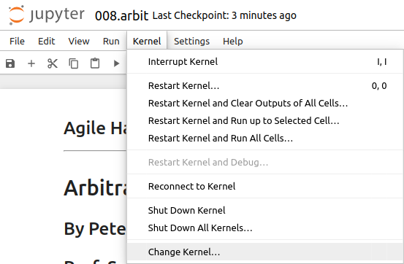
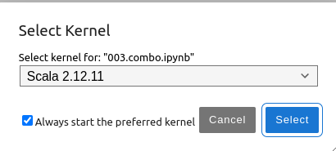
8 Arbitration
https://www.youtube.com/watch?v=itCgwjJdDIM&list=PLfrN7RIcMe6g2LBRJLTHTdhyj5s8ag0Rg&index=8
Arbitration (0:26-0:38/1:02:36)
We discuss Chisel Collection.
> jupyter notebook 006.combo.ipynb > Kernel > Change Kernel … > Select Scala2.21.22
> Run All Cells

Slide 5
8.1 Plan

Slide 6
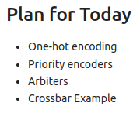
8.1 Plan
https://www.youtube.com/watch?v=itCgwjJdDIM&list=PLfrN7RIcMe6g2LBRJLTHTdhyj5s8ag0Rg&index=8
Plan (0:39-0:53/1:02:36)

Slide 7
8.2 Import Chisel Library

Slide 8
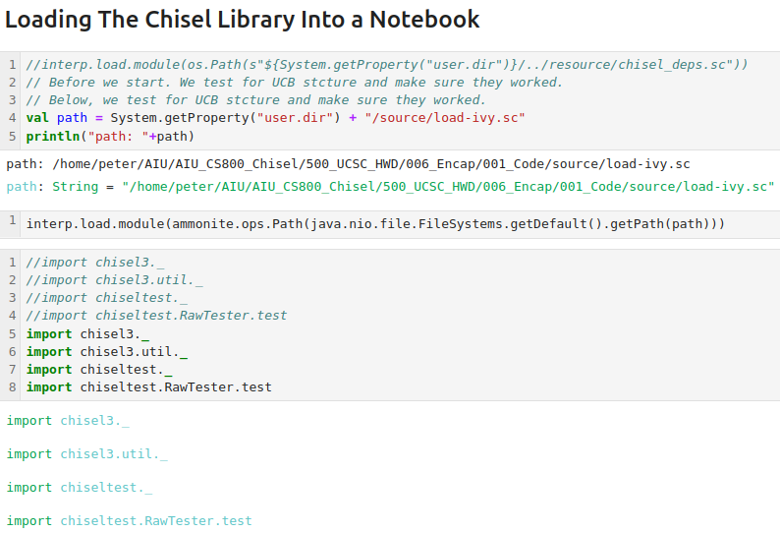
8.2 Import Chisel Library
https://www.youtube.com/watch?v=itCgwjJdDIM&list=PLfrN7RIcMe6g2LBRJLTHTdhyj5s8ag0Rg&index=8
Import Chisel Library (0:54-0:55/1:02:36)

Slide 9
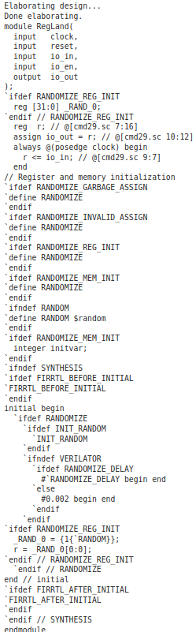
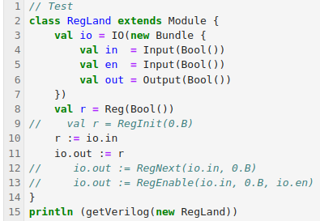
8.2 Import Chisel Library
https://www.youtube.com/watch?v=itCgwjJdDIM&list=PLfrN7RIcMe6g2LBRJLTHTdhyj5s8ag0Rg&index=8
Import Chisel Library (0:56-0:58/1:02:36)
Test

Slide 10
8.3 One-Hot Encoding

Slide 11
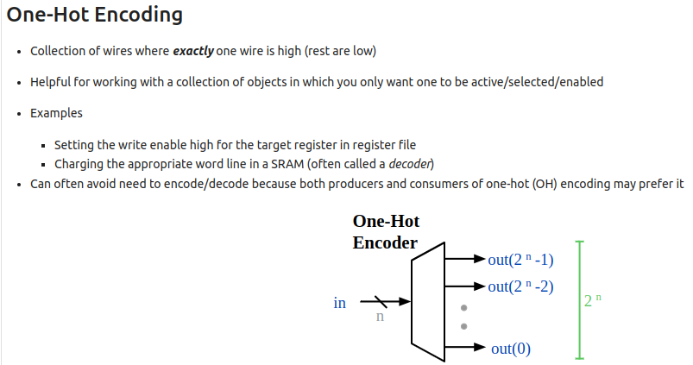
8.3 One-Hot Encoding
https://www.youtube.com/watch?v=itCgwjJdDIM&list=PLfrN7RIcMe6g2LBRJLTHTdhyj5s8ag0Rg&index=8
One-Hot Encoding (0:59-2:43/1:02:36)
In the hardware design, we have one hot encoding.
Q. What is One-Hot Encoding?
Ans: One-hot encoding is a technique that converts categorical data into numerical values. It's used in machine learning to improve prediction.
In hardware design, for example, we have encode a number into a stream of binary (0001, 0010, 0100, 1000). Each digit is unique, i.e., we have collection of wires but only exactly one wire is selected (high). The others are deselected (low).
Examples:
1. We may have a register file. Only write enable to one target register in the register file.
2. We may have a SRAM, we have a word to decode. A decoder to to access just one row of memory location.
In the right diagram, we have hardware of one-hot encoding, we use
1. we use encode to generate the parallel and unique of bit streams
2. decode to select one of the bit stream.

Slide 12
8.4 Implement One-Hot Encoder

Slide 13
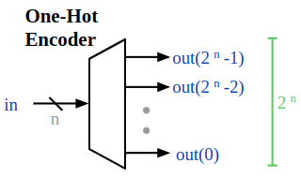
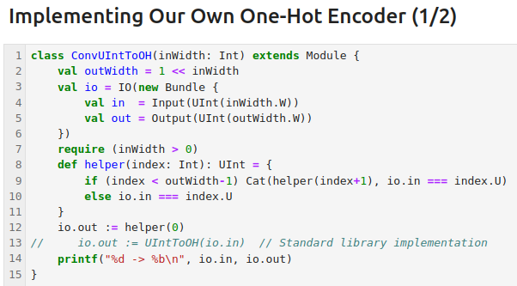
8.4 Implement One-Hot Encoder
https://www.youtube.com/watch?v=itCgwjJdDIM&list=PLfrN7RIcMe6g2LBRJLTHTdhyj5s8ag0Rg&index=8
Implement One-Hot Encoding (2:44-3:43/1:02:36)
If we passed in n = 3 to ConvUIntToOH (3)
1. > outWidth = 1 << inWidth: 1 << 3 => “0001” << 3 => outWidth = “1000”
2. > required (inWidth > 0): required (3 > 0) => truth
3. > helper (0):
4. > if (index < outWidth -1): if (0 < “1000”) => true
5. > Cat (helper (index + 1), io.in === index.U): catenate “result of helper()” and column of comparison “io.in === index.U”) => “1000”.
6. helper (0): Westart from index = 0 to the end of input.
7. printf(): Print the result of simulation.
8. Q: What is difference “==” and “===” in Scala?
== return a boolean
=== returns a column (which contains the result of the comparison of the elements of two columns)

Slide 14
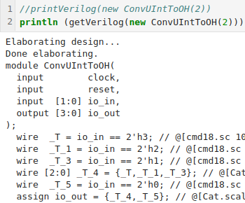
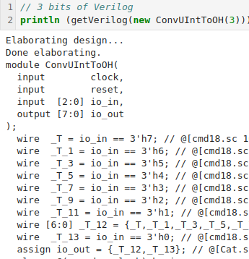
8.4 Implement One-Hot Encoder
https://www.youtube.com/watch?v=itCgwjJdDIM&list=PLfrN7RIcMe6g2LBRJLTHTdhyj5s8ag0Rg&index=8
Implement One-Hot Encoding (3:44-3:59/1:02:36)
Print the Hardware Verilog Code for 2 bits (2^2) and 3 bits (2^3).

Slide 15
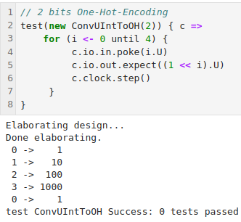
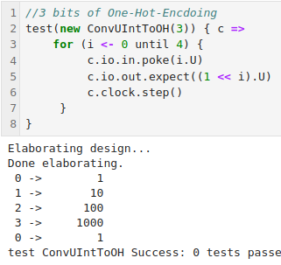
8.4 Implement One-Hot Encoder
https://www.youtube.com/watch?v=itCgwjJdDIM&list=PLfrN7RIcMe6g2LBRJLTHTdhyj5s8ag0Rg&index=8
Implement One-Hot Encoding (4:00-6:43/1:02:36)
One-Hot-Encoding for 2 bits: 2 ^2 and 3 bits: 2^3.

Slide 16
8.5 Simplify One-Hot Encoder

Slide 17
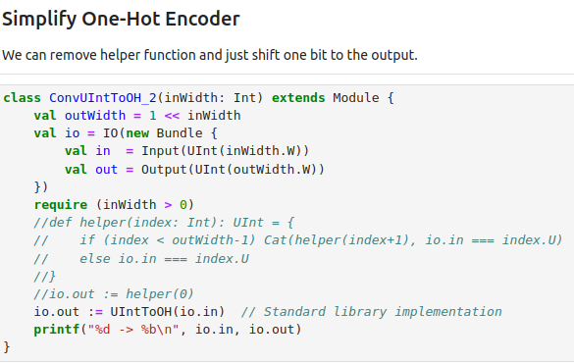
8.5 Simplify One-Hot Encoder
https://www.youtube.com/watch?v=itCgwjJdDIM&list=PLfrN7RIcMe6g2LBRJLTHTdhyj5s8ag0Rg&index=8
Simplify One-Hot Encoding (6:44-6:50/1:02:36)
We can remove helper function and just shift one bit to the output.

Slide 18
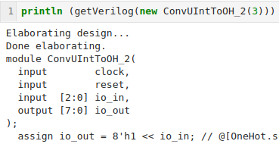
8.5 Simplify One-Hot Encoder
https://www.youtube.com/watch?v=itCgwjJdDIM&list=PLfrN7RIcMe6g2LBRJLTHTdhyj5s8ag0Rg&index=8
Simplify One-Hot Encoding (6:51-6:54/1:02:36)
Print Hardware Verilog

Slide 19
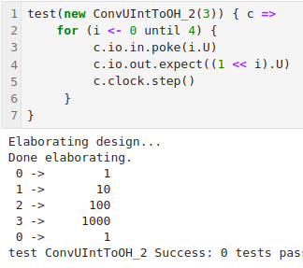
8.5 Simplify One-Hot Encoder
https://www.youtube.com/watch?v=itCgwjJdDIM&list=PLfrN7RIcMe6g2LBRJLTHTdhyj5s8ag0Rg&index=8
Simplify One-Hot Encoding (6:55-8:30/1:02:36)
Perform Hardware Verilog Simulation.
Note:
There are multiple ways to solve the Encoder problem depending on how designer want to solve.
With Chisel, get the functionality work first and then optimize the hardware components.

Slide 20
8.6 Priority Encoder

Slide 21
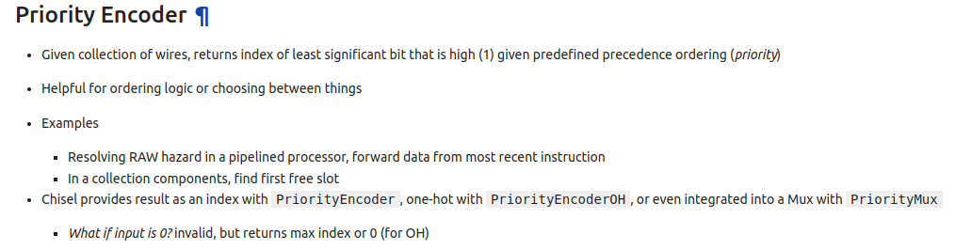
8.6 Priority Encoder
https://www.youtube.com/watch?v=itCgwjJdDIM&list=PLfrN7RIcMe6g2LBRJLTHTdhyj5s8ag0Rg&index=8
Priority Encoder (8:31-10:58/1:02:36)
Least Significant bit of high (1) in the bit streams.
Given a lot of wires, we want to find the index of a bit with high (1). This bit can be the least significant bit or most significant bit. There is some notion of priority and ordering. We want to find the bit is the highest priority.
For example,
1. If we have processor pipeline, for example, there is five-stage pipeline. We want to know the data from the instruction.
2. If we have collection of components, we want to know which slot is free.
Chisel provides the index with PriorityEncoder, on-hot with PriorityEncoderOH, and Mux with PriorityMux.
If the input is 0, then return the max index of 0.

Slide 22
8.7 One-Hot Priority Encoder

Slide 23
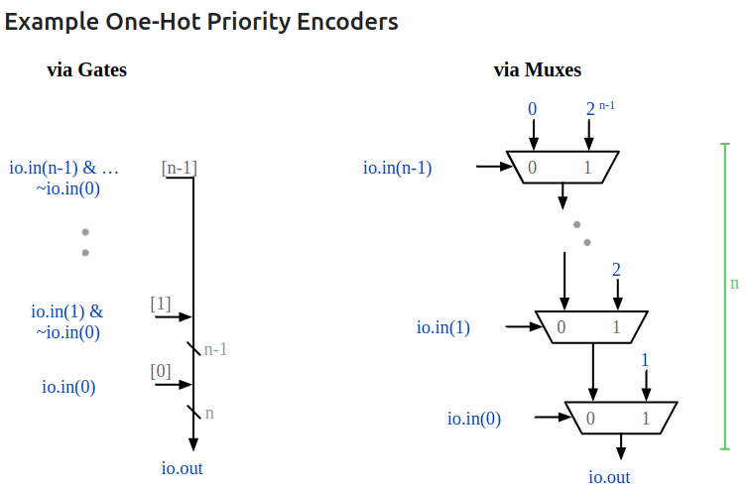
8.7 One-Hot Priority Encoder
https://www.youtube.com/watch?v=itCgwjJdDIM&list=PLfrN7RIcMe6g2LBRJLTHTdhyj5s8ag0Rg&index=8
One-Hot Priority Encoder (11:21-13:20/1:02:36)
Below, we have n wires (0 to n-1 wires) combine together.
Left below, we use Gates to select the index of 0 (highest priority 0). These signals 0 or 1 are produced from AND gates, i.e., io.in(0), io.in(1) & ~io.in(0), etc. We want to know where is the first 0 in the wires.
In another word, we want to know the most significant position of highest priority (0) of the n-wires, i.e., we want to know where is the most significant index of highest priority (0) among the wires.

Slide 24
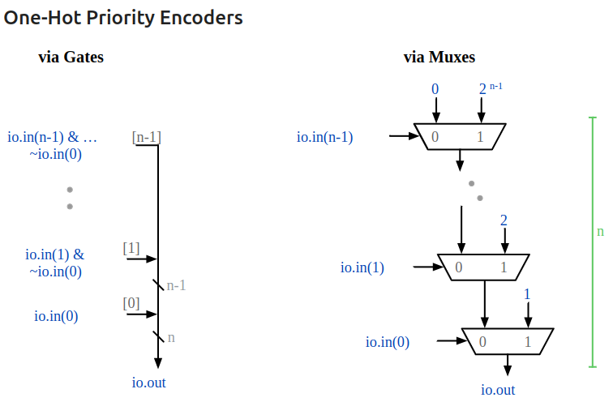
8.7 One-Hot Priority Encoder
https://www.youtube.com/watch?v=itCgwjJdDIM&list=PLfrN7RIcMe6g2LBRJLTHTdhyj5s8ag0Rg&index=8
One-Hot Priority Encoder (12:59-15:53/1:02:36)
Right below, we use the Mux to select the priority (highest index of 0).
If io.in(b) is false, we do not select the input bit (0).
If io.in(n) is true, we will select the input bit (0) out to the output.

Slide 25
8.8 Implement One-Hot Priority Encoder

Slide 26
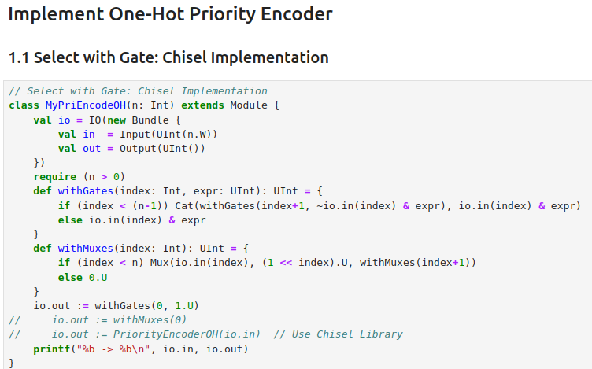
8.8 Implement One-Hot Priority Encoder
https://www.youtube.com/watch?v=itCgwjJdDIM&list=PLfrN7RIcMe6g2LBRJLTHTdhyj5s8ag0Rg&index=8
Select with Gate (15:54-18:00/1:02:36)
1.1 Select with Gate: Chisel Implementation

Slide 27
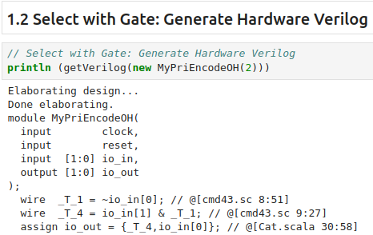
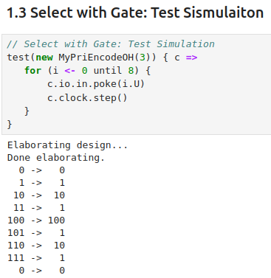
8.8 Implement One-Hot Priority Encoder
https://www.youtube.com/watch?v=itCgwjJdDIM&list=PLfrN7RIcMe6g2LBRJLTHTdhyj5s8ag0Rg&index=8
Select with Gate (18:01-22:00/1:02:36)
1.2 Select with Gate: Print the Hardware Verilog.
1.3 Select with Gate: Test Simulation

Slide 28
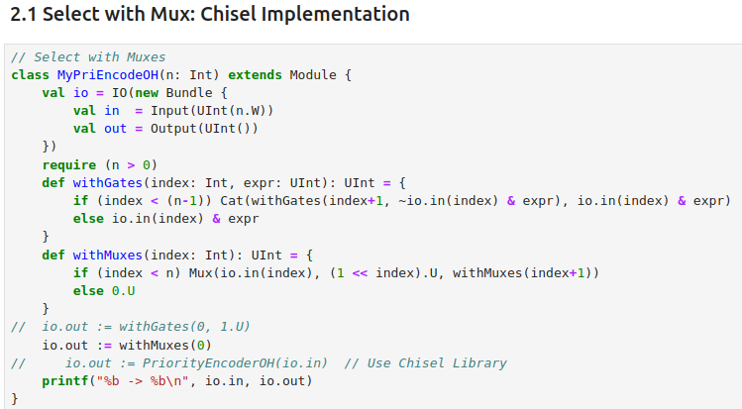
8.8 Implement One-Hot Priority Encoder
https://www.youtube.com/watch?v=itCgwjJdDIM&list=PLfrN7RIcMe6g2LBRJLTHTdhyj5s8ag0Rg&index=8
Select with Mux (22:01-21:20/1:02:36)
2.1 Select with Mux: Chisel Implementation

Slide 29
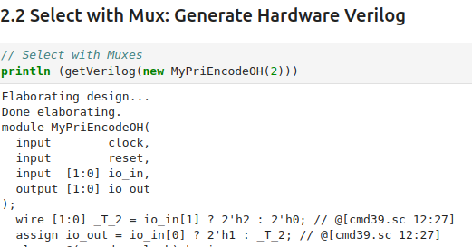
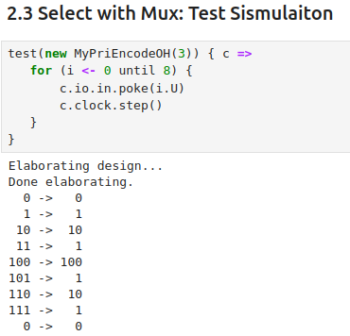
8.8 Implement One-Hot Priority Encoder
https://www.youtube.com/watch?v=itCgwjJdDIM&list=PLfrN7RIcMe6g2LBRJLTHTdhyj5s8ag0Rg&index=8
Select with Mux (21:21-23:00/1:02:36)
2.2 Select with Mux: Print the Hardware Verilog.
1.3 Select with Mux: Test Simulation

Slide 30
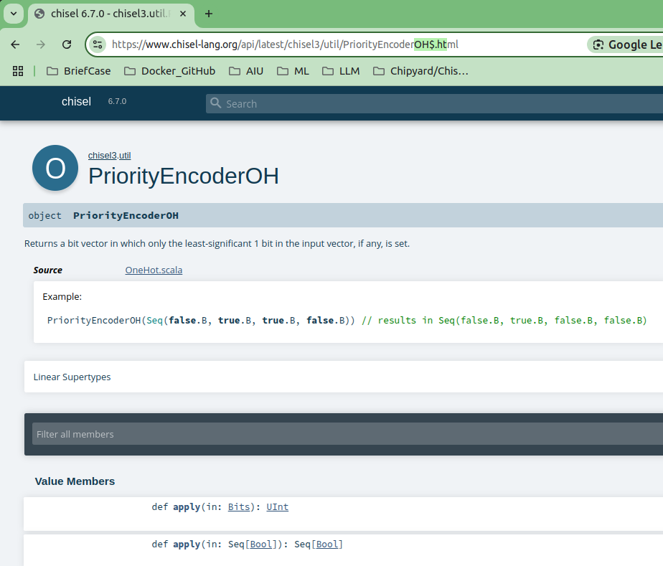
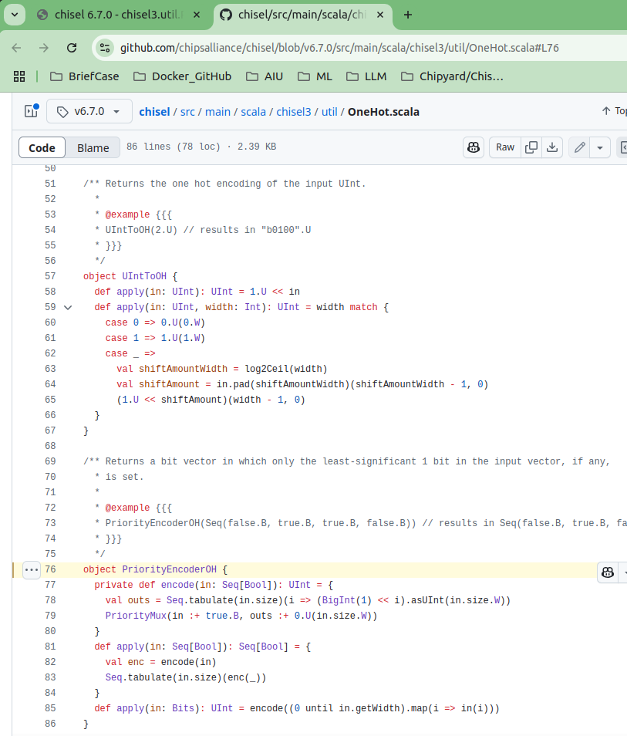
8.8 Implement One-Hot Priority Encoder
https://www.youtube.com/watch?v=itCgwjJdDIM&list=PLfrN7RIcMe6g2LBRJLTHTdhyj5s8ag0Rg&index=8
Select with Chisel Library(23:01-23:30/1:02:36)
Google search “Chisel HDL PriorityEncoderOH”
https://www.chisel-lang.org/api/latest/chisel3/util/PriorityEncoderOH$.html

Slide 31
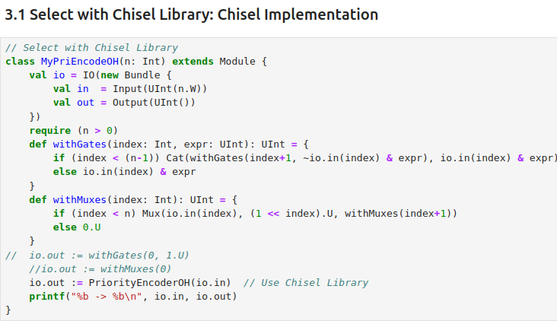
8.8 Implement One-Hot Priority Encoder
https://www.youtube.com/watch?v=itCgwjJdDIM&list=PLfrN7RIcMe6g2LBRJLTHTdhyj5s8ag0Rg&index=8
Select with Chisel Library(23:31-24:00/1:02:36)
3.1 Select with Chisel Library: Chisel Implementation

Slide 32
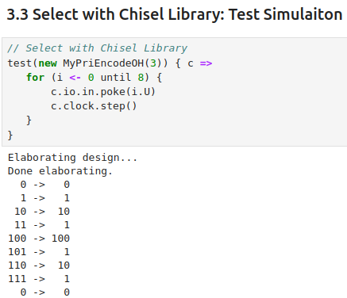
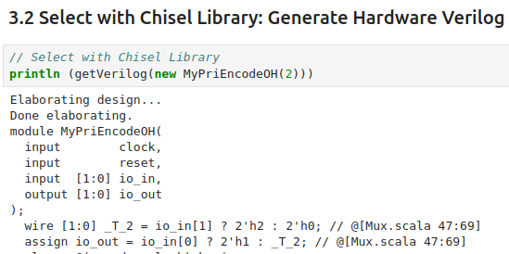
8.8 Implement One-Hot Priority Encoder
https://www.youtube.com/watch?v=itCgwjJdDIM&list=PLfrN7RIcMe6g2LBRJLTHTdhyj5s8ag0Rg&index=8
Select with Chisel Library (24:01-24:30/1:02:36)
3.2 Select with Chisel Library: Print the Hardware Verilog.
3.3 Select with Chisel Library: Test Simulation

Slide 33
8.9 Arbiter

Slide 34
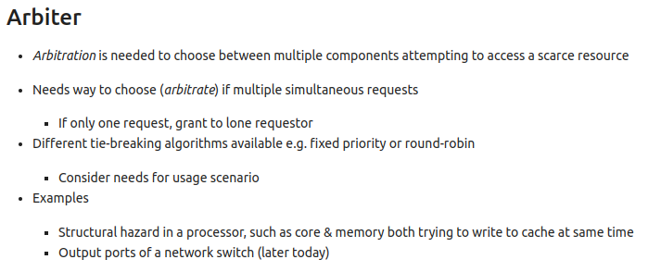
8.9 Arbiter
https://www.youtube.com/watch?v=itCgwjJdDIM&list=PLfrN7RIcMe6g2LBRJLTHTdhyj5s8ag0Rg&index=8
Arbiter (24:31-26:05/1:02:36)
Arbitration: If we have multiple components contend (perform the simulation) at the same time, how to poll one of the components and let it writes the data?.
Example:
1. Hazardous situation: core or memory want to write the cache at the same time.
2. Output ports of a network switch.

Slide 35
8.10 Arbiter in Chisel

Slide 36
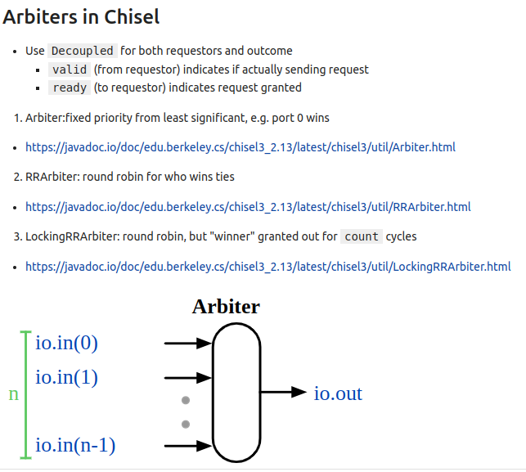
8.9 Arbiter
https://www.youtube.com/watch?v=itCgwjJdDIM&list=PLfrN7RIcMe6g2LBRJLTHTdhyj5s8ag0Rg&index=8
Arbiter (26:06-29:27/1:02:36)
1. Use Decoupled for requestor and outcome
  1.1 valid: from requestor to send request
  1.2 ready: to requestor for grant request.
2. Utility in Chisel Library:
  2.1 Arbiter: Fixed Priority from least significant for 0.
  2.2 RRArbiter: Round Robin Arbiter.
  2.3 LockingRRArbiter: Round Robin, Lock the winner. Only one person at a time.
3. Link:
  3.1 Utility Arbiter:
  https://javadoc.io/doc/edu.berkeley.cs/chisel3_2.13/latest/chisel3/util/Arbiter.html
  3.2 Utility RRArbiter:
  https://javadoc.io/static/edu.berkeley.cs/chisel3_2.12/3.3.0-RC2/chisel3/util/RRArbiter.html
  3.3 Utility LockingRRArbiter:
  https://javadoc.io/doc/edu.berkeley.cs/chisel3_2.13/latest/chisel3/util/LockingRRArbiter.html

Slide 37
8.11 Arbiter Utility

Slide 38
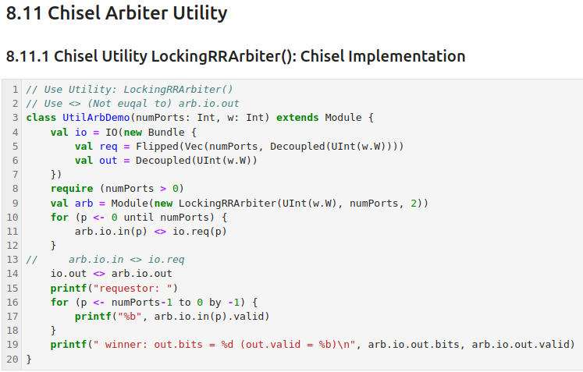
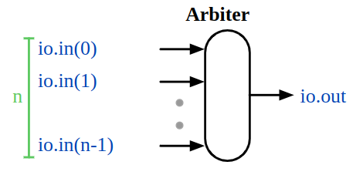
8.11 Arbiter Utility
https://www.youtube.com/watch?v=itCgwjJdDIM&list=PLfrN7RIcMe6g2LBRJLTHTdhyj5s8ag0Rg&index=8
Implement Using Chisel Utility LockingRRArbiter (29:28-30:20/1:02:36)
8.11.1 We use Arbiter Utility LockingRRArbiter() to write the Arbiter.
Q: Why do we flip (Invert signal) here?
Ans: Decoupled defaults to being an output, that is its argument, in this case the UInt(8.W) will bring data into the module. Decoupled adds ready and valid handshaking signals to in. The Flipped() changes the direction of all fields of it's argument. So out is suitable for communicating information out of the module.
https://stackoverflow.com/questions/48343073/what-does-flipped-do-in-chisel3

Slide 39
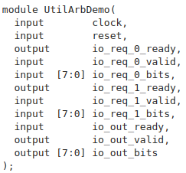
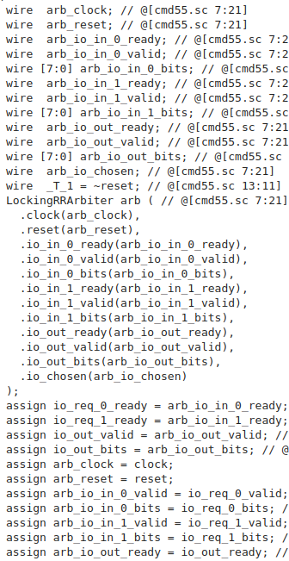

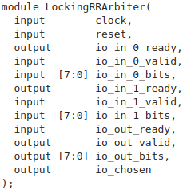
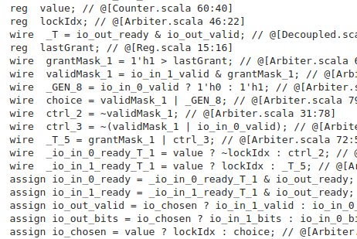
8.11 Arbiter Utility
https://www.youtube.com/watch?v=itCgwjJdDIM&list=PLfrN7RIcMe6g2LBRJLTHTdhyj5s8ag0Rg&index=8
Generate LockingRRArbiter Verilog (30:21-30:24/1:02:36)
8.11.2 Generate Hardware Verilog
There are two modules generated: One is the module we created. The other is the utility module.

Slide 40
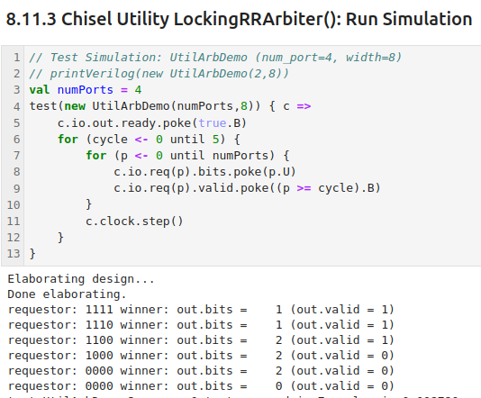
8.11 Arbiter Utility
https://www.youtube.com/watch?v=itCgwjJdDIM&list=PLfrN7RIcMe6g2LBRJLTHTdhyj5s8ag0Rg&index=8
Run Simulation (30:25-39:05/1:02:36)
8.11.3 Run Simulation
Requestor data: 1111, 1110, 1100, Only check valid = 1 => No 0 found (bit 1), 0 found in bit 1, 0 found in bit 2.

Slide 41
8.12 MyArb

Slide 42
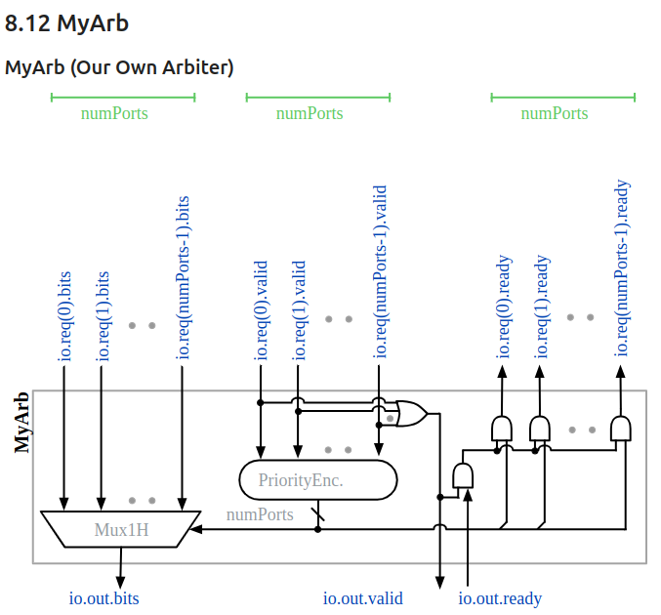
8.12 MyArb
https://www.youtube.com/watch?v=itCgwjJdDIM&list=PLfrN7RIcMe6g2LBRJLTHTdhyj5s8ag0Rg&index=8
MyArb (39:06-44:58/1:02:36)
Below, is our own Arbiter. We have:
Input: input data (0 to n-1), valid (0 to n-1), ready/not ready
Output: ready (0 to n-1), bit position, valid/not valid.
Note:
The io.out.valid is AND all of the io.req (0 to n).
io.out.valid

Slide 43
8.13 Implement MyArb (2/3)

Slide 44
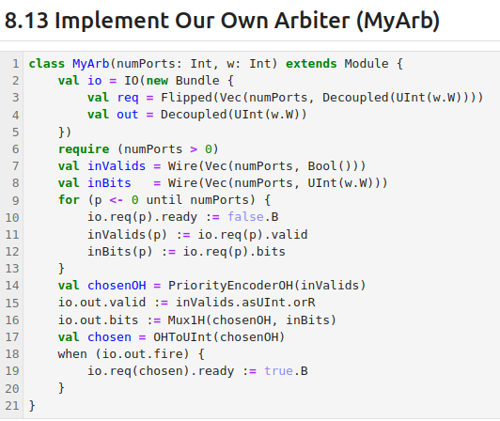
8.13 Implement MyArb
https://www.youtube.com/watch?v=itCgwjJdDIM&list=PLfrN7RIcMe6g2LBRJLTHTdhyj5s8ag0Rg&index=8
Implement MyArb (44:59-47:56/1:02:36)
Implementing Our Own Arbiter (2/3)
io.out.valid

Slide 45
8.14 Implement MyArb (3/3)

Slide 46
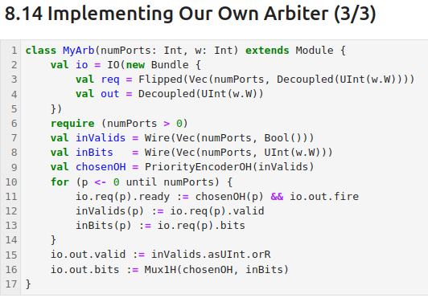
8.14 Implement MyArb (3/3)
https://www.youtube.com/watch?v=itCgwjJdDIM&list=PLfrN7RIcMe6g2LBRJLTHTdhyj5s8ag0Rg&index=8
Implement MyArb (47:57-50:00/1:02:36)
Implementing Our Own Arbiter (3/3)
We modify a little bit below.
io.out.valid

Slide 47
8.15 Crossbar Example

Slide 48
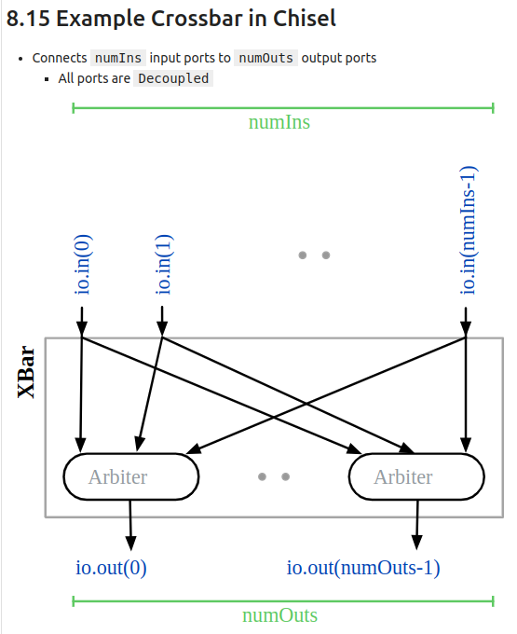
8.15 Crossbar Example
https://www.youtube.com/watch?v=itCgwjJdDIM&list=PLfrN7RIcMe6g2LBRJLTHTdhyj5s8ag0Rg&index=8
Crossbar Example (50:01-51:07/1:02:36)
We want to automate the crossbar example.
We have multiple input in crossbar.

Slide 49
8.16 Implement Crossbar (1/2)

Slide 50
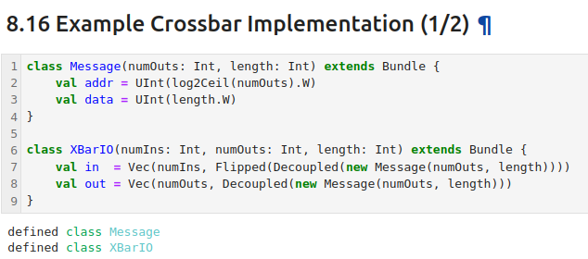
8.16 Implement Crossbar (1/2)
https://www.youtube.com/watch?v=itCgwjJdDIM&list=PLfrN7RIcMe6g2LBRJLTHTdhyj5s8ag0Rg&index=8
Implement Crossbar (51:08-52:27/1:02:36)
We define modules for Message and XBarIO.
Vector in input and output port for module XBarIO.

Slide 51
8.17 Implement Crossbar (2/2)

Slide 52
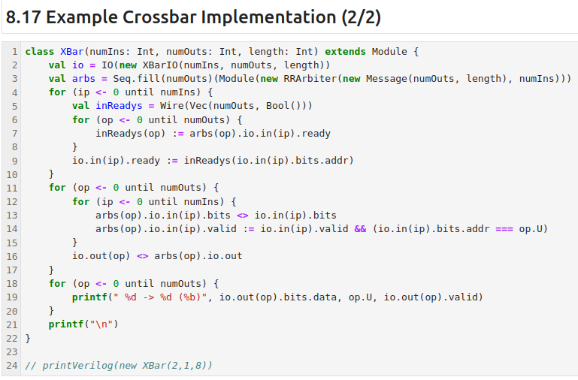
8.17 Implement Crossbar (3/2)
https://www.youtube.com/watch?v=itCgwjJdDIM&list=PLfrN7RIcMe6g2LBRJLTHTdhyj5s8ag0Rg&index=8
Implement Crossbar (52:28-57:50/1:02:36)
We define the module XBar (Crossbar)
1. inReadys
2. io.in(ip).ready
3. arbs.xxx.bits: Arbiter output port.
4. arbs.xxx.valid: Arbiter output port.
5. print the data and valid.

Slide 53
8.18 Generate Hardware Verilog

Slide 54
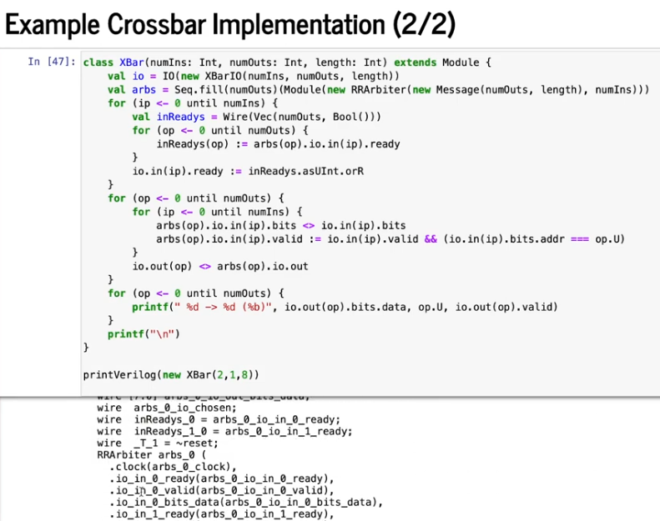
8.18 Generate Hardware Verilog
https://www.youtube.com/watch?v=itCgwjJdDIM&list=PLfrN7RIcMe6g2LBRJLTHTdhyj5s8ag0Rg&index=8
Generate Hardware Verilog (57:51-58:40/1:02:36)

Slide 55
8.19 Crossbar Simulation

Slide 56
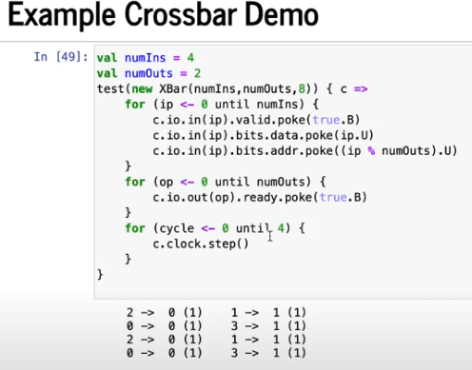
8.19 Crossbar Simulation
https://www.youtube.com/watch?v=itCgwjJdDIM&list=PLfrN7RIcMe6g2LBRJLTHTdhyj5s8ag0Rg&index=8
Crossbar (59:28-1:02:36/1:02:36)

Slide 57
End

