Slide 1

0.2 Install JDK/SBT/Scala
Peter H. Chen

Slide 2
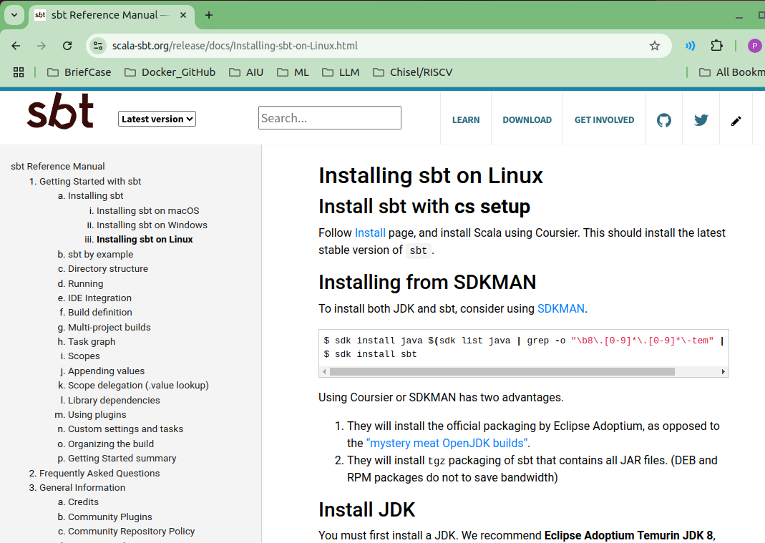
0.2 Install JDK/SBT/Scala
https://github.com/ucb-bar/chisel-tutorial?tab=readme-ov-file
Install JDK/SBT/Scala
Below, we have installed the SDK, now, we can use SDK to install JDK, SBT, and Scala.
https://www.scala-sbt.org/release/docs/Installing-sbt-on-Linux.html

Slide 3
0.2.1 Install JDK

Slide 4


0.2.1 Install JDK
https://github.com/ucb-bar/chisel-tutorial?tab=readme-ov-file
Install JDK
After we install JDK, we can check
1. Java Compiler version:
> javac -version
>> javac 1.8.0_432 # Java 1.8 or Java 8
2. JVM (JVM is part of JRE) version
> java -version
>> openjdk version “1.8._432”
>> OpenJDK Runtime Environment (JRE): 1.8
>> OpenJDK 64-bit Server VM (JVM)
https://www.scala-sbt.org/release/docs/Installing-sbt-on-Linux.html
1
2

Slide 5
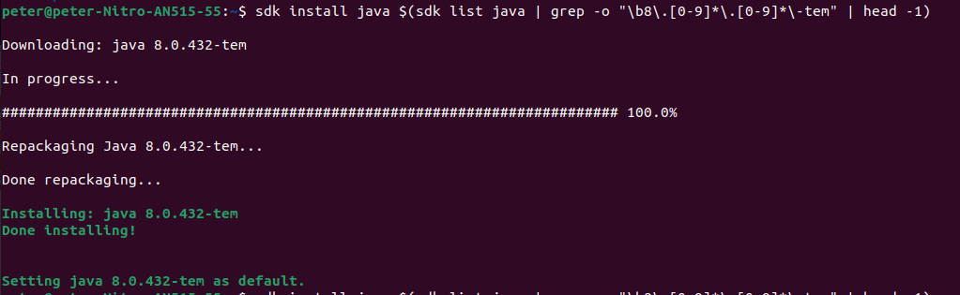
0.2.1 Install JDK
https://github.com/ucb-bar/chisel-tutorial?tab=readme-ov-file
Install JDK
Below, we use SDK to install JDK
> sdk install java $(sdk list java | grep -o "\b8\.[0-9]*\.[0-9]*\-tem" | head -1)
https://www.scala-sbt.org/release/docs/Installing-sbt-on-Linux.html

Slide 6
0.2.2 Install SBT

Slide 7
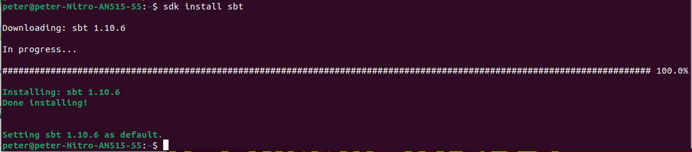
0.2.2 Install SBT
https://github.com/ucb-bar/chisel-tutorial?tab=readme-ov-file
Install SBT
Install SBT:
> sdk install sbt
https://www.scala-sbt.org/release/docs/Installing-sbt-on-Linux.html

Slide 8

0.2.2 Install SBT
https://github.com/ucb-bar/chisel-tutorial?tab=readme-ov-file
Check SBT Version
After we install SBT, we can check sbt version
> sbt -version
https://www.scala-sbt.org/release/docs/Installing-sbt-on-Linux.html

Slide 9
0.2.3 Install Scala

Slide 10
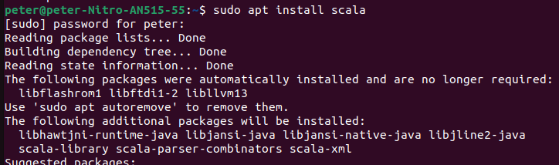
0.2.3 Install Scala
https://medium.com/beeranddiapers/installing-scala-on-ubuntu-7a4b14d26bdc
Install Scala
After we install JDK, we can install Scala.
> sudo apt install scala
https://medium.com/beeranddiapers/installing-scala-on-ubuntu-7a4b14d26bdc

Slide 11
0.2.3 Install Scala
https://medium.com/beeranddiapers/installing-scala-on-ubuntu-7a4b14d26bdc
Check Scala Version
Check scala version
> scala -version
>> Scala code runner version 2.11.12
https://medium.com/beeranddiapers/installing-scala-on-ubuntu-7a4b14d26bdc

Slide 12
End

