Slide 1

2 Run Chisel
Peter H. Chen

Slide 2
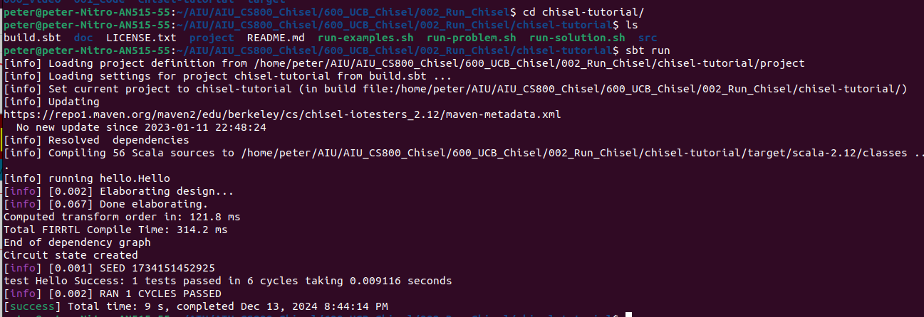
2 Run Chisel
https://github.com/ucb-bar/chisel-tutorial?tab=readme-ov-file
Run Chisel
Test our System first. Make sure that we have sbt (the scala build tool) installed.
In the Chisel tutorial directory:
1. > cd chisel-tutorial
2. > ls
Make sure there is a file “build.sbt”
3. > sbt run

Slide 3
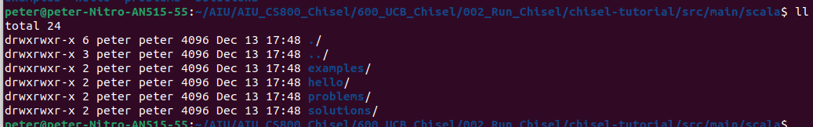
2 Run Chisel
https://github.com/ucb-bar/chisel-tutorial?tab=readme-ov-file
Run Chisel
> sbt run
The above run will generate and test a simple block (Hello) that always outputs the number 42 (aka 0x2a).
You should see [success] on the last line of output (from sbt) and PASSED on the line before indicating the block passed the testcase.
If you are doing this for the first time, sbt will automatically download the appropriate versions of Chisel3, the Chisel Testers harness and Scala and cache them (usually in ~/.ivy2).
Q: How sbt know which program to run?
1. In the src/main/scala, there are several directories, only one of them contains the main() entry.
2. Below, we have “hello/Hello.scala” contains the “main()” which is the application for sbt to pick. Other examples are pickup by sbt based on the passing parameters.
1
2

Slide 4
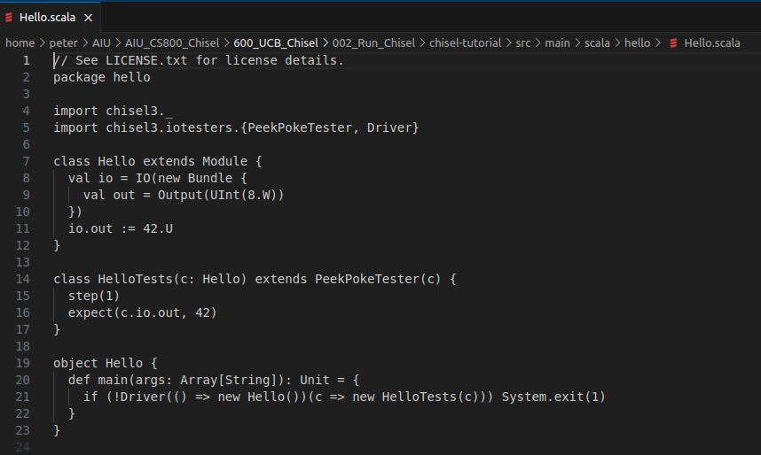
2 Run Chisel
https://github.com/ucb-bar/chisel-tutorial?tab=readme-ov-file
Run Chisel
> sbt run
The above run will generate and test a simple block (Hello) that always outputs the number 42 (aka 0x2a).
You should see [success] on the last line of output (from sbt) and PASSED on the line before indicating the block passed the testcase.
If you are doing this for the first time, sbt will automatically download the appropriate versions of Chisel3, the Chisel Testers harness and Scala and cache them (usually in ~/.ivy2).

Slide 5
End

