Slide 1

15 Network
Peter H. Chen

Slide 2
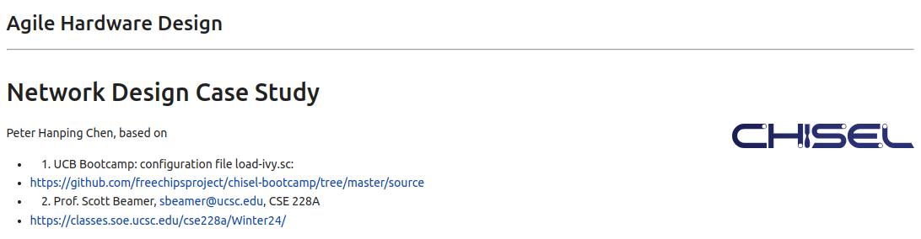
15 Network
https://www.youtube.com/watch?v=RNwI5zN3qAs
Network (0:00-0:01/44:47)
We used UCB bootcamp configuration file (load_ivy.sc)
source/load-ivy.sc (https://github.com/freechipsproject/chisel-bootcamp)

Slide 3
15 Network
https://www.youtube.com/watch?v=RNwI5zN3qAs
Network (0:02-0:45/44:47)
We discuss Network (Crossbar, Ring Network, Torus Network) Design.
Topics:
1. Setup: jupyter notebook, select scala, and run cells.
2. Network Design with Abstract Class, Inheritance (Case class), Generic Tem,plate <T>, and Factory Pattern.
3. Crossbar: cross every Inputs into each host.
4. Ring Network: Single/Double linked list for message forward/reversed.
5. Torus Network: 2-Dimensional row/column network
6. Generic Parameter input
7. Define abstract class
8. Define case class for single/multiple inheritance
9. Define/Parsing: Generic template <T>,
10. Factory Design for crossbar, ring network, and Torus Network.

Slide 4
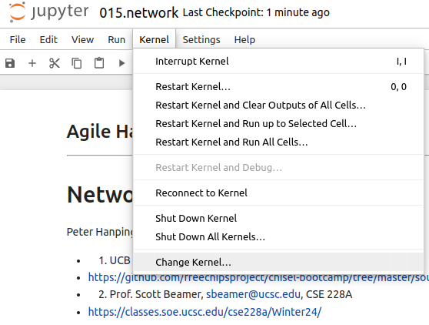
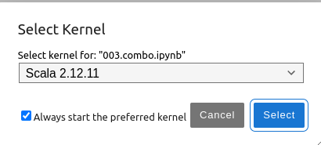
15 Network
https://www.youtube.com/watch?v=RNwI5zN3qAs
Network (0:03-1:01/44:47)
We discuss Chisel Collection.
> jupyter notebook 015.network.ipynb > Kernel > Change Kernel … > Select Scala2.21.22
> Run All Cells

Slide 5
15.1 Plan

Slide 6
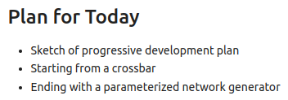
15.1 Plan
https://www.youtube.com/watch?v=RNwI5zN3qAs
Plan (1:02-1:10/44:47)
Today, we talk about Network.

Slide 7
15.1 Plan

Slide 8
15.1 Plan
https://www.youtube.com/watch?v=RNwI5zN3qAs
Plan (1:02-1:10/44:47)
Today, we talk about Network.

Slide 9
15.2 Import Chisel Library

Slide 10
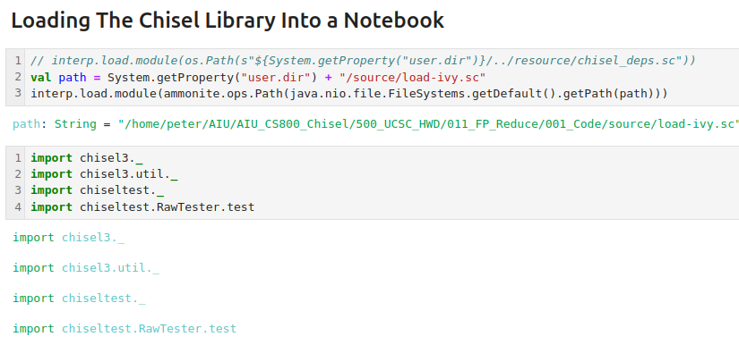
15.2 Import Chisel Library
https://www.youtube.com/watch?v=RNwI5zN3qAs
Import Chisel Library (01:11-01:16/44:47)

Slide 11
15.3 Goal

Slide 12
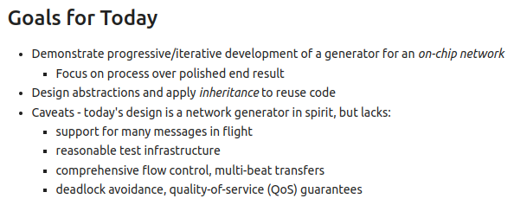
15.3 Goal
https://www.youtube.com/watch?v=RNwI5zN3qAs
Goal (1:16-2:18/44:47)
We will use inheritance for design.
At the end, we will have good network without deadlock and with good QoS (Quality of Service).

Slide 13
15.4 Crossbar (XBar): From 008.Arbit

Slide 14
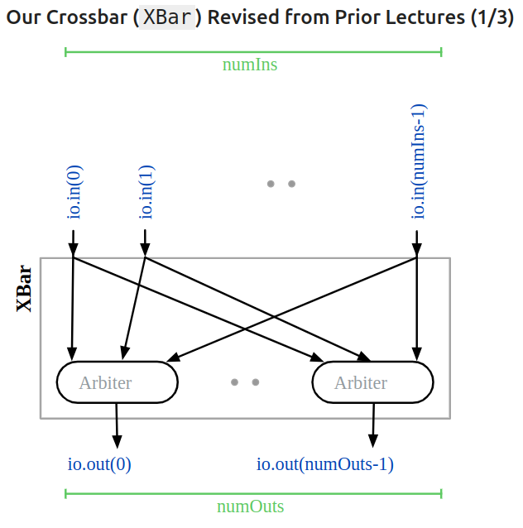
15.4 Crossbar (XBar): From 008.Arbit
https://www.youtube.com/watch?v=RNwI5zN3qAs
Crossbar (XBar): From 008.Arbit (2:19-2:20/44:47)
We have Crossbar (XBar) Design which contains the Arbiter. We have input and Output to XBar.

Slide 15
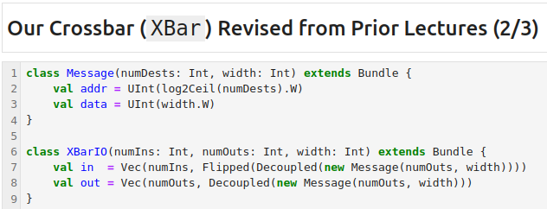
15.4 Crossbar (XBar): From 008.Arbit
https://www.youtube.com/watch?v=RNwI5zN3qAs
Crossbar (XBar): From 008.Arbit (2:21-3:18/44:47)
In 008.Arbit, we have Crossbar (XBar) Design.
From class Message, we have
1. address from numDests.W
2. data from width.W.
From XBarIO, we have
1. input from vector (numIns, Flipped (Decoupled (new Message(numOuts, width))))
2. output from vector (numOuts, Decoupled (new Message (numOuts, width)))).

Slide 16
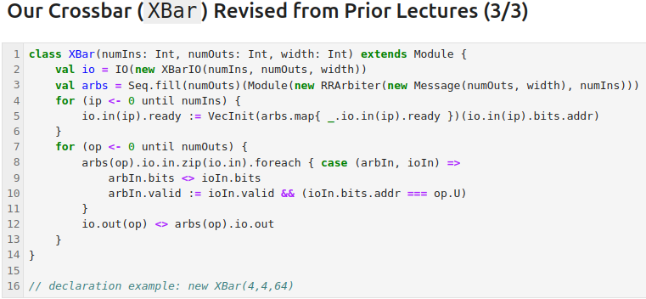
15.4 Crossbar (XBar): From 008.Arbit
https://www.youtube.com/watch?v=RNwI5zN3qAs
Crossbar (XBar): From 008.Arbit (3:19-5:01/44:47)
In 008.Arbit, we have Crossbar (XBar) Design.
We define the class XBar():
1. io from o from class XBarIO()
2. arbiter from class RRArbiter( Message)
Now, we have to bind the io to the arbiter. We use map for input port to the corresponding signal ready and data.
We set the arbiter data and output.

Slide 17
15.5 Crossbar (XBar): Case Class

Slide 18
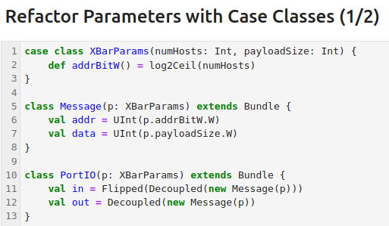
15.5 Crossbar (XBar): Case Class
https://www.youtube.com/watch?v=RNwI5zN3qAs
Crossbar (XBar): Case Class (5:02-5:30/44:47)
We define class XBarParams to extract the parameters (address bit).

Slide 19
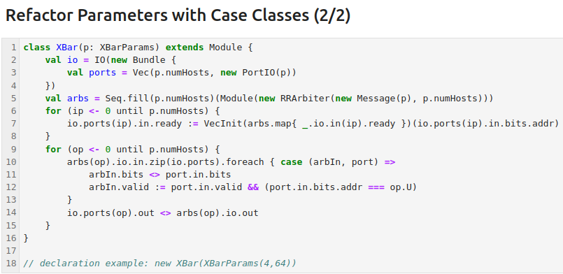
15.5 Crossbar (XBar): Case Class
https://www.youtube.com/watch?v=RNwI5zN3qAs
Crossbar (XBar): Case Class (5:31-7:05/44:47)
We pass in XBar with class XBarParams.
We make the run robin arbiters check for each port.

Slide 20
15.6 Crossbar (XBar): Template Type

Slide 21
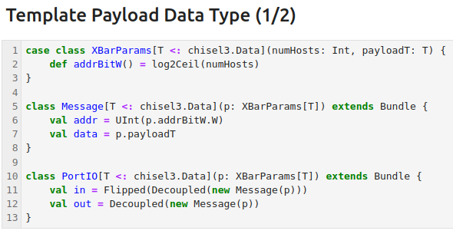
15.6 Crossbar (XBar): Template Type
https://www.youtube.com/watch?v=RNwI5zN3qAs
Crossbar (XBar): Template Type (7:06-8:05/44:47)
We discussed the generic type of parameter.
1. In class XBarParams, we have generic type T for payload.
2. In class Message, we passed in class XBarParams[T].
3. In class PortIO, we passed in class XBarParams[T].

Slide 22
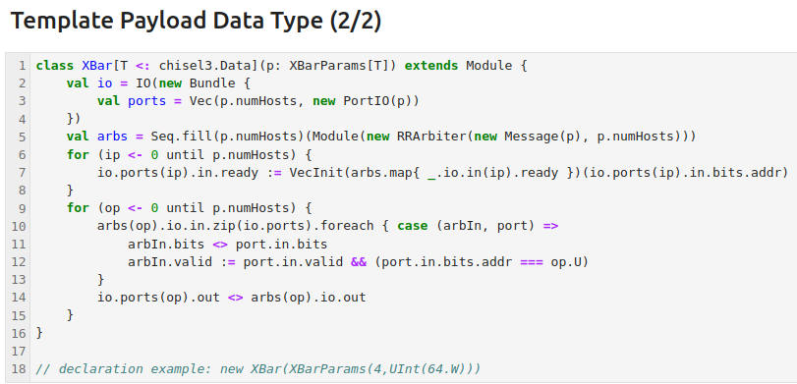
15.6 Crossbar (XBar): Template Type
https://www.youtube.com/watch?v=RNwI5zN3qAs
Crossbar (XBar): Template Type (8:06-9:58/44:47)
1. We passed the data (p: XBarParams[T]) to class XBar[T] and passed in Message (p) to Round Robin library RRArbiter.
2. We use <> Connect operator for object arbIn.bit and port.in.bits.
3. We can new XBar ()

Slide 23
15.7 Multi-Hop Network

Slide 24
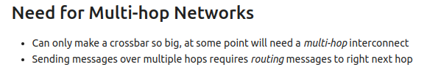
15.7 Multi-Hop Network
https://www.youtube.com/watch?v=RNwI5zN3qAs
Multi-Hop Network (9:59-10:10/44:47)
We now discuss Multi-Hop Network.

Slide 25
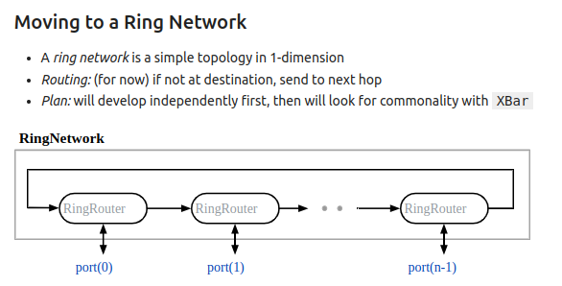
15.7 Multi-Hop Network
https://www.youtube.com/watch?v=RNwI5zN3qAs
Ring Network (10:11-13:23/44:47)
Below, we have Ring Network. It is special case of Multiple Hop Network.
1. Ring Network is 1-Dimension. Ring Network can be multiple dimensions routing.
2. Routing: Send to next.
3. Routing can be send to multiple addresses.
4. We will do independent ring network first
5. We will merge the ring network with class XBar.

Slide 26
15.8 Implement Ring Network

Slide 27
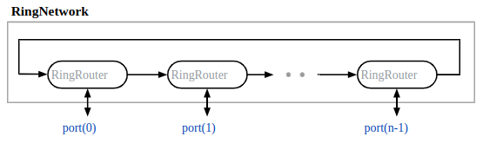
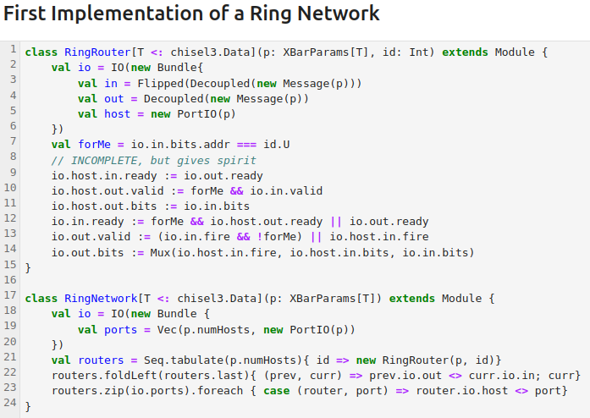
15.8 Implement Ring Network
https://www.youtube.com/watch?v=RNwI5zN3qAs
Implement Ring Network (13:24-15:58/44:47)
1. We define class RingRouter, we pass in XBarParams[T] and ID.
2. We define IO for Ring Network.
3. We wire the ready, valid, Bits, and use the Mux for output.
4. We define class RingNetwork, we passed in Number of Hosts with XBarParams[T].
5. In class RingNetwork, we create vector with number of host. Each host is a Ring Network router.
6. We connect the Ring Network hardware with IO.
7. We forward the router information.

Slide 28
15.9 Integrate XBar and Ring Network

Slide 29
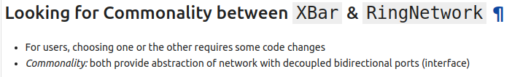
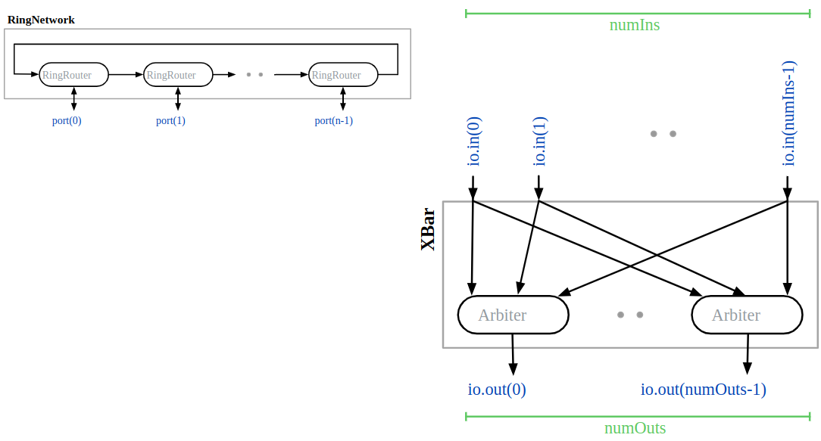
15.9 Integrate XBar and Ring Network
https://www.youtube.com/watch?v=RNwI5zN3qAs
Integrate XBar and Ring Network (13:24-13:58/44:47)
We have crossbar and a ring network.
How can we put them together?

Slide 30
15.10 Generic Port for Network

Slide 31
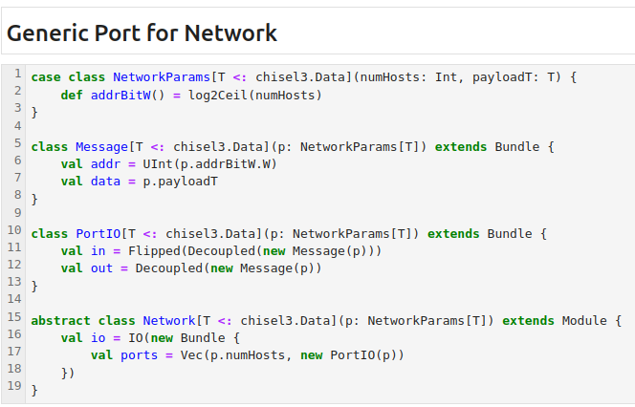
15.10 Generic Port for Network
https://www.youtube.com/watch?v=RNwI5zN3qAs
Generic Port for Network (18:09-18:08/44:47)
Below, we have class crossbar and a class for ring network. We need to have common ground for both networks. Both class has bidirectional IO ports. The interface abstraction is the same.
We will need to implement this interface.
1. We define case class NetworkParams. Case class is good for modeling the immutable data. There is a crossover parameters and another parameter of number of host.
2. We have class Message. We use this to instantiate the port.
3. The abstract class Network pass in case class generic NetworkParams [T] and create the vector IO Ports for each host.

Slide 32
15.11 XBar with Inherited Interface

Slide 33
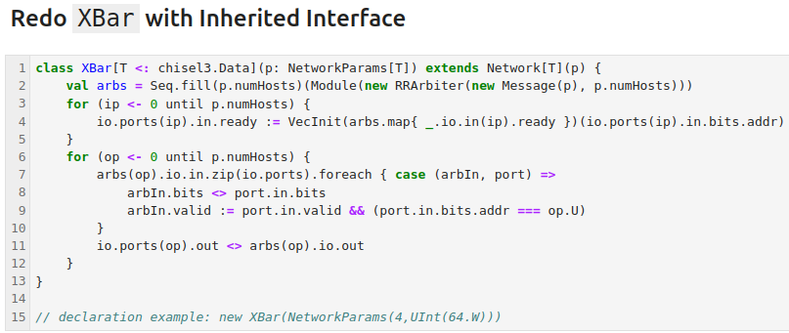
15.11 XBar with Inherited Interface
https://www.youtube.com/watch?v=RNwI5zN3qAs
XBar with Inherited Interface (13:59-18:50/44:47)
We redo XBar with Inherited Interface.
1. create arbiter object arbs by Seq and RRArbiter and passed in class Message and number of Hosts.
2. get port ready from arbs object.
3. Loop for hosts;
3.1 For each host, we get the data bits and valid and
3.2 Set the output.

Slide 34
15.12 RingNetwork with Inherited Interface

Slide 35
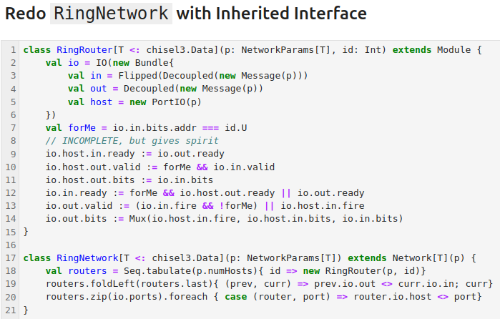
15.12 RingNetwork with Inherited Interface
https://www.youtube.com/watch?v=RNwI5zN3qAs
RingNetwork with Inherited Interface (18:51-23:20/44:47)
We redo RingNetwork with Inherited Interface.
1. We create the routers with class RingRouter.
2. We find the current router.
3. zip Loop for routers and ports, i.e., (router1, port1), (router2, port2), …
At the end, we have final (outer, port) list.

Slide 36
15.13 Assess RingNetwork

Slide 37
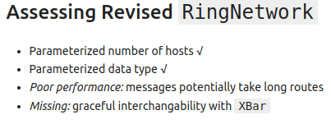
15.13 Assess RingNetwork
https://www.youtube.com/watch?v=RNwI5zN3qAs
Assess RingNetwork (23:21-24:00/44:47)
We have Parameterized the host, Parameterized data type, Poor Performance: Message take long time, and do not have good interchangeable with XBar.

Slide 38
15.14 Send Message in Shorter Direction

Slide 39
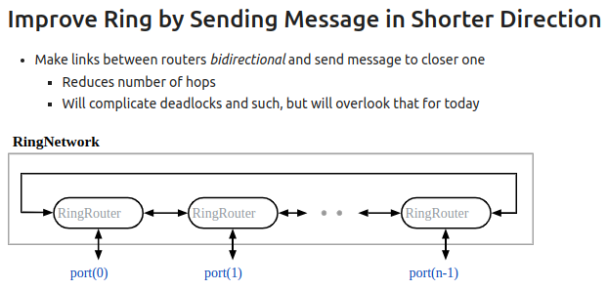
15.14 Send Message in Shorter Direction
https://www.youtube.com/watch?v=RNwI5zN3qAs
Send Message in Shorter Direction (24:01-26:33/44:47)
We have Parameterized the host, Parameterized data type, Poor Performance: Message take long time, and do not have good interchangeable with XBar.
Below, we:
1. Make bi-directional ring and
2. Send message to closer one
We will get less number of hop but we maybe get a big issue, deadlock.
Before, we always send message in the same direction. But now, we can send backward. The forward and backward may get a deadlock.
We need: 1. Destination Address, 2. Connectivity, i.e., architecture of crossbar.

Slide 40
15.15 Bidirectional RingRouter with XBar

Slide 41
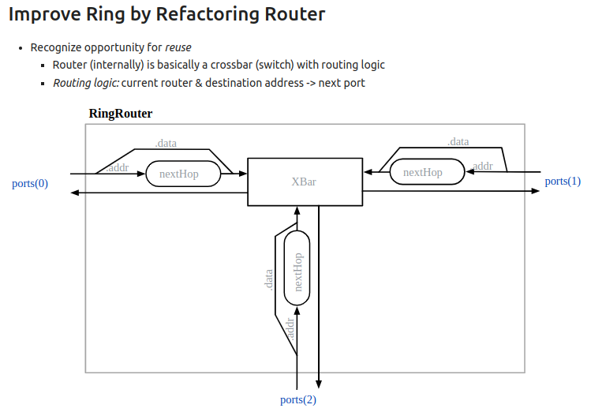
15.15 Bidirectional RingRouter with XBar
https://www.youtube.com/watch?v=RNwI5zN3qAs
Bidirectional RingRouter with XBar (26:34-26:40/44:47)
Below:
1. nextHop () is to find the next destination address.

Slide 42
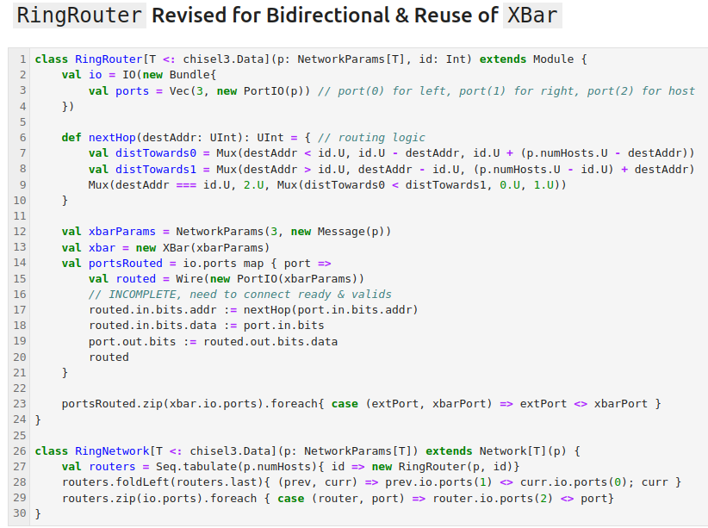
15.15 Bidirectional RingRouter with XBar
https://www.youtube.com/watch?v=RNwI5zN3qAs
Bidirectional RingRouter with XBar (26:41-30:48/44:47)
In class RingRouter,
1. We input port (0) for left, port (1) for right, and port(2) for host.
2. nextHop () is to find the next destination address. We use Mux to find the next destination address.
3. routed address = nextHop (input address), routed data, output port and return the external port and XBar Port.
In class RingNetwork, we create routers and interface with new RingRouter.

Slide 43
15.16 Assess Interchangeability XBar

Slide 44
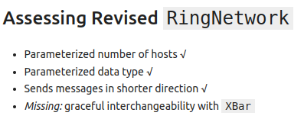
15.16 Assess Interchangeability XBar
https://www.youtube.com/watch?v=RNwI5zN3qAs
Assess Interchangeability with XBar (30:49-30:50/44:47)
Now, we want to have nice interchangeability wit XBar.

Slide 45
15.17 Make Network Factory

Slide 46
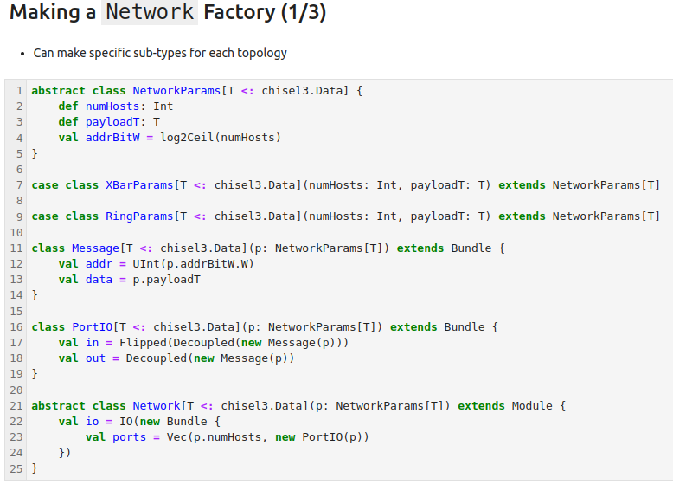
15.17 Make Network Factory
https://www.youtube.com/watch?v=RNwI5zN3qAs
Assess Interchangeability with XBar (30:49-32:10/44:47)
1. abstract class NetworkParamas
2. class XBarParams
3. class Message
4. class PortIO
5. abstract class Network

Slide 47
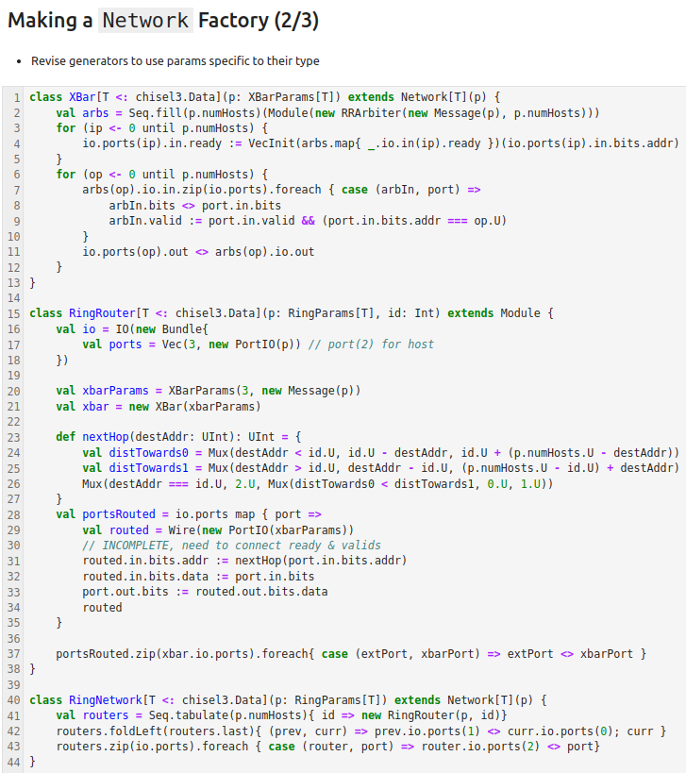
15.17 Make Network Factory
https://www.youtube.com/watch?v=RNwI5zN3qAs
Assess Interchangeability with XBar (32:13-32:30/44:47)
1. class XBar
2. class RingRouter
3. class RingNetwork

Slide 48
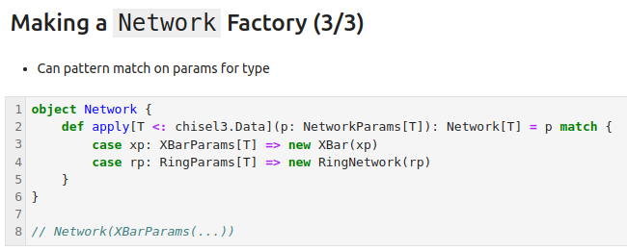
15.17 Make Network Factory
https://www.youtube.com/watch?v=RNwI5zN3qAs
Assess Interchangeability with XBar (32:31-33:00/44:47)
Object Network with pattern/parameter match.

Slide 49
15.18 Assess RingNetwork

Slide 50
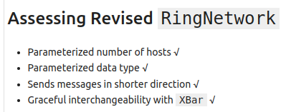
15.18 Assess RingNetwork
https://www.youtube.com/watch?v=RNwI5zN3qAs
Assess RingNetwork (33:01-33:30/44:47)
We have all the features for RingNetwork.

Slide 51
15.19 Add More Network Topology

Slide 52
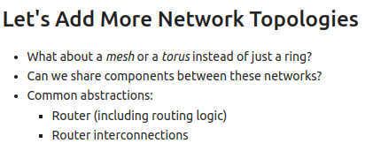
15.19 Add More Network Topology
https://www.youtube.com/watch?v=RNwI5zN3qAs
Add More Network Topology (33:31-34:20/44:47)
Now, we have Ring Network. We will use library to add
1. Mesh
2. Torus (环面)
We can share the components between these network library.
We will need to have below abstraction for the network library.
1, Router/Router Logic
2. Router interconnection

Slide 53
15.20 Torus Network Topology

Slide 54
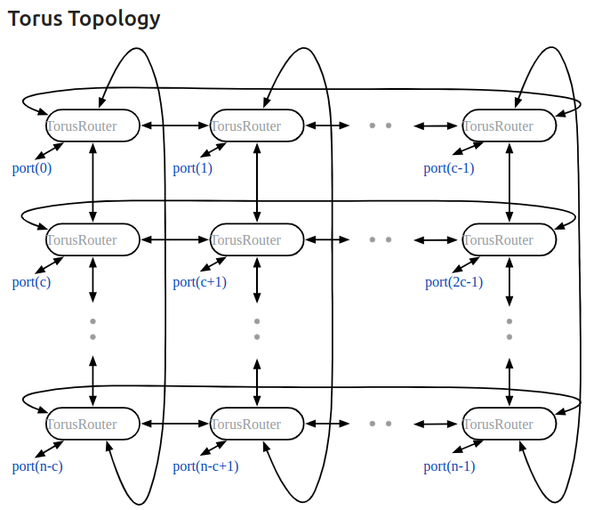
15.20 Torus Network Topology
https://www.youtube.com/watch?v=RNwI5zN3qAs
Torus Network Topology (34:21-35:14/44:47)
Torus is a multi-dimensional ring. In the below example, it is a 2-D Torus. Both first dimension and the second dimension are ring. We can see left-right and top-bottom dimensions. They both are independent rings. Each router has the minimum hop.
Since Torus is 2-Dimension, each router has four ports for distant routing. The fifth port for input/output communication.

Slide 55
15.21 Generalized Router

Slide 56
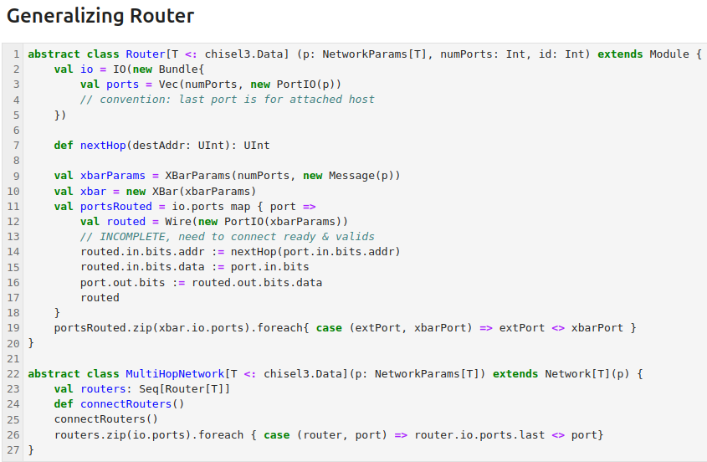
15.24 Generic Network
https://www.youtube.com/watch?v=RNwI5zN3qAs
Generic Network (35:15-36:20/44:47)
We want to have a multi-hop network which has some number of routers.
We define a generic data type [T] for abstract class MultiHopNetwork. We
1. Pass in generic Network Parameters data [T]
2. Create routers with Seq (Router[T])
3. Define interface handle connectRouters()
4. Connect the multi-port routers.
5. Connect external ports, rout the messages for all routers.

Slide 57
15.21 Generalized Router
https://www.youtube.com/watch?v=RNwI5zN3qAs
Generalized Router (36:21-37:24/44:47)
We also define a generic datatype [T] for abstract class Router. We
1. Pass in Generic Network Parameter data [T], number of port, host ID.
2. Define IO ports.
3. Define interface handle nextHop()
4. Get crossbar parameters.
5. Define crossbar network.
6. Router connection logic

Slide 58
15.22 RingNetwork Based on MultiHopNetwork

Slide 59
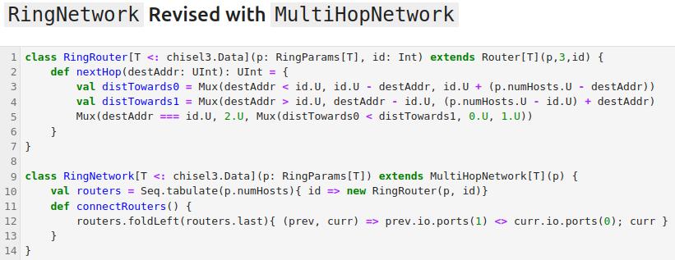
15.22 RingNetwork Based on MultiHopNetwork
https://www.youtube.com/watch?v=RNwI5zN3qAs
RingNetwork Based on MultiHopNetwork (37:25-39:25/44:47)
We take a RingNetwork as the example.
In class RingRouter (port, host ID), we
1. Define nextHop()
In class RingNetwork, we
1. input the generic Ring Parameters [T]. We extend from MultiHopNetwork with port.
2. We connect RingRouter (port, host ID). // Where do we pass in host ID?
3. Connect routers with foldLeft().

Slide 60
15.23 2D Torus Network

Slide 61
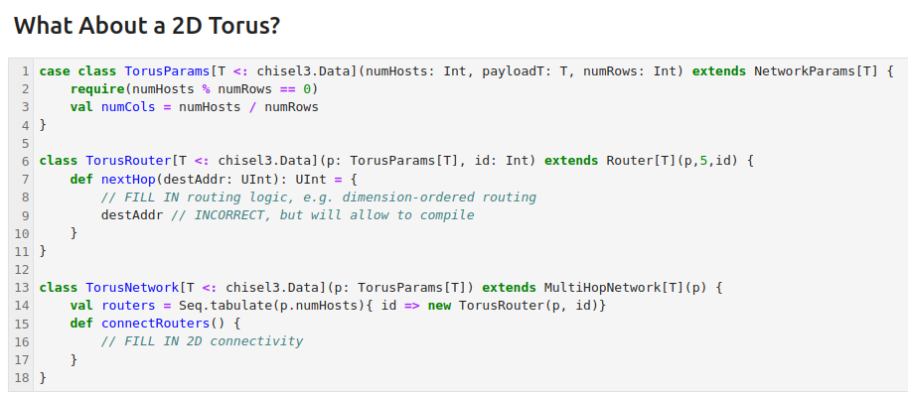
15.23 2D Torus Network
https://www.youtube.com/watch?v=RNwI5zN3qAs
2D Torus Network (39:26-41:38/44:47)
Below, we take a Torus Network.
In class TorusParams, we define number of column = (number of host) / (number of row).
In class TorusRouter, we define nextHop(): Fill in routing logic.
In class TorusNetwork, we
1. Define routers with host (port and host ID)
2. Connect router: fill in 2D connectivity with functional programming.

Slide 62
15.24 Generic Network

Slide 63
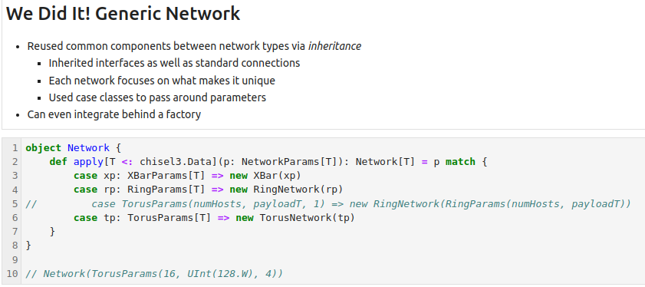
15.24 Generic Network
https://www.youtube.com/watch?v=RNwI5zN3qAs
Generic Network (41:39-42:51/44:47)
Below is a Generic Network for XBar, RingNetwork, TorusNetwork.

Slide 64
15.25 Summary

Slide 65
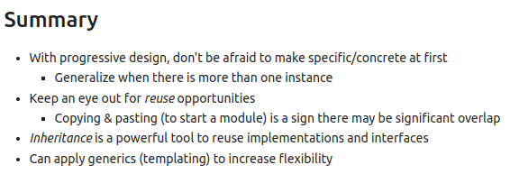
15.25 Summary
https://www.youtube.com/watch?v=RNwI5zN3qAs
Summary (42:52-44:47/44:47)
We use
1. Inheritance
2. Scala/Chisel Generic Template
3. Network Factory
for XBar, Ring Network, and Torus Network.

Slide 66
End

